Slide 1
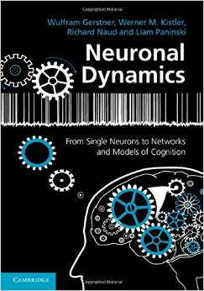
Biological Modeling of Neural Networks
3.1 From Hodgkin-Huxley to 2D
3.2 Phase Plane Analysis
3.3 Analysis of a 2D Neuron Model
4.1 Separation of time scales
4.2 Type I and II Neuron Models
- limit cycles: constant input
4.3 Pulse input
- where is the firing threshold?
4.4. Further reduction to 1 dim
- nonlinear integrate-and-fire (again)
Week 4
Reducing detail:
Analysis of 2D models
Wulfram Gerstner
EPFL, Lausanne, Switzerland
Reading for week 4:
NEURONAL DYNAMICS
- Ch. 4.4 – 4.7
Cambridge Univ. Press
Notes:
In 2018: the new format worked very well. Exercise on inhibitory rebound after 12 or 15 minutes! – early in the lesson!
Exercise 2 at 10:45 at the end of second hour.
The Reduction to 1 dimension was dropped (but it will reappear in the very last lecture!)
In 2016: first hour (45 minutes) until Quiz 1 and separation of time scales, prep for Exercises 1+2
Second hour: Exercises
Third hour: Part 4.2 and 4.3. At the beginning discussion of exercises.
The timing was perfect, except that a few more minutes at the end would be good.
If I waste too much time with the exercises, the further reduction to 1dim needs to be dropped.

Slide 2
Week 4 – Review from week 3
Reduction of Hodgkin-Huxley to 2 dimension
-step 1: separation of time scales
-step 2: exploit similarities/correlations

Slide 3
Week 4 – Review from week 3
1) dynamics of m are fast
2) dynamics of h and n are similar
w(t)
w(t)

Slide 4
Week 4 – review from week 3
2-dimensional equation
stimulus
w
I(t)=I₀
Enables graphical analysis!
u
Pulse input
→ AP firing (or not)
Constant input
→ repetitive firing (or not)
→ limit cycle (or not)

Slide 5
Week 4 – Reducing Detail – 2D models
ramp input/
constant input
neuron
I0
Type I and type II
f-I curve
f-I curve
f
I0
I0

Slide 6
4.1 Nullclines change for constant stimulus
stimulus
w
w-nullcline
I(t)=I₀
apply constant stimulus I0
u
Blackboard 1
u-nullcline

Slide 8
4.1 Separation of time scales
stimulus
w
w-nullcline
I(t)=I₀
Blackboard 1
u
u-nullcline

Slide 9
4.1. Separation of time scales
stimulus
w
Separation of time scales
I(t)=0
u
Blackboard 1
Δw
Δu
Stable fixed point
Δw<<
Δu
Unless close to nullcline

Slide 10
Week 4 – Exercise 1 on inhibitory rebound NOW!
w
Start at 9:30
Next lecture at 9:40
I(t)=0
u
I(t)=I₀<0
Now exercises
Notes:
I should be her after 10 minutes

Slide 12
Biological Modeling of Neural Networks
3.1 From Hodgkin-Huxley to 2D
3.2 Phase Plane Analysis
3.3 Analysis of a 2D Neuron Model
4.1 Separation of time scales
4.2 Type I and II Neuron Models
- limit cycles: constant input
4.3 Pulse input
- where is the firing threshold?
4.4. Further reduction to 1 dim
- nonlinear integrate-and-fire (again)
Week 4
Reducing detail:
Analysis of 2D models
Notes:
In 2018: the new format worked very well. Exercise on inhibitory rebound after 12 or 15 minutes! – early in the lesson!
In 2016: first hour (45 minutes) until Quiz 1 and separation of time scales, prep for Exercises 1+2
Second hour: Exercises
Third hour: Part 4.2 and 4.3. At the beginning discussion of exercises.
The timing was perfect, except that a few more minutes at the end would be good.
If I waste too much time with the exercises, the further reduction to 1dim needs to be dropped.

Slide 13
Week 4 – 4.2. Type I and II Neuron Models
neuron
ramp input/
constant input
I0
Type I and type II models
f-I curve
f-I curve
f
I0
I0

Slide 14
Review: Nullclines change for constant stimulus
stimulus
w
w-nullcline
I(t)=I₀
apply constant stimulus I0
u
u-nullcline

Slide 15
4.2. Limit cycle (example: FitzHugh Nagumo Model)
stimulus
w
I(t)=I₀
-unstable fixed point
-closed boundary
with arrows pointing inside
u
limit cycle
limit cycle

Slide 16
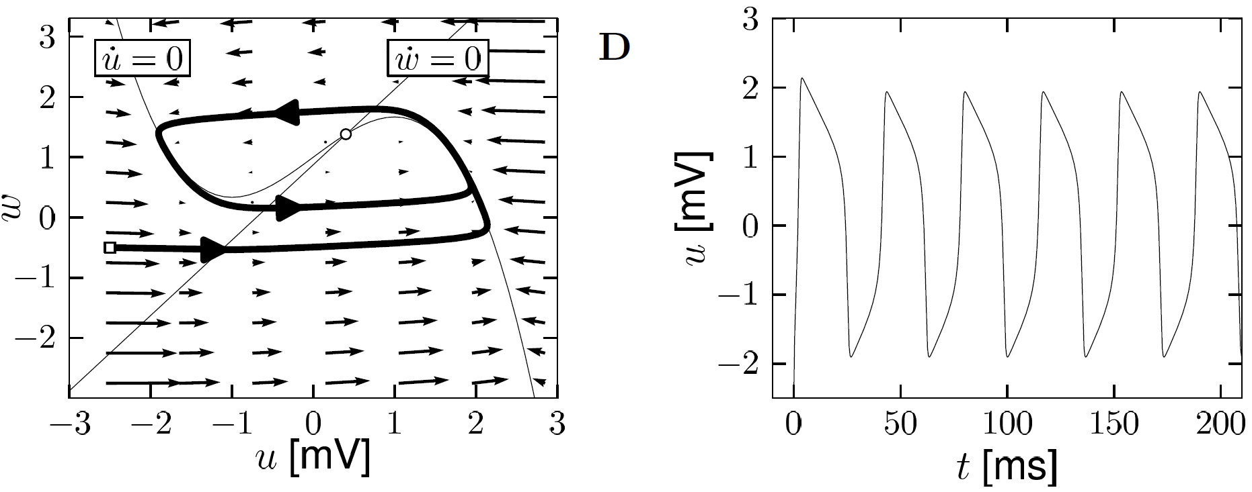
4.2. Limit Cycle
-unstable fixed point in 2D
-bounding box with inward flow
→ limit cycle (Poincare Bendixson)
Image: Neuronal Dynamics,
Gerstner et al.,
Cambridge Univ. Press (2014)

Slide 17
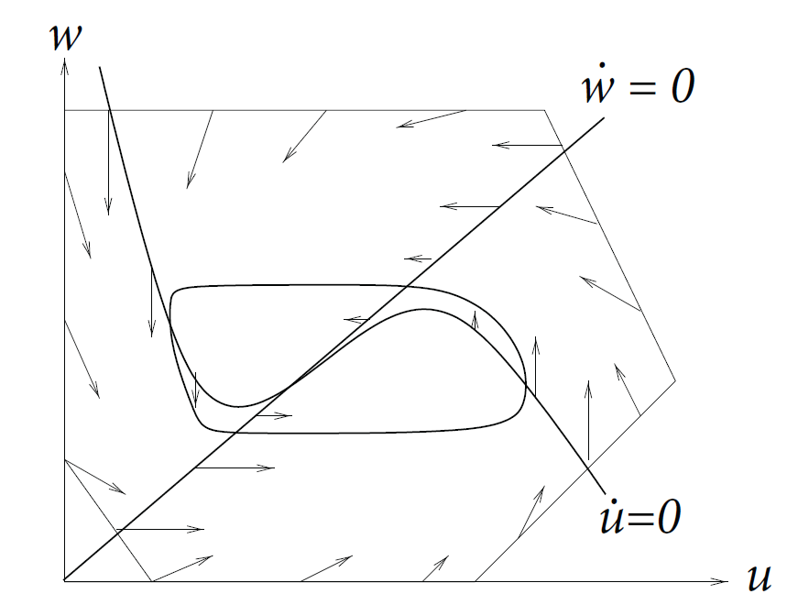
4.2. Limit Cycle
In 2-dimensional equations,
a limit cycle must exist, if we can
find a surface
-containing one unstable fixed point
-no other fixed point
-bounding box with inward flow
→ limit cycle (Poincare Bendixson)
Image: Neuronal Dynamics,
Gerstner et al.,
Cambridge Univ. Press (2014)

Slide 18
4.2 Type II Model
constant input
stimulus
w
Hopf bifurcation
I(t)=I₀
u
Discontinuous gain function
I₀
Stability lost → oscillation with finite frequency

Slide 19
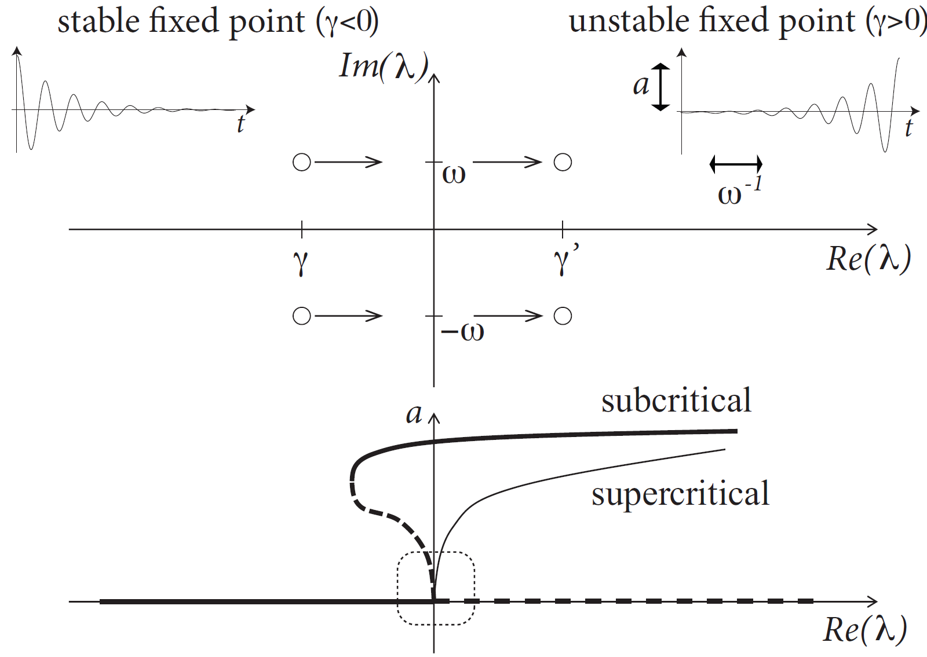
4.1. Hopf bifurcation
u(t)
Blackboard 2
Image: Neuronal Dynamics,
Gerstner et al.,
Cambridge Univ. Press (2014)

Slide 21
4.2. Hopf bifurcation: f-I -curve
f-I curve
Discontinuous
gain function: Type II
ramp input/
constant input
I0
I₀
Hopf bifurcation: pair of complex Eigenvalues
Stability lost → oscillation with finite frequency
Subcritical → local oscillation is also unstable, and
therefore jump (in neuron models)
to a large limit cycle

Slide 22
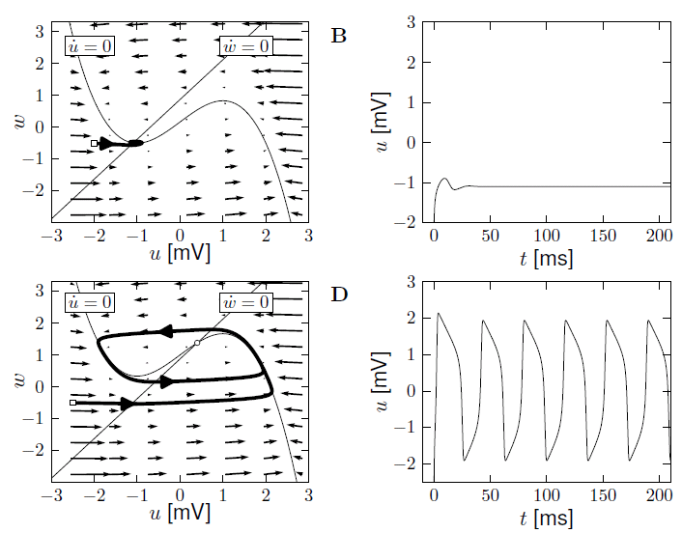
4.2 Example: FitzHugh-Nagumo / Hopf bifurcation
I=0
I>Ic

Slide 23
4.2. Type I and II Neuron Models
neuron
ramp input/
constant input
I0
Now:
Type I model
Type I and type II models
f-I curve
f-I curve
f
I0
I0

Slide 24
4.2. Type I Neuron Models: saddle-node bifurcation
type I Model: 3 fixed points
stimulus
size of arrows!
w
apply constant stimulus I0
I(t)=I₀
u
Saddle-node bifurcation
unstable
saddle
stable

Slide 25
4.2. Type I Neuron Models: saddle-node bifurcation
constant input
stimulus
w
Blackboard 3:
- flow arrows,
- ghost/ruins
I(t)=I₀
u
unstable
saddle
stable

Slide 27
4.2. Type I Neuron Models: saddle-node bifurcation
constant input
stimulus
w
I(t)=I₀
u
Low-frequency firing
I₀

Slide 28
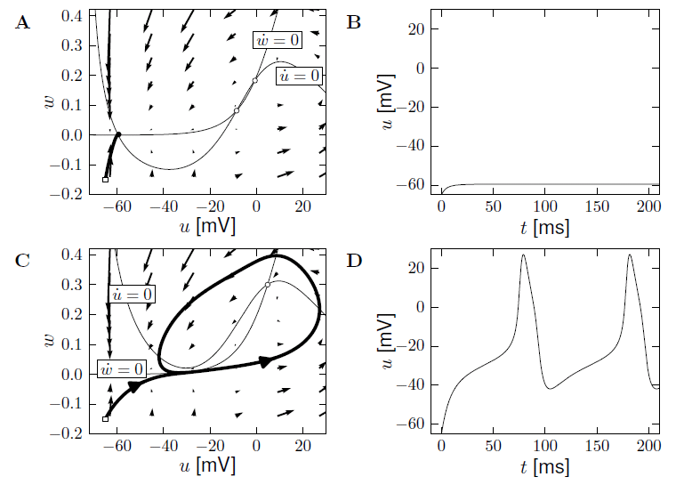
4.2. Example: Morris-Lecar as type I Model
I=0
I>Ic

Slide 29
4.2. Example: Morris-Lecar as type I Model
stimulus
w
I(t)=I₀
u
Low-frequency firing
I₀

Slide 30
4.2. Type I and II Neuron Models
Response at firing threshold?
Type I type II
Saddle-Node
Onto limit cycle
For example:
Subcritical Hopf
ramp input/
constant input
f-I curve
f-I curve
f
f
I0
I0
I0

Slide 31
4.2. Type I and II Neuron Models
2-dimensional equation
neuron
stimulus
ramp input/
constant input
I0
Type I and type II models
Enables graphical analysis!
Constant input
→ repetitive firing (or not)
→ limit cycle (or not)
f-I curve
f-I curve
f
I0
I0

Slide 32
Neuronal Dynamics – Quiz 4.1.
2-dimensional neuron model with (supercritical) saddle-node-onto-limit cycle bifurcation
[ ] The neuron model is of type II, because there is a jump in the f-I curve
[ ] The neuron model is of type I, because the f-I curve is continuous
[ ] The neuron model is of type I, if the limit cycle passes through a regime where the flow is very slow.
B. Threshold in a 2-dimensional neuron model with subcritical Hopf bifurcation
[ ] The neuron model is of type II, because there is a jump in the f-I curve
[ ] The neuron model is of type I, because the f-I curve is continuous
[ ] starting with zero current, and slowly increasing the current, is this true?
“ in the regime below the Hopf bifurcation, the neuron is
at rest or will necessarily converge to the resting state”
Notes:
Ich war hier nach 40 Minuten

Slide 33
Week 4 - Exercise 2.1-2.5: NOW!
w
Next lecture at 11:15
I(t)=0
u
I(t)=I₀<0
Now exercises

Slide 34
4.2. Exercise
Blackboard 4:
Saddle, stable manifold,
Slow response
stimulus
w
pulse input
I(t)
I(t)=I₀
u
stable

Slide 36
4.2 Bifurcations, simplifications
Bifurcations in neural modeling,
Type I/II neuron models,
Canonical simplified models
Nancy Koppell,
Bart Ermentrout,
John Rinzel,
Eugene Izhikevich
and many others

Slide 37
Biological Modeling of Neural Networks
3.1 From Hodgkin-Huxley to 2D
3.2 Phase Plane Analysis
3.3 Analysis of a 2D Neuron Model
4.1 Separation of time scales
4.2 Type I and II Neuron Models
- limit cycles: constant input
4.3 Pulse input
- where is the firing threshold?
4.4. Further reduction to 1 dim
- nonlinear integrate-and-fire (again)
Week 4
Reducing detail:
Analysis of 2D models

Slide 38
4.3. Threshold for Pulse Input in 2dim. Neuron Models
neuron
pulse input
I(t)
Delayed spike
u
Reduced amplitude
u

Slide 39
Review from 4.1: Saddle-node onto limit cycle bifurcation
stimulus
w
I(t)=I₀
u
unstable
saddle
stable

Slide 40
4.3 Threshold for Pulse input
Blackboard 4:
Saddle, stable manifold,
Slow response
stimulus
w
pulse input
I(t)
I(t)=I₀
u
unstable
saddle
stable

Slide 42
4.3 Type I model: Pulse input
saddle
stimulus
w
pulse input
Slow!
u
I(t)
Threshold
for pulse input

Slide 43
4.3 Type I model: Threshold for Pulse input
Stable manifold plays role of
‘Threshold’ (for pulse input)
Image: Neuronal Dynamics,
Gerstner et al.,
Cambridge Univ. Press (2014)

Slide 44
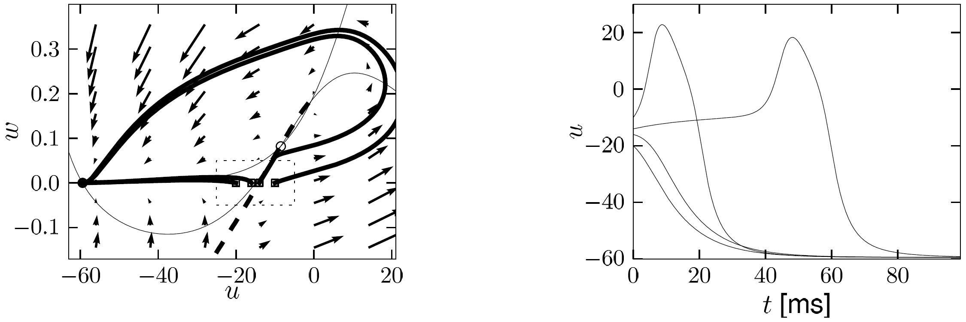
4.3 Type I model: Delayed spike initation for Pulse input
Delayed spike initiation close to
‘Threshold’ (for pulse input)
Image: Neuronal Dynamics,
Gerstner et al.,
Cambridge Univ. Press (2014)

Slide 45
Week 4– Quiz 4.2.
Threshold in a 2-dimensional neuron model with saddle-node bifurcation
[ ] The voltage threshold for repetitive firing is always the same
as the voltage threshold for pulse input.
[ ] in the regime below the saddle-node bifurcation, the voltage threshold for repetitive firing is given by the stable manifold of the saddle.
[ ] in the regime below the saddle-node bifurcation, the voltage threshold for action potential firing in response to a short pulse input is given by the stable manifold of the saddle point.
Notes:
Entweder noch vor Ende der Stunde oder gar nicht (in 2018: das war mein letztes slide vor 12:00)

Slide 46
4.3 Threshold for pulse input in 2dim. Neuron Models
neuron
pulse input
I(t)
Delayed spike
Reduced amplitude
u
u
NOW: model with subc. Hopf

Slide 47
Review from 4.1: FitzHugh-Nagumo Model: Hopf bifurcation
stimulus
w
w-nullcline
I(t)=I₀
apply constant stimulus I0
u
u-nullcline

Slide 48
4.3 FitzHugh-Nagumo Model with pulse input
stimulus
w
No explicit
threshold
for pulse input
pulse input
I(t)
u
Stable fixed point
I(t)=0

Slide 49
Biological Modeling of Neural Networks
Week 4 – part 2: Threshold for pulse input in 2D models
3.1 From Hodgkin-Huxley to 2D
3.2 Phase Plane Analysis
3.3 Analysis of a 2D Neuron Model
4.1 Type I and II Neuron Models
- limit cycles
4.2 Pulse input
- where is the firing threshold?
- separation of time scales
4.3. Further reduction to 1 dim
- nonlinear integrate-and-fire (again)
Week 4
Reducing detail:
Analysis of 2D models
Wulfram Gerstner
EPFL, Lausanne, Switzerland

Slide 50
Biological Modeling of Neural Networks
3.1 From Hodgkin-Huxley to 2D
3.2 Phase Plane Analysis
3.3 Analysis of a 2D Neuron Model
4.1 Separation of time scales
4.2 Type I and II Neuron Models
- limit cycles: constant input
4.3 Pulse input
- where is the firing threshold?
- with separation of time scales
4.4. Further reduction to 1 dim
- nonlinear integrate-and-fire (again)
Week 4
Reducing detail:
Analysis of 2D models

Slide 51
4.3 Separation of time scales, example FitzHugh-Nagumo Model
stimulus
w
Separation of time scales
pulse input
I(t)=0
I(t)
u
Stable fixed point

Slide 52
4.3 FitzHugh-Nagumo model: Threshold for Pulse input
Assumption:
Middle branch of u-nullcline
plays role of
‘Threshold’ (for pulse input)
Image: Neuronal Dynamics,
Gerstner et al.,
Cambridge Univ. Press (2014)

Slide 53
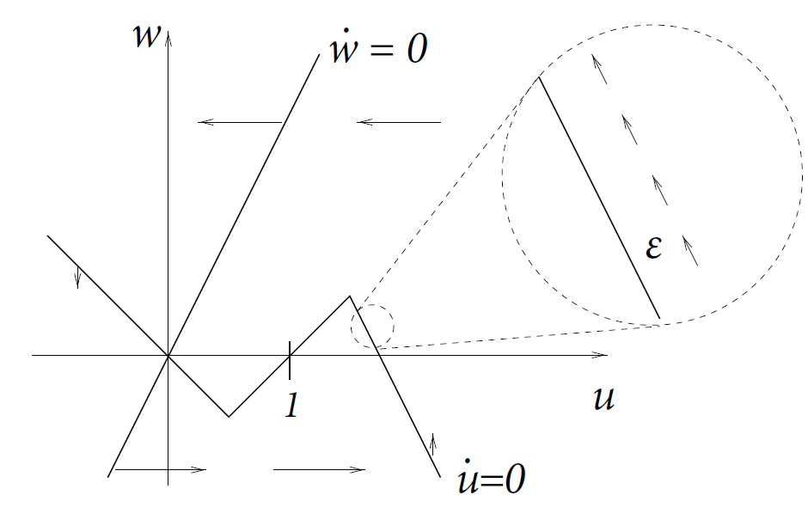
4.3 Detour: Separation fo time scales in 2dim models
stimulus
Assumption:
Image: Neuronal Dynamics,
Gerstner et al.,
Cambridge Univ. Press (2014)

Slide 54
4.3 FitzHugh-Nagumo model: Threshold for Pulse input
Assumption:
slow
fast
slow
slow
fast
slow
trajectory
-follows u-nullcline:
-jumps between branches:
slow
Image: Neuronal Dynamics,
Gerstner et al.,
Cambridge Univ. Press (2014)
fast

Slide 55
4.2 Threshold for pulse input in 2dim. Neuron Models
neuron
pulse input
I(t)
Biological input scenario
Mathematical explanation:
Graphical analysis in 2D
Delayed spike
Reduced amplitude
u
u

Slide 56
Week 4– Quiz 4.3.
B. Threshold in a 2-dimensional neuron model with subcritical Hopf bifurcation
[ ] in the regime below the Hopf bifurcation, the voltage threshold for action potential firing in response to a short pulse input is the middle branch of the u-nullcline.
[ ] in the regime below the bifurcation, a voltage threshold for action potential firing in response to a short pulse input exists only if
Notes:
Entweder noch vor Ende der Stunde oder gar nicht (in 2018: das war mein letztes slide vor 12:00)

Slide 57
The END
The END

Slide 58
Biological Modeling of Neural Networks
3.1 From Hodgkin-Huxley to 2D
3.2 Phase Plane Analysis
3.3 Analysis of a 2D Neuron Model
4.1 Separation of time scales
4.2 Type I and II Neuron Models
- limit cycles: constant input
4.3 Pulse input
- where is the firing threshold?
4.4. Further reduction to 1 dim
- nonlinear integrate-and-fire (again)
Week 4
Reducing detail:
Analysis of 2D models

Slide 59
4.4. Further reduction to 1 dimension
stimulus
w
Separation of time scales
I(t)=0
u
→ Flux nearly horizontal
Stable fixed point

Slide 60
4.4. Further reduction to 1 dimension
2-dimensional equation
stimulus
slow!
Separation of time scales
w is nearly constant
(most of the time)

Slide 61
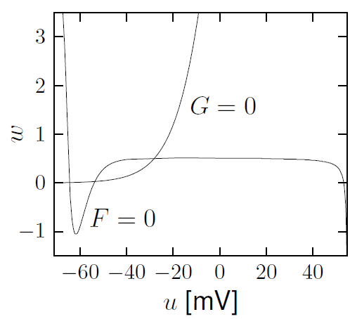
4.4. Further reduction to 1 dimension
Hodgkin-Huxley reduced to 2dim
Separation of time scales
Stable fixed point
During preparation/initation of spike

Slide 62
4.4. Spike initiation: Nonlinear Integrate-and-Fire Model
Image: Neuronal Dynamics,
Gerstner et al.,
Cambridge Univ. Press (2014)
→ Nonlinear I&F (see week 1!)
During spike initiation, the 2D models with separation of time scales
can be reduced to a 1D model equivalent to nonlinear integrate-and-fire

Slide 63
4.4. 2D model, after spike initiation
2-dimensional equation
Separation of time scales
w is constant (if not firing)
Relevant during spike
and downswing of AP
Integrate-and-fire:
threshold+reset for AP

Slide 64
4.4. From 2D to Nonlinear Integrate-and-Fire Model
2-dimensional equation
2dimensional Model
Relevant during spike
and downswing of AP
Separation of time scales
w is constant (if not firing)
Nonlinear Integrate-and-Fire Model
w-dynamics replaced by
Threshold and reset in
Integrate-and-ire
Linear plus exponential

Slide 65
Neuronal Dynamics – Literature for week 3 and 4.1
Reading: W. Gerstner, W.M. Kistler, R. Naud and L. Paninski,
Neuronal Dynamics: from single neurons to networks and
models of cognition. Chapter 4 Cambridge Univ. Press, 2014
OR J. Rinzel and G.B. Ermentrout, (1989). Analysis of neuronal excitability and oscillations. In Koch, C. Segev, I., editors, Methods in neuronal modeling. MIT Press, Cambridge, MA.
Selected references.
-Ermentrout, G. B. (1996). Type I membranes, phase resetting curves, and synchrony.
Neural Computation, 8(5):979-1001.
Fourcaud-Trocme, N., Hansel, D., van Vreeswijk, C., and Brunel, N. (2003). How spike generation mechanisms determine the neuronal response to fluctuating input.
J. Neuroscience, 23:11628-11640.
Badel, L., Lefort, S., Berger, T., Petersen, C., Gerstner, W., and Richardson, M. (2008). Biological Cybernetics, 99(4-5):361-370.
- E.M. Izhikevich, Dynamical Systems in Neuroscience, MIT Press (2007)

Slide 66
4.3. Nonlinear Integrate-and-Fire Model
Exponential integrate-and-fire model
(EIF)
Image: Neuronal Dynamics,
Gerstner et al.,
Cambridge Univ. Press (2014)
→ Nonlinear I&F (see week 1!)

Slide 67
Neuronal Dynamics – 4.2. Exponential Integrate-and-Fire Model
Direct derivation from Hodgkin-Huxley
Fourcaud-Trocme et al, J. Neurosci. 2003
gives expon. I&F

Slide 68
Neuronal Dynamics – Quiz 4.3.
Exponential integrate-and-fire model.
The model can be derived
[ ] from a 2-dimensional model, assuming that the auxiliary variable w is constant.
[ ] from the HH model, assuming that the gating variables h and n are constant.
[ ] from the HH model, assuming that the gating variables m is constant.
[ ] from the HH model, assuming that the gating variables m is instantaneous.
B. Reset.
[ ] In a 2-dimensional model, the auxiliary variable w is necessary to implement a
reset of the voltage after a spike
[ ] In a nonlinear integrate-and-fire model, the auxiliary variable w is necessary to implement a reset of the voltage after a spike
[ ] In a nonlinear integrate-and-fire model, a reset of the voltage after a spike is implemented algorithmically/explicitly

