Slide 1
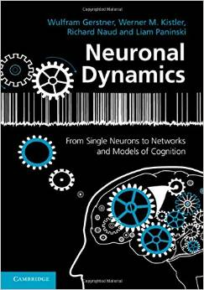
Biological Modeling of Neural Networks
8.1. Aims and challenges
- review: mean-field arguments
8.2. Transients
- generalized integrate-and-fire model
- transients can be sharp or slow
8.3. Spatial continuum (cortex)
  - orientation columns
8.4. Spatial cotinuum (model)
- field equations
8.5. Solution types
- uniform solution
- bump solution
8.6. Perception
8.7. Head direction cells
Week 8 – Continuum models:
Cortical fields and perception
Wulfram Gerstner
EPFL, Lausanne, Switzerland
Reading for week 8:
NEURONAL DYNAMICS
Ch. 18 +
+Ch. 12.3.7+Ch 15.1-15.2.3
Wulfram Gerstner
EPFL, Lausanne, Switzerland
Cambridge Univ. Press
Notes:
In 2016 this became lecture 8new.
Lecture 8new:
1st lecture: Quiz after 40 minutes, then spatial continuum (idea) until slide 32.
2nd lecture: blackboard calculation and continuum limit: Exercise 1.2 at 10:40-11:15
3rd lecture : Discussion of exercise 1, then a few slides, and Exercise 2 at 11:28-11:40
Finally applications (8.6 and 8.7). I Stopped at 12:00

Slide 2

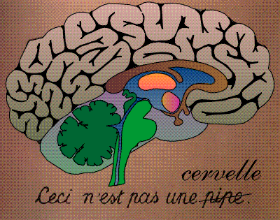
8.1: Aims and Challenges; Interacting Populations
I(t)
Sense of direction
→ internal compass
Perception
→weak contrasts
→world is continuous
Visual cortex
Notes:
Welcome.
1)Look around the room – now CLOSE your eyes. Turn your shoulders and Point your NOSE to the door through which you entered. Point with your NOSE to the other door. OPEN YOUR EYES. → Internal compass
2) Turn around and look at the corner in the back of the room.

Slide 3
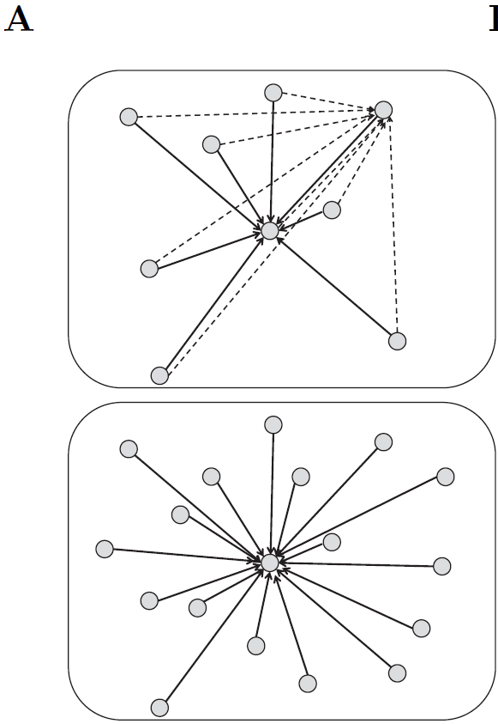
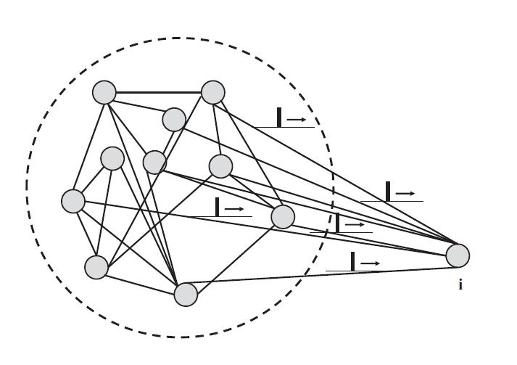
review from Week 7: mean-field arguments
Single population
full connectivity
All neurons receive the same
total input current (‘mean field’)

Slide 4
Review from week7: mean-field arguments
All neurons receive the same total input current (‘mean field’)
Ultra-short current pulse
fully
connected
Index i disappears
Blackboard 1:
A(t)
All spikes, all neurons
i

Slide 6
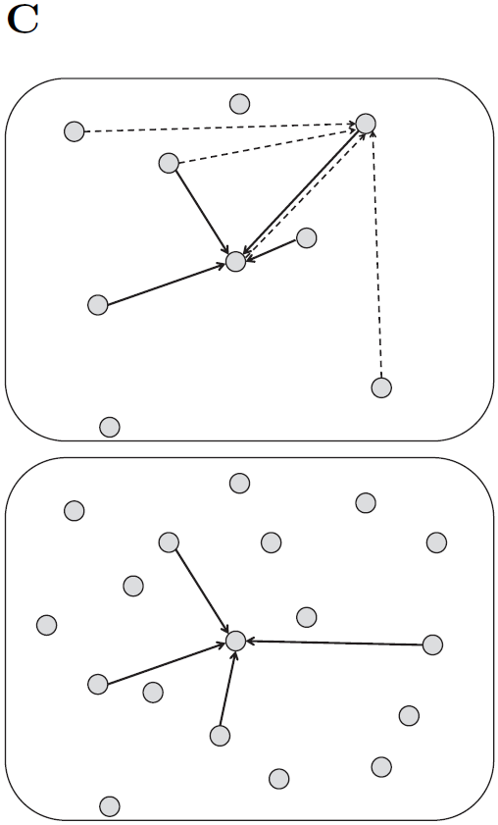
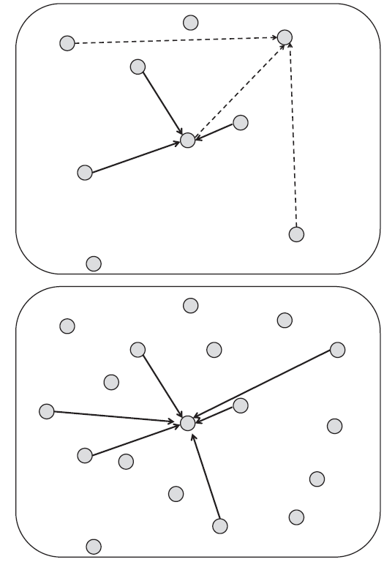
Review from week 7: mean-field also works for random coupling
full connectivity
random: prob p fixed
random: number K
of inputs fixed
Image: Gerstner et al.
Neuronal Dynamics (2014)

Slide 7
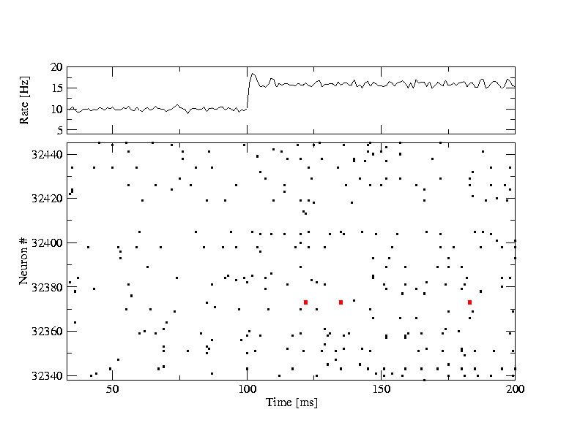
Review from Week 7: stationary state/asynchronous activity
Homogeneous network
All neurons are identical,
Single neuron rate = population rate
A(t)= A0= const
Single neuron
constant input
Gain function at appropriate noise level
frequency (single neuron)
rate=1/(meanInterval)

Slide 8
Review : mean-field argument for homogeneous population
- single neuron is driven by the ‘population activity’ of all others
- all neurons in populations receive the same input
- mean-field argument work for fully connected and randomly
connected populations
- in the stationary state, the single neuron firing rate is equal to
the ‘population activity’ of a homogeneous population
- in the stationary state, ‘population activity’ can be predicted by
(i) single neuron gain function (f-I curve)
(ii) external input
(iii) intra-population coupling strength
- in the stationary state, choice of neuron model irrelevant
(apart from gain function/f-I curve)

Slide 9
8.1. Aims and challenges
Mathematical aims:
I(t)
beyond stationary states
more than one population
functional consequences
transients?
how many? continuum?
Cognitive Modeling aims:
visual perception?
sense of direction?
Visual cortex

Slide 10
8.1. Aims and challenges: compass and perception
sense of direction? visual perception?
Image: Neuronal Dynamics,
Gerstner et al.,
Cambridge Univ. Press (2014),

Slide 11
Biological Modeling of Neural Networks
8.1. Mean-field argument (review)
- aims and challenges for this week
8.2. Transients
- generalized integrate-and-fire model
- transients can be sharp or slow
8.3. Spatial continuum (cortex)
  - orientation columns
8.4. Spatial cotinuum (model)
- field equations
8.5. Solution types
- uniform solution
- bump solution
8.6. Perception
8.7. Head direction cells
Week 8 – Continuum models:
Cortical fields and perception
Wulfram Gerstner
EPFL, Lausanne, Switzerland
Reading for week 8:
NEURONAL DYNAMICS
Ch. 18 +
+Ch. 12.3.7+Ch 15.1-15.2.3
Wulfram Gerstner
EPFL, Lausanne, Switzerland
Cambridge Univ. Press
Notes:
In 2016 this became lecture 8new. I added a bit of receptive fields, orientation maps, and course coding that I had removed from week7new.
Lecture 8new:
1st lecture: Quiz after 40 minutes, then spatial continuum (idea) until slide 32.
2nd lecture: blackboard calculation and continuum limit: Exercise 1.2 at 10:40-11:15
3rd lecture : Discussion of exercise 1, then a few slides, and Exercise 2 at 11:28-11:40
Finally applications (8.4 and 8.5). I Stopped at 12:00

Slide 12
8.2. Aims and challenges
beyond stationary states
transients?
- but then neuron model matters!
introduce generalized integrate-and-fire models:
- Spike Response Model (SRM)
- Generalized Linear Model (GLM)

Slide 13
review from week 1 – Leaky Integrate-and-Fire Model
Spike emission
j
i
reset
I
linear
Fire+reset
threshold

Slide 14
review from week 1 – Leaky Integrate-and-Fire type Model
Spike emission
Leaky
Integate-and-Fire Model:
passive membrane
+ threshold
+ reset
Input spike causes an EPSP
= excitatory postsynaptic potential
-output spikes are events
-generated at threshold
-after spike: reset/refractoriness
equivalent
description
add (spike afterpotential)
Notes:
The simplest integrate-and-fire model is a passive membrane combined with a threshold.
The reset can be replaced by adding a negative spike-after potential

Slide 15

Spike Response Model (SRM)
Generalized Linear Model (GLM)
Gerstner et al.,
1992,2000
Truccolo et al., 2005
Pillow et al. 2008
S(t)
+
potential
firing intensity
(escape noise)
Blackboard 2:
h(t)
e.g.

Slide 17
Spike Response Model (SRM)
Generalized Linear Model (GLM)
Gerstner et al.,
1992,2000
Truccolo et al., 2005
Pillow et al. 2008
S(t)
+
potential
input potential
reset potential

Slide 18
8. 2. Transients in a population of uncoupled neurons
t
?
I(t)
Students:
Which would you choose?
h(t)
potential
population
activity
A(t)
A(t)
A(t)
A(t)

Slide 19
8. 2. Transients in a population of neurons
Population
- 50 000 neurons
- 20 percent inhibitory
- randomly connected
Connections
4000 external
4000 within excitatory
1000 within inhibitory
input
-low rate
-high rate

Slide 20
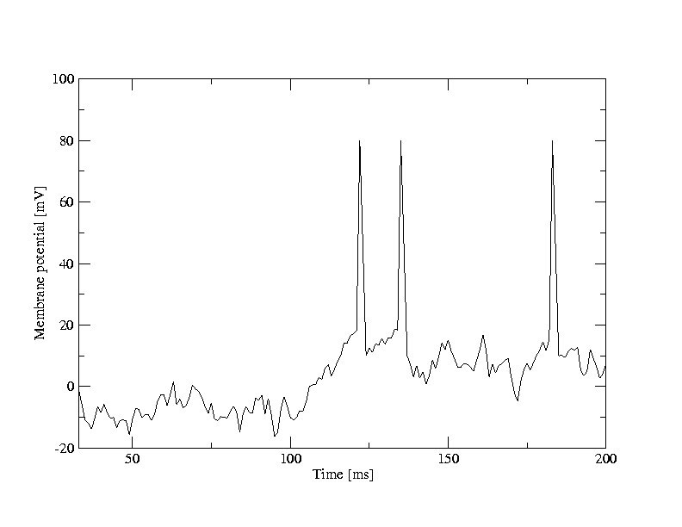
8.2. Transients in a population of neurons
A [Hz]
10
32440
Neuron #
32340
time [ms]
200
input
-low rate
-high rate
50
100
100
Neuron # 32374
u [mV]
Population
- 50 000 neurons
- 20 percent inhibitory
- randomly connected
0
50
100
time [ms]
200

Slide 21
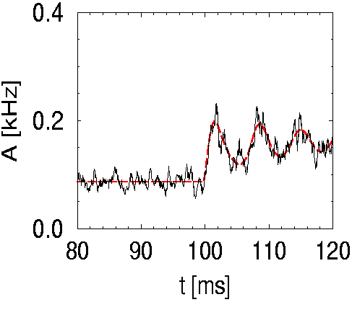
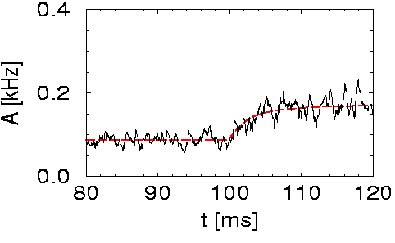
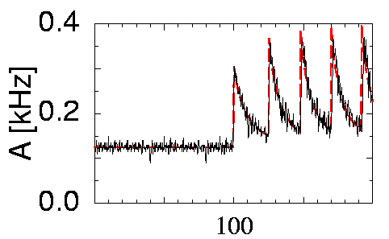
8. 2. Transients for populations of noisy neurons
uncoupled population
of SRM neurons with noise (escape noise)
low noise
low noise
high noise
noise-free
I(t)
I(t)
h(t)
h(t)
fast transient
slow transient
But transient oscillations

Slide 22
8.2. High-noise activity equation
blackboard
(escape noise)
In the limit of high noise,
high noise
Population activity
Membrane potential caused by input
I(t)
h(t)
slow transient

Slide 24
8. 2. High-noise activity equation
Population activity
(escape noise)
high noise
Membrane potential caused by input
I(t)
h(t)
slow transient
1 population = 1 differential equation

Slide 25
Quiz 1, now
Population equations
A single homogeneous population of neurons is driven by a step
current causing a transient response of the population activity.
[ ] A single cortical model population can exhibit transient oscillations
[ ] Transients are always sharp
[ ] Transients are always slow
[ ] in a certain limit transients can be slow
[ ] An escape noise model in the high-noise limit
has transients which are always slow
[ ] A single population described by a
single first-order differential equation (no integrals/no delays)
can exhibit transient oscillations
curre

Slide 26
Biological Modeling of Neural Networks
8.1. Mean-field argument (review)
- aims and challenges for this week
8.2. Transients
- generalized integrate-and-fire model
- transients can be sharp or slow
8.3. Spatial continuum (cortex)
  - orientation columns
8.4. Spatial cotinuum (model)
- field equations
8.5. Solution types
- uniform solution
- bump solution
8.6. Perception
8.7. Head direction cells
Week 8 – Continuum models:
Cortical fields and perception
Wulfram Gerstner
EPFL, Lausanne, Switzerland
Reading for week 8:
NEURONAL DYNAMICS
Ch. 18 +
+Ch. 12.3.7+Ch 15.1-15.2.3
Wulfram Gerstner
EPFL, Lausanne, Switzerland
Cambridge Univ. Press

Slide 27
Review: Interacting Populations
I(t)
Visual cortex

Slide 28
Review: Receptive fields with Orientation Tuning
Receptive fields:
visual cortex V1
preferred orientation
rate
0
Orientation selective
Stimulus orientation

Slide 29
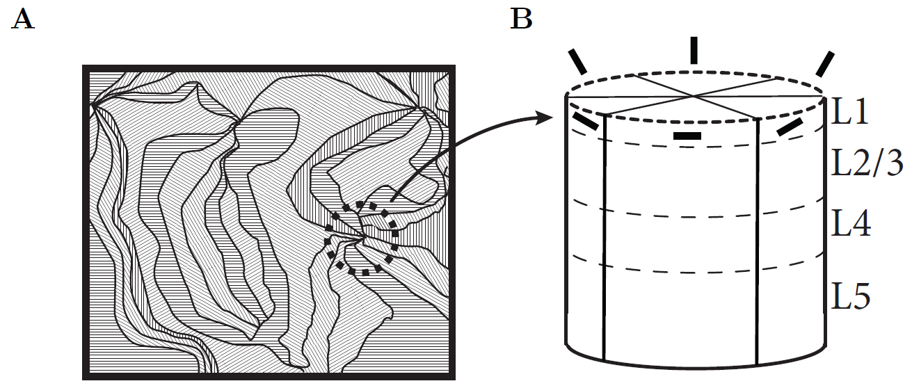
8.3. Orientation Map
population of neighboring neurons: similar orientations
As we move along cortical surface: orientation changes
pinwheel
Image: Gerstner et al.
Neuronal Dynamics (2014)
Bonhoeffer&Grinvald, 1991;
Bressloff&Cowan, 2002;
Kaschube et al. 2010
Visual cortex

Slide 30
8.3. Do Orientation Columns exist? Do identical cells exist?
rate
Cell 1
0
Stimulus orientation

Slide 31
8.3. Do Orienation colums exist? Do identical cells exist?
Coarse coding
Many cells
(from different columns)
respond to a single
stimulus with different rate
rate
Cell 1
Cell 5
0
Oriented stimulus

Slide 32
8.3. multiple populations → continuum

Slide 33
Biological Modeling of Neural Networks
8.1. Mean-field argument (review)
- aims and challenges for this week
8.2. Transients
- generalized integrate-and-fire model
- transients can be sharp or slow
8.3. Spatial continuum (cortex)
  - orientation columns
8.4. Spatial cotinuum (model)
- field equations
8.5. Solution types
- uniform solution
- bump solution
8.6. Perception
8.7. Head direction cells
Week 8 – Continuum models:
Cortical fields and perception
Wulfram Gerstner
EPFL, Lausanne, Switzerland
Reading for week 8:
NEURONAL DYNAMICS
Ch. 18 +
+Ch. 12.3.7+Ch 15.1-15.2.3
Wulfram Gerstner
EPFL, Lausanne, Switzerland
Cambridge Univ. Press
Notes:
In 2016 this became lecture 8new. I added a bit of receptive fields, orientation maps, and course coding that I had removed from week7new.
Lecture 8new:
1st lecture: Quiz after 40 minutes, then spatial continuum (idea) until slide 32.
2nd lecture: blackboard calculation and continuum limit: Exercise 1.2 at 10:40-11:15
3rd lecture : Discussion of exercise 1, then a few slides, and Exercise 2 at 11:28-11:40
Finally applications (8.4 and 8.5). I Stopped at 12:00

Slide 34
8.4. multiple populations → continuum
Blackboard

Slide 36
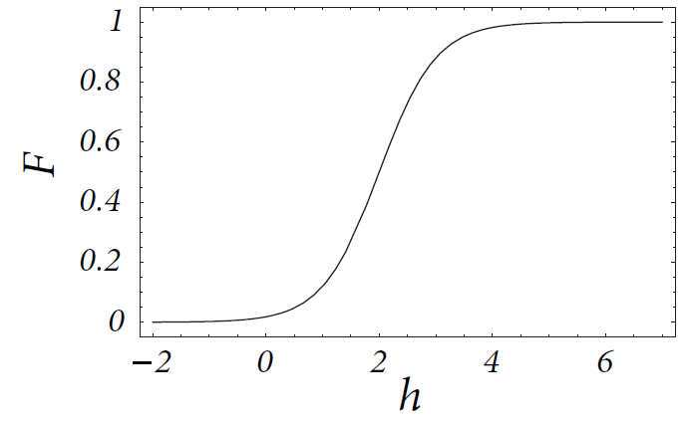
Wilson and Cowan, 1973
8. 4: Field equation (continuum model)
Population activity
Membrane potential caused by input
1 field = 1 integro-differential equation

Slide 37
Exercise 1.1 now (stationary solution)
Consider a continuum model,
Find analytical solutions:
- spatially uniform solution A(x,t)= A0
Next lecture at
11:15
If done: start with Exercise 1.2 now (spatial stability)
Notes:
Start exercise at 10:30

Slide 39
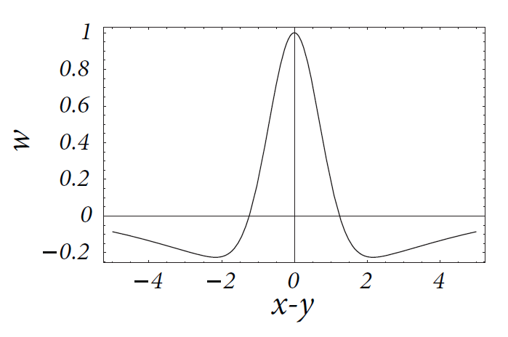
8.4: coupling across continuum
x
y
Mexican hat
local excitation,
long-range inhibition

Slide 40
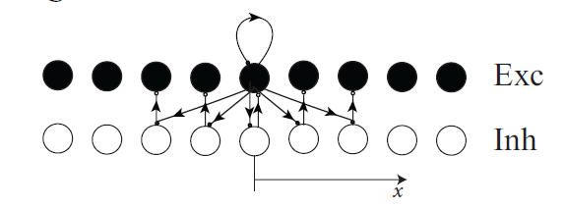
8.4: more realistic cortical coupling
Effective long-range negative interaction with local inhibition

Slide 41
8. 4: Summary: Field equations and coupling
-field equations = population activity
models in the spatial continuum
-coupling often distance-dependent
-activity
-effective long-range inhibition
instead of local inhibitory neurons
-variable x can represent space or
abstract quantity (e.g., orientation)

Slide 42
Biological Modeling of Neural Networks
8.1. Aims and challenges
- review: mean-field arguments
8.2. Transients
- generalized integrate-and-fire model
- transients can be sharp or slow
8.3. Spatial continuum (cortex)
  - orientation columns
8.4. Spatial continuum (model)
- field equations
8.5. Solution types
- uniform solution
- bump solution
8.6. Perception
8.7. Head direction cells
Week 8 – Continuum models:
Cortical fields and perception
Wulfram Gerstner
EPFL, Lausanne, Switzerland
Reading for week 8:
NEURONAL DYNAMICS
Ch. 18
Cambridge Univ. Press

Slide 43
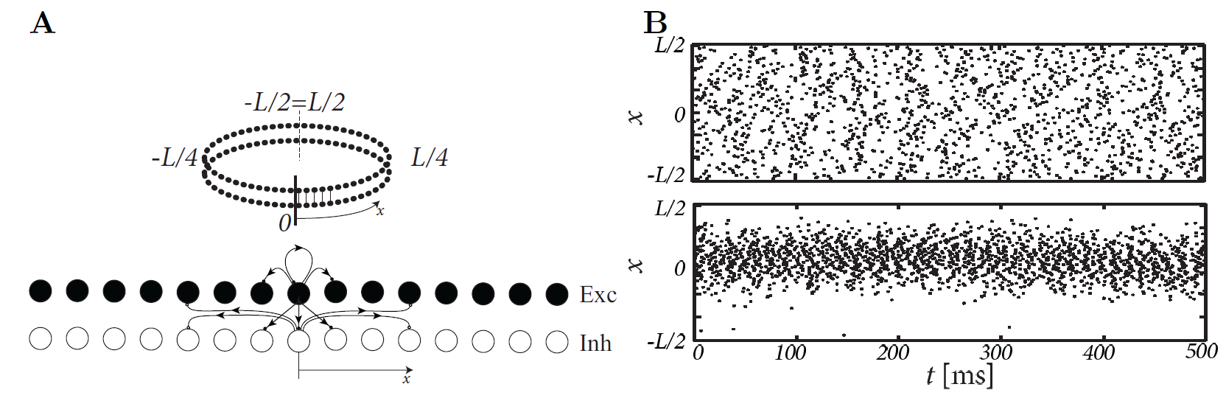
8.5. Two Solution Types (ring model)
Coupling:
Input-driven regime
Bump attractor regime
Image: Neuronal Dynamics,
Gerstner et al.,
Cambridge Univ. Press (2014),

Slide 44
8.5. Solution types: input driven regime
Field Equations:
Wilson and Cowan, 1973
I. Edge enhancement
A(x)
Weaker lateral connectivity
Possible interpretation
of visual cortex cells:
(see later today)
0
I(x)

Slide 45
8.5. Solution types: bump solution
Field Equations:
Wilson and Cowan, 1972
II: Bump formation:
activity profile in the absence of input
A
strong lateral connectivity
Possible interpretation
of head direction cells:
→ (see later today)
0
Notes:
I stopped here the end of the second lecture (at 11:00)

Slide 46
Exercise 2.1+2.2 now (stationary bump solution)
Consider a continuum model with step gain-fuctnion,
Find analytically the bump solutions
w(x-y)
Next lecture at
11:40
A(x)
d
h(x)
calculate input potential
at location x0
x0
Notes:
Start here at 11:28

Slide 48
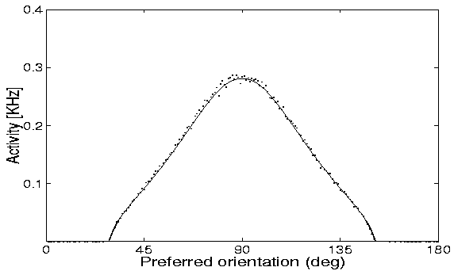
8.5. Solution types: bump solution
Spiridon&Gerstner
Comparison: simulation of neurons
and macroscopic field equation
Continuum: stationary profile
Image: Neuronal Dynamics,
Gerstner et al.,
Cambridge Univ. Press (2014),

Slide 49
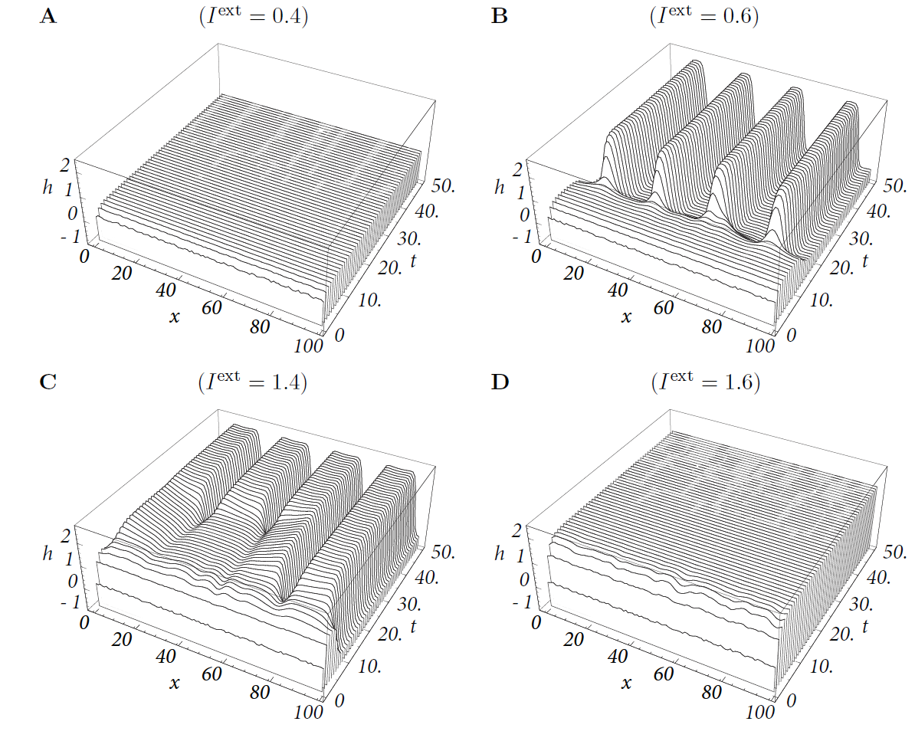
8.5. Solution types: multiple bump solutions with local interaction
time
Image: Neuronal Dynamics,
Gerstner et al.,
Cambridge Univ. Press (2014),

Slide 50
Quiz → see exercises 1 and 2
Solution of Field equations (1-dimensional ring model)
[ ] If a solution exists with a single bump localized around x0,
equivalent solutions exist at other locations.
[ ] If the interaction is Mexican hat, a stationary solution can have
at most a single bump
[ ] A homogeneous solution (constant in time and space)
always exists
[ ] A homogeneous solution (constant in time and space)
is always stable
[ ] If I increase in a model the spatial scale of inhibition, the activity
profile of an existing bump solution becomes broader
[ ] If I increase in a model the amplitude of excitation and the spatial
scale of inhibition, a bump solution is more likely to exist

Slide 51
Biological Modeling of Neural Networks
8.1. Aims and challenges
- review: mean-field arguments
8.2. Transients
- generalized integrate-and-fire model
- transients can be sharp or slow
8.3. Spatial continuum (cortex)
  - orientation columns
8.4. Spatial continuum (model)
- field equations
8.5. Solution types
- uniform solution
- bump solution
8.6. Perception
8.7. Head direction cells
Week 8 – Continuum models:
Cortical fields and perception
Wulfram Gerstner
EPFL, Lausanne, Switzerland
Reading for week 8:
NEURONAL DYNAMICS
Ch. 18
Cambridge Univ. Press
Notes:
In 2016 this became lecture 8new. I added a bit of receptive fields, orientation maps, and course coding that I had removed from week7new.
Lecture 8new:
1st lecture: Quiz after 40 minutes, then spatial continuum (idea) until slide 32.
2nd lecture: blackboard calculation and continuum limit: Exercise 1.2 at 10:40-11:15
3rd lecture : Discussion of exercise 1, then a few slides, and Exercise 2 at 11:28-11:40
Finally applications (8.4 and 8.5). I Stopped at 12:00

Slide 52
8.6. uniform/input driven solution
Field Equations
for edge enhancement
Wilson and Cowan, 1973
Grossberg, 1973
Basic phenomenology
I. Edge enhancement
A(x)
(Weak lateral connectivity)
Possible interpretation
of visual cortex cells:
contrast enhancement in
- orientation
- location
0
I(x)

Slide 53
8.6. Perception -grid illusion
Image: Neuronal Dynamics,
Gerstner et al.,
Cambridge Univ. Press (2014),

Slide 54
8.6. Perception – Mach bands
Mach, 1865, 1906
Image: Neuronal Dynamics,
Gerstner et al.,
Cambridge Univ. Press (2014),

Slide 55
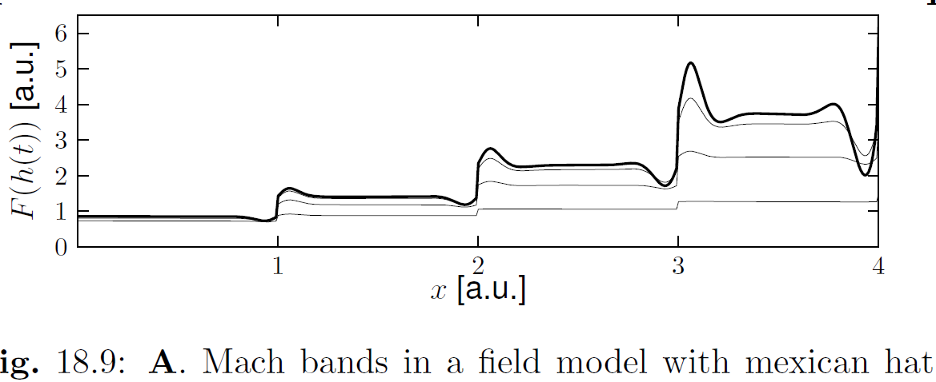
8.6. Mach bands in a continuum model
Mexican-hat coupling
Image: Neuronal Dynamics,
Gerstner et al.,
Cambridge Univ. Press (2014),

Slide 56
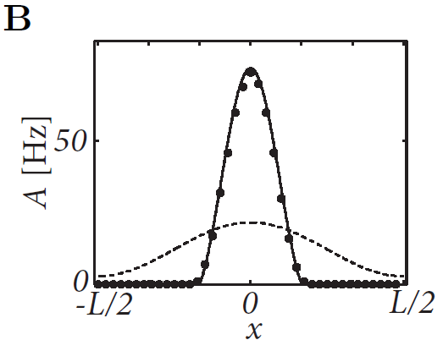
8.6: Field models and Perception: contrast enhancement
contrast enhancement
→ Sharpening
Shriki et al. (2003):
Ring model in input-driven regime,
driven by broad input (dashed line),
causes sharp activity bump;
See also: Ben-Yishai et al. 1995;
Hansel and Sompolinsky, 1998

Slide 57
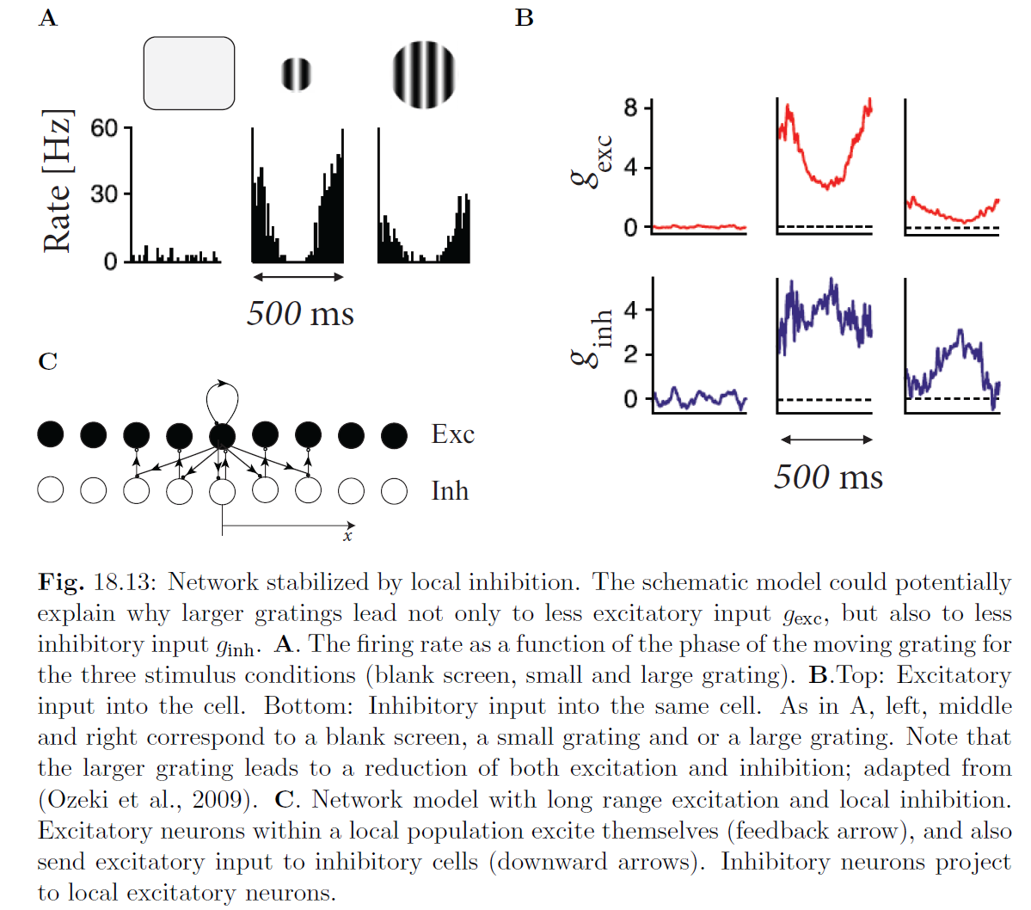
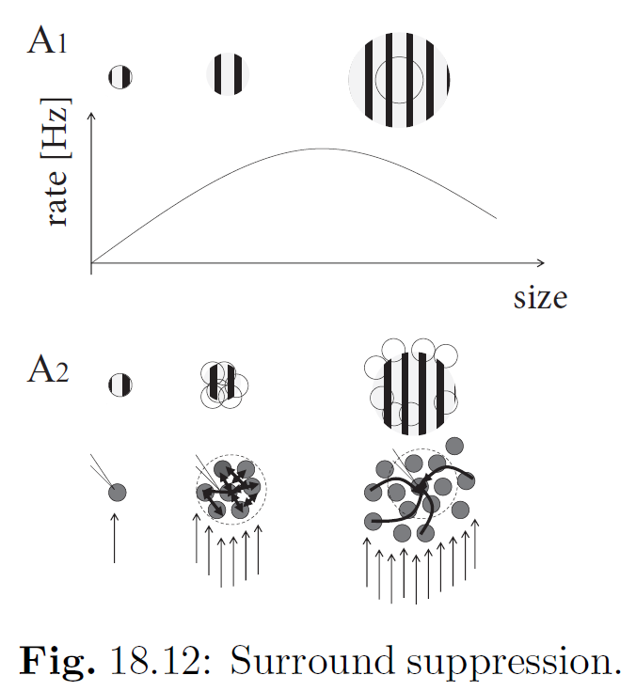
8.6: Field models and Perception: surround suppresion
Ozeki et al. (2009):
Image: Neuronal Dynamics,
Gerstner et al.,
Cambridge Univ. Press (2014),

Slide 58
8.6: Field models and Perception
-contrast enhancement is a stable
psychophysical phenomenon
-Mach bands are one example
-the activity of V1 cell first increases and
then decreases with size of stimulus
-both excitatory and inhibitory input
into a cell show similar changes
-Mach bands can be explained by
a continuum model with Mexican-hat
interaction in the input-driven regime
-contrast enhancement = ‘sharpening’

Slide 59
Biological Modeling of Neural Networks
8.1. Aims and challenges
- review: mean-field arguments
8.2. Transients
- generalized integrate-and-fire model
- transients can be sharp or slow
8.3. Spatial continuum (cortex)
  - orientation columns
8.4. Spatial continuum (model)
- field equations
8.5. Solution types
- uniform solution
- bump solution
8.6. Perception
8.7. Head direction cells
Week 8 – Continuum models:
Cortical fields and perception
Wulfram Gerstner
EPFL, Lausanne, Switzerland
Reading for week 8:
NEURONAL DYNAMICS
Ch. 18
Cambridge Univ. Press

Slide 60
8.7. Bump solution
Basic phenomenology
Bump formation
A
strong lateral connectivity
Possible interpretation
of head direction cells:
always some cells active
→ indicate current orientation
0

Slide 61
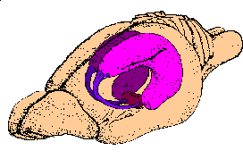
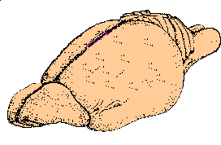
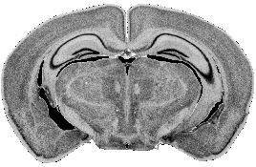
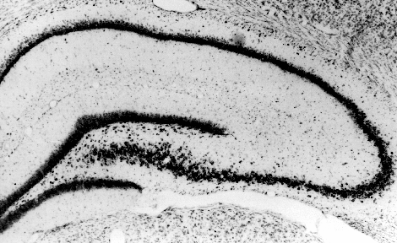
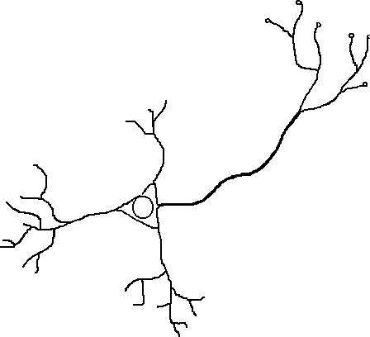
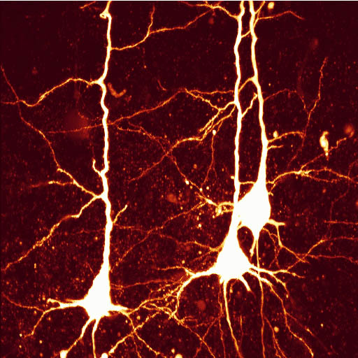
8.7. Hippocampal place cells
CA1
CA3
rat brain
DG
Place fields
electrode
synapses
axon
soma
dendrites
pyramidal cells

Slide 62
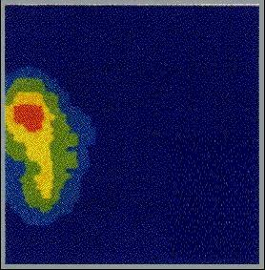

8.7. Hippocampal place cells
Main property: encoding the animal’s location
place field

Slide 63
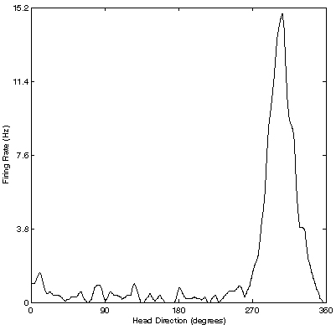
8.7. Head direction cells
Main property: encoding the animal ’s heading
r (θ)
i
Φ
θ
θ
Taube and Muller, Hippocampus 1998,
θ
i
Preferred firing direction

Slide 64
8.7. Head direction cells
Main property: encoding the animal ’s allocentric heading
90
r (θ)
i
180
0
300
270
θ
θ
i
Preferred firing direction

Slide 65
8.7. Head direction cells
Image: Neuronal Dynamics,
Gerstner et al.,
Cambridge Univ. Press (2014),
Adapted from Zugaro et al. (2003), J. Neurosci. 23:3478-3482

Slide 66
Similar to the rat: head direction cells in fly brain (ellipsoid body)
stimulus on screen:
activity in
ellipsoid body
bump activity persists in the dark
cue is landmark configuration
Seelig and Jarayaman, Nature, 2015,
Neural dynamics for landmark orientation and angular path integration

Slide 67
8.7. Head direction cells: summary
head direction cells
- are sensitive to direction of head
with respect to visual cues
- keep their activity if light is switched off
- exist in rodents and in flies
- can be explained by bump solution in ring model
Taube and Muller, Hippocampus 1998,
Zugaro et al., J. Neurosci. 2003
Seelig and Jarayaman, Nature, 2015
Redish et al., Network, 1996, Zhang, J. Neurosci. 1996

Slide 68
8.7. Summary: field models
Continuum model provides understanding for:
head direction cell
→ bumps of activity
contrast enhancement and some visual illusions
→ input driven regime

Slide 69
6. Selected References: Field Models
Field Models
H. R. Wilson and J. D. Cowan (1973) A mathematical theory of the functional dynamics of cortical and thalamic nervous tissue. Kybernetik 13, pp. 55–80
S. Grossberg (1973) Contour enhancement, short term memory and constancies in reverberating neural networks. Studies in Applied Mathematics 52:217-257.
Mach bands and Field Models for Visual Cortex and contrast Enhancement
E. Mach (1865) Über die Wirkung der räumlichen vertheilung des Lichtreizes auf die Netzhaut. Sitzungsberichte der mathematisch-naturwissenschaftlichen Classe kaiserl. Akademie der Wissenschaften 52, pp. 303–322.
E. Mach (1906) Die Analyse der Ampfindungen. 5th edition, Gustav Fischer, Jena.
R. Ben-Yishai, R.L. Bar-Or and H. Sompolinsky (1995) Theory of orientation tuning in visual cortex. Proc. Natl. Acad. Sci. USA 92, pp. 3844–3848.
O. Shriki, D. Hansel and H. Sompolinsky (2003) Rate models for conductance-based cortical neuronal networks. Neural Computation 15, pp. 1809–1841
Head Direction Cells and Field Models for Head direction and Spatial Working Memory
J. S. Taube and R. U. Muller (1998) Comparisons of head direction cell activity in the postsubiculum and anterior thalamus of freely moving rats. Hippocampus 8, pp. 87–108.
A.D. Redish, A.N. Elga and D.S. Touretzky (1996) A coupled attractor model of the rodent head direction system. Network 7, pp. 671–685.
K. Zhang (1996) Representaton of spatial orientation by the intrinsic dynamics of the head-direction ensemble: a theory. J. Neurosci. 16, pp. 2112–2126.
A Compte, N Brunel, PS Goldman-Rakic, XJ Wang (2000) Synaptic mechanisms and network dynamics underlying spatial working memory, Cerebral Cortex 10 (9), 910-923

Slide 70
Biological Modeling of Neural Networks
Week 8 – Continuum models:
Cortical fields and perception
Reading for week 8:
NEURONAL DYNAMICS
Ch. 18 +
+Ch. 12.3.7+Ch 15.1-15.2.3
Wulfram Gerstner
EPFL, Lausanne, Switzerland
THE END

