Slide 1
Exam:
- written exam Wedn. 3.07.2019 from 8:15-11:00
- sample exams of previous years online
- miniproject counts 30 percent towards final grade
For written exam:
-bring 1 sheet A5 of own notes/summary
-HANDWRITTEN!
-no calculator, no textbook

Slide 2
LEARNING OUTCOMES
Solve linear one-dimensional differential equations
Analyze two-dimensional models in the phase plane
Develop a simplified model by separation of time scales
Analyze connected networks in the mean-field limit
Formulate stochastic models of biological phenomena
Formalize biological facts into mathematical models
Prove stability and convergence
Apply model concepts in simulations
Predict outcome of dynamics
Describe neuronal phenomena
Look at samples of
past exams
Use a textbook,
(Use video lectures)
don’t use slides (only)
Transversal skills
Plan and carry out activities in a way which makes optimal use of available time and other resources.
Collect data.
Write a scientific or technical report.
miniproject

Slide 3
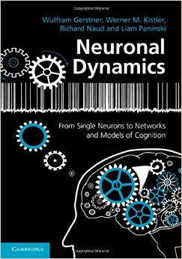
Biological Modeling of Neural Networks:
9.1 Introduction
- decision making
9.2 Perceptual decision making
- V5/MT
- Decision dynamics: Area LIP
9.3 Theory of decision dynamics
- competition via shared inhibition
- effective 2-dim model
9.4. Solutions
- symmetric case
-biased case
9.5. Simulations and Experiments
- simulations and theory
- simulations and experiments
9.6. Decisions, actions, volition
- the problem of free will
Week 9 – Decision models:
Competitive dynamics
Wulfram Gerstner
EPFL, Lausanne, Switzerland
Reading for week 9:
NEURONAL DYNAMICS
Ch. 16 (except 16.4.2)
Cambridge Univ. Press
Notes:
Lecture 1, includes the
Blackboard part of the Salzman et al experiment
Blackboard part Reduction from 3 to 2 dimensions
Lecture 2
continuation of blackboard with linearization of the inhibitory neurons
Then Exercise 1, nullclines etc. from 10:25-10:38 (should be extended to 10:45_
Afterwards, the shifting nullclines, discussion of regimes, fixed points etc.
3rd lecture: Simulations of Wang + Free will (section 9.5)

Slide 4
9.1. How do I decide?
We take decisions all the time
Coffee before class or not?
Vote for candidate A or B?
Turn left or right at the crossing?
Notes:
DO NOT ask students here – ask them in section 9.5.

Slide 5
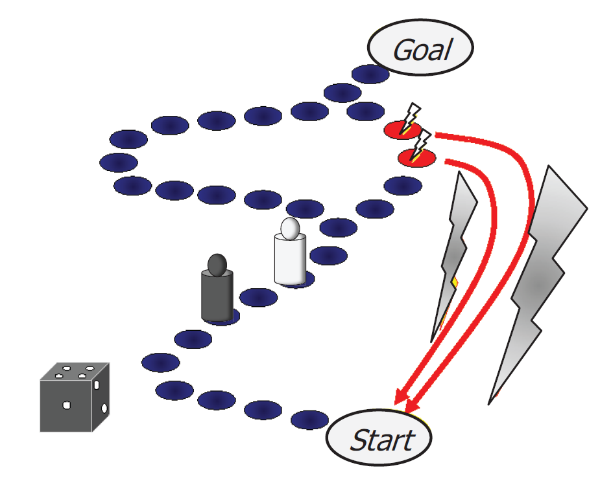
9.1. How do I decide?
Notes:
DO NOT ask students here – ask them in section 9.5.

Slide 6
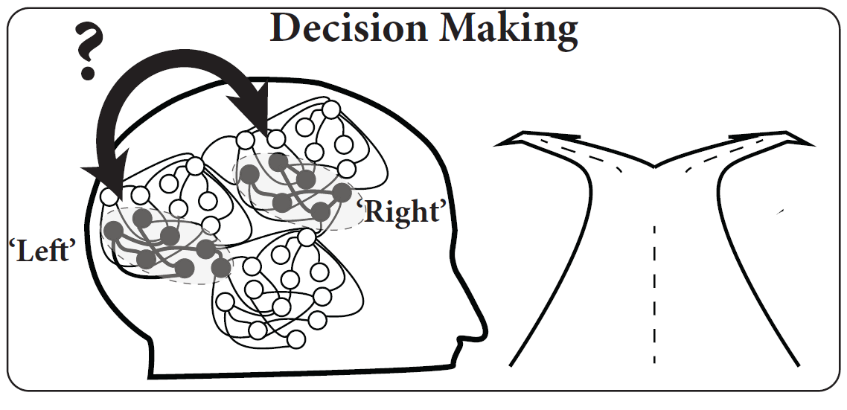
9.1. Decision making
turn
Left? Right?

Slide 7
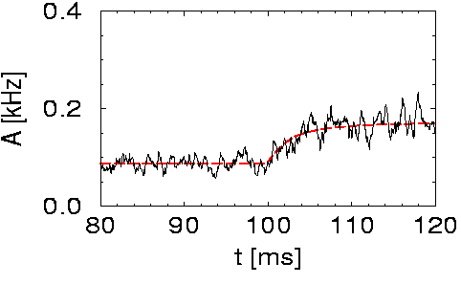
9.1. Review of week 8: High-noise activity equation
Population activity
noise model A
(escape noise/fast noise)
Membrane potential caused by input
high noise
Attention:
- valid for high noise only, else
transients might be wrong
- valid for high noise only, else
spontaneous oscillations may arise
I(t)
h(t)
slow transient

Slide 8
9.1. Review: microscopic vs. macroscopic
I(t)

Slide 9
9.1. Competition between two populations
Input indicating
‘left’
Input indicating
‘right’

Slide 10
9. 1. How do YOU decide?
As selected EPFL student, pick your money at EPFL:
30CHF tomorrow / 100 CHF May first next year
90CHF tomorrow / 100 CHF May first next year
‘Neuro-economics’

Slide 11
9.1. Perceptual decision making?
Bisection task:
‘Is the middle bar shifted to the left or to the right?’

Slide 12
9.1. decision making - aims
Decisions are everywhere
Model: populations of neurons
Model feature Competition
Experimental data
Perceptual Decision task

Slide 13
Biological Modeling of Neural Networks:
9.1 Introduction
- decision making
9.2 Perceptual decision making
- V5/MT
- Decision dynamics: Area LIP
9.3 Theory of decision dynamics
- competition via shared inhibition
- effective 2-dim model
9.4. Solutions
- symmetric case
-biased case
9.5. Simulations and Experiments
- simulations and theory
- simulations and experiments
9.6. Decisions, actions, volition
- the problem of free will
Week 9 – Decision models:
Competitive dynamics
Wulfram Gerstner
EPFL, Lausanne, Switzerland
Reading for week 9:
NEURONAL DYNAMICS
Ch. 16 (except 16.4.2)
Cambridge Univ. Press
Notes:
Lecture 1, includes the
Blackboard part of the Salzman et al experiment
Blackboard part Reduction from 3 to 2 dimensions
Lecture 2
continuation of blackboard with linearization of the inhibitory neurons
Then Exercise 1, nullclines etc. from 10:25-10:38
Afterwards, the shifting nullclines, discussion of regimes, fixed points etc.
3rd lecture: Simulations of Wang + Free will (section 9.5)

Slide 14
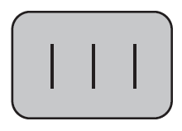
9.2. Perceptual decision making?
Bisection task:
‘Is the middle bar shifted to the left or to the right?’
e.g., Herzog lab, EPFL

Slide 15
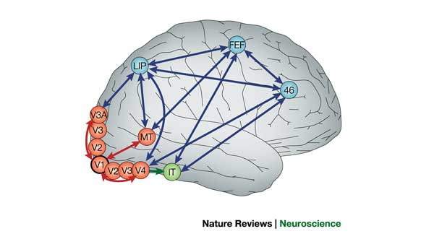
9.2. Detour: receptive fields in V5/MT
visual
cortex
IMAGE
1) Cells in visual cortex MT/V5 respond
to motion stimuli
2) Neighboring cells in visual cortex MT/V5
respond to motion in similar direction
cortical columns
Albright, Desimone,Gross,
J. Neurophysiol, 1985

Slide 16
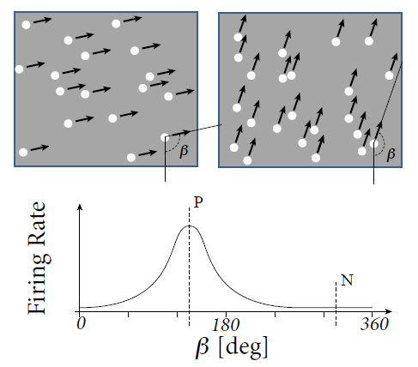
9. 2. Detour: receptive fields in V5/MT
Recordings from a single neuron in V5/MT
Receptive Fields depend
on direction of motion
Random moving dot stimuli:
e.g.Salzman, Britten, Newsome, 1990
Roitman and Shadlen, 2002
Gold and Shadlen 2007

Slide 17
9.2. Detour: receptive fields in V5/MT
Receptive Fields depend
on direction of motion: β = preferred direction = P
Image:
Gerstner et al. (2014),
Neuronal Dynamics

Slide 18
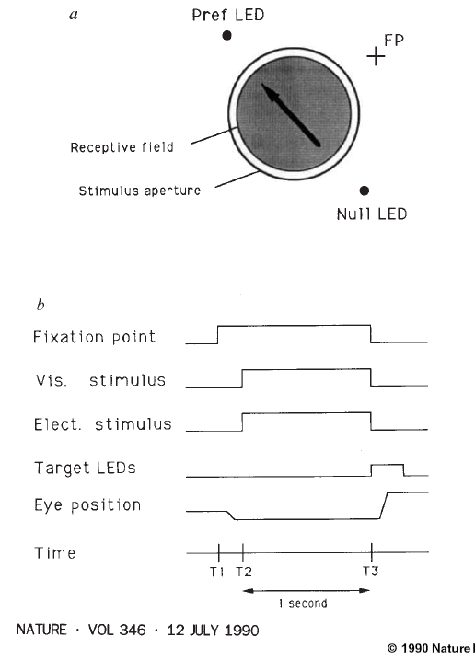
9.2. Experiment of Salzman et al. 1990
coherence 0.8=80%
monkey indicates
decision by
eye movement
coherence 0.5 = 50%
coherence 0.0
Eye movement
coherence -1.0
opposite
direction
Image: Salzman, Britten, Newsome, 1990

Slide 19
9. 2: Experiment of Salzman et al. 1990
Monkey behavior w. or w/o Stimulation
of neurons in V5/MT
N
Monkey
chooses right
P
fixation
visual stim.
LED
-1.0
0.5
0.5
1.0
X = coherent motion
to bottom right
Salzman, Britten,
Newsome, 1990
No bias, each point
moves in random direction
Blackboard:
Motion detection/stimulation

Slide 21
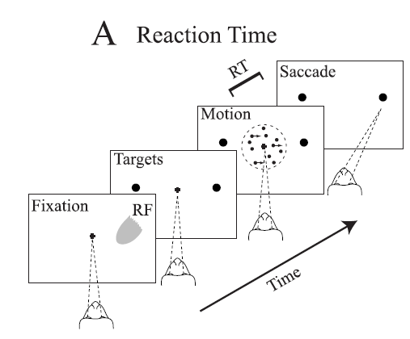
9.2: Experiment of Salzman et al. 1990
P
coherence 0.8=80%
N
coherence 0.5 = 50%
coherence 0.0
excites this group of neurons
coherence -1.0

Slide 22
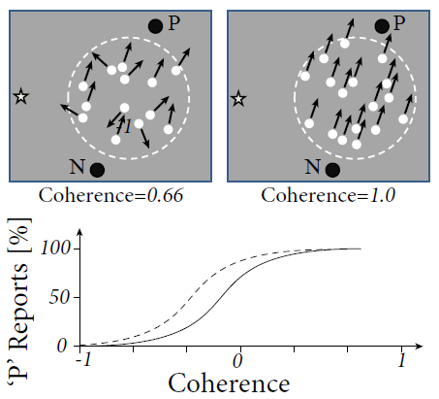
9. 2. Experiment of Salzman et al. 1990
Behavior: psychophysics
Image:
Gerstner et al. (2014),
Neuronal Dynamics;
Redrawn after
Salzman et al, 1990
With stimulation

Slide 23
9. 2. Perceptual Decision Making
9.1 Review: Population dynamics
- competition
9.2 Perceptual decision making
- V5/MT
- Decision dynamics: Area LIP
9.3 Theory of decision dynamics
- shared inhibition
- effective 2-dim model
9.4. Decisions in connected pops.
- unbiased case
- biased input
9.5. Decisions, actions, volition
- the problem of free will
Notes:
Lecture 1, includes the
Blackboard part of the Salzman et al experiment
Blackboard part Reduction from 3 to 2 dimensions
Lecture 2
continuation of blackboard with linearization of the inhibitory neurons
Then Exercise 1, nullclines etc. from 10:25-10:38
Afterwards, the shifting nullclines, discussion of regimes, fixed points etc.
3rd lecture: Simulations of Wang + Free will (section 9.5)

Slide 24
9.2. Experiment of Roitman and Shadlen in LIP (2002)
coherence 85%
coherence 50%
RF of Neuron in LIP:
-selective to target of saccade
- response increases faster if signal is stronger
- activity is noisy
coherence 0%
LIP is somewhere between
MT (movement detection) and Frontal Eye Field (saccade control)
Roitman and Shadlen 2002

Slide 25
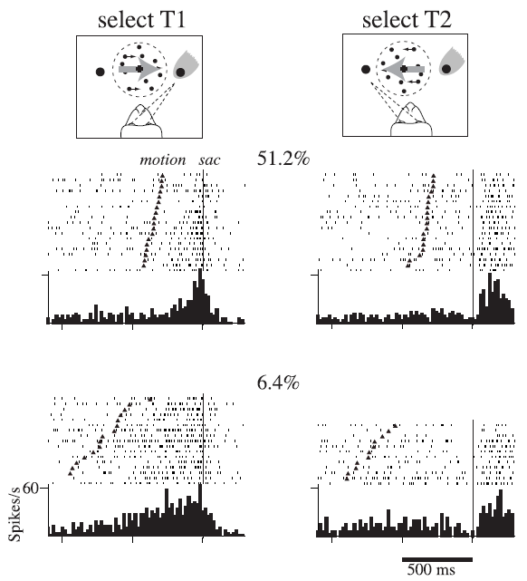
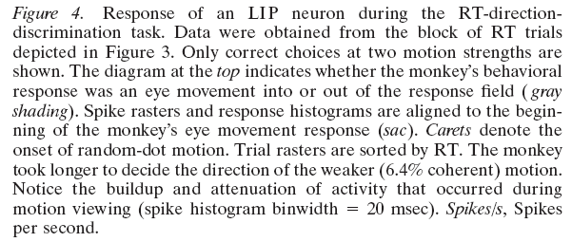
9. 2: Experiment of Roitman and Shadlen in LIP (2002)
Neurons in LIP:
-selective to target of saccade
-increases faster if signal is stronger
- activity is noisy
LIP is somewhere between MT (movement detection) and Frontal Eye Field
(saccade control)

Slide 26
2. Experiment of Roitman and Shadlen in LIP (2002)
Neurons in LIP:
- Selective to target of saccade
- Activity increases faster if signal is stronger
Activity is noisy
Located in the signal processing stream between sensory areas and saccade control
I do not claim that these neurons ‘take the decision’
Interesting correlations with decision outcome

Slide 27
Quiz 1, now
Receptive field in LIP
[ ] related to the target of a saccade
[ ] depends on movement of random dots

Slide 28
Biological Modeling of Neural Networks:
9.1 Introduction
- decision making
9.2 Perceptual decision making
- V5/MT
- Decision dynamics: Area LIP
9.3 Theory of decision dynamics
- competition via shared inhibition
- effective 2-dim model
9.4. Solutions
- symmetric case
-biased case
9.5. Simulations and Experiments
- simulations and theory
- simulations and experiments
9.6. Decisions, actions, volition
- the problem of free will
Week 9 – Decision models:
Competitive dynamics
Wulfram Gerstner
EPFL, Lausanne, Switzerland
Reading for week 9:
NEURONAL DYNAMICS
Ch. 16 (except 16.4.2)
Cambridge Univ. Press
Notes:
Lecture 1, includes the
Blackboard part of the Salzman et al experiment
Blackboard part Reduction from 3 to 2 dimensions
Lecture 2
continuation of blackboard with linearization of the inhibitory neurons
Then Exercise 1, nullclines etc. from 10:25-10:38
Afterwards, the shifting nullclines, discussion of regimes, fixed points etc.
3rd lecture: Simulations of Wang + Free will (section 9.5)

Slide 29
9.3. Theory of decision dynamics
activity equations
Membrane potential caused by input
Input indicating
left movement
Input indicating
right movement
population activity
Blackboard:
reduction from
3 to 2 equations

Slide 31
9.3. Theory of decision dynamics
Population activity
activity equations
Blackboard:
Linearized inhibition
Inhibitory Population

Slide 32
9.3. Effective 2-dim. model
activity equations
Membrane potential caused by input
Input indicating
left movement
Input indicating
right movement
population activity

Slide 33
Exercise 1 now: draw nullclines and flow arrows
h
1.0
1.0
0.8
0.2
0.0
1.0
0.8
0.2
0.0
Next Lecture
at 10:40
Notes:
If we continue at 10:45, the timing will work out.

Slide 35
Biological Modeling of Neural Networks:
9.1 Introduction
- decision making
9.2 Perceptual decision making
- V5/MT
- Decision dynamics: Area LIP
9.3 Theory of decision dynamics
- competition via shared inhibition
- effective 2-dim model
9.4. Solutions
- symmetric case
-biased case
9.5. Simulations and Experiments
- simulations and theory
- simulations and experiments
9.6. Decisions, actions, volition
- the problem of free will
Week 9 – Decision models:
Competitive dynamics
Wulfram Gerstner
EPFL, Lausanne, Switzerland
Reading for week 9:
NEURONAL DYNAMICS
Ch. 16 (except 16.4.2)
Cambridge Univ. Press
Notes:
Lecture 1, includes the
Blackboard part of the Salzman et al experiment
Blackboard part Reduction from 3 to 2 dimensions
Lecture 2
continuation of blackboard with linearization of the inhibitory neurons
Then Exercise 1, nullclines etc. from 10:25-10:38
Afterwards, the shifting nullclines, discussion of regimes, fixed points etc.
3rd lecture: Simulations of Wang + Free will (section 9.5)

Slide 36
9.4. Theory of decision dynamics
Phase plane, strong external input

Slide 37
Quiz 2, take 5 minutes now
Continue with Exercise 1, but change the external inputs.
A Keep the input to population 1,
but reduce the input to population 2 from 0.8 to 0.2
[ ] The nullcline for dh2/dt shifts vertically downward
[ ] The nullcline for dh2/dt shifts horizontally leftward
[ ] The nullcline for dh1/dt shifts vertically downward
[ ] The number of fixed points changes
B In addition, you now also reduce the input to population 1,
0.8 to 0.2
[ ] The nullcline for dh2/dt shifts vertically downward
[ ] The nullcline for dh2/dt shifts horizontally leftward
[ ] The nullcline for dh1/dt shifts vertically downward
Notes:
New Quiz, added after the lecture 2017

Slide 38
9.4. Theory of decision dynamics: biased input
Phase plane – biased input:
Population activity

Slide 39
9.4. Theory of decision dynamics: unbiased weak
Phase plane – symmetric but small input
Weak external input:
Stable fixed point

Slide 40
9.4. decision dynamics: unbiased strong to biased
Symmetric, but strong input
Phase plane
unbiased strong input
= 2 stable fixed points

Slide 41
9.4. Theory of decision dynamics: biased strong
Phase plane
Population activity
Biased input = stable fixed point
→ decision reflects bias

Slide 42
9.4. Theory of decision dynamics: unbiased strong
Phase plane
Homogeneous solution
= saddle point
→ decision must be taken

Slide 43
Biological Modeling of Neural Networks:
9.1 Introduction
- decision making
9.2 Perceptual decision making
- V5/MT
- Decision dynamics: Area LIP
9.3 Theory of decision dynamics
- competition via shared inhibition
- effective 2-dim model
9.4. Solutions
- symmetric case
-biased case
9.5. Simulations and Experiments
- simulations and theory
- simulations and experiments
9.6. Decisions, actions, volition
- the problem of free will
Week 9 – Decision models:
Competitive dynamics
Wulfram Gerstner
EPFL, Lausanne, Switzerland
Reading for week 9:
NEURONAL DYNAMICS
Ch. 16 (except 16.4.2)
Cambridge Univ. Press
Notes:
3rd lecture starts here: Simulations of Wang (9.5) + Free will (section 9.6)

Slide 44
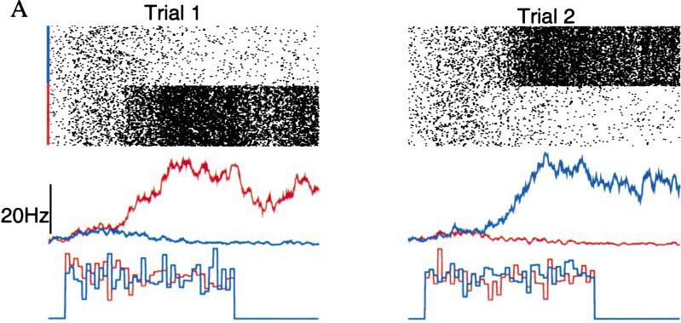
9.5. Decisions in populations of neurons: simulation
Simulation of 3 populations of spiking neurons, unbiased strong input
X.J. Wang, 2002
NEURON
Popul. 2
Popul.1
stimulus
Notes:
Start here at 11:15

Slide 45
9.5: Comparison: Simulation and Theory
1) Before stimulus is given: symmetric but small input
Weak unbiased input:
Stable fixed point
→ no decision
Exercise 2 at home:
stability of symmetric solution

Slide 46
9.5: Comparison: Simulation and Theory
2) When stimulus is given: symmetric but strong input
Phase plane
Homogeneous solution
= saddle point
→ decision must be taken

Slide 47
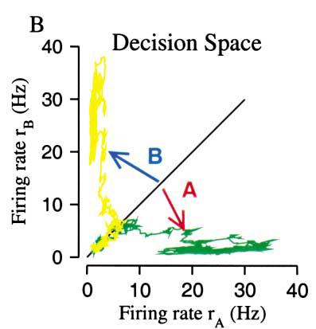
9.5: Decisions in populations of neurons: simulation
Simulation of 3 populations of spiking neurons, unbiased strong input
X.J. Wang, 2002
NEURON
Popul. 2
Popul.1
stimulus
Notes:
Start here at 11:15

Slide 48
9.5. Comparison with experiment: biased strong input
Prediction by theory - for input potential
- population activity
Biased input = stable fixed point
→ decision reflects bias

Slide 49
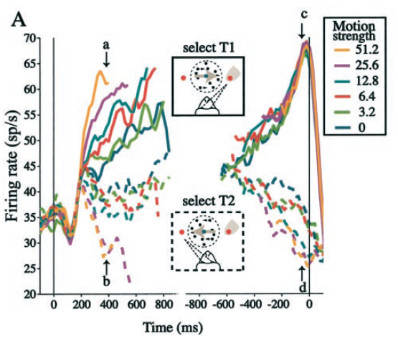
9.5. Decisions in populations of neurons: LIP data
Stimulus onset
saccade onset
Roitman and Shadlen 2002
Notes:
End of second lecture

Slide 50
9.5. Decisions in populations of neurons: simulations and data
simulation of competing populations
shares properties with LIP data:
- faster increase for strong bias
- suppression for opposite saccade
BUT: there is no claim that
decision is taken in LIP
LIP is somewhere in the processing
stream from input to saccades
Notes:
End of second lecture

Slide 51
Biological Modeling of Neural Networks:
9.1 Introduction
- decision making
9.2 Perceptual decision making
- V5/MT
- Decision dynamics: Area LIP
9.3 Theory of decision dynamics
- competition via shared inhibition
- effective 2-dim model
9.4. Solutions
- symmetric case
-biased case
9.5. Simulations and Experiments
- simulations and theory
- simulations and experiments
9.6. Decisions, actions, volition
- the problem of free will
Week 9 – Decision models:
Competitive dynamics
Wulfram Gerstner
EPFL, Lausanne, Switzerland
Reading for week 9:
NEURONAL DYNAMICS
Ch. 16 (except 16.4.2)
Cambridge Univ. Press
Notes:
Lecture 1, includes the
Blackboard part of the Salzman et al experiment
Blackboard part Reduction from 3 to 2 dimensions
Lecture 2
continuation of blackboard with linearization of the inhibitory neurons
Then Exercise 1, nullclines etc. from 10:25-10:38
Afterwards, the shifting nullclines, discussion of regimes, fixed points etc.
3rd lecture: Simulations of Wang + Free will (section 9.5)

Slide 52
9.6. Decision: risky vs. safe
How would you decide?
goal

Slide 53
9.6. Decision: risky vs. safe
How would you decide?
goal
Start

Slide 54
9.6. fMRI variant of Libet experiment: volition and free will
Decision and Movement
Preparation
-Subject decides spontaneously
to move left or right hand
- report when they made their decision
Libet, Behav. Brain Sci., 1985
Soon et al., Nat. Neurosci., 2008

Slide 55
What decides? Who decides?
‘Your brain decides what you want or what you prefer … ’
‘ … but your brain – this is you!!!’
Your experiences are memorized in your brain
Your values are memorized in your brain
Your decisions are reflected in brain activities
‘We don’t do what we want, but we want what we do’ (W. Prinz)
goal
goal
The problem of
Free Will
(see e.g. Wikipedia
article)
Start

Slide 56
9.6. Decision: risky vs. safe
- decisions are taken in the brain
- competition between populations is a
transparent model
- relevant decisions involve
personal values and experiences
goal

Slide 57
9.6. Selected References: Decision Making
Suggested Reading: - Salzman et al. Nature 1990
- Roitman and Shadlen, J. Neurosci. 2002
- Abbott, Fusi, Miller:
Theoretical Approaches to Neurosci.
- X.-J. Wang, Neuron 2002
- Libet, Behav. Brain Sci., 1985
- Soon et al., Nat. Neurosci., 2008
- free will, Wikipedia
Chapter 16, Neuronal Dynamics, Gerstner et al. Cambridge 2014

Slide 58
Exercise 2.1 now: stability of homogeneous solution
Membrane potential caused by input
Assume:
a) Calculate homogeneous fixed point
b) Analyze stability of the fixed point h(b) as a function of b

Slide 59
Online course evaluation,
still open this week.
1 summary question per class
→ please do it
(for all your classes)

Slide 60
Quick feedback on course:
“What can I do better and differently next year?”
- support: link to book chapter, video, slides
not sufficient, sufficient, good, excellent
- integrated exercises?
repeat next year, do not repeat next year
- workload for a 4 credit course (=6 h p. week, for 18 weeks)
In addition to class 9-12: 2h or less, 3h, 4h or more
- difficulty?
easier than other theory classes,
same, harder than other theory classes
- other points?

Slide 61
Biological Modeling of Neural Networks
Week 1: A first simple neuron model/
neurons and mathematics
Week 2: Hodgkin-Huxley models and
biophysical modeling
Week 3: Two-dimensional models and
phase plane analysis
Week 4: Two-dimensional models,
type I and type II models
Week 5,6: Associative Memory,
Hebb rule, Hopfield
Week 7-9: Perception, Cognition, Decision
Week 10-12: Noise models, noisy neurons
and coding
Week 13: Learning in Networks
Week x: Online video: Dendrites/Biophysics
Week xx: Online video: GLM/ estimating neuron models
Wulfram Gerstner
EPFL, Lausanne, Switzerland

Slide 62
LEARNING OUTCOMES
Solve linear one-dimensional differential equations
Analyze two-dimensional models in the phase plane
Develop a simplified model by separation of time scales
Analyze connected networks in the mean-field limit
Formulate stochastic models of biological phenomena
Formalize biological facts into mathematical models
Prove stability and convergence
Apply model concepts in simulations
Predict outcome of dynamics
Describe neuronal phenomena
Look at samples of
past exams
Use a textbook,
(Use video lectures)
don’t use slides (only)
Transversal skills
Plan and carry out activities in a way which makes optimal use of available time and other resources.
Collect data.
Write a scientific or technical report.
miniproject

Slide 63
Biological Modeling of Neural Networks
Written Exam (70%)
+ miniproject (30%)
http://neuronaldynamics.epfl.ch/
Textbook:
Written exam:
- checks ‘Learning Outcomes’
- no calculator, no textbook
- bring A5 sheet of handwritten notes
Videos:
https://lcnwww.epfl.ch/gerstner/NeuronalDynamics-MOOCall.html

Slide 64
The end:
good luck with your exams!

