Slide 1
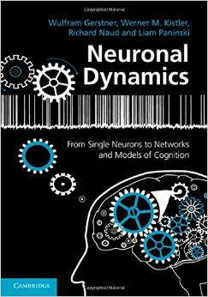
Biological Modeling of Neural Networks
5.1 Introduction
- networks of neuron
- systems for computing
- associative memory
5.2 Classification by similarity
5.3 Detour: Magnetic Materials
5.4 Hopfield Model
5.5 Learning of Associations
5.6 Storage Capacity
Week 5
NETWORKS of NEURONS and
ASSOCIATIVE MEMORY
Wulfram Gerstner
EPFL, Lausanne, Switzerland
Reading for week 5:
NEURONAL DYNAMICS
- Ch. 17.1 - 17.2.4
Cambridge Univ. Press
Notes:
2016: I had to shift exercise 1 and 2 to the second period of 45 minutes, otherwise unchanged with respect to previous years.
2019: same: I went to an interview talk from 10h15-11h00, while students did the exercises.
2014, 2015, 2017,2018: Traditional timing
The first part now took less than 35 minutes and leads up to the Swiss-cross exercise (1 pattern only!)
Second part: I started at 10:15 and took questions for exercise 1, and introduced the notation w_ij = p_i p_j that lead then naturally to the question of what can we do with several patters. I plugged in the weights in the dynamics and introduced the overlap; then I showed the demo, (DEMO is on LCN home page under teaching -> neural java)
and explained why you should use random patterns. Then exercise 2.
c) Third part: I started at 11:15 and showed how to do the calculation for exercise 2, explained orthogonality and why random patterns are nearly orthogonal. This then led over to the storage capacity for random patterns. I finished at 12:00

Slide 2
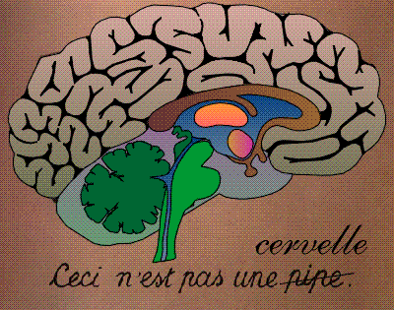
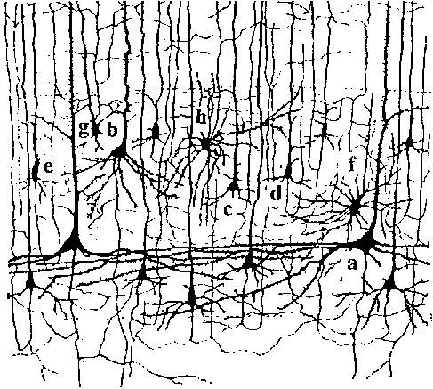
5.1. memory
-president
-first day at EPFL
-apple
Our memory has multiple aspects
- recent and far-back
- events, places, facts, concepts

Slide 3
5.1. Systems for computing and information processing
Brain
Computer
memory
CPU
input
Distributed architecture
Von Neumann architecture
10
1 CPU
(10 proc. Elements/neurons)
10
(10 transistors)
No separation of
processing and memory

Slide 4
5.1. Systems for computing and information processing
1mm
10 000 neurons
3 km of wire

Slide 5
5.1. Systems for computing and information processing
1mm
Brain
10 000 neurons
3 km of wire
Distributed architecture
10
10 neurons
4
10 connections/neurons
No separation of
processing and memory

Slide 6
5.1. Associations, Associative memory
Read this text NOW!
I find it rea*l* amazin* t*at y*u ar* abl* to re*d t*is tex* despit* th* fac* *hat more t*an t*ent* perc*n* of t** char*cte*s a*e mis*ing.
*his mean* t*at you* brai* i* abl* ** fill in missin* info*matio*.

Slide 7
5.1. Associations, Associative memory
pattern completion/word recognition
atom
brave
brain
brass
brai*
brain
Noisy word
List of words
Output the closest one
Your brain fills in missing information:
‘associative memory’

Slide 8
Biological Modeling of Neural Networks
Week 5: Networks of Neurons-Introduction
5.1 Introduction
- networks of neuron
- systems for computing
- associative memory
5.2 Classification by similarity
5.3 Detour: Magnetic Materials
5.4 Hopfield Model
5.5 Learning of Associations
5.6 Storage Capacity
Week 5
NETWORKS of NEURONS and
ASSOCIATIVE MEMORY
Wulfram Gerstner
EPFL, Lausanne, Switzerland

Slide 9
5.2 Classification by similarity: pattern recognition
A
B
Classification:
comparison
with prototypes
image
T
Z
Noisy image
Prototypes

Slide 10
5.2 Classification by similarity: pattern recognition
Classification by closest prototype
Blackboard:
Noisy image
Prototypes

Slide 11
5.2 pattern recognition and Pattern completion
Aim: Understand Associative Memory
Associative
memory/
collective
computation
Noisy
image
Full
image
Partial
word
Full
word
Brain-style computation

Slide 12
Quiz 5.1: Connectivity
A typical neuron in the brain makes connections
To 6-20 neighbors
To 100-200 neurons nearby
To more than 1000 neurons nearby
To more than 1000 neurons nearby or far away.
In a typical cristal in nature, each atom interacts
with 6-20 neighbors
with 100-200 atoms nearby
with more than 1000 atoms nearby
with more than 1000 atoms nearby or far away.

Slide 13
Biological Modeling of Neural Networks
Week 5: Networks of Neurons-Introduction
5.1 Introduction
- networks of neuron
- systems for computing
- associative memory
5.2 Classification by similarity
5.3 Detour: Magnetic Materials
5.4 Hopfield Model
5.5 Learning of Associations
5.6 Storage Capacity
Week 5
NETWORKS of NEURONS and
ASSOCIATIVE MEMORY
Wulfram Gerstner
EPFL, Lausanne, Switzerland

Slide 14
5.3 Detour: magnetism
N
S

Slide 15
5.3 Detour: magnetism
Noisy magnet
pure magnet

Slide 16
5.3 Detour: magnetism
Elementary magnet
S_{i} = +1
Blackboard:
example
S_{i} = -1
dynamics
Sum over all
interactions with i

Slide 18
5.3 Detour: magnetism
Anti-ferromagnet
Elementary magnet
S_{i} = +1
w_{ij} = +1
S_{i} = -1
w_{ij} = -1
dynamics
Sum over all
interactions with i
blackboard

Slide 19
5.3 Magnetism and memory patterns
blackboard
Elementary pixel
w_{ij} = +1
S_{i} = +1
w_{ij} = +1
S_{i} = -1
w_{ij} = -1
dynamics
Hopfield model:
Several patterns→ next section
Sum over all
interactions with i

Slide 20
Exercise 1: Associative memory (1 pattern)
Elementary pixel
Exercises: later
w_{ij} = +1
S_{i} = +1
w_{ij} = +1
Next lecture at
10h15
S_{i} = -1
dynamics
9 neurons
- define appropriate weights
- what happens if one neuron wrong?
- what happens if n neurons wrong?
Sum over all
interactions with i

Slide 21
Biological Modeling of Neural Networks
Week 5: Networks of Neurons-Introduction
5.1 Introduction
- networks of neuron
- systems for computing
- associative memory
5.2 Classification by similarity
5.3 Detour: Magnetic Materials
5.4 Hopfield Model
5.5 Learning of Associations
5.6 Storage Capacity
Week 5
NETWORKS of NEURONS and
ASSOCIATIVE MEMORY
Wulfram Gerstner
EPFL, Lausanne, Switzerland
Notes:
THIS IS THE Second part: I started at 10:15 and took questions for exercise 1, and introduced the notation w_ij = p_i p_j that lead then naturally to the question of what can we do with several patters. I plugged in the weights in the dynamics and introduced the overlap; then I showed the demo, and explained why you should use random patterns. Then exercise 3 (four orthogonal patterns).
c) Third part: I started at 11:15 and showed how to do the calculation for exercise 3, explained orthogonality and why random patterns are nearly orthogonal. This then led over to the storage capacity for random patterns. I finished at 12:00

Slide 22
5.4 Hopfield Model of Associative Memory
Blackboard: pi pj
interactions
Sum over all
prototypes
dynamics
Prototype
p¹
Prototype
p²
Hopfield model
Sum over all
interactions with i

Slide 23
5.4 Hopfield Model of Associative Memory
This rule
is very good
for random
patterns
interactions
It does not work well
for correlated patters
Sum over all
prototypes
Prototype
p¹
DEMO
dynamics
Random patterns, fully connected:
Hopfield model
all interactions with i
J. Hopfield, 1982
Notes:
(DEMO is on LCN home page under teaching -> neural java)

Slide 24
5.4 Hopfield Model of Associative Memory
Blackboard
overlap

Slide 25
5.4 Hopfield Model of Associative Memory
Interacting neurons
Prototype
p¹
Finds the closest prototype
i.e. maximal overlap
(similarity)
Computation
- without CPU,
- without explicit
memory unit
Hopfield model

Slide 26
Exercise 1: Associative memory (1 pattern)
Elementary pixel
w_{ij} = +1
S_{i} = +1
w_{ij} = +1
Next lecture at
10h15
S_{i} = -1
dynamics
9 neurons
- define appropriate weights
- what happens if one neuron wrong?
- what happens if n neurons wrong?
Sum over all
interactions with i

Slide 27
Exercise 2.1 (now) and start with 2.2
Next lecture at
11h15
Prototype
p¹
Sum over all
interactions with i
Assume 4 patterns. At time t=0, overlap with
Pattern 3, no overlap with other patterns.
discuss temporal evolution (of overlaps)
(assume that patterns are orthogonal)
Notes:
I arrived here at 10:45

Slide 29
Biological Modeling of Neural Networks
Week 5-5: Learning of Associations
5.1 Introduction
- networks of neuron
- systems for computing
- associative memory
5.2 Classification by similarity
5.3 Detour: Magnetic Materials
5.4 Hopfield Model
5.5 Learning of Associations
5.6 Storage Capacity
Week 5
NETWORKS of NEURONS and
ASSOCIATIVE MEMORY
Wulfram Gerstner
EPFL, Lausanne, Switzerland
Notes:
c) Third part: I started at 11:15 and showed how to do the calculation for exercise 2, explained orthogonality and why random patterns are nearly orthogonal. This then led over to the storage capacity for random patterns. I finished at 12:00

Slide 30
5.5 Learning of Associations
Where do the connections come from?
pre j
i
k
post
Hebbian Learning
When an axon of cell j repeatedly or persistently
takes part in firing cell i, then j’s efficiency as one
of the cells firing i is increased
Hebb, 1949
- local rule
- simultaneously active (correlations)

Slide 31
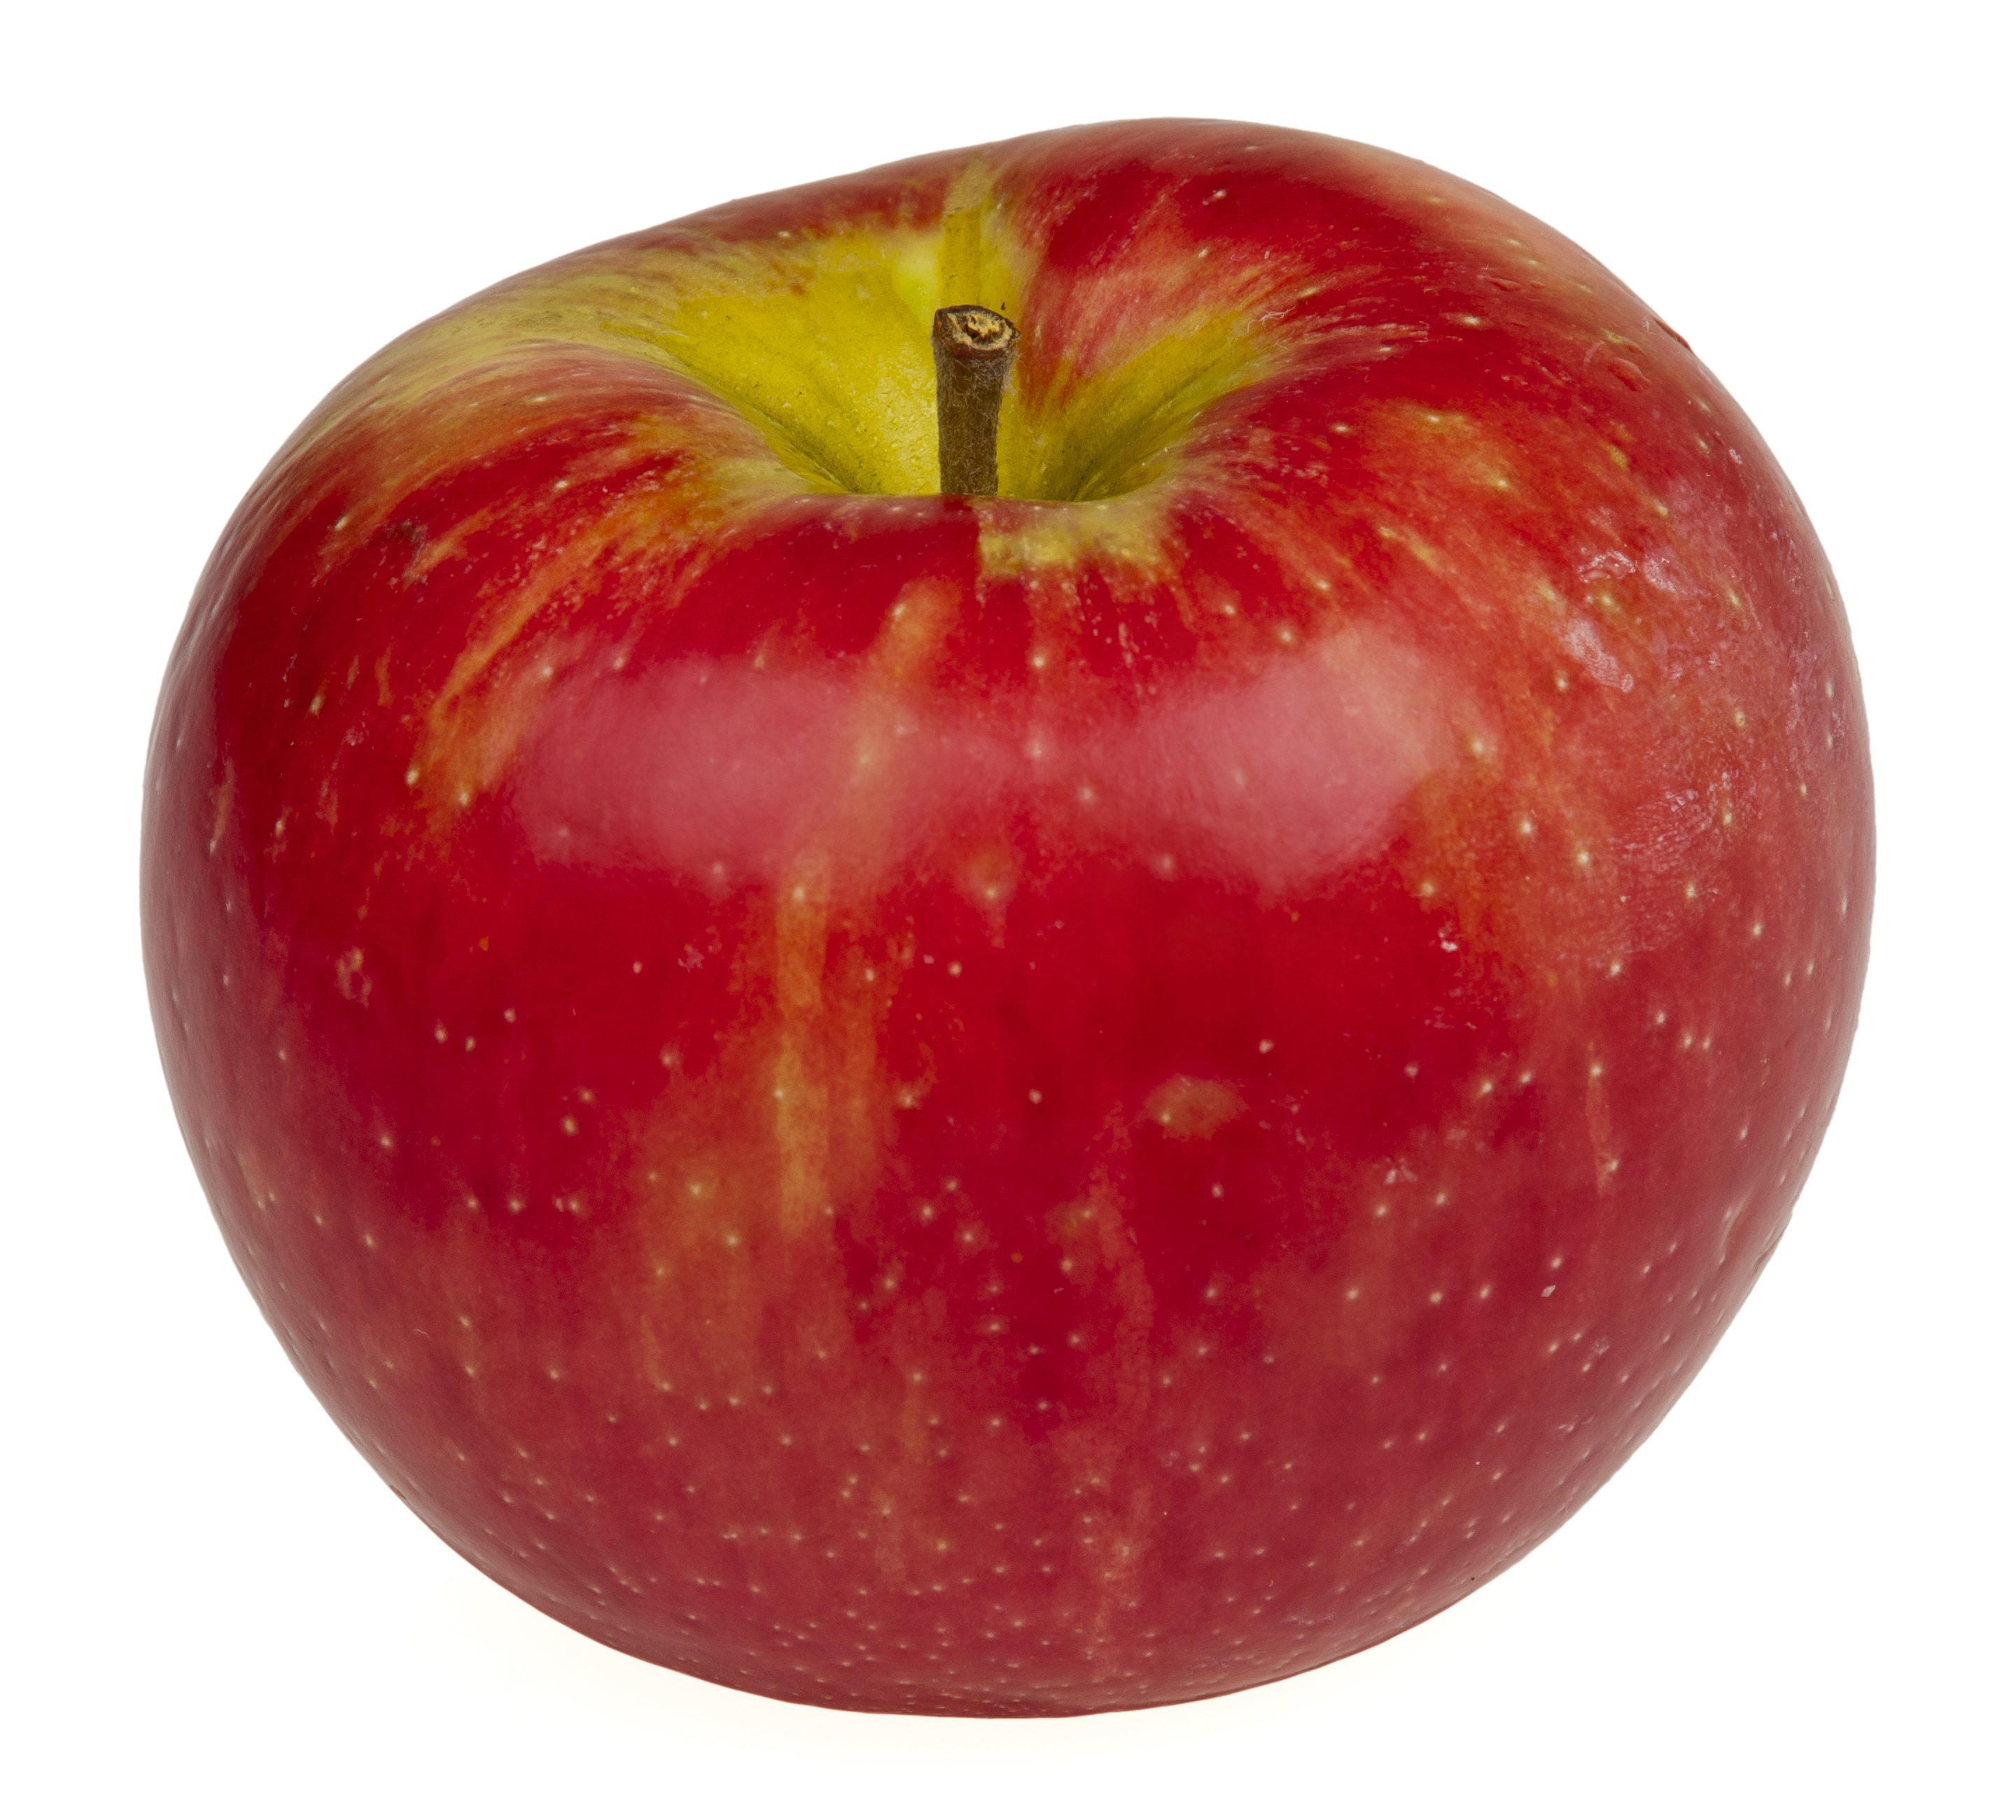
5.5 Hebbian Learning of Associations

Slide 32
5.5 Hebbian Learning of Associations
item memorized

Slide 33
5.5 Hebbian Learning: Associative Recall
Recall:
Partial info
item recalled

Slide 34
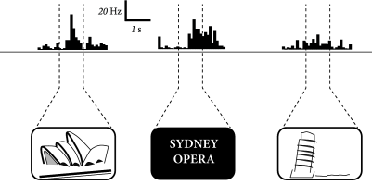
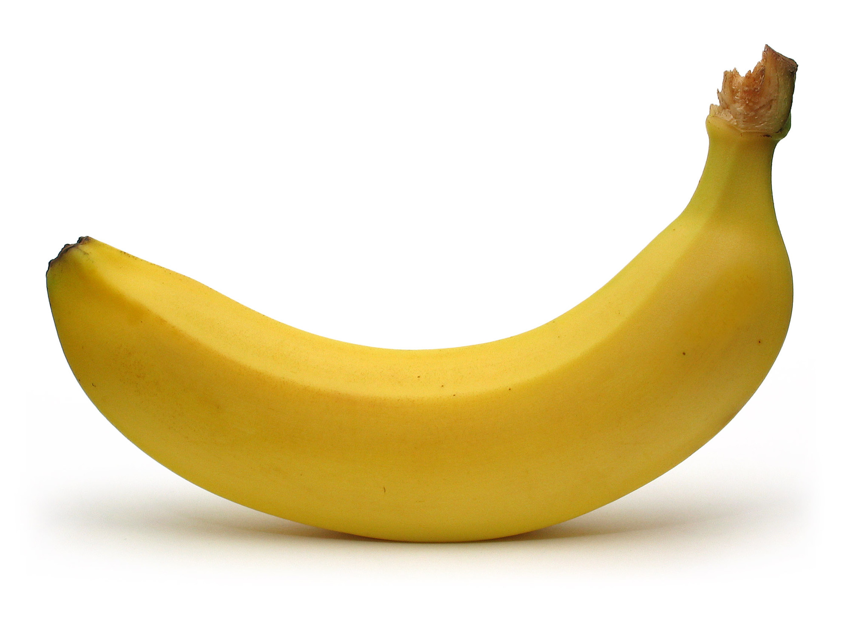
5.5 Learned concepts
Activity of neurons in human brain
Image: Neuronal Dynamics,
Gerstner et al.,
Cambridge Univ. Press (2014),
Adapted from Quiroga et al. (2005),
Nature 435:1102-1107

Slide 35
5.5 Associative Recall
Tell me the color
for the following list of 5 items:
Tell me the object shape
for the following list of 5 items:
be as fast as possible:
time

Slide 36
5.5 Associative Recall
Tell me the color
for the following list of 5 items:
Red
Blue
Yellow
Green
Red
be as fast as possible:
time
Stroop effect:
Slow response: hard to work
Against natural associations

Slide 37
5.5 Associative Recall
Hierarchical organization of
Associative memory
animals
birds
fish
Name as fast as possible
an example of a bird
swan (or goose or raven or …)
Write down first letter: s for swan or r for raven …

Slide 38
5.5 Associative Recall
Nommez au plus vite possible
un exemple d’un /d’une
name as fast as possible
an example of a
outil
tool
hammer
red
Apple
violin
couleur
color
fruit
fruit
instrument
de musique
music
instrument

Slide 39
Biological Modeling of Neural Networks
Week 5-5: Learning of Associations
5.1 Introduction
- networks of neuron
- systems for computing
- associative memory
5.2 Classification by similarity
5.3 Detour: Magnetic Materials
5.4 Hopfield Model
5.5 Learning of Associations
5.6 Storage Capacity
Week 5
NETWORKS of NEURONS and
ASSOCIATIVE MEMORY
Wulfram Gerstner
EPFL, Lausanne, Switzerland
Notes:
THIS IS THE Third part: I started at 11:30 and moved to the storage capacity for random patterns. I finished at 12:00

Slide 40
5.6. learning of several prototypes
interactions
(1)
Prototype
p¹
Prototype
p²
Sum over all
prototypes
Question: How many prototypes can be stored?
dynamics
all interactions with i

Slide 41
5.6. Storage capacity: How many prototypes can be stored?
blackboard
Random patterns
Prototype
p¹
Prototype
p²
Interactions (1)
Dynamics (2)
Minimal condition: pattern is fixed point of dynamics
Assume we start directly in one pattern (say pattern )
Pattern must stay
Attention: Retrieval requires more (pattern completion)

Slide 43
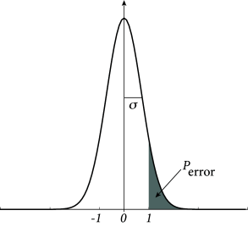
Q: How many prototypes can be stored?
blackboard
A: If too many prototypes, errors (wrong pixels) show up.
The number of prototypes M that can be stored
is proportional to number of neurons N;
memory load = M/N
Error-free if
Gaussian
Image: Neuronal Dynamics,
Gerstner et al.,
Cambridge Univ. Press (2014),

Slide 44
Aim: Understand Associative Memory
Associative
memory/
collective
computation
Partial
information
Full
concept
Brain-style computation
Memory stored in connections
Many memories can be stored in same network
Retrieval of memories without centralized controller
Interactions of neurons makes network converge to most similar pattern

Slide 45
Exercise 3 now: Associative memory
Q: How many prototypes can be stored?
End of lecture, exercise+
Computer exercise : 12:00
Prototype
p¹
Prototype
p²
Interactions (1)
Dynamics (2)
Random patterns → random walk
a) show relation to erf function: importance of p/N
b) network of 1000 neurons – allow at most 1 wrong pixel?
c) network of N neurons – at most 1 promille wrong pixels?

Slide 46
The end

