Slide 1
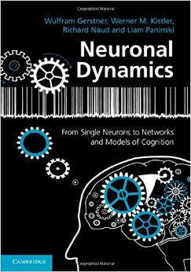
Week 7: Neuronal Populations
Biological Modeling of Neural Networks
7.1 Cortical Populations
- population activity
- columns and receptive fields
7.2 Connectivity
- cortical connectivity
- model connectivity schemes
7.3 Mean-field argument
- asynchronous state
7.4 Random Networks
- Balanced state
Wulfram Gerstner
EPFL, Lausanne, Switzerland
Reading for week 7:
NEURONAL DYNAMICS
Ch. 12.1 – 12.4.3
(except Section 12.3.7)
Wulfram Gerstner
EPFL, Lausanne, Switzerland
Cambridge Univ. Press
Notes:
IN 2016 this became lecture 7. The exercise 2 is only looking at mean current now, no fluctuations. The old exercises 2 and 3 have been removed.
IN 2015 this was given as lecture 10.
1st lecture: 25 minutes to arrive at Quiz 2, 45 minutes to arrive at slide 30: 1st lecture finished with asynchrounous state on blackboard.
2nd lecture: 30 minutes, to arrive at exercise 1 (from 10:45 – 11:15)
3rd lecture: 15 minutes to explain exercise; then noise-dependent gain function and random networks.

Slide 2
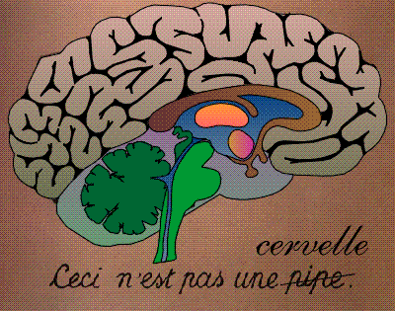
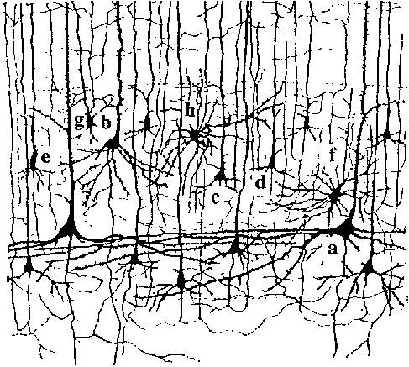
Biological Modeling of Neural Networks – Review from week 1
10 000 neurons
3 km of wire
motor
cortex
1mm
frontal
cortex
to motor
output

Slide 3
7.1 Population activity, definition
population of neurons
with similar properties
neuron 1
neuron 2
Neuron K
Brain
stim

Slide 4
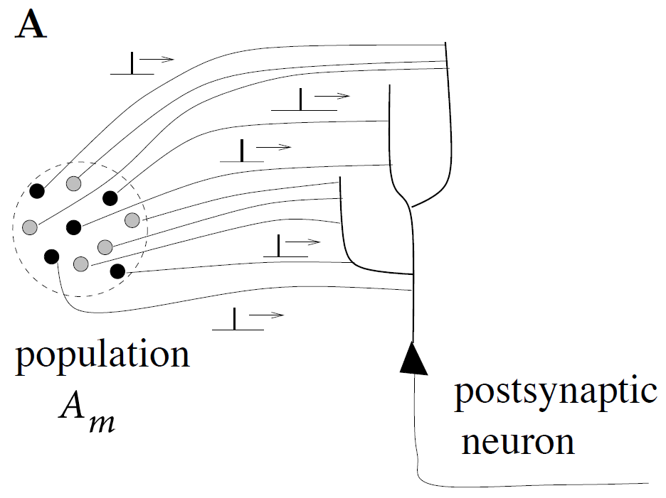
7.1 Population activity: definition
population activity - rate defined by population average
t
t
‘natural readout’
population
activity
Blackboard-1:
definition A(t)
Image: Neuronal Dynamics,
Gerstner et al.,
Cambridge Univ. Press (2014),

Slide 5
7.1 Population activity: definition

Slide 6
7.1 Population activity: example
population of neurons
with similar properties
Brain
Image: Neuronal Dynamics,
Gerstner et al.,
Cambridge Univ. Press (2014),

Slide 7
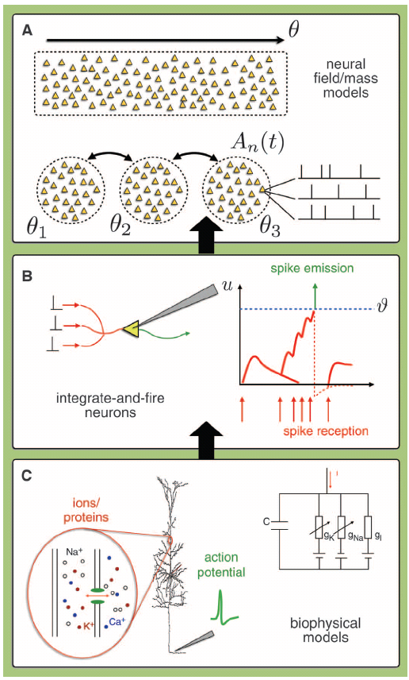
7.1: Scales of neuronal processes
population of neurons
with similar properties
Brain
Image: Gerstner et al.,
Science (2012),

Slide 8
7.1 Population activity
population of neurons
with similar properties
population activity
A(t)
Are there such populations?
Brain

Slide 9
Week 7 – Quiz 1, now
The population activity
[ ] Is a firing rate
[ ] Is a fast variable on the time scale of milliseconds
[ ] Is proportional to the number of spikes
counted across a population in a short time window
[ ] Is defined as the number of spikes
counted across a population in a short time window

Slide 10
Week 7: Neuronal Populations
Biological Modeling of Neural Networks
7.1 Cortical Populations
- population activity
- columns and receptive fields
7.2 Connectivity
- cortical connectivity
- model connectivity schemes
7.3 Mean-field argument
- asynchronous state
7.4 Random Networks
- Balanced state
Wulfram Gerstner
EPFL, Lausanne, Switzerland
Notes:
IN 2015> Lecture 10:
1st lecture: 45 minutes to arrive at slide 32: 1st lecture finished with asynchrounous state on blackboard.
2nd lecture: 30 minutes, to arrive at exercise 1 (from 10:45 – 11:15)
3rd lecture: 15 minutes to explain exercise; then noise-dependent gain function and random networks.
In 2015 I removed the gain function of renewal model/SRM (too technical/cuts main flow of reasoning)

Slide 11
7.1: Receptive fields
visual
cortex
electrode

Slide 12
7.1: Receptive fields
visual
cortex
electrode

Slide 13
7.1: Receptive fields and Retinotopic Map
visual
cortex
Neighboring cells
in visual cortex
have similar preferred
center of receptive field

Slide 14
7.1: Receptive fields with Orientation Tuning
Receptive fields:
Retina, LGN
Receptive fields:
visual cortex V1
Orientation selective

Slide 15
7.1: Receptive fields with Orientation Tuning
Receptive fields:
visual cortex V1
Orientation selective

Slide 16
7.1: Receptive fields with Orientation Tuning
Receptive fields:
visual cortex V1
preferred orientation
rate
0
Orientation selective
Stimulus orientation

Slide 17
7.1: Orientation Tuning and Orientation Maps
Receptive fields:
visual cortex V1
visual
cortex
1st pop
2nd pop
2nd pop
Neighboring neurons have similar properties
Orientation selective

Slide 18
7.1: Orientation Map
visual
cortex
Neighboring cells in visual cortex
Have similar preferred orientation:
cortical orientation map
Hubel and Wiesel 1968; Bonhoeffer&Grinvald, 1991;
Bressloff&Cowan, 2002; Kaschube et al. 2010

Slide 19
Week 7 – Quiz 2, now
The receptive field of a visual neuron refers to
[ ] The localized region of space to which it is sensitive
[ ] The orientation of a light bar to which it is sensitive
[ ] The set of all stimulus features to which it is sensitive
The receptive field of a auditory neuron refers to
[ ] The set of all stimulus features to which it is sensitive
[ ] The range of frequencies to which it is sensitive
The receptive field of a somatosensory neuron refers to
[ ] The set of all stimulus features to which it is sensitive
[ ] The region of body surface to which it is sensitive

Slide 20
Week 7: Neuronal Populations
Biological Modeling of Neural Networks
7.1 Cortical Populations
- population activity
- columns and receptive fields
7.2 Connectivity
- cortical connectivity
- model connectivity schemes
7.3 Mean-field argument
- asynchronous state
7.4 Random Networks
- Balanced state
Wulfram Gerstner
EPFL, Lausanne, Switzerland

Slide 21
7. 2: Interacting Populations in models
I(t)
1 population =
What?

Slide 22
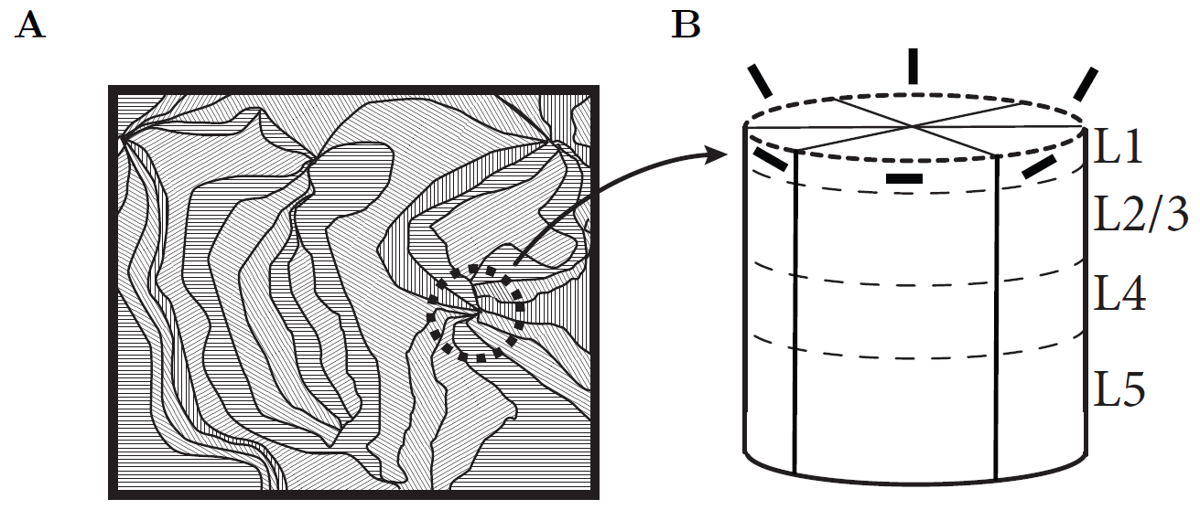
7.2: a single model population
population = group of neurons
with
- similar neuronal properties
- similar input
- similar receptive field
- similar connectivity
Rec. Field on Screen
Sheet of visual cortex
cortical column
make this more precise

Slide 23
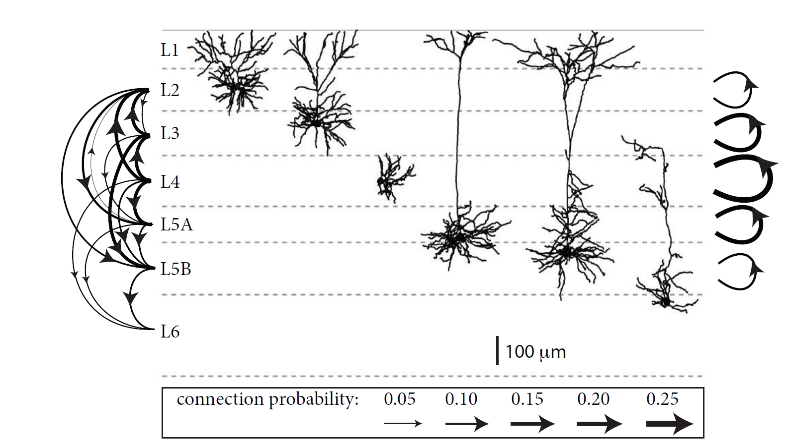
7.2: local cortical connectivity across layers
(mouse somatosensory cortex)
Here:
Excitatory neurons
1 population =
all neurons of given type
in one layer of same column
(e.g. excitatory in layer 3)
Lefort et al. NEURON, 2009

Slide 24
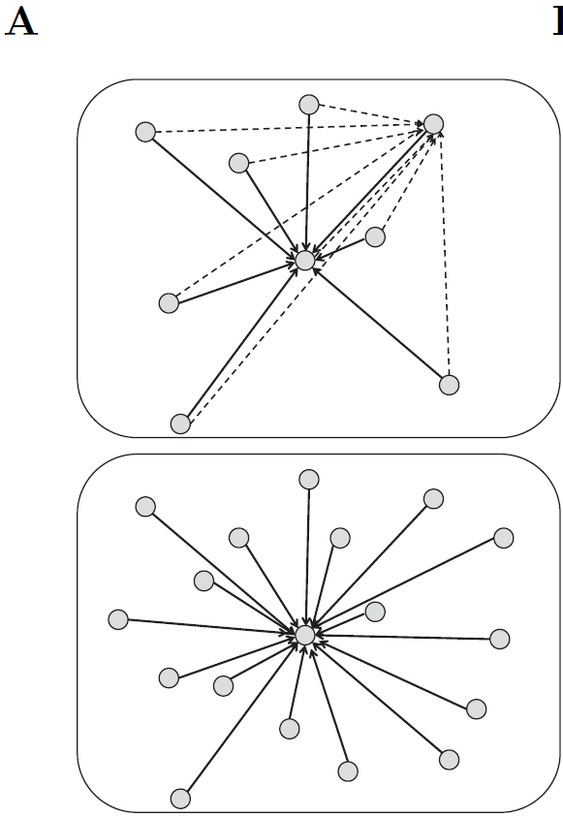
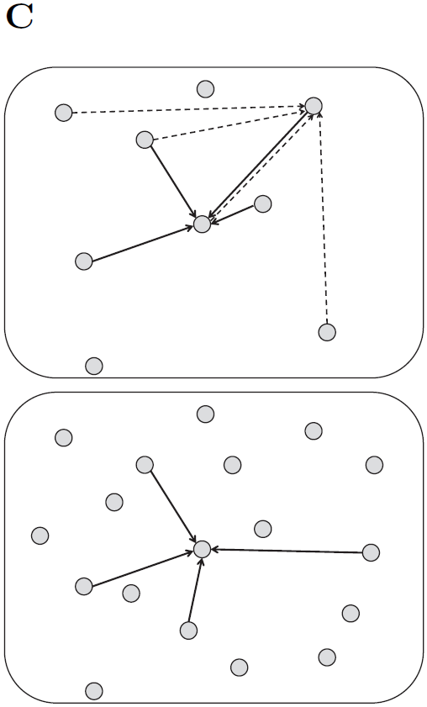
7. 2: Connectivity schemes (models)
full connectivity
Random connectivity
w. number K of inputs fixed
all-to-all
N=5000
neurons
N=10000
neurons
Image: Gerstner et al.
Neuronal Dynamics (2014)
Each neuron receives
N connections
Each neuron receives
K connections

Slide 25
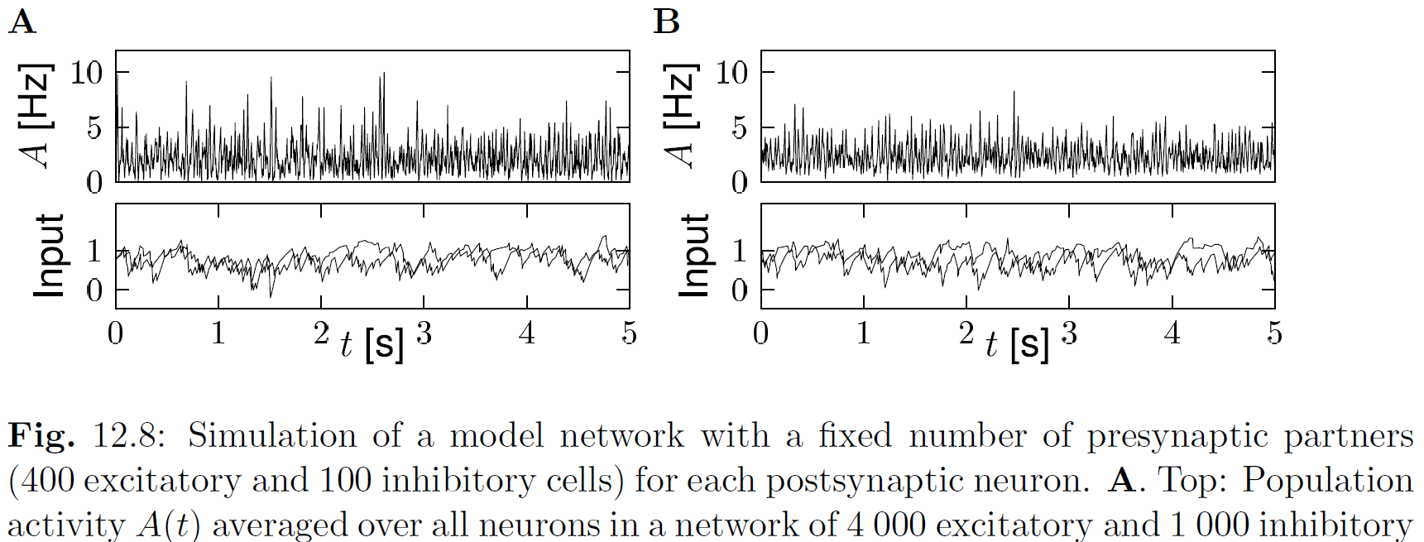
7.2: Random connectivity – fixed number of inputs
random: number of inputs K=500, fixed
Network N=5 000
Network N=10 000
Image: Gerstner et al.
Neuronal Dynamics (2014)

Slide 26
7.2: Random connectivity – fixed number of inputs
random: number of inputs K=500, fixed
Network N=5 000
Network N=10 000
Image: Gerstner et al.
Neuronal Dynamics (2014)

Slide 27
7.2: Random Connectivity: fixed p
Can we mathematically predict
the population activity?
given
- connection probability p and weight wij
- properties of individual neurons
- large population
asynchronous
activity
A(t) is nearly constant
Input is nearly identical
for different neurons
(and nearly constant)

Slide 28
Week 7: Neuronal Populations
Biological Modeling of Neural Networks
7.1 Cortical Populations
- population activity
- columns and receptive fields
7.2 Connectivity
- cortical connectivity
- model connectivity schemes
7.3 Mean-field argument
- asynchronous state
7.4 Random Networks
- Balanced state
Wulfram Gerstner
EPFL, Lausanne, Switzerland

Slide 29
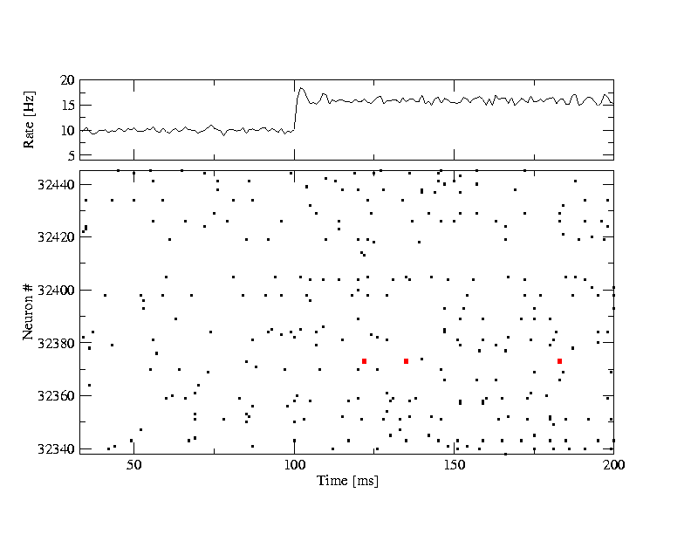
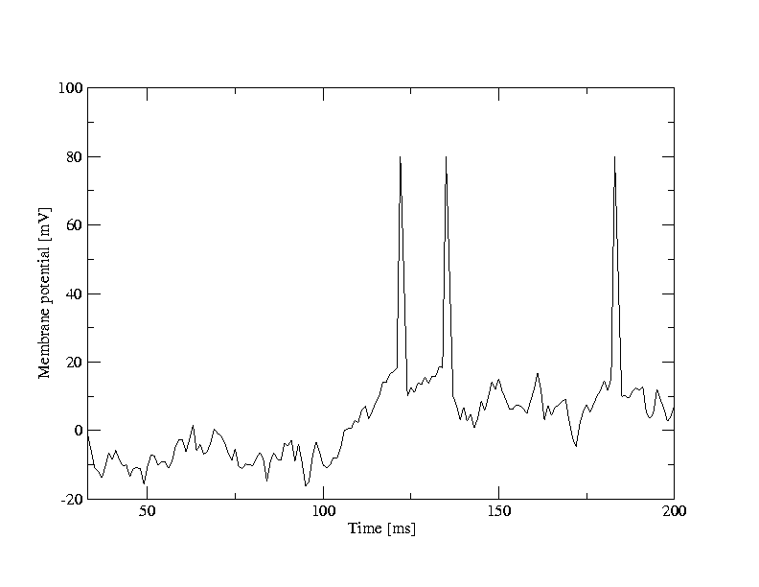
7.3: asynchronous firing / asynchronous state
A [Hz]
10
32440
Neuron #
input
-low rate
-high rate
32340
time [ms]
200
50
100
100
Neuron # 32374
u [mV]
Population
- 50 000 neurons
- 20 percent inhibitory
- randomly connected
0
50
100
time [ms]
200

Slide 30
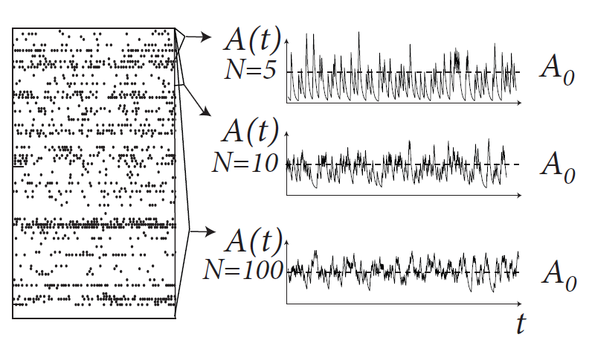
7.3: asynchronous state
Blackboard-2:
Definition of A(t)
filtered A(t)
<A(t)>
convergence in weak sense
Asynchronous state
<A(t)> = A0= constant
Image: Gerstner et al.
Neuronal Dynamics (2014)
Next lecture:
10h15
Weak convergence in Hilbert space:
https://en.wikipedia.org/wiki/Weak_convergence_(Hilbert_space)

Slide 31
7.1 Population activity: definition

Slide 32
7.3: asynchronous state – counter examples, <A(t)> not constant
population of neurons
with similar properties
Systematic oscillation
→ not ‘asynchronous’
Brain
Notes:
At the end of 45 minutes, I was here.

Slide 33
7.3: asynchronous state in a homogeneous network
population activity?
t
?
I(t)
Homogeneous network:
all neurons are ‘the same’
all synapses are ‘the same’
each neuron receives input
from k neurons in network
-each neuron receives the same
(mean) external input
t
population
activity

Slide 34
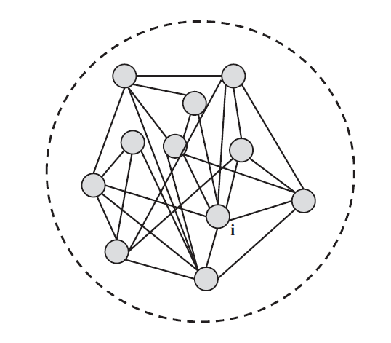
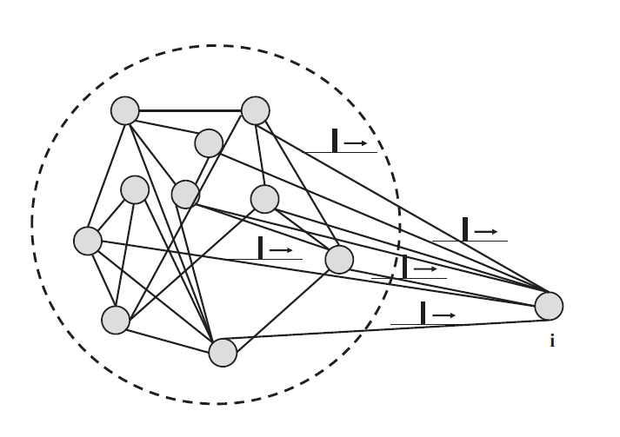
7.3: mean-field arguments (full connectivity)
Blackboard-3:
Input to neuron i

Slide 35
7.1 Population activity: definition

Slide 36
7.3: mean-field arguments (full connectivity)
Full connectivity

Slide 37
7.3: mean-field arguments (full connectivity)
Fully connected network
fully
connected
N >> 1
All spikes, all neurons
Synaptic coupling

Slide 38
7.3: mean-field arguments (full connectivity)
All neurons receive the same total input current
(‘mean field’)
fully
connected
Index i disappears
All spikes, all neurons

Slide 39
7.3: mean-field arguments: asynchronous state
Blackboard-4:
Stationary state
Assume all variables are constant in time:
Firing rate? Population rate?

Slide 40
7.1 Population activity: definition

Slide 41
7.3: mean-field arguments: population activity (asynchr. state)
Input is constant and identical for all neurons
(1)
frequency (single-neuron gain function)
A(t)= A0= const
(2)
Single neuron
Homogeneous network
All neurons are identical,
Single neuron rate = population rate
(3)

Slide 42
7.3: stationary solution: population activity (asynchr. State)
Stationary solution
=asynchronous state
(1)
(2)
Stationary solution
(3)
fully
connected
N >> 1
Homogeneous network, stationary,
All neurons are identical,
Single neuron rate = population rate

Slide 43
Exercise 1, now
Next lecture:
11h15
Exercise 1: homogeneous stationary solution (asynchronous)
fully
connected
N >> 1
Homogeneous network
All neurons are identical,
Single neuron rate = population rate

Slide 44
7.3: stationary solution: population activity (asynchr. state)
Stationary solution
=asynchronous state
(1)
(2)
Stationary solution
(3)
fully
connected
N >> 1
Homogeneous network, stationary,
All neurons are identical,
Single neuron rate = population rate

Slide 45
7.3: stationary solution: population activity (asynchr. state)
Single Population
- population activity
- full connectivity
- stationary state/asynchronous state
Single neuron rate = population rate
What is this function g?
Examples: - leaky integrate-and-fire (see week 1)
- Hodgkin-Huxley model (see week 2)

Slide 46
7.3: gain function (f-I-curve)
Gain-function g =frequency-current relation
function g can be calculated analytically or measured in
single-neuron simulations/single-neuron experiments
g

Slide 47
Week 7: Neuronal Populations
Biological Modeling of Neural Networks
7.1 Cortical Populations
- population activity
- columns and receptive fields
7.2 Connectivity
- cortical connectivity
- model connectivity schemes
7.3 Mean-field argument
- asynchronous state
7.4 Random Networks
- Changing network size
- Balanced state
Wulfram Gerstner
EPFL, Lausanne, Switzerland

Slide 48
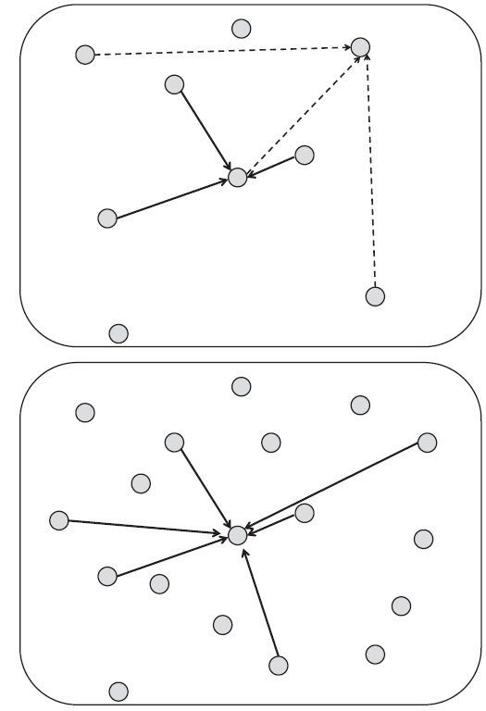
7.4: mean-field arguments (random connectivity)
random connectivity
full connectivity
random: prob p fixed
random: number K
of inputs fixed
Image: Gerstner et al.
Neuronal Dynamics (2014)

Slide 49
7.4: Review from 7.2 - Random Connectivity: fixed p
Can we mathematically predict
the population activity?
given
- connection probability p and weight wij
- properties of individual neurons
- large population
asynchronous
activity
Input is nearly identical
for different neurons

Slide 50
7.4: mean-field arguments (random connectivity)
Blackboard-5:
Excitatory input
I&F with
stochastic spike arrival
For any arbitrary neuron in the population
EPSC
Can we predict the mean current?
- and its fluctuations?
IPSC
excitatory input spikes

Slide 51
7.1 Population activity: definition

Slide 52
7.4: mean-field arguments (random connectivity)
random: probability p=0.1 fixed, weights chosen as
Network N=5 000
Network N=10 000
Image: Gerstner et al.
Neuronal Dynamics (2014)
fluctations of A decrease
fluctations of I decrease

Slide 53
7.4: Random connectivity – fixed number of inputs
random: input connections K=500 fixed, weights chosen as
Network N=5 000
Network N=10 000
Image: Gerstner et al.
Neuronal Dynamics (2014)
fluctations of A decrease
fluctations of I remain

Slide 54
Exercise 2.: Random network, K inputs per neuron
Randomly connected network
N =8000 neurons, each has
K=1000 presynaptic neurons,
Whenever a spike arrives it generates a
Current pulse
random: number
of inputs K fixed
Next lecture:
11h40
The current to neuron i is therefore
Assume that * the weights are
* activity is constant
Give an intuitive or a mathematical argument why
What happens if we increase N? What is the
Current to another neuron j in the network?
Notes:
Was here at 11:28

Slide 55
7.1 Population activity: definition

Slide 56
7.4: gain function is noise-dependent
Gain-function g =frequency-current relation
function g can be calculated analytically or measured in
single-neuron simulations/single-neuron experiments
g
different noise levels
fluctuations of input current=effective noise level

Slide 57
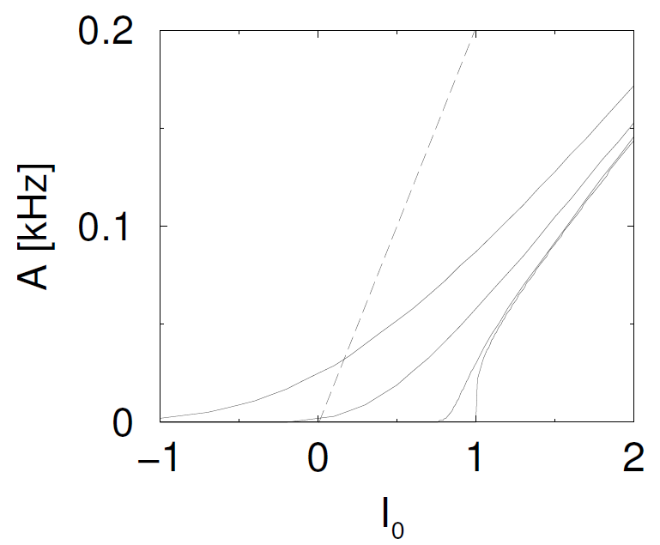
7.4: Example: integrate-and-fire neurons (outlook)
different noise levels
function g can be calculated
Fluctuations and noise will be treated in Weeks 10-12

Slide 58
7.4: Connectivity schemes – random, fixed p, but balanced
inh
exc
Blackboard-6:
Exc. + Inh. input
make network bigger, but
keep mean input close to zero
keep variance of input
Fluctuations and noise will be treated in Weeks 10-12

Slide 59
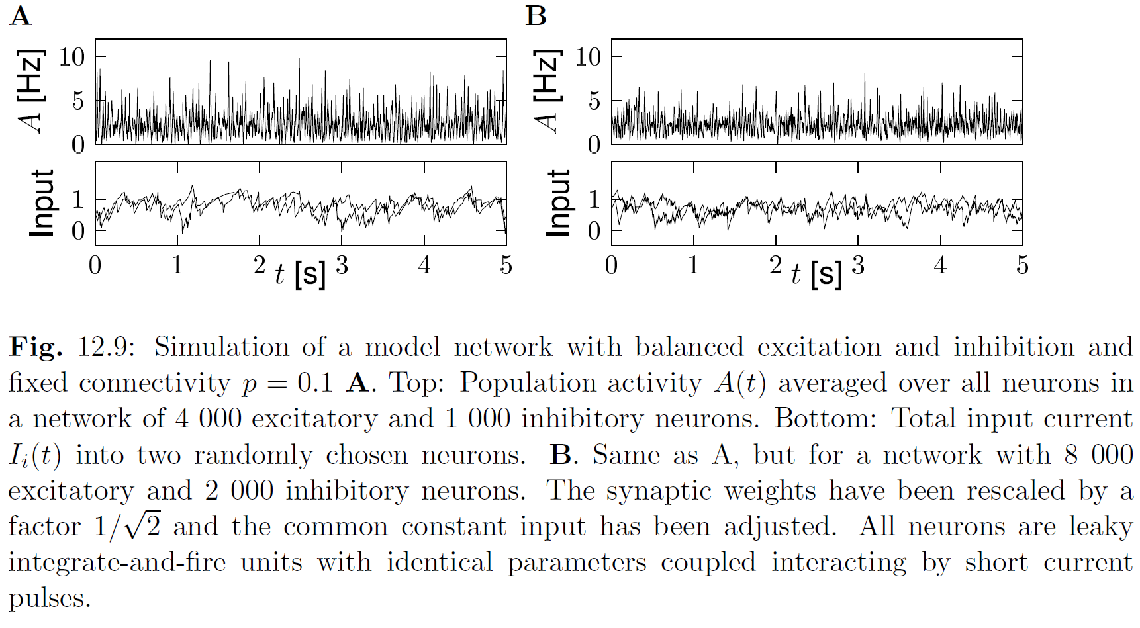
7.4: Connectivity schemes – random, fixed p, but balanced
Image: Gerstner et al.
Neuronal Dynamics (2014)
fluctations of A decrease
fluctations of I become ‘smooth’

Slide 60
7.4: Connectivity schemes – random, fixed p, but balanced
One population
→ multiple populations
Application to visual cortex
→ visual processing, week 8
Application to decision making
→ week9
Understanding the fluctuations,
→ noise and the neural code, week 10-12
I(t)

Slide 61
Biological Modeling of Neural Networks
7.1 Cortical Populations
- population activity
- columns and receptive fields
7.2 Connectivity
- cortical connectivity
- model connectivity schemes
7.3 Mean-field argument
- asynchronous state
7.4 Random Networks
- Changing network size
- Balanced state
The END
Reading for week 7:
NEURONAL DYNAMICS
Ch. 12.1 – 12.4.3
(except Section 12.3.7)
Wulfram Gerstner
EPFL, Lausanne, Switzerland
Cambridge Univ. Press

