Slide 1
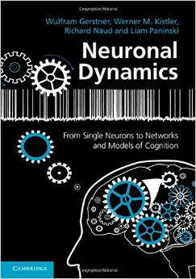
Biological Modeling of Neural Networks
10.1 Variability of spike trains
- experiments
10.2 Sources of Variability?
- Is variability equal to noise?
10.3 Poisson Model
- homogeneous/inhomogeneous
10.4 Three definitions of Rate Code
10.5 Stochastic spike arrival
- Membrane potential fluctuations
Week 10 – Variability and Noise:
The question of the neural code
Wulfram Gerstner
EPFL, Lausanne, Switzerland
Reading for week 10:
NEURONAL DYNAMICS
Ch. 7.1-7.3
Wulfram Gerstner
EPFL, Lausanne, Switzerland
Cambridge Univ. Press
Notes:
First Lecture: 10.1, 10.2, and 10.3 (HOMOGENEOUS Poisson Model). Dann um 9:50h vor der Pause, Exercise 1 (Poisson Model)
Second Lecture: 10.3 (INHOMOGENEOUS Poisson model, Quiz 1, and three definitions of rate). Quiz 2, five minutes before the end.
Third Lecture: 10.4 Stochastic spike arrival, on the blackboard, then exercise 2.
2018: I did not have time for exercise 2 as in-class, but I presented directly the solution. In class would have been better.

Slide 2
10.1 Variability in vivo – review from week 1
motor
cortex
frontal
cortex
visual
cortex
to motor
output

Slide 3
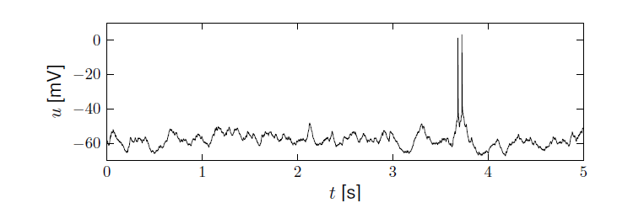
10.1 Variability in vivo – review from week 1
Variability
- of membrane potential?
- of spike timing?
Spontaneous activity in vivo
awake mouse, cortex, freely whisking,
Crochet et al., 2011

Slide 4
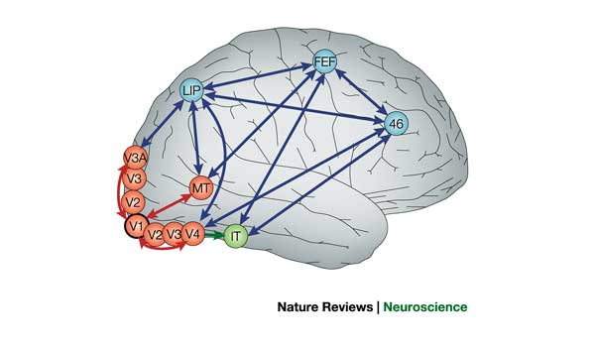
10.1 Variability in vivo – Detour: Motion Sensitive Neurons
Detour: Receptive fields in V5/MT
visual
cortex
cells in visual cortex MT/V5
respond to motion stimuli

Slide 5
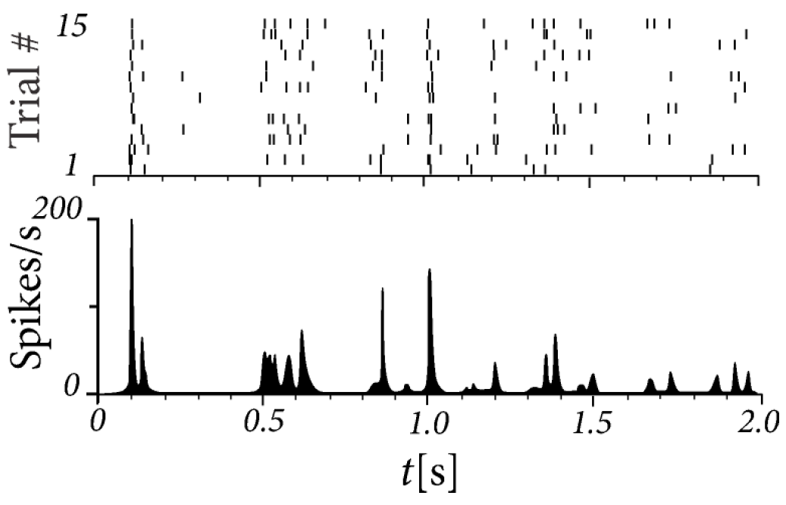
10.1 Variability in vivo – Neurons in MT/V5
15 repetitions of the same random dot motion pattern
adapted from Bair and Koch 1996;
data from Newsome 1989

Slide 6
Human Hippocampus
10.1 Variability in vivo
(single electrode)
Quiroga, Reddy,
Kreiman, Koch,
and Fried (2005).
Nature, 435:1102-1107.
Sidney opera
Sidney opera
Sidney opera

Slide 7
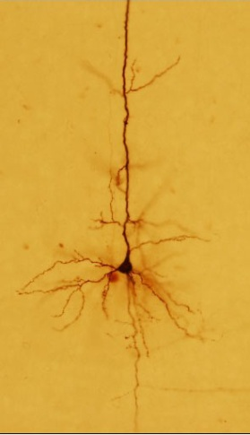
10.1 Variability in vitro
4 repetitions of the same time-dependent stimulus,
brain slice
I(t)
Image: Gerstner et al.
Neuronal Dynamics (2014)
Adapted from
Naud and Gerstner (2012)

Slide 8
10.1 Summary and Questions: Variability
Observed Fluctuations
of membrane potential
of spike times
In vivo data
→ looks ‘noisy’
→ differences between trials
→ fluctuations of
membrane potential
In vitro data
→ fluctuations of
membrane potential
→ spikes at slightly different
times in each trail
fluctuations=noise?
relevance for coding?
source of fluctuations?
model of fluctuations?

Slide 9
10.1 Summary and Questions: Variability
We observe fluctuations in data recorded in vivo or in vitro.
Today and in the next weeks we ask the question:
Are this fluctuations really noise?
Or do they reflect a coding scheme?
What is the physical or biological source
of the observed variability?
Can we write down a good model
to describe the membrane potential fluctuations
or variability of spike times between trials?

Slide 10
Biological Modeling of Neural Networks
10.1 Variability of spike trains
- experiments
10.2 Sources of Variability?
- Is variability equal to noise?
10.3 Poisson Model
- homogeneous/inhomogeneous
10.4 Three definitions of Rate Code
10.5 Stochastic spike arrival
- Membrane potential fluctuations
Week 10 – Variability and Noise:
The question of the neural code
Wulfram Gerstner
EPFL, Lausanne, Switzerland
Notes:
First Lecture: 10.1, 10.2, and 10.3 (HOMOGENEOUS Poisson Model). Dann um 9:50h vor der Pause, Exercise 1 (Poisson Model)
Second Lecture: 10.3 (INHOMOGENEOUS Poission model, Quiz 1, and three definitions of rate). Quiz 2, five minutes before the end.
Third Lecture: 10.4 Stochastic spike arrival, on the blackboard, then exercise 2.

Slide 11
10.2. Sources of Variability
- Intrinsic noise (ion channels)
Finite number of channels
Finite temperature
Na⁺
K⁺

Slide 12
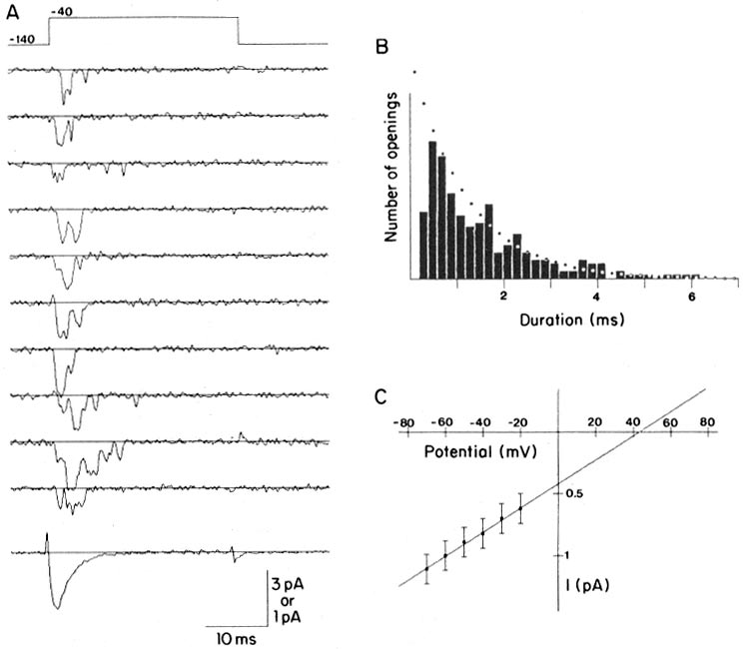
Review from week 2 Ion channels
Na⁺
stochastic opening and closing
K⁺
Steps:
Different
number
of open
channels
Ca²⁺
Ions/proteins
Na+ channel from rat heart (Patlak and Ortiz 1985)
A traces from a patch containing several channels.
Bottom: average gives current time course.
B. Opening times of single channel events

Slide 13
10.2. Sources of Variability
- Intrinsic noise (ion channels)
Finite number of channels
Finite temperature
Na⁺
K⁺
Network noise (background activity)
Spike arrival from other neurons
Beyond control of experimentalist
Check intrinisic noise by removing the network

Slide 14
10.2 Variability in vitro is low
neurons are fairly reliable
I(t)
Image adapted from
Mainen&Sejnowski 1995

Slide 15
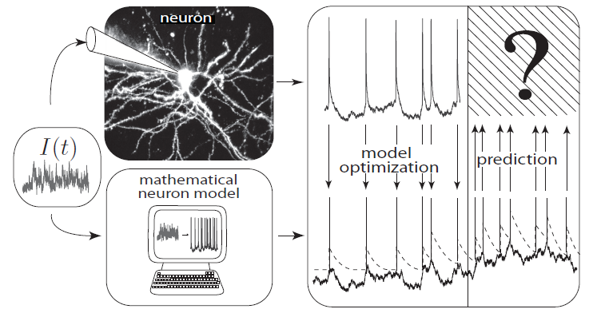
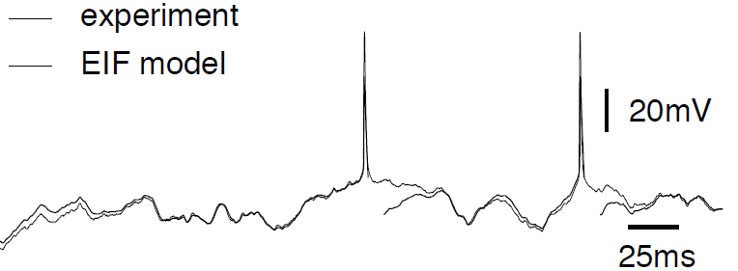
REVIEW from week1: How good are integrate-and-fire models?
Badel et al., 2008
Aims: - predict spike initiation times
- predict subthreshold voltage
only possible, because
neurons are fairly reliable

Slide 16
10.2. Sources of Variability
- Intrinsic noise (ion channels)
Finite number of channels
Finite temperature
Na⁺
small contribution!
K⁺
Network noise (background activity)
Spike arrival from other neurons
Beyond control of experimentalist
Check network noise by simulation!

Slide 17
10.2 Sources of Variability
The Brain: a highly connected system
Brain
High connectivity:
systematic, organized in local populations
but seemingly random
Distributed architecture
10
10 neurons
4
10 connections/neurons

Slide 18
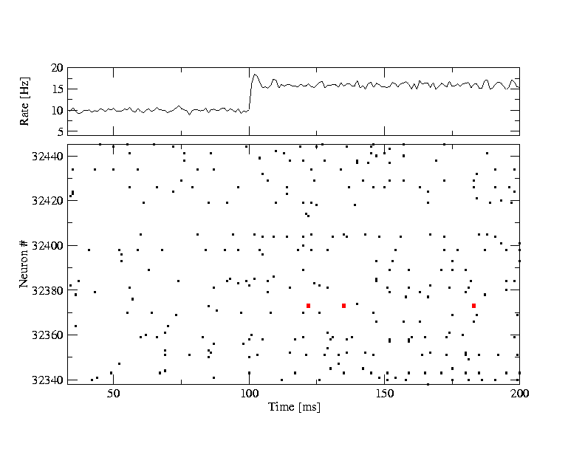
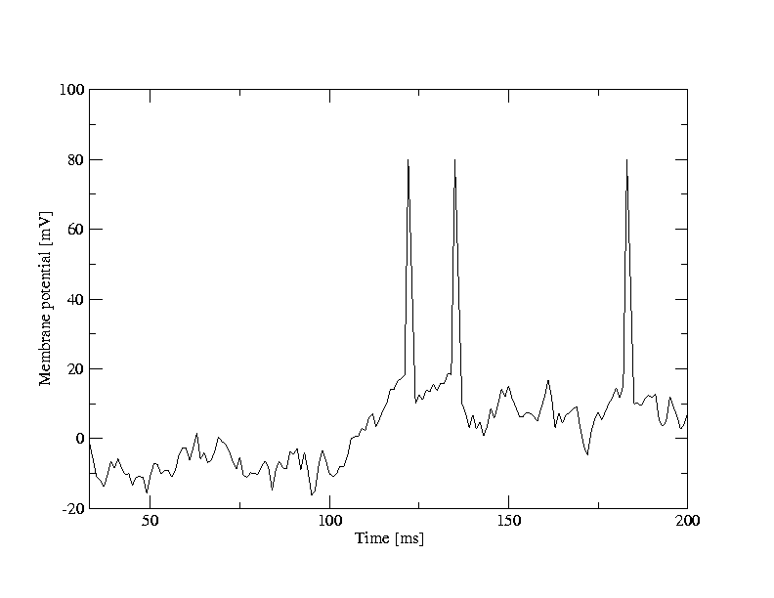
10.2 Random firing in a population of LIF neurons
A [Hz]
10
32440
Neuron #
input
-low rate
-high rate
32340
time [ms]
200
50
100
Brunel, J. Comput. Neurosc. 2000
Mayor and Gerstner, Phys. Rev E. 2005
Vogels et al., 2005
Network of deterministic
leaky integrate-and-fire:
‘fluctuations’
Population
- 50 000 neurons
- 20 percent inhibitory
- randomly connected

Slide 19
10.2 Random firing in a population of LIF neurons
A [Hz]
10
32440
Neuron #
input
-low rate
-high rate
32340
time [ms]
200
50
100
100
Neuron # 32374
u [mV]
Population
- 50 000 neurons
- 20 percent inhibitory
- randomly connected
0
50
100
time [ms]
200

Slide 20
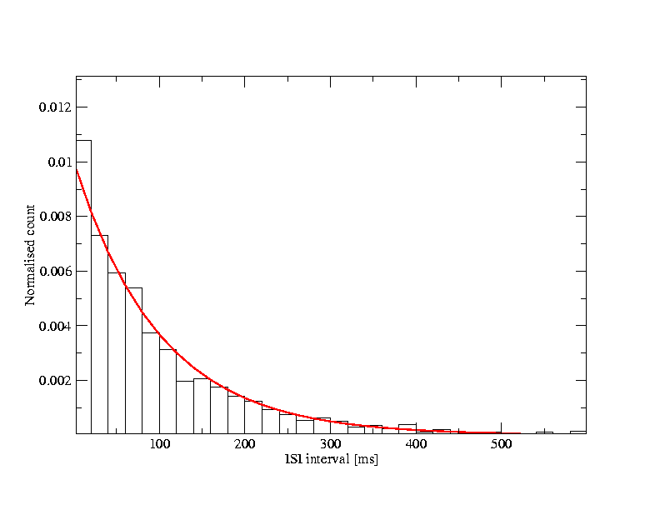
10.2. Interspike interval distribution
- Variability of interspike intervals (ISI)
here in simulations,
but also in vivo
100
u [mV]
ISI
ISI distribution
0
100
100
t [ms]
500
50
100
time [ms]
200
Variability of spike trains:
broad ISI distribution
Brunel,
J. Comput. Neurosc. 2000
Mayor and Gerstner,
Phys. Rev E. 2005
Vogels and Abbott,
J. Neuroscience, 2005

Slide 21
10.2. Sources of Variability
- Intrinsic noise (ion channels)
In vivo data
→ looks ‘noisy’
In vitro data
→small fluctuations
→nearly deterministic
Na⁺
small contribution!
K⁺
Network noise
big contribution!

Slide 22
Quiz 10.1.
A- Spike timing in vitro and in vivo
[ ] Reliability of spike timing can be assessed by repeating several times the same stimulus
[ ] Spike timing in vitro is more reliable under injection of constant current than with fluctuating current
[ ] Spike timing in vitro is more reliable than spike timing in vivo
[x]
[ ]
[x]
B – Interspike Interval Distribution (ISI)
[ ] An isolated deterministic leaky integrate-and-fire neuron driven by a constant current can have a broad ISI
[ ] A deterministic leaky integrate-and-fire neuron embedded into a randomly connected network of integrate-and-fire neurons can have a broad ISI
[ ] A deterministic Hodgkin-Huxley model as in week 2 embedded into a randomly connected network of Hodgkin-Huxley neurons can have a broad ISI
[ ]
[x]
[x]

Slide 23
10.2 Summary: Sources of variability
There are two important sources of fluctuations observed in data recorded
in vivo or in vitro:
Intrinsically generated fluctuations caused by a finite temperature together with a finite number of ion channels. Individual Ion channels open and close stochastically. We refer to these intrinsically generated fluctuations as ‘intrinsic noise’. Given that for current injection into the soma a neuron behaves rather
reliably, we conclude that the importance of intrinsic noise is relatively low.
A single neuron j embedded in the network receives spikes from many other
neurons. Since an external observer cannot control the spike times of all neurons, the spike arrival times to neuron j the spike arrival times are often considered as ‘random’. In fact, even in a simulation of a deterministic network of spiking neurons, spike arrival looks ‘random’. We refer to these effects as ‘network noise’.
As a first measure of the variability of spike trains, we have used the interspike interval distribution (ISI). A deterministic network of spiking neurons with fixed (but random) connectivity often exhibits stationary activity with a broad ISI.

Slide 24
Biological Modeling of Neural Networks
10.1 Variability of spike trains
- experiments
10.2 Sources of Variability?
- Is variability equal to noise?
10.3 Poisson Model
- homogeneous/inhomogeneous
10.4 Three definitions of Rate Code
10.5 Stochastic spike arrival
- Membrane potential fluctuations
Week 10 – Variability and Noise:
The question of the neural code
Wulfram Gerstner
EPFL, Lausanne, Switzerland
Notes:
First Lecture: 10.1, 10.2, and 10.3 (HOMOGENEOUS Poisson Model). Dann um 9:50h vor der Pause, Exercise 1 (Poisson Model)
Second Lecture: 10.3 (INHOMOGENEOUS Poission model, Quiz 1, and three definitions of rate). Quiz 2, five minutes before the end.
Third Lecture: 10.4 Stochastic spike arrival, on the blackboard, then exercise 2.

Slide 25
10.3 Poisson Model
Homogeneous Poisson model: constant rate
Blackboard1:
Poisson model
Probability of finding a spike
stochastic spiking → Poisson model

Slide 27
10.3 Interval distribution of Poisson Process
?
Probability of firing:
(i) Continuous time
(ii) Discrete time steps
prob to ‘survive’
Blackboard2:
Poisson model
Notes:
Start with Blackboard 2 but stop at 9:50

Slide 28
Exercise 1.1, 1.2, and 1.3: Poisson neuron
Start 9:50 - Next lecture at 10:18
s
Poisson rate
stimulus
1.1. - Probability of NOT firing during time t?
1.2. - Interval distribution p(s)?
1.3.- How can we detect if rate switches from
(1.4 at home:)
-2 neurons fire stochastically (Poisson) at 20Hz.
Percentage of spikes that coincide within +/-2 ms?)

Slide 29
Week 10 – Two short quizzes (derivatives)
Quiz 2: define
What is
Quiz 1: define
What is

Slide 30
10.3 Inhomogeneous Poisson Process
rate changes
Probability of firing
Survivor function
Interval distribution

Slide 31
Week 10 Quiz 3 Poisson Process
A Homogeneous Poisson Process:
A spike train is generated by a homogeneous Poisson process with rate 25Hz with time steps of 0.1ms.
[ ] The most likely interspike interval is 25ms.
[ ] The most likely interspike interval is 40 ms.
[ ] The most likely interspike interval is 0.1ms
[ ] We can’t say.
[ ]
[ ]
[x]
[ ]
B Inhomogeneous Poisson Process
A spike train is generated by an inhomogeneous Poisson process with a rate that oscillates periodically (sine wave) between 0 and 50Hz (mean 25Hz). The period is 40ms. A first spike has been fired at a time when the rate was at its maximum. Time steps are 0.1ms.
[ ] The most likely interval before the next spike is 20ms.
[ ] The most likely interval before the next spike is 40 ms.
[ ] The most likely interval before the next spike is 0.1ms.
[ ] We can’t say.
[ ]
[ ]
[x]
[ ]
Notes:
This worked very well. Students were REALLY suprised that the most likely interval is the shortest one (in both cases)

Slide 32
10.3 Summary: Poisson model
In a Poisson model, spike times are independent from each other. Knowledge of the last firing time does not help to predict the present firing time.
The Poisson model is formulated in continuous time with a ‘stochastic intensity’ or ‘firing intensity’ , sometimes also called the ‘rate’ of the Poisson process.
In the homogeneous (or stationary) Poisson process, the stochastic intensity is constant.
In the inhomogeneous Poisson process, the stochastic intensity is time dependent.
Two important concepts are the interval distribution and the survivor function.
The interval distribution of the inhomogeneous Poisson Process is:
And the survivor function is:
For the homogeneous Poisson process both functions simplify to a standard exponential decay as a function of the time difference $t−\hat{t}$ where $\hat{t}$ is the previous spike time.

Slide 33
Biological Modeling of Neural Networks
10.1 Variability of spike trains
- experiments
10.2 Sources of Variability?
- Is variability equal to noise?
10.3 Poisson Model
- homogeneous/inhomogeneous
10.4 Three definitions of Rate Code
10.5 Stochastic spike arrival
- Membrane potential fluctuations
Week 10 – Variability and Noise:
The question of the neural code
Wulfram Gerstner
EPFL, Lausanne, Switzerland
Notes:
First Lecture: 10.1, 10.2, and 10.3 (HOMOGENEOUS Poisson Model). Dann um 9:50h vor der Pause, Exercise 1 (Poisson Model)
Second Lecture: 10.3 (INHOMOGENEOUS Poission model, Quiz 1, and three definitions of rate). Quiz 2, five minutes before the end.
Third Lecture: 10.4 Stochastic spike arrival, on the blackboard, then exercise 2.

Slide 34
10.4. Three definitions of Rate Codes
3 definitions
Temporal averaging
Averaging across repetitions
Population averaging (‘spatial’ averaging)

Slide 35
10.4. Rate codes: spike count
Variability of spike timing
trial 1
rate as a (normalized) spike count:
single neuron/single trial:
temporal average
T=1s
Brain
stim

Slide 36
10.4. Rate codes: spike count
single neuron/single trial:
temporal average
Variability of interspike intervals (ISI)
measure regularity
100
u [mV]
ISI
ISI distribution
0
100
100
t [ms]
500
50
100
time [ms]
200

Slide 37
10.4. Spike count: FANO factor
trial 1
trial 2
trial K
Fano factor
T
Brain
stim

Slide 38
10.4. Three definitions of Rate Codes
3 definitions
Temporal averaging (spike count)
ISI distribution (regularity of spike train)
Fano factor (repeatability across repetitions)
Averaging across repetitions
Population averaging (‘spatial’ averaging)
Problem: slow!!!

Slide 39
10.4. Rate codes: PSTH
Variability of spike timing
trial 1
trial 2
trial K
Brain
stim

Slide 40
10.4. Rate codes: PSTH
Averaging across repetitions
single neuron/many trials:
average across trials
t
K repetitions
Stim(t)
PSTH(t)
K=50 trials

Slide 41
10.4. Three definitions of Rate Codes
3 definitions
Temporal averaging
Averaging across repetitions
Population averaging
Problem: not useful for animal!!!

Slide 42
10.4. Rate codes: population activity
population of neurons
with similar properties
neuron 1
neuron 2
Neuron K
Brain
stim

Slide 43
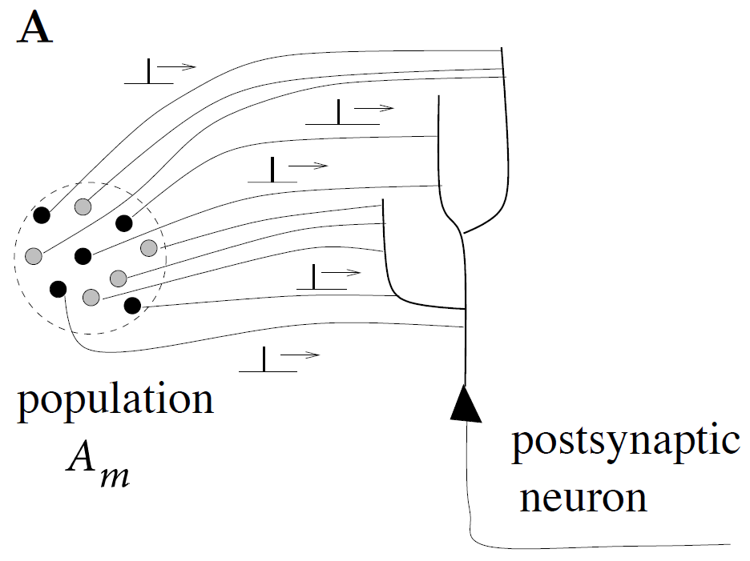
10.4. Rate codes: population activity (review from week 7)
population activity - rate defined by population average
t
t
‘natural readout’
population
activity

Slide 44
10.4. Rate codes: population activity (review from week 7)
population of neurons
with similar properties
Brain

Slide 45
10.4. Three definitions of Rate codes: summary
Three averaging methods
over time
over repetitions
over population (space)
Too slow
for animal!!!
single neuron
single neuron
Not possible
for animal!!!
many neurons
‘natural’

Slide 46
10.4 Inhomogeneous Poisson Process
t
A(t)
I(t)
n_{sp}
T
population
activity
inhomogeneous Poisson model consistent with rate coding

Slide 47
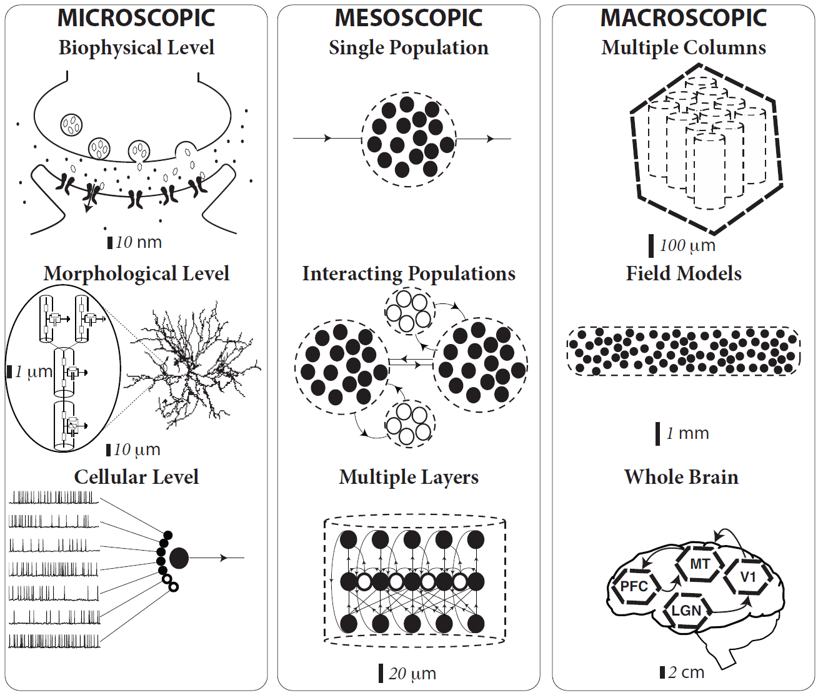
Image: Gerstner et al.
Neuronal Dynamics (2014)
10.4: Scales of neuronal processes
population of neurons
with similar properties
Brain

Slide 48
Quiz 4.
Rate codes. Suppose that in some brain area we have a group of 500 neurons. All neurons have identical parameters and they all receive the same input (you decide what this means!). Input is given by sensory stimulation and passes through 2 preliminary neuronal processing steps before it arrives at our group of 500 neurons. Within the group, neurons are not connected to each other. The group is embedded in a brain model network containing 100 000 nonlinear integrate-and-fire neurons with some arbitrary connectivity, so that we know exactly how each neuron functions.
Experimentalist A makes a measurement in a single trial on all 500 neurons using a multi-electrode array, during a period of sensory stimulation.
Experimentalist B picks an arbitrary single neuron and repeats the same sensory stimulation 500 times (with long pauses in between, say one per day).
Experimentalist C repeats the same sensory stimulation 500 times (1 per day), but every day he picks a random neuron (amongst the 500 neurons).
All three determine the time-dependent firing rate.
[ ] A and B and C are expected to find the same result.
[ ] A and B are expected to find the same result, but that of C is expected to be different.
[ ] B and C are expected to find the same result, but that of A is expected to be different.
[ ] None of the above three options is correct.
Start at 10:50,
Discussion at 10:55
Notes:
The 5 minutes of discussion were really great, because students did have different opinions and arguments.

Slide 49
10.4 Summary: Rate models
There are three different definitions of rate.
Rate as a temporal average: spike count for a single neuron over a few hundred milliseconds are a few seconds, divided by the time. Disadvantage: it is too slow to be the biological code.
Rate as an average of several repetitions of the same experiment: spike count in a short time bin (a few milliseconds), summed over repetitions, divided by bin width and number of repetitions.
Disadvantage: it is too slow (we need repetitions!) to be the biological code, even though the temporal resolution is high
3. Rate as an average over a population: Populations activity A(t) defined earlier.
several repetitions of the same experiment.
Disadvantage: works best for completely homogeneous populations, but should also work for ‘similar’ neurons such as those within one layer of a cortical column.
Advantages: it is a rapid code and averaging over group is natural since every postsynaptic neuron does this.

Slide 50
Biological Modeling of Neural Networks
10.1 Variability of spike trains
- experiments
10.2 Sources of Variability?
- Is variability equal to noise?
10.3 Poisson Model
- homogeneous/inhomogeneous
10.4 Three definitions of Rate Code
10.5 Stochastic spike arrival
- Membrane potential fluctuations
Week 10 – Variability and Noise:
The question of the neural code
Wulfram Gerstner
EPFL, Lausanne, Switzerland
Notes:
First Lecture: 10.1, 10.2, and 10.3 (HOMOGENEOUS Poisson Model). Dann um 9:50h vor der Pause, Exercise 1 (Poisson Model)
Second Lecture: 10.3 (INHOMOGENEOUS Poission model, Quiz 1, and three definitions of rate). Quiz 2, five minutes before the end.
Third Lecture: 10.4 Stochastic spike arrival, on the blackboard, then exercise 2.

Slide 51
10.5 Variability in vivo – review from 10.1
Spontaneous activity in vivo
Variability
of membrane potential?
awake mouse, freely whisking,
Crochet et al., 2011

Slide 52
10.5 Variability in networks – review from 10.2
A [Hz]
10
32440
Neuron #
input
-low rate
-high rate
32340
time [ms]
200
50
100
100
Neuron # 32374
u [mV]
Population
- 50 000 neurons
- 20 percent inhibitory
- randomly connected
0
50
100
time [ms]
200

Slide 53
10.5 Membrane potential fluctuations
from neuron’s point
of view:
stochastic spike arrival
Pull out one neuron
‘Network noise’
big contribution!

Slide 54
10.5. Stochastic Spike Arrival (Poisson model of input)
Blackboard
now!
Total spike train of K presynaptic neurons
spike train
Pull out one neuron
Probability of spike arrival:
Take
expectation
$$\left\langle S(t)\right\rangle =Kρ_{0}$$

Slide 56
10.5. Calculating the mean
use for exercise
rate of inhomogeneous
Poisson process

Slide 57
week 10 – Quiz 5
A linear (=passive) membrane has a potential given by
Suppose the neuronal dynamics are given by
[ ] the filter f is exponential with time constant
[ ] the constant a is equal to the time constant
[ ] the constant a is equal to
[ ] the amplitude of the filter f is proportional to q
[ ] the amplitude of the filter f is q

Slide 58
Week 10 - Exercise 2.1 NOW
Passive membrane
A leaky integrate-and-fire neuron without threshold (=passive membrane) receives stochastic spike arrival, described as a homogeneous Poisson process.
Calculate the mean membrane potential. To do so, use the above formula.
Start at 11:40,
Discussion at 11:52
Notes:
In 2018, Exercise 2.1 was NOT DOEN IN CLASS

Slide 59
10.5. Calculating the mean
mean: assume Poisson process
use for exercise
$$\left\langle I(t)\right\rangle =\frac{1}{R}{\sum_{k}{w_{k}}\int_{0}^{∞}{α\left(s\right)}ρ\left(t−s\right)ds }_{}$$
rate of inhomogeneous
Poisson process

Slide 60
10.5. Fluctuation of potential
for a passive membrane, we can analytically predict the mean of membrane potential fluctuations
Passive membrane
Passive membrane
=Leaky integrate-and-fire
without threshold
Next week:
1) Calculate fluctuations
2) ADD THRESHOLD
→ Leaky Integrate-and-Fire

Slide 61
10.5 Summary: Stochastic spike arrival
The network noise is often described as stochastic spike arrivals.
Suppose that spikes arrive stochastically (according to a Poisson Process) with time-dependent stochastic intensity $ρ$.
Since input currents sum up linearly, we can calculate the mean input current by ‘averaging over the stochastic spike arrivals’ which is equivalent to ‘taking the expectation over stochasticity of the Poisson process’.
Similarly, if the voltage of the neuronal membrane is approximated by a linear model (see week 1, passive membrane, or week 8, input potential), then we can also calculate the mean membrane potential.
In both cases taking the expectation is easy since the average of the spike arrivals yields the stochastic intensity.
$\left\langle \sum_{f}{δ\left(t−t_{}^{f}\right)}\right\rangle =ρ\left(t\right)$
Next week we extend the calculation so as to also include fluctuations (not just the mean).

Slide 62
week 10 – References and Suggested Reading
Reading: W. Gerstner, W.M. Kistler, R. Naud and L. Paninski,
Neuronal Dynamics: from single neurons to networks and models of cognition. Ch. 7: Cambridge, 201
-Rieke, F., Warland, D., de Ruyter van Steveninck, R., and Bialek, W. (1996). Spikes - Exploring the neural code. MIT Press.
-Faisal, A., Selen, L., and Wolpert, D. (2008). Noise in the nervous system. Nat. Rev. Neurosci., 9:202
-Gabbiani, F. and Koch, C. (1998). Principles of spike train analysis. In Koch, C. and Segev, I., editors,
Methods in Neuronal Modeling, chapter 9, pages 312-360. MIT press, 2nd edition.
Softky, W. and Koch, C. (1993). The highly irregular firing pattern of cortical cells is inconsistent with temporal integration of random epsps. J . Neurosci., 13:334-350.
Stein, R. B. (1967). Some models of neuronal variability. Biophys. J., 7:37-68.
Siegert, A. (1951). On the first passage time probability problem. Phys. Rev., 81:617{623.
Konig, P., et al. (1996). Integrator or coincidence detector? the role of the cortical neuron revisited. Trends Neurosci, 19(4):130-137.
THE END

