Slide 1
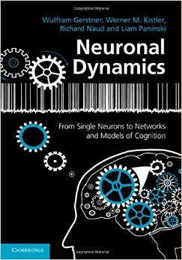
Biological Modeling of Neural Networks
11.1 Variation of membrane potential
- white noise approximation
11.2 Autocorrelation of Poisson
11.3 Noisy integrate-and-fire
- superthreshold and subthreshold
11.4 Escape noise
- stochastic intensity
11.5 Renewal models
Week 11 – Variability and Noise:
Autocorrelation
Wulfram Gerstner
EPFL, Lausanne, Switzerland
Reading for week 11:
NEURONAL DYNAMICS
Ch. 7.4-7.5.1
Ch. 8.1-8.3 + Ch. 9.1
Wulfram Gerstner
EPFL, Lausanne, Switzerland
Cambridge Univ. Press
Notes:
First lecture: I introduced white noise as a limit of short synaptic time constant.
Then introduced how to calculate with white noise. Stopped at 9:50 for first exercise.
Second lecture: Introduced the discrete-time autocorrelation of the Poisson, then at 10:30 next exercise.
Afterward I used the Quiz with the units to discuss this exercise. Subthreshold and superthreshold regime before end of 2nd hour.
Third lecture: Escape rate and Time-Dependent Renewal theory.

Slide 2
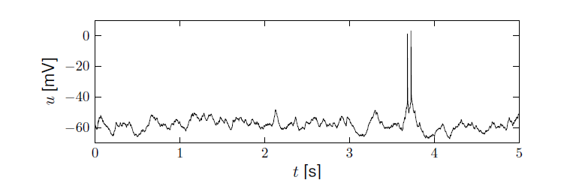
11.1 Review from week 10
Variability
- of membrane potential?
- of spike timing?
Spontaneous activity in vivo
awake mouse, cortex, freely whisking,
Crochet et al., 2011

Slide 3
11.1 Review from week 10
Fluctuations
of membrane potential
of spike times
In vivo data
→ looks ‘noisy’
In vitro data
→ fluctuations
fluctuations=noise?
relevance for coding?
source of fluctuations?
model of fluctuations?

Slide 4
11.1. Review from week 10
- Intrinsic noise (ion channels)
Finite number of channels
Finite temperature
Na⁺
K⁺
Network noise (background activity)
Spike arrival from other neurons
Beyond control of experimentalist

Slide 5
11.1. Review from week 10
- Intrinsic noise (ion channels)
In vivo data
→ looks ‘noisy’
In vitro data
→small fluctuations
→nearly deterministic
Na⁺
small contribution!
K⁺
Network noise
big contribution!

Slide 6
11.1 Review from week 10: Calculating the mean
mean: assume Poisson process
use for exercises
use for next slides
rate of inhomogeneous
Poisson process

Slide 7
11.1. Fluctuation of potential
for a passive membrane, predict
-mean
variance
of membrane potential fluctuations
Passive membrane
Passive membrane
=Leaky integrate-and-fire
without threshold

Slide 8
11.1. Fluctuation of current/potential
Synaptic current pulses of shape α
Blackboard1,
Math detour:
White noise
EPSC
Passive membrane
I(t)
Fluctuating input current

Slide 9
11.1 Calculating autocorrelations
I(t)
Autocorrelation
Fluctuating input current
Mean:
use -
-
Notes:
Present this on the blackboard, but finish BEFORE 9:50!

Slide 10
11.1. Fluctuation of potential
for a passive membrane, predict
-mean
variance
of membrane potential fluctuations
Passive membrane
Blackboard2,
Math detour

Slide 11
White noise: Exercise 1.1-1.2 now
Assumption:
far away from theshold
Input starts here
Next lecture:
10:15
Expected voltage at time t
Variance of voltage at time t
Report variance as function of time!
Notes:
Start at 9:50

Slide 12
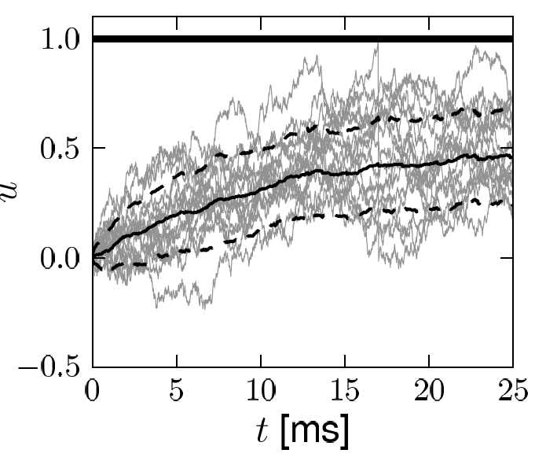
11.1 Calculating autocorrelations for stochastic spike arrival
First approach: white noise (to mimic stochastic spike arrival)
Image:
Gerstner et al. (2014),
Neuronal Dynamics
Math argument
variance
Autocorrelation of membrane potential
later

Slide 13
Poisson spike arrival: Mean and autocorrelation of filtered signal
11.1 Conclusion: Mean and autocorrelation of the membrane potential
S(t)
u(t)
First approach to calculate autocorrelations.
A spike train S(t) causes a fluctuating current I(t).
We separate the fluctuating current into a mean current <I(t)> and a noise component ξ(t) .
By definition the mean of the noise vanishes: < ξ(t) >=0 at any moment in time.
If the time constant of the synapse is extremely short, we can formulate the noise
component as white noise. White noise has a vanishing autocorrelation,
<ξ(t) ξ(t’)> = 0 whenever t’ is different from t, and a delta-peak for t=t’.
For a passive membrane model with time constant τ, we can calculate the mean <u(t)>
of the membrane potential and its autocorrelation at times t and t’ . The variance of the
membrane potential is derived from its autocorrelation for t=t’ by subtracting the mean.
Actual realizations are trajectories with a (Gaussian) distribution around the mean <u(t)>,
The fact that the distribution is Gaussian has not been shown in the lecture today.

Slide 14
11.1 Calculating autocorrelations: second approach
work directly with spike trains
Autocorrelation
Mean:
rate of inhomogeneous
Poisson process

Slide 15
Poisson spike arrival: Mean and autocorrelation of filtered signal
11.1 Mean and autocorrelation of filtered spike signal
Filter
Assumption:
stochastic spiking
rate
mean
Autocorrelation of output
Autocorrelation of input

Slide 16
Poisson spike arrival: Mean and autocorrelation of filtered signal
11.1 Conclusion: Mean and autocorrelation of filtered spike train
Second approach to calculate autocorrelations.
A spike train S(t) is formulated as a sequence of delta functions.
The expectation <S(t)> of S(t) at time t is the instantaneous ‘rate’ ν(t).
The auto-correlation of S(t) with S(t’) is <S(t)S(t’)>
After filtering with a filter F(s) we get a variable x(t).
The mean and autocorrelation of x can be calculated.
The formulas will be used a lot in this and the next lectures.

Slide 17
Biological Modeling of Neural Networks
11.1 Variation of membrane potential
- white noise approximation
11.2 Autocorrelation of Poisson
11.3 Noisy integrate-and-fire
- superthreshold and subthreshold
11.4 Escape noise
- stochastic intensity
11.5 Renewal models
Week 11 – Variability and Noise:
Autocorrelation
Wulfram Gerstner
EPFL, Lausanne, Switzerland
Notes:
First lecture: I introduced white noise as a limit of short synaptic time constant.
Then introduced how to calculate with white noise. Stopped at 9:50 for first exercise.
Second lecture: Introduced the discrete-time autocorrelation of the Poisson, then at 10:33 next exercise.
Afterward I used the Quiz with the units to discuss this exercise. Subthreshold and superthreshold regime before end of 2nd hour.
Third lecture: Escape rate and Renewal.

Slide 18
11.2 Autocorrelation of Poisson (preparation)
Justify autocorrelation of spike input:
Poisson process in discrete time
Stochastic spike arrival:
Blackboard3
In each small time step
Prob. Of firing
Firing independent between one time step and the next

Slide 19
Exercise 3 now: Poisson process in continuous time
Stochastic spike arrival:
excitation, total rate
Next lecture:
10:57
In each small time step
Prob. Of firing
Firing independent between one time step and the next
Show that autocorrelation
for
Show that in a a long interval of duration T,
the expected number of spikes is
Notes:
Start exercise at 10:33; 10 minutes is plenty of time.

Slide 20
Quiz – 1. Autocorrelation of Poisson
The Autocorrelation (continuous time)
Has units
[ ] probability (unit-free)
[ ] probability squared (unit-free)
[ ] rate (1 over time)
[ ] (1 over time)-squred
spike train
Notes:
Quiz helps to initiate discussions for the previous exercise.

Slide 21
11.2. Autocorrelation of Poisson
math detour
now!
Probability of spike
in step n AND step k
spike train
Probability of spike in time step:
Autocorrelation (continuous time)

Slide 22
11.2. Autocorrelation of Poisson: units
Assumption: stochastic spiking (Poisson)
rate
Autocorrelation of output
Autocorrelation of input (Poisson)
We integrate twice!
Notes:
The delta function and the units (1/t)^2 cause often problems: BUT WE INTEGRATE TWICE!!

Slide 23
Exercise 2 Homework: stochastic spike arrival
Stochastic spike arrival:
excitation, total rate
Synaptic current pulses
Assume that for t>0 spikes arrive stochastically with rate
Calculate mean voltage
u
2. Assume autocorrelation
- Calculate

Slide 24
Poisson spike arrival: Mean and autocorrelation of filtered signal
11.2 Conclusion: Mean and autocorrelation of the Poisson Process.
S(t)
x(t)
Second approach to calculate autocorrelations.
A spike train S(t) is formulated as a sequence of delta functions generated
by a Poisson process
The expectation <S(t)> of S(t) at time t is the instantaneous ‘rate’ ν(t),
given by the rate ρ(t) of the Poisson process.
The auto-correlation of the Poisson Process <S(t)S(t’)> is
<S(t)S(t’)> = ν(t) ν(t’) + ν(t) δ(t-t’)
Note1: if the variable x is a filtered version of the spike train with a filter F,
we insert the autocorrelation of the Poisson process, to get the autocorrelation
and variance of x (see Section 11.1).
Note2: stochastic pulses such as a Poissone spike train is also called ‘shot noise’.

Slide 25
Biological Modeling of Neural Networks
11.1 Variation of membrane potential
- white noise approximation
11.2 Autocorrelation of Poisson
11.3 Noisy integrate-and-fire
- superthreshold and subthreshold
11.4 Escape noise
- stochastic intensity
11.5 Renewal models
Week 11 – Variability and Noise:
Autocorrelation
Wulfram Gerstner
EPFL, Lausanne, Switzerland

Slide 26
11.3 Noisy Integrate-and-fire
for a passive membrane, we can analytically predict the mean of membrane potential fluctuations
Passive membrane
Passive membrane
=Leaky integrate-and-fire
without threshold
ADD THRESHOLD
→ Leaky Integrate-and-Fire

Slide 27
11.3 Noisy Integrate-and-fire
effective noise current
I
u(t)
LIF
noisy input/
diffusive noise/
stochastic spike
arrival

Slide 28
11.3 Noisy Integrate-and-fire
fluctuating input current
I(t)
Random spike arrival
fluctuating potential

Slide 29
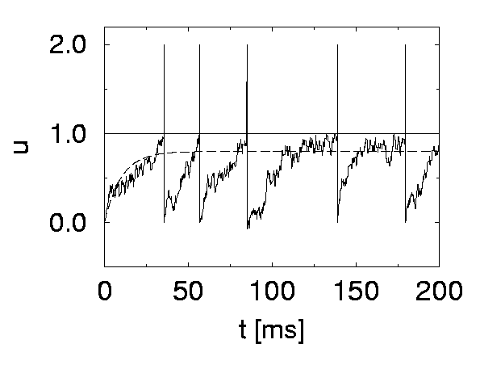
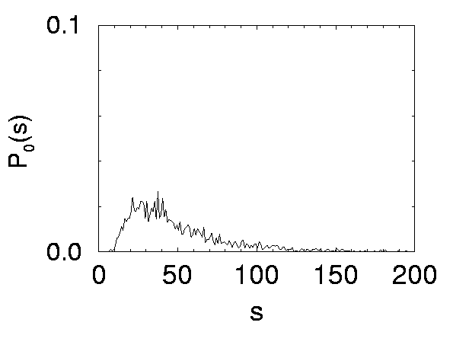
11.3 Noisy Integrate-and-fire (noisy input)
stochastic spike arrival in I&F – interspike intervals
I
ISI distribution
white noise
Image:
Gerstner et al. (2014),
Neuronal Dynamics,

Slide 30
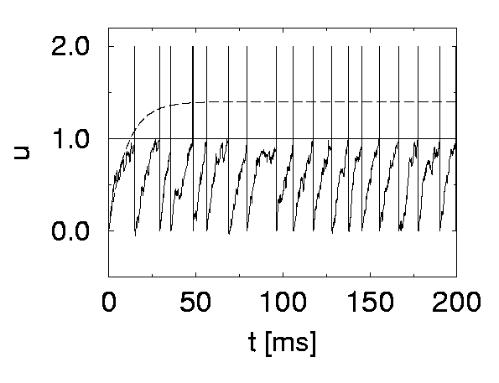
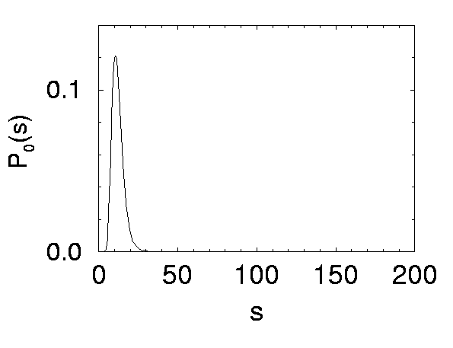
11.3 Noisy Integrate-and-fire (noisy input)
Superthreshold vs. Subthreshold regime
Image:
Gerstner et al. (2014),
Neuronal Dynamics,
Cambridge Univ. Press;
See: Konig et al. (1996)

Slide 31
11.3. Noisy integrate-and-fire (noisy input)
noisy input/ diffusive noise/
stochastic spike arrival
u(t)
subthreshold regime:
- firing driven by fluctuations
- broad ISI distribution
- in vivo like
ISI distribution
Image:
Gerstner et al. (2014),
Neuronal Dynamics,

Slide 32
review- Variability in vivo
Spontaneous activity in vivo
Variability
of membrane potential?
awake mouse, freely whisking,
Image:
Gerstner et al. (2014),
Neuronal Dynamics,
Cambridge Univ. Press;
Courtesy of: Crochet et al. (2011)
Crochet et al., 2011
Subthreshold regime

Slide 33
11.3 Noisy Integrate-and-fire (noisy input)
Stochastic spike arrival:
for a passive membrane, we can analytically predict the amplitude of membrane potential fluctuations
Passive membrane
Leaky integrate-and-fire
in subthreshold regime
can explain variations
of membrane potential and ISI
fluctuating potential

Slide 34
Poisson spike arrival: Mean and autocorrelation of filtered signal
11.3 Conclusion: Leaky integrate-and-fire with noisy input.
The leaky integrate-and-fire model (LIF) is a passive membrane model together
with a threshold.
When driven with a constant mean current plus a white noise, two regimes emerge:
Superthreshold regime. The mean current alone would be sufficient to fire spikes.
In this case the interspike interval distribution (ISI) is fairly regular, visible as a sharp peak around the noise-free interspike-interval.
Subtrheshold regime. The mean current alone would not be sufficient to fire spikes.
Noise is essential to make the neuron fire. In this case, the ISI is very broad and extends to very long intervals.
In the subthreshold regime we observe fluctuations of the membrane potential in a regime below threshold and rare spiking, consistent with typical experimental results in vivo.

Slide 35
Biological Modeling of Neural Networks
11.1 Variation of membrane potential
- white noise approximation
11.2 Autocorrelation of Poisson
11.3 Noisy integrate-and-fire
- superthreshold and subthreshold
11.4 Escape noise
- stochastic intensity
11.5 Renewal models
Week 11 – Variability and Noise:
Autocorrelation
Wulfram Gerstner
EPFL, Lausanne, Switzerland

Slide 36
Review: Sources of Variability
- Intrinsic noise (ion channels)
Finite number of channels
Finite temperature
Na⁺
small contribution!
K⁺
Network noise (background activity)
Spike arrival from other neurons
Beyond control of experimentalist
Noise models?
big contribution!

Slide 37
11.4 Noise models: Escape noise vs. input noise
escape process,
stochastic intensity
stochastic spike arrival
(diffusive noise)
u(t)
t
escape rate
noisy integration
Now:
Escape noise!
Relation between the two models:
see Ch. 9.4 of
Neuronal Dynamics

Slide 38
11.4 Escape noise
escape process
escape rate
u(t)
t
escape rate
Example: leaky integrate-and-fire model
u

Slide 39
11.4 stochastic intensity
escape process
Escape rate = stochastic intensity
of point process
u(t)
t
escape rate
examples
u

Slide 40
11.4 mean waiting time
escape rate
u(t)
t
u
1ms
I(t)
mean waiting time, after switch
t
Blackboard4,
Math detour

Slide 41
11.4 escape noise/stochastic intensity
Escape rate = stochastic intensity
of point process
Escape rate depends
on momentary distance
of u(t) to threshold
u(t) depends on the input
but also on previous
spikes
(because of the reset)
u(t)
t

Slide 42
Quiz 4
Escape rate/stochastic intensity in neuron models
[ ] The escape rate of a neuron model has units one over time
[ ] The stochastic intensity of a point process has units one over time
[ ] For large voltages, the escape rate of a neuron model always saturates
at some finite value
[ ] After a step in the membrane potential, the mean waiting time until a spike is fired is proportional to the escape rate
[ ] After a step in the membrane potential, the mean waiting time until a spike is fired is equal to the inverse of the escape rate
[ ] The stochastic intensity of a leaky integrate-and-fire model with reset only depends on the external input current but not on the time of the last reset
[ ] The stochastic intensity of a leaky integrate-and-fire model with reset depends on the external input current AND on the time of the last reset

Slide 43
Poisson spike arrival: Mean and autocorrelation of filtered signal
11.4 Conclusion: Escape noise
All noise models are ad hoc. In part 11.1 we focused on white noise as an approximation of stochastic spike arrival. We can think of this as noise in the input.
In this section we focused on a different noise model that we call escape noise.
In discrete time, the probability to generate a spike with the escape noise model
depends on the momentary distance between the membrane potential u(t) and the threshold θ.
In continuous time, this ‘probability’ corresponds to a stochastic intensity of spike firing
ρ(t) = f[u(t) – θ]. We can think of escape noise as a noise in the output.
Escape noise can be combined with a leaky integrate-and-fire model: As soon as a spike is fired, the membrane potential is reset to a lower value so that a second spike becomes unlikely. In this case a good choice of the function f is an exponential.
ρ0=c/Δ is a constant the characterizes the mean firing
rate at u(t) = θ
Here the parameter Δ indicates how ‘smooth’ the threshold is. In practice, for
u(t) < θ − 3Δ the neuron is unlikely to fire and for u(t) > θ + 3Δ it fires immediately.

Slide 44
Biological Modeling of Neural Networks
11.1 Variation of membrane potential
- white noise approximation
11.2 Autocorrelation of Poisson
11.3 Noisy integrate-and-fire
- superthreshold and subthreshold
11.4 Escape noise
- stochastic intensity
11.5 Renewal models
Week 11 – Variability and Noise:
Autocorrelation
Wulfram Gerstner
EPFL, Lausanne, Switzerland
Notes:
First lecture: I introduced white noise as a limit of short synaptic time constant.
Then introduced how to calculate with white noise. Stopped at 9:50 for first exercise.
Second lecture: Introduced the discrete-time autocorrelation of the Poisson, then at 10:33 next exercise.
Afterward I used the Quiz with the units to discuss this exercise. Subthreshold and superthreshold regime before end of 2nd hour.
Third lecture: Escape rate and Renewal.

Slide 45
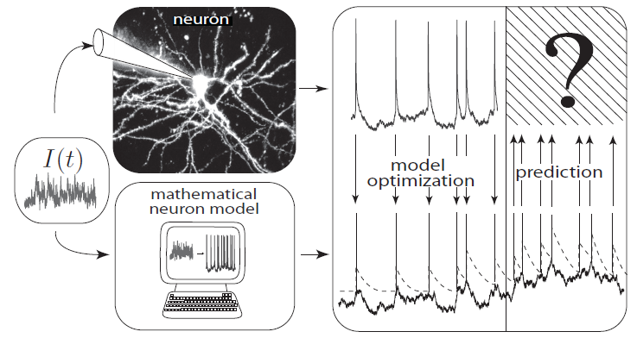
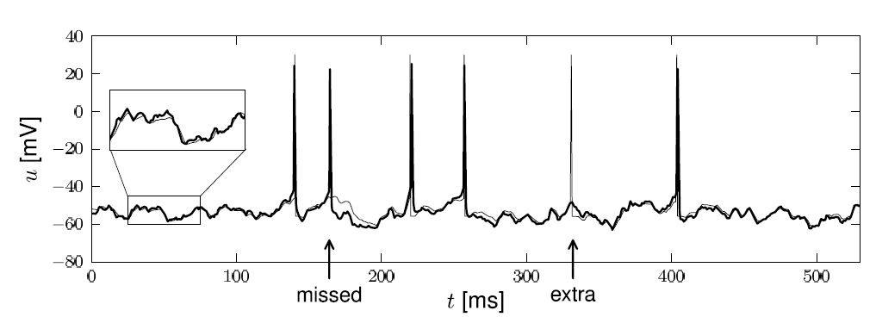
11.5. Interspike Intervals for time-dependent input
t
deterministic part of input
noisy part of input/intrinsic noise
→ escape rate
Example:
nonlinear integrate-and-fire model
Example:
exponential stochastic intensity

Slide 46
11.5. Interspike Interval distribution (time-dependent inp.)
escape process
Blackboard
escape rate
u(t)
Survivor function
t
t
t

Slide 47
11.5. Interspike Intervals
escape process
Survivor function
Examples now
A
u(t)
t
escape rate
Interval distribution
escape
rate
Survivor function
u

Slide 48
11.5. Renewal theory
Example: I&F with reset, constant input
escape rate
Survivor function
1
Interval distribution

Slide 49
11.5. Time-dependent Renewal theory
Example: I&F with reset, time-dependent input,
escape rate
Survivor function
1
Interval distribution

Slide 50
Homework assignement: Exercise 4
neuron with relative refractoriness, constant input
escape rate
Survivor function
1
Interval distribution

Slide 51
Outlook: Helping Humans
Application: Neuroprosthetics
frontal
cortex
Many groups
world wide
work on this
problem!
motor
cortex
Model of
‘Decoding’
Predict intended arm movement,
given Spike Times

Slide 52
11.5 Conclusion: Renewal models
Even though the interspike-interval-distribution is most often used for STATIONARY data, (or constant input), we can also define an interspike-interval distribution for time-dependent input: Given an observed spike at time t^, and given that we know the time-dependent input up to time t, we ask: what is the probability density that the next spike occurs at time t? The answer is given by the ISI distribution P(t|t^).
In the same way we can ask: Given an observed spike at time t^, and given that we know the time-dependent input up to time t, what is the probability that the neuron ‘survives’ without firing up to time t? The answer is given by the survivor function S(t|t^).
Similarly, given an observed spike at time t^, and given that we know the time-dependent input up to time t, what is the momentary rate of firing at time t? The answer is given by the stochastic intensity ρ(t|t^), also called the ‘hazard’. The three functions are closely related to each other.
For constant input, all three functions only depend on the time difference t-t^. If the stochastic intensity (e.g., of a neuron model) only depends on the time difference t-t^ it is called a (stationary) renewal model. If it depends on t-t^ and the input (but not on earlier spikes), it is a generalized (or time-dependent) renewal model. The LIF with escape noise and constant input is a renewal model, with time-dependent input it is a generalized renewal model.

Slide 53
11.5. Renewal process, firing probability
Escape noise = stochastic intensity
Renewal theory
- hazard function
- survivor function
- interval distribution
time-dependent renewal theory
discrete-time firing probability
Link to experiments
THE END
→ basis for modern methods of
neuron model fitting

