Slide 1
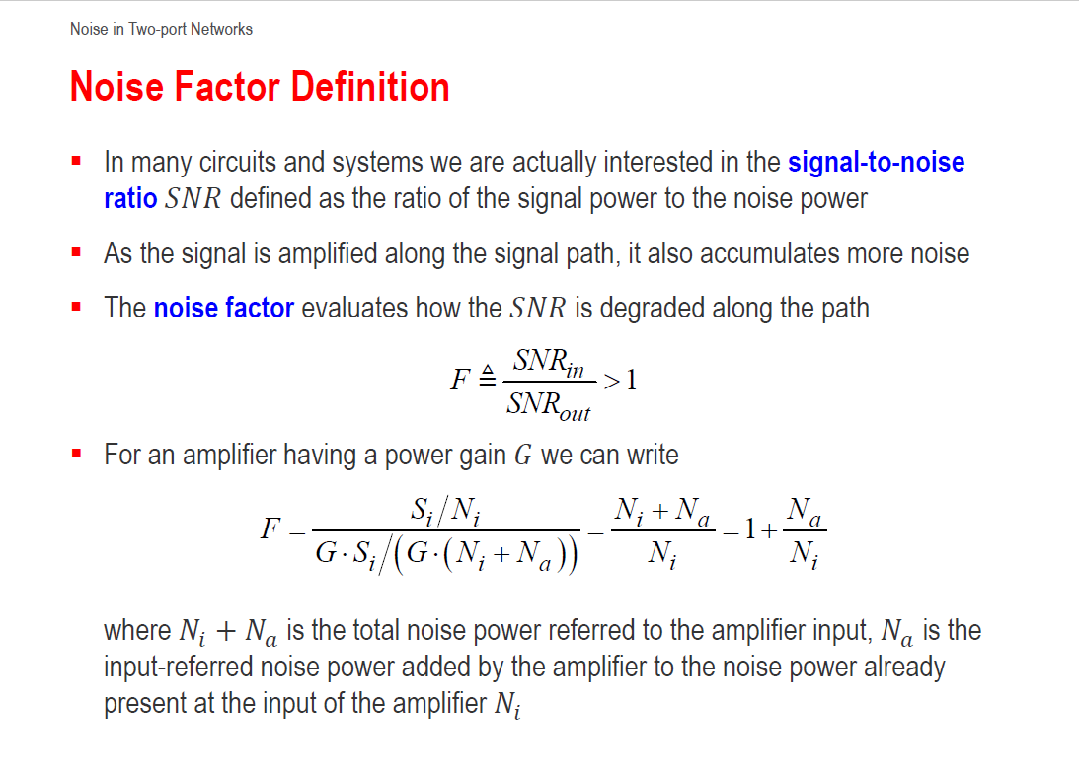

Slide 2
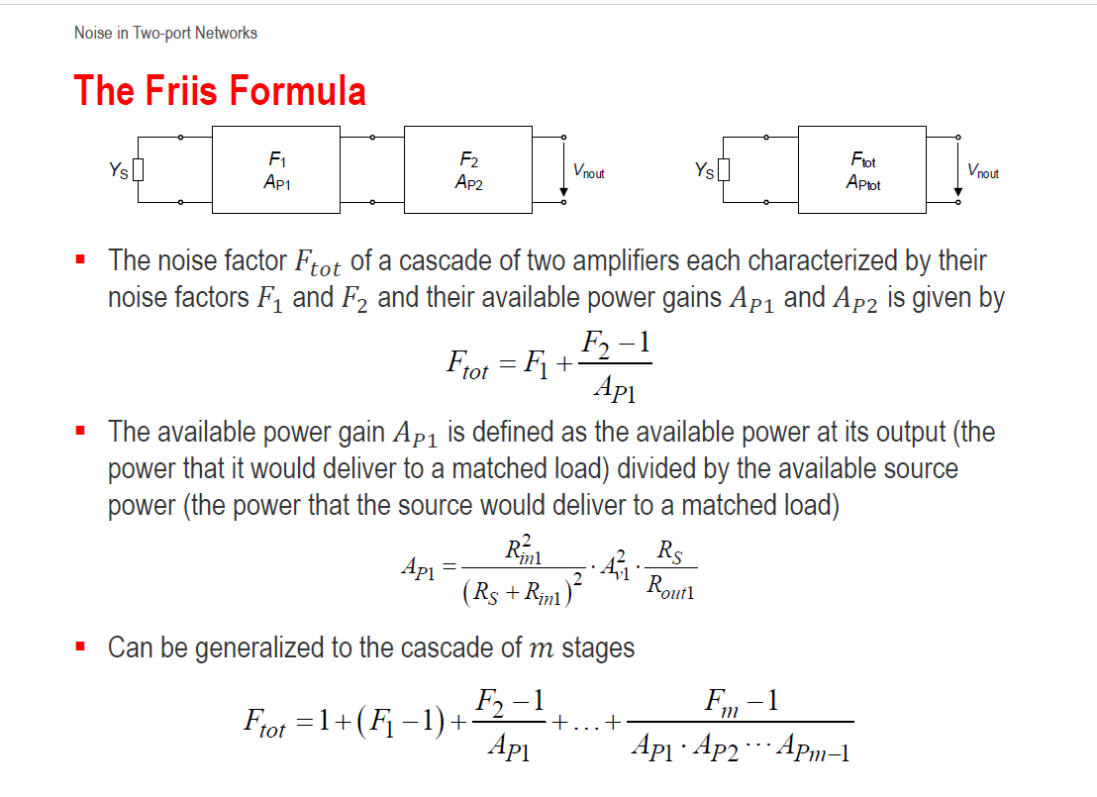

Slide 3




Useful formula’s for Ex.5
Friis formula’s
dB to linear conversion

