Slide 1
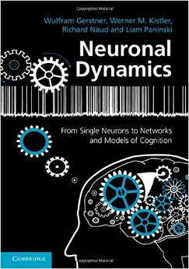
Biological Modeling of Neural Networks:
9.1 Introduction
- decision making
9.2 Perceptual decision making
- V5/MT
- Decision dynamics: Area LIP
9.3 Theory of decision dynamics
- competition via shared inhibition
- effective 2-dim model
9.4. Solutions
- symmetric case
-biased case
9.5. Simulations and Experiments
- simulations and theory
- simulations and experiments
9.6. Decisions, actions, volition
- the problem of free will
Week 9 – Decision models:
Competitive dynamics
Wulfram Gerstner
EPFL, Lausanne, Switzerland
Reading for week 9:
NEURONAL DYNAMICS
Ch. 16 (except 16.4.2)
Cambridge Univ. Press
Notes:
Lecture 1, includes the
Blackboard part of the Salzman et al experiment
Blackboard part Reduction from 3 to 2 dimensions
Lecture 2
continuation of blackboard with linearization of the inhibitory neurons
Then Exercise 1, nullclines etc. from 10:25-10:38 (should be extended to 10:45_
Afterwards, the shifting nullclines, discussion of regimes, fixed points etc.
3rd lecture: Simulations of Wang + Free will (section 9.5)

Slide 2
9.1. How do I decide?
We take decisions all the time
Coffee before class or not?
Vote for candidate A or B?
Turn left or right at the crossing?
Notes:
DO NOT ask students here – ask them in section 9.5.

Slide 3
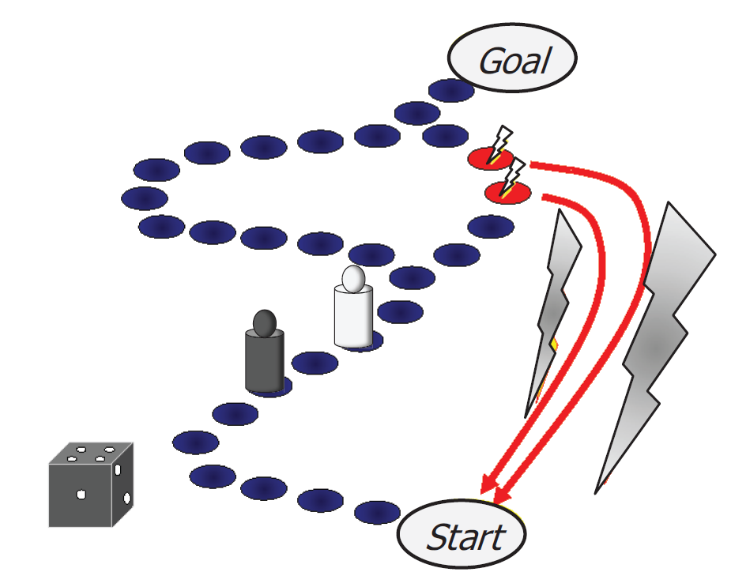
9.1. How do I decide?
Notes:
DO NOT ask students here – ask them in section 9.5.

Slide 4
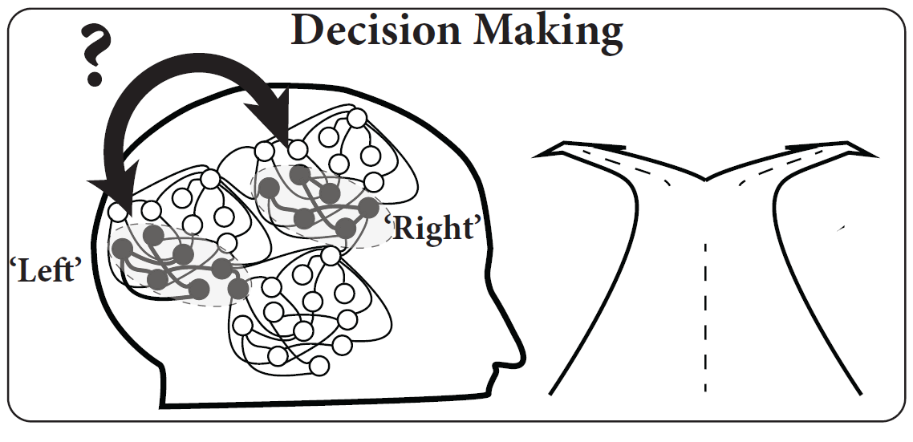
9.1. Decision making
turn
Left? Right?

Slide 5
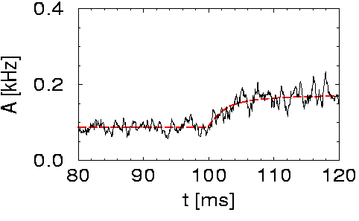
9.1. Review of week 8: High-noise activity equation
Population activity
noise model A
(escape noise/fast noise)
Membrane potential caused by input
high noise
Attention:
- valid for high noise only, else
transients might be wrong
- valid for high noise only, else
spontaneous oscillations may arise
I(t)
h(t)
slow transient

Slide 6
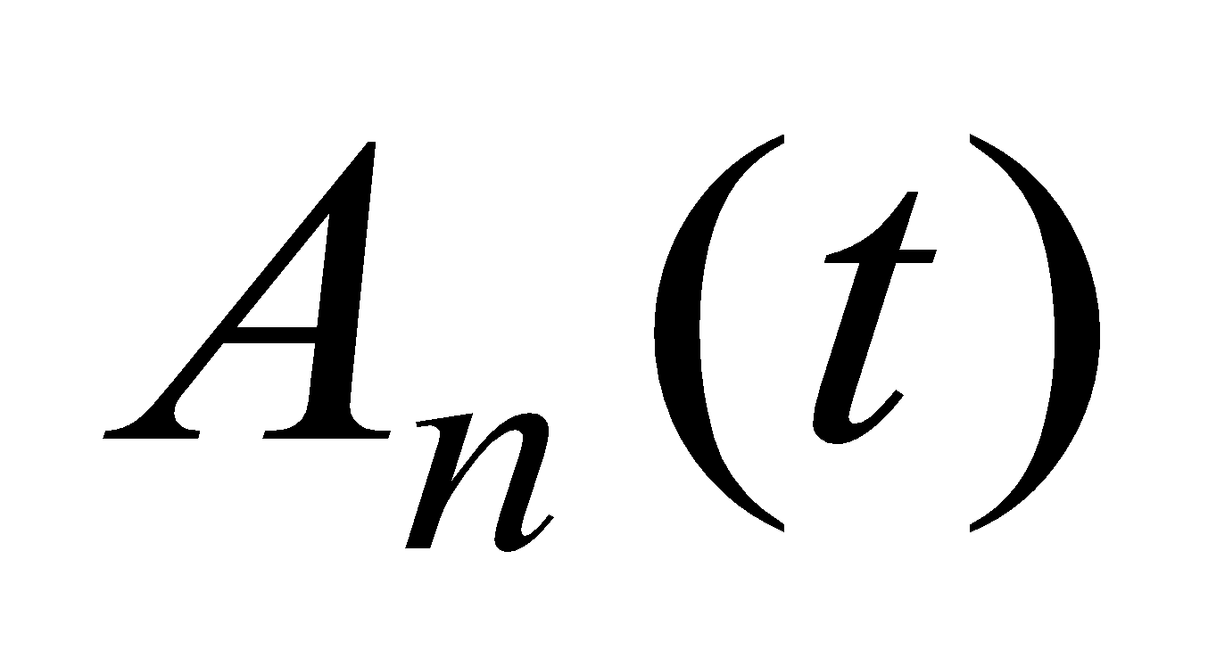
9.1. Review: microscopic vs. macroscopic
I(t)

Slide 7
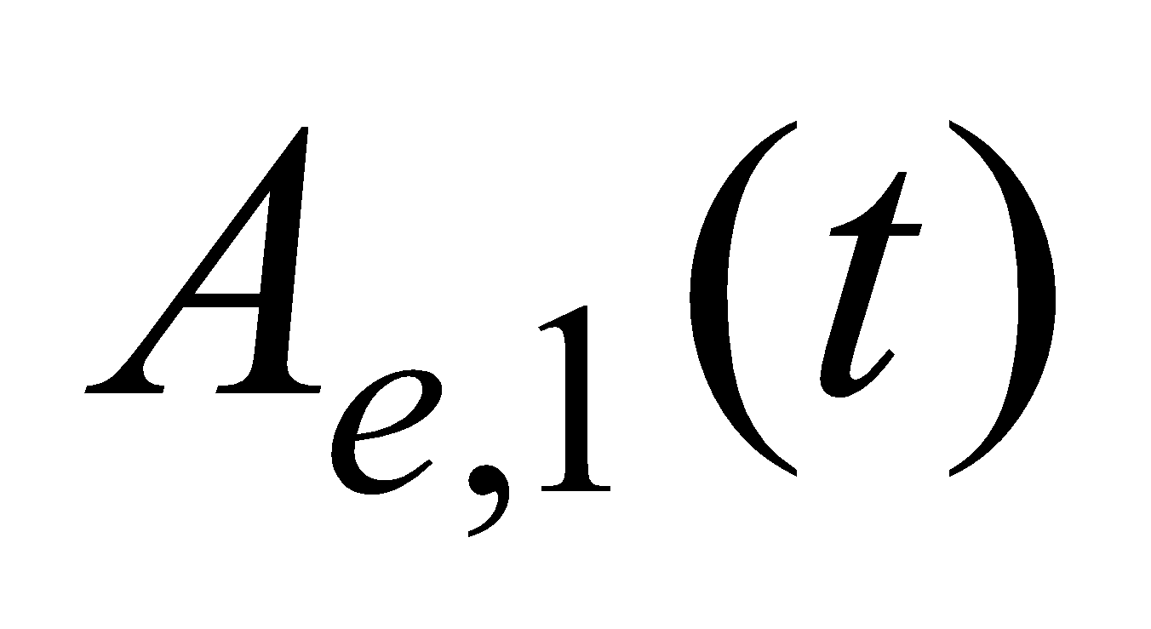
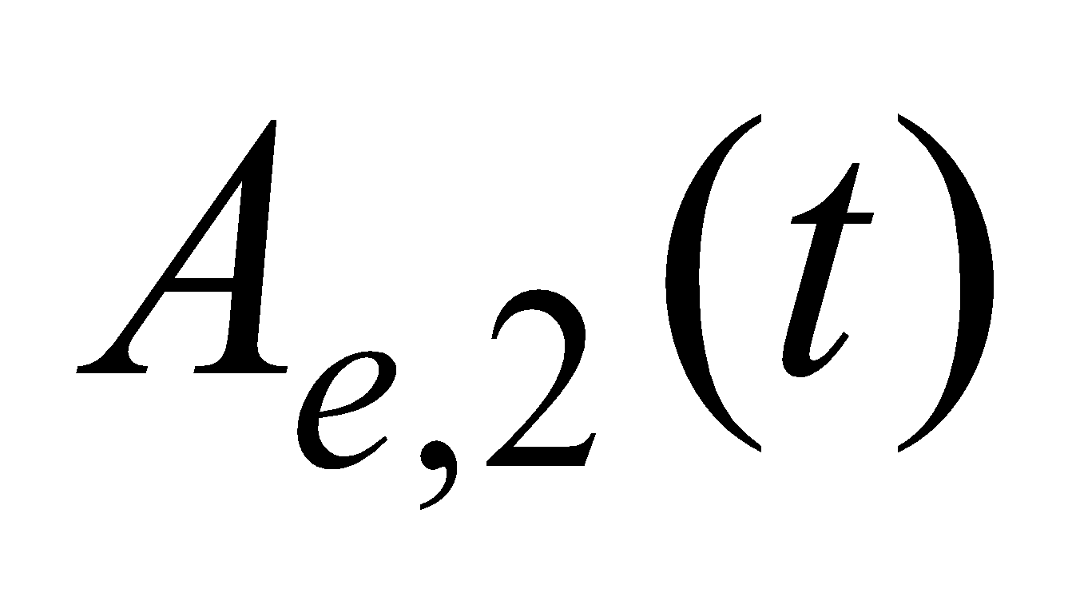
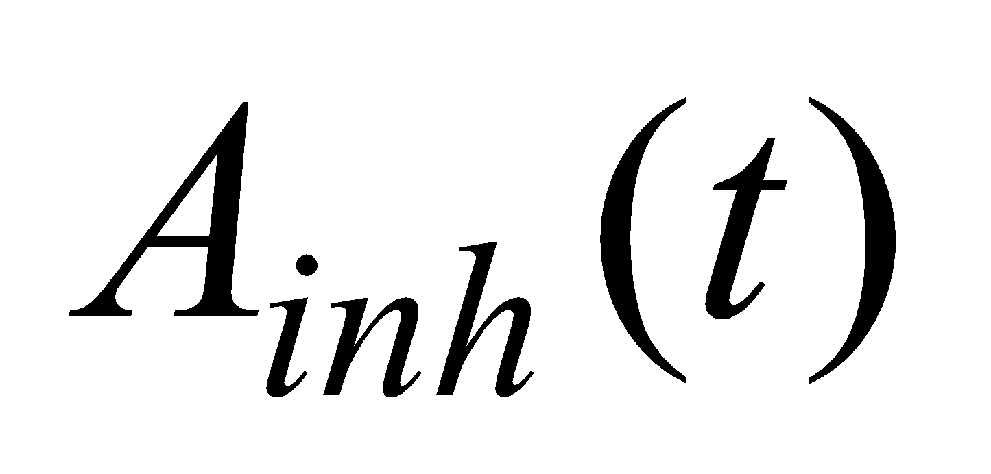
9.1. Competition between two populations
Input indicating
‘left’
Input indicating
‘right’

Slide 8
9. 1. How do YOU decide?
As selected EPFL student, pick your money at EPFL:
30CHF tomorrow / 100 CHF May first next year
90CHF tomorrow / 100 CHF May first next year
‘Neuro-economics’

Slide 9
9.1. Perceptual decision making?
Bisection task:
‘Is the middle bar shifted to the left or to the right?’

Slide 10
9.1. decision making - aims
Decisions are everywhere
Model: populations of neurons
Model feature Competition
Experimental data
Perceptual Decision task

Slide 11
Biological Modeling of Neural Networks:
9.1 Introduction
- decision making
9.2 Perceptual decision making
- V5/MT
- Decision dynamics: Area LIP
9.3 Theory of decision dynamics
- competition via shared inhibition
- effective 2-dim model
9.4. Solutions
- symmetric case
-biased case
9.5. Simulations and Experiments
- simulations and theory
- simulations and experiments
9.6. Decisions, actions, volition
- the problem of free will
Week 9 – Decision models:
Competitive dynamics
Wulfram Gerstner
EPFL, Lausanne, Switzerland
Reading for week 9:
NEURONAL DYNAMICS
Ch. 16 (except 16.4.2)
Cambridge Univ. Press
Notes:
Lecture 1, includes the
Blackboard part of the Salzman et al experiment
Blackboard part Reduction from 3 to 2 dimensions
Lecture 2
continuation of blackboard with linearization of the inhibitory neurons
Then Exercise 1, nullclines etc. from 10:25-10:38
Afterwards, the shifting nullclines, discussion of regimes, fixed points etc.
3rd lecture: Simulations of Wang + Free will (section 9.5)

Slide 12
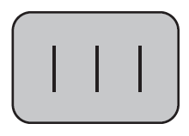
9.2. Perceptual decision making?
Bisection task:
‘Is the middle bar shifted to the left or to the right?’
e.g., Herzog lab, EPFL

Slide 13
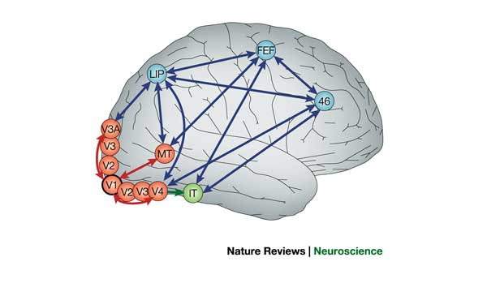
9.2. Detour: receptive fields in V5/MT
visual
cortex
IMAGE
1) Cells in visual cortex MT/V5 respond
to motion stimuli
2) Neighboring cells in visual cortex MT/V5
respond to motion in similar direction
cortical columns
Albright, Desimone,Gross,
J. Neurophysiol, 1985

Slide 14
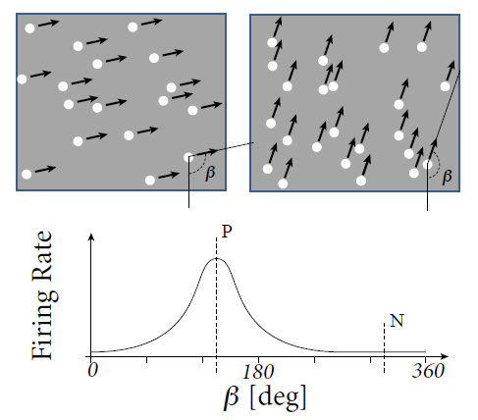
9. 2. Detour: receptive fields in V5/MT
Recordings from a single neuron in V5/MT
Receptive Fields depend
on direction of motion
Random moving dot stimuli:
e.g.Salzman, Britten, Newsome, 1990
Roitman and Shadlen, 2002
Gold and Shadlen 2007

Slide 15
9.2. Detour: receptive fields in V5/MT
Receptive Fields depend
on direction of motion: β = preferred direction = P
Image:
Gerstner et al. (2014),
Neuronal Dynamics

Slide 16
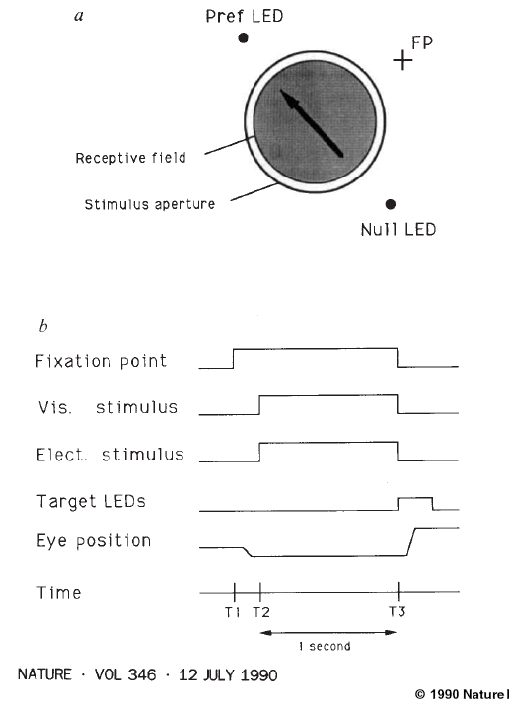
9.2. Experiment of Salzman et al. 1990
coherence 0.8=80%
monkey indicates
decision by
eye movement
coherence 0.5 = 50%
coherence 0.0
Eye movement
coherence -1.0
opposite
direction
Image: Salzman, Britten, Newsome, 1990

Slide 17
9. 2: Experiment of Salzman et al. 1990
Monkey behavior w. or w/o Stimulation
of neurons in V5/MT
N
Monkey
chooses right
P
fixation
visual stim.
LED
-1.0
0.5
0.5
1.0
X = coherent motion
to bottom right
Salzman, Britten,
Newsome, 1990
No bias, each point
moves in random direction
Blackboard:
Motion detection/stimulation

Slide 19
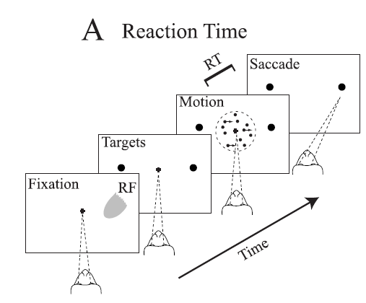
9.2: Experiment of Salzman et al. 1990
P
coherence 0.8=80%
N
coherence 0.5 = 50%
coherence 0.0
excites this group of neurons
coherence -1.0

Slide 20
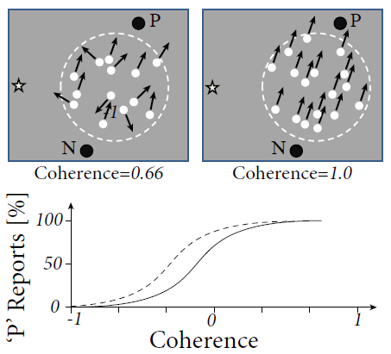
9. 2. Experiment of Salzman et al. 1990
Behavior: psychophysics
Image:
Gerstner et al. (2014),
Neuronal Dynamics;
Redrawn after
Salzman et al, 1990
With stimulation

Slide 21
9. 2. Perceptual Decision Making
9.1 Review: Population dynamics
- competition
9.2 Perceptual decision making
- V5/MT
- Decision dynamics: Area LIP
9.3 Theory of decision dynamics
- shared inhibition
- effective 2-dim model
9.4. Decisions in connected pops.
- unbiased case
- biased input
9.5. Decisions, actions, volition
- the problem of free will
Notes:
Lecture 1, includes the
Blackboard part of the Salzman et al experiment
Blackboard part Reduction from 3 to 2 dimensions
Lecture 2
continuation of blackboard with linearization of the inhibitory neurons
Then Exercise 1, nullclines etc. from 10:25-10:38
Afterwards, the shifting nullclines, discussion of regimes, fixed points etc.
3rd lecture: Simulations of Wang + Free will (section 9.5)

Slide 22
9.2. Experiment of Roitman and Shadlen in LIP (2002)
coherence 85%
coherence 50%
RF of Neuron in LIP:
-selective to target of saccade
- response increases faster if signal is stronger
- activity is noisy
coherence 0%
LIP is somewhere between
MT (movement detection) and Frontal Eye Field (saccade control)
Roitman and Shadlen 2002

Slide 23
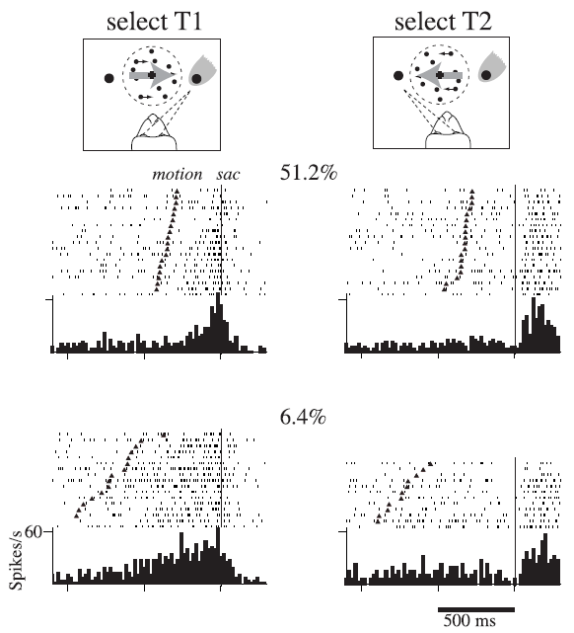
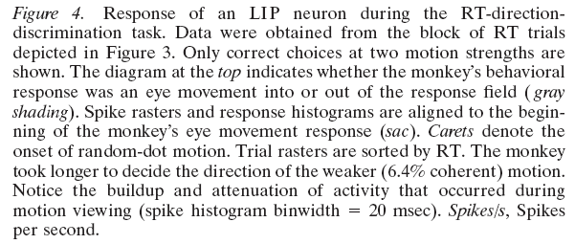
9. 2: Experiment of Roitman and Shadlen in LIP (2002)
Neurons in LIP:
-selective to target of saccade
-increases faster if signal is stronger
- activity is noisy
LIP is somewhere between MT (movement detection) and Frontal Eye Field
(saccade control)

Slide 24
2. Experiment of Roitman and Shadlen in LIP (2002)
Neurons in LIP:
- Selective to target of saccade
- Activity increases faster if signal is stronger
Activity is noisy
Located in the signal processing stream between sensory areas and saccade control
I do not claim that these neurons ‘take the decision’
Interesting correlations with decision outcome

Slide 25
Quiz 1, now
Receptive field in LIP
[ ] related to the target of a saccade
[ ] depends on movement of random dots

Slide 26
Biological Modeling of Neural Networks:
9.1 Introduction
- decision making
9.2 Perceptual decision making
- V5/MT
- Decision dynamics: Area LIP
9.3 Theory of decision dynamics
- competition via shared inhibition
- effective 2-dim model
9.4. Solutions
- symmetric case
-biased case
9.5. Simulations and Experiments
- simulations and theory
- simulations and experiments
9.6. Decisions, actions, volition
- the problem of free will
Week 9 – Decision models:
Competitive dynamics
Wulfram Gerstner
EPFL, Lausanne, Switzerland
Reading for week 9:
NEURONAL DYNAMICS
Ch. 16 (except 16.4.2)
Cambridge Univ. Press
Notes:
Lecture 1, includes the
Blackboard part of the Salzman et al experiment
Blackboard part Reduction from 3 to 2 dimensions
Lecture 2
continuation of blackboard with linearization of the inhibitory neurons
Then Exercise 1, nullclines etc. from 10:25-10:38
Afterwards, the shifting nullclines, discussion of regimes, fixed points etc.
3rd lecture: Simulations of Wang + Free will (section 9.5)

Slide 27
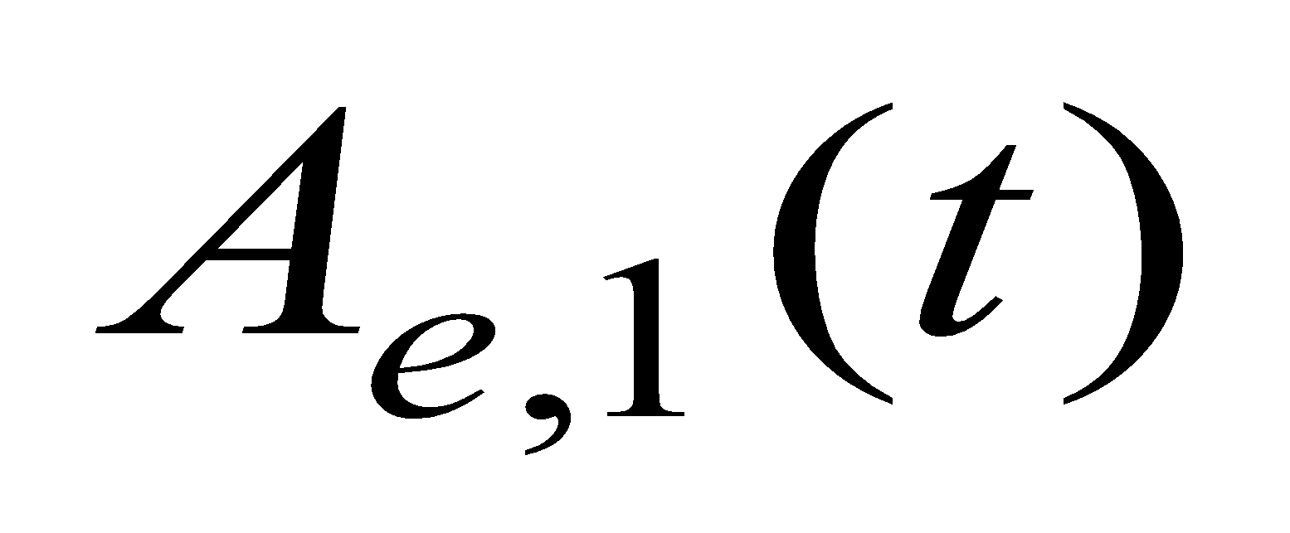
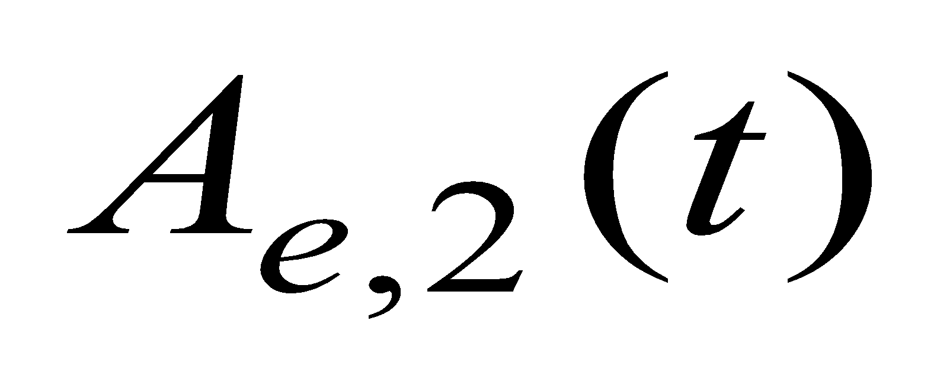
9.3. Theory of decision dynamics
activity equations
Membrane potential caused by input
Input indicating
left movement
Input indicating
right movement
population activity
Blackboard:
reduction from
3 to 2 equations

Slide 29
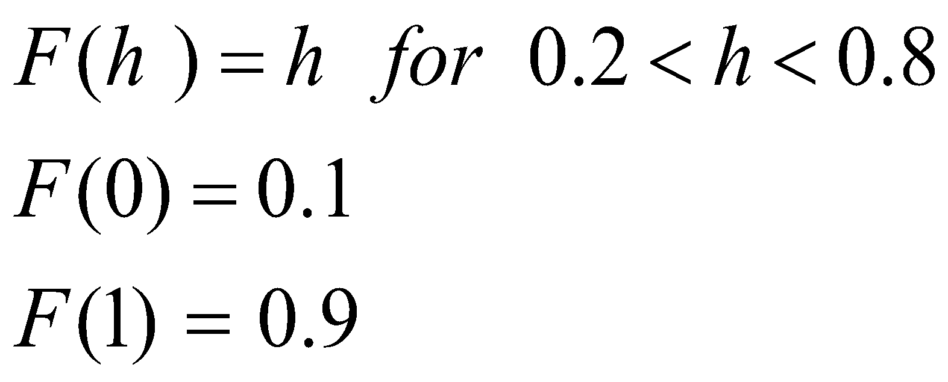
9.3. Theory of decision dynamics
Population activity
activity equations
Blackboard:
Linearized inhibition
Inhibitory Population

Slide 30
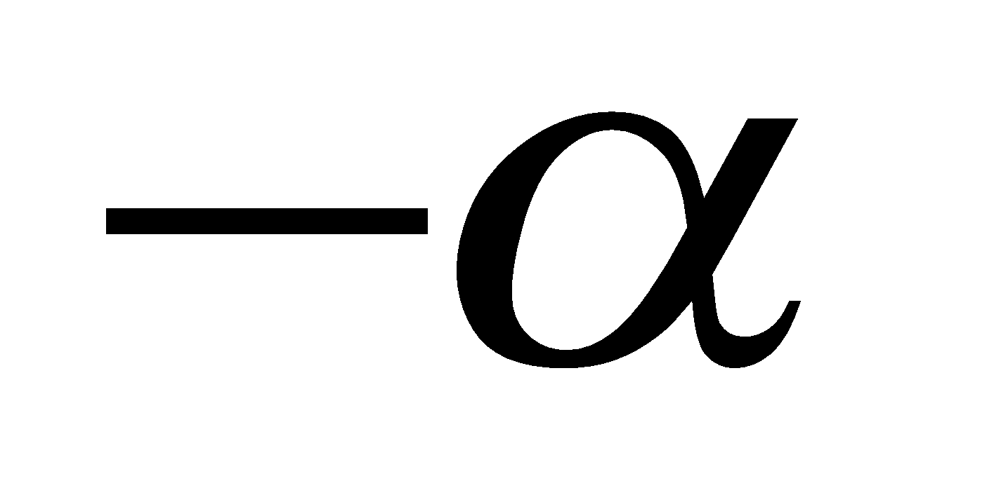
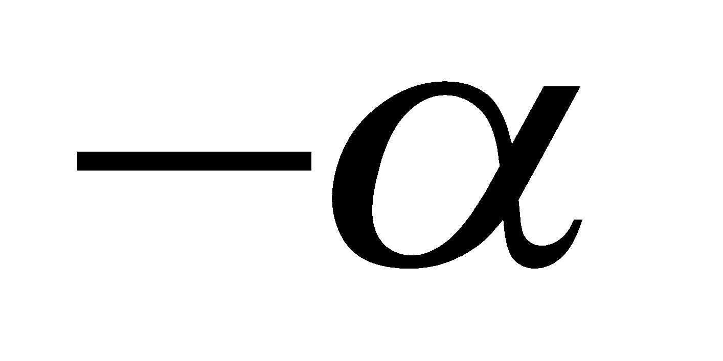
9.3. Effective 2-dim. model
activity equations
Membrane potential caused by input
Input indicating
left movement
Input indicating
right movement
population activity

Slide 31
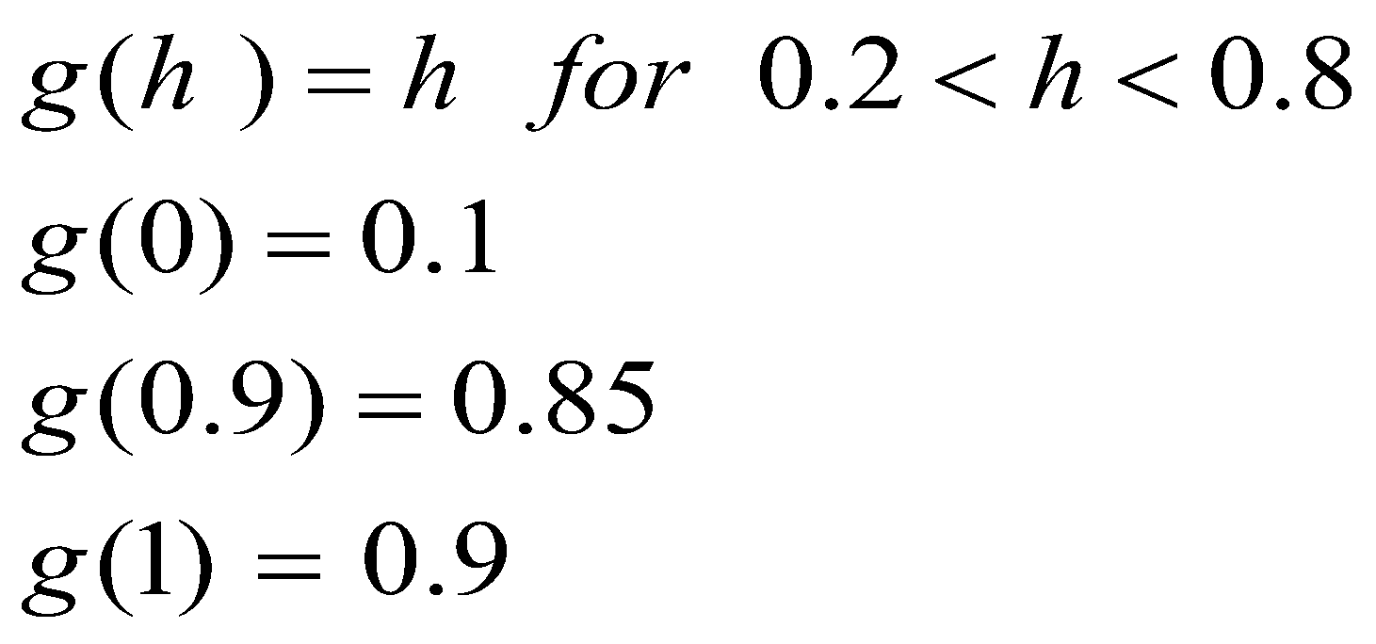
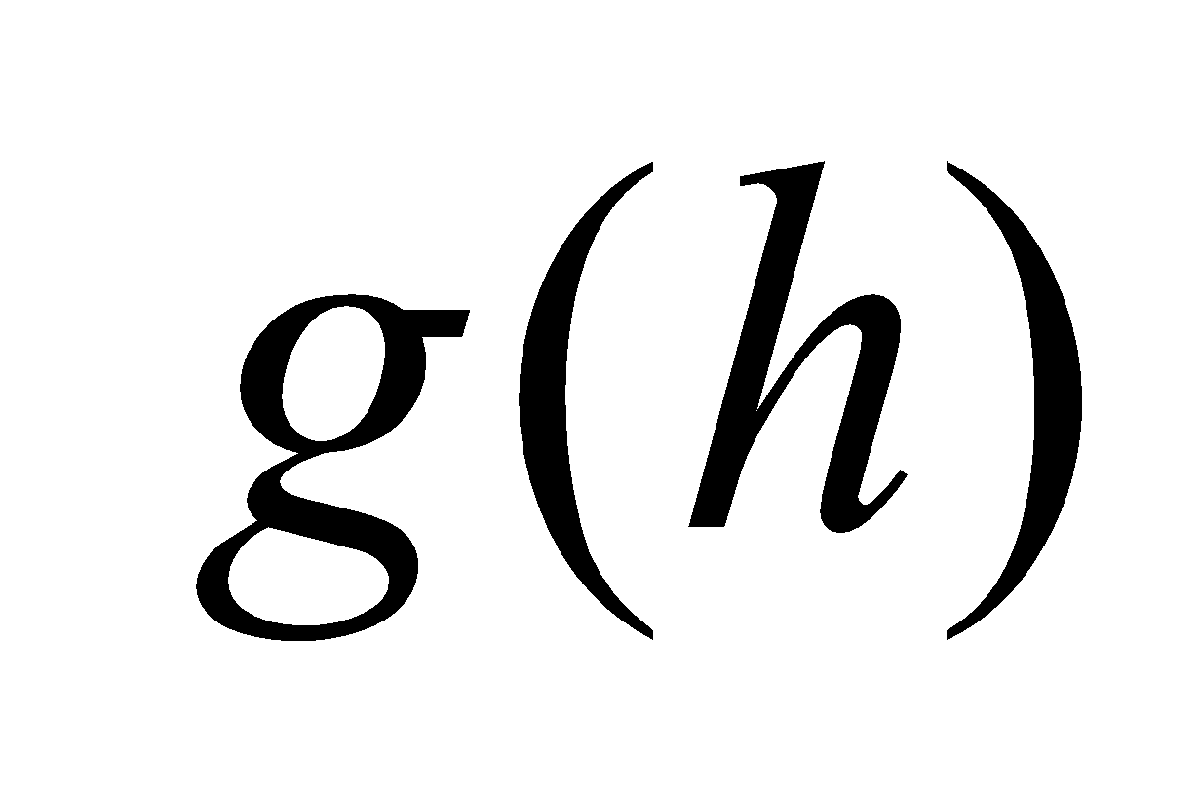
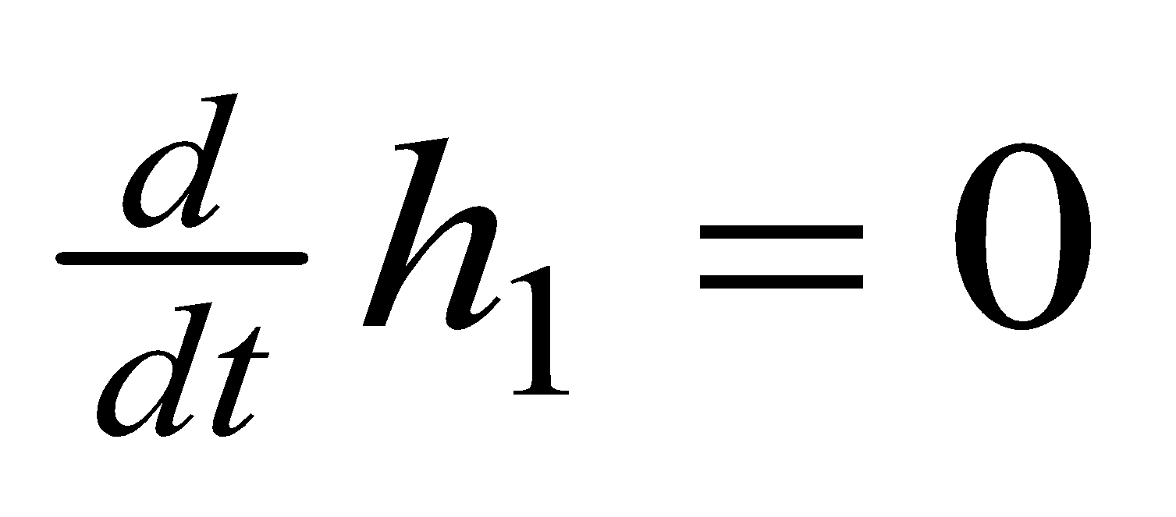
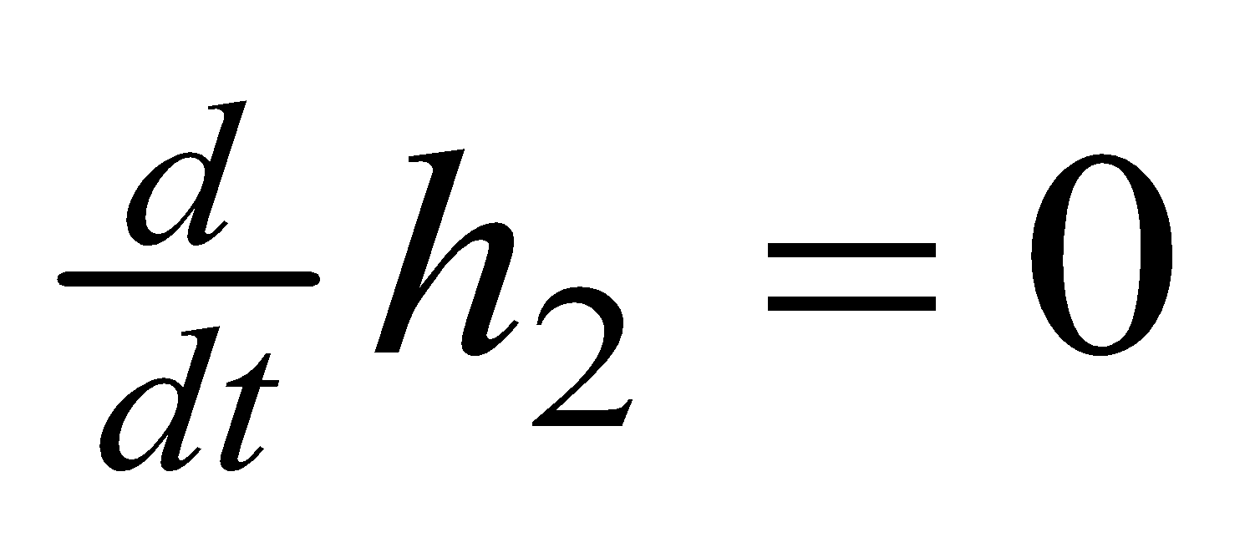
Exercise 1 now: draw nullclines and flow arrows
h
1.0
1.0
0.8
0.2
0.0
1.0
0.8
0.2
0.0
Next Lecture
at 10:40
Notes:
If we continue at 10:45, the timing will work out.

Slide 33
Biological Modeling of Neural Networks:
9.1 Introduction
- decision making
9.2 Perceptual decision making
- V5/MT
- Decision dynamics: Area LIP
9.3 Theory of decision dynamics
- competition via shared inhibition
- effective 2-dim model
9.4. Solutions
- symmetric case
-biased case
9.5. Simulations and Experiments
- simulations and theory
- simulations and experiments
9.6. Decisions, actions, volition
- the problem of free will
Week 9 – Decision models:
Competitive dynamics
Wulfram Gerstner
EPFL, Lausanne, Switzerland
Reading for week 9:
NEURONAL DYNAMICS
Ch. 16 (except 16.4.2)
Cambridge Univ. Press
Notes:
Lecture 1, includes the
Blackboard part of the Salzman et al experiment
Blackboard part Reduction from 3 to 2 dimensions
Lecture 2
continuation of blackboard with linearization of the inhibitory neurons
Then Exercise 1, nullclines etc. from 10:25-10:38
Afterwards, the shifting nullclines, discussion of regimes, fixed points etc.
3rd lecture: Simulations of Wang + Free will (section 9.5)

Slide 34
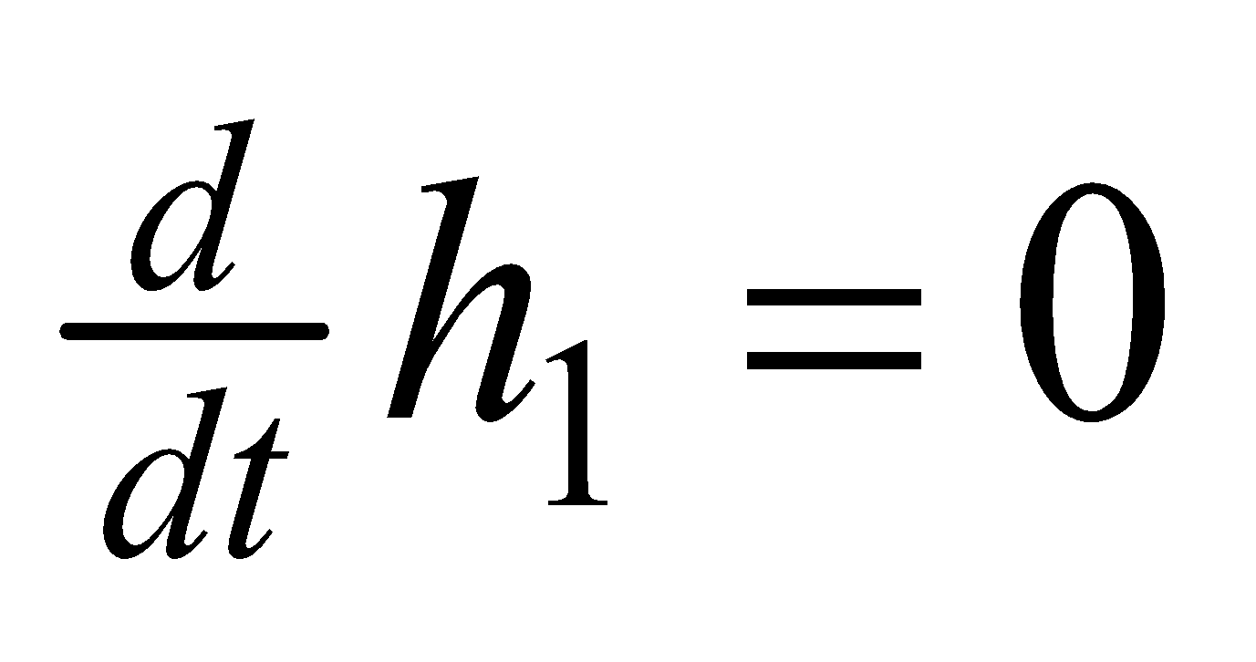
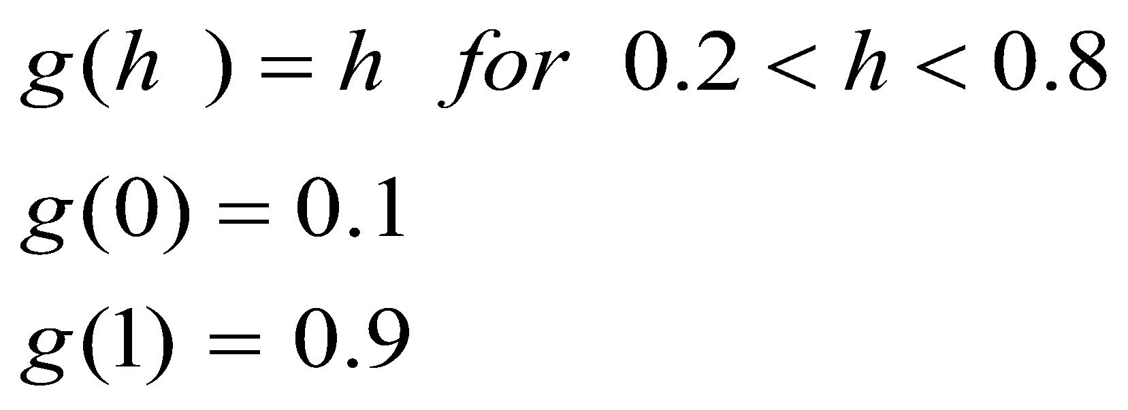
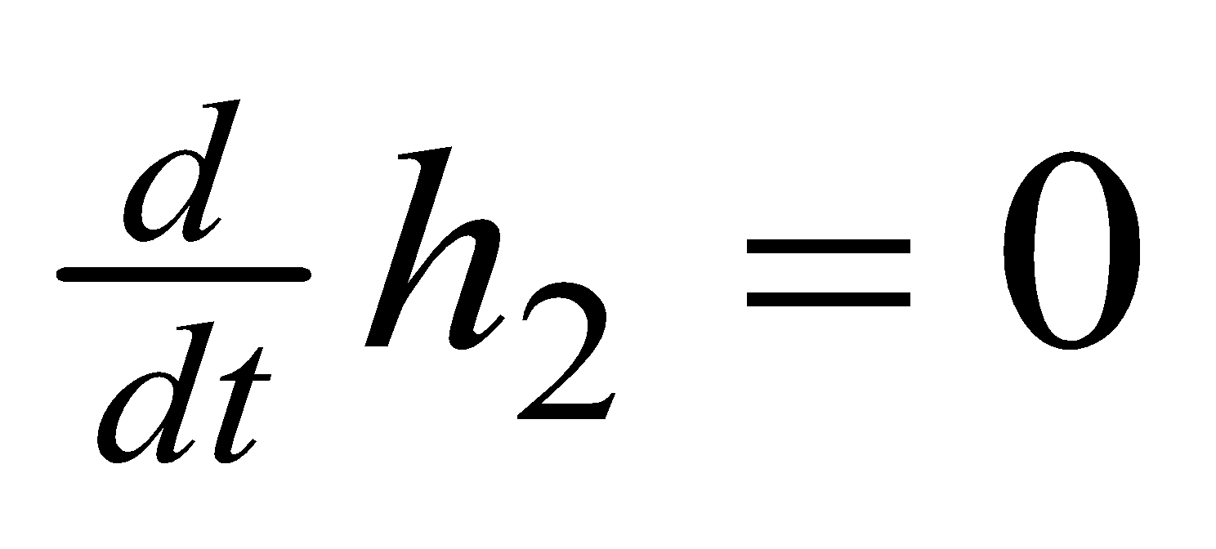
9.4. Theory of decision dynamics
Phase plane, strong external input

Slide 35
Quiz 2, take 5 minutes now
Continue with Exercise 1, but change the external inputs.
A Keep the input to population 1,
but reduce the input to population 2 from 0.8 to 0.2
[ ] The nullcline for dh2/dt shifts vertically downward
[ ] The nullcline for dh2/dt shifts horizontally leftward
[ ] The nullcline for dh1/dt shifts vertically downward
[ ] The number of fixed points changes
B In addition, you now also reduce the input to population 1,
0.8 to 0.2
[ ] The nullcline for dh2/dt shifts vertically downward
[ ] The nullcline for dh2/dt shifts horizontally leftward
[ ] The nullcline for dh1/dt shifts vertically downward
Notes:
New Quiz, added after the lecture 2017

Slide 36
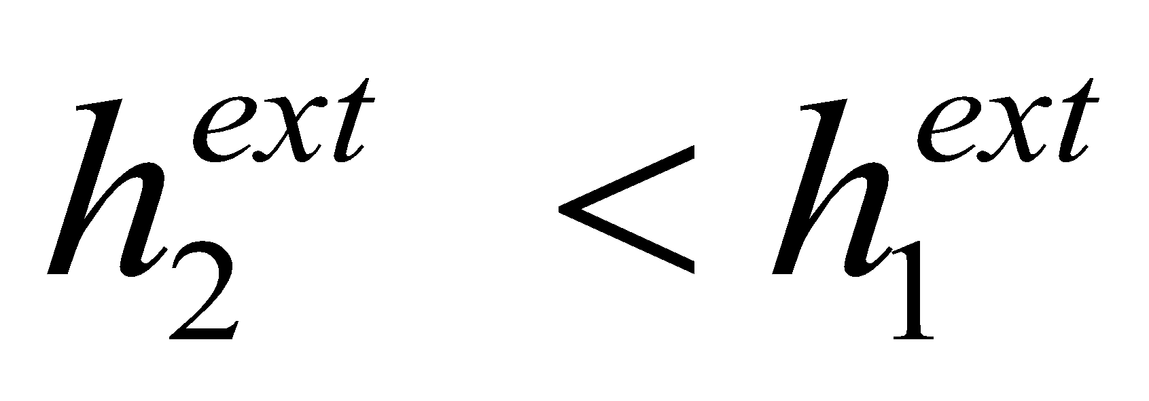
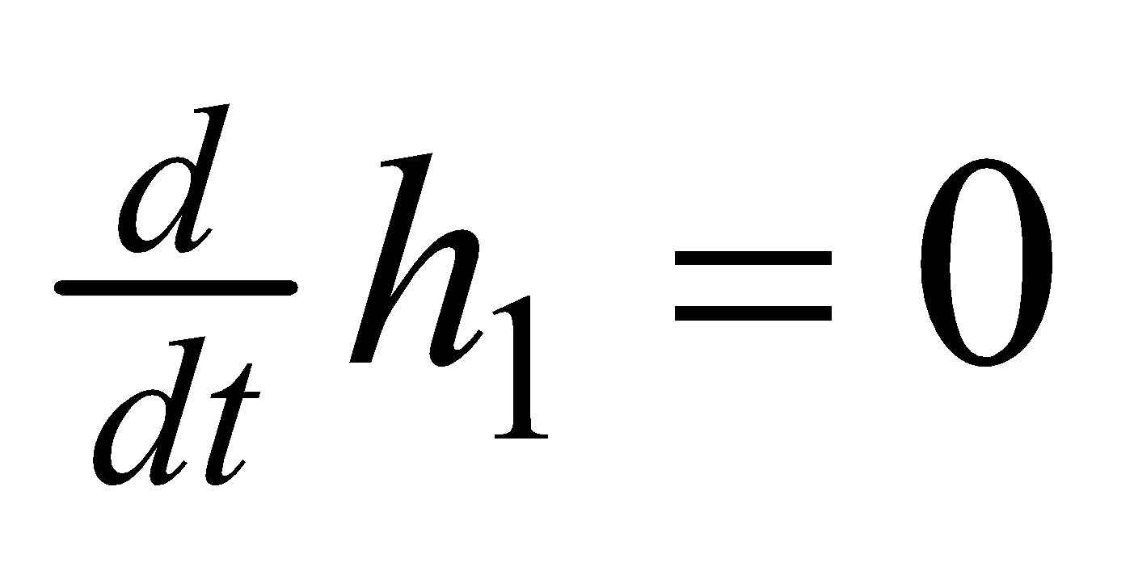
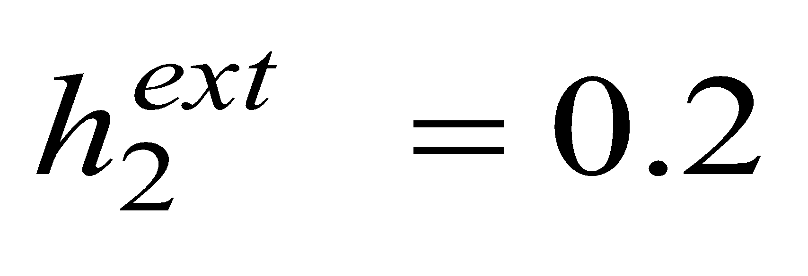
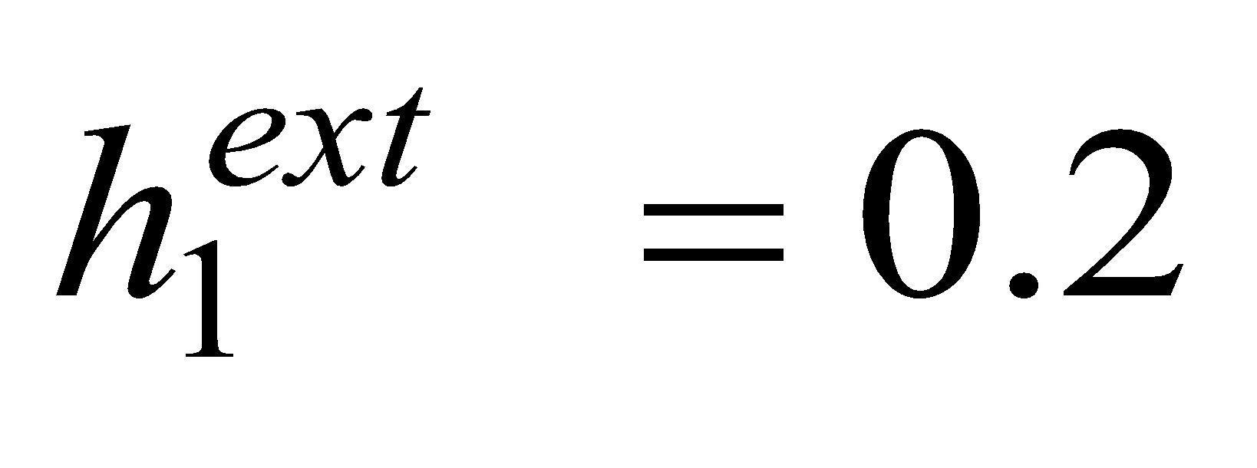
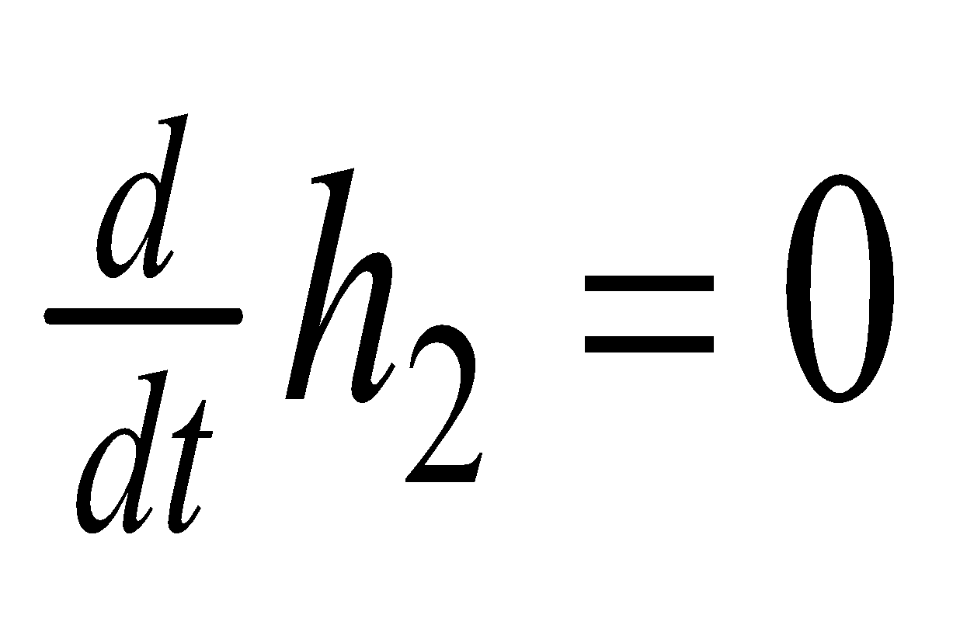
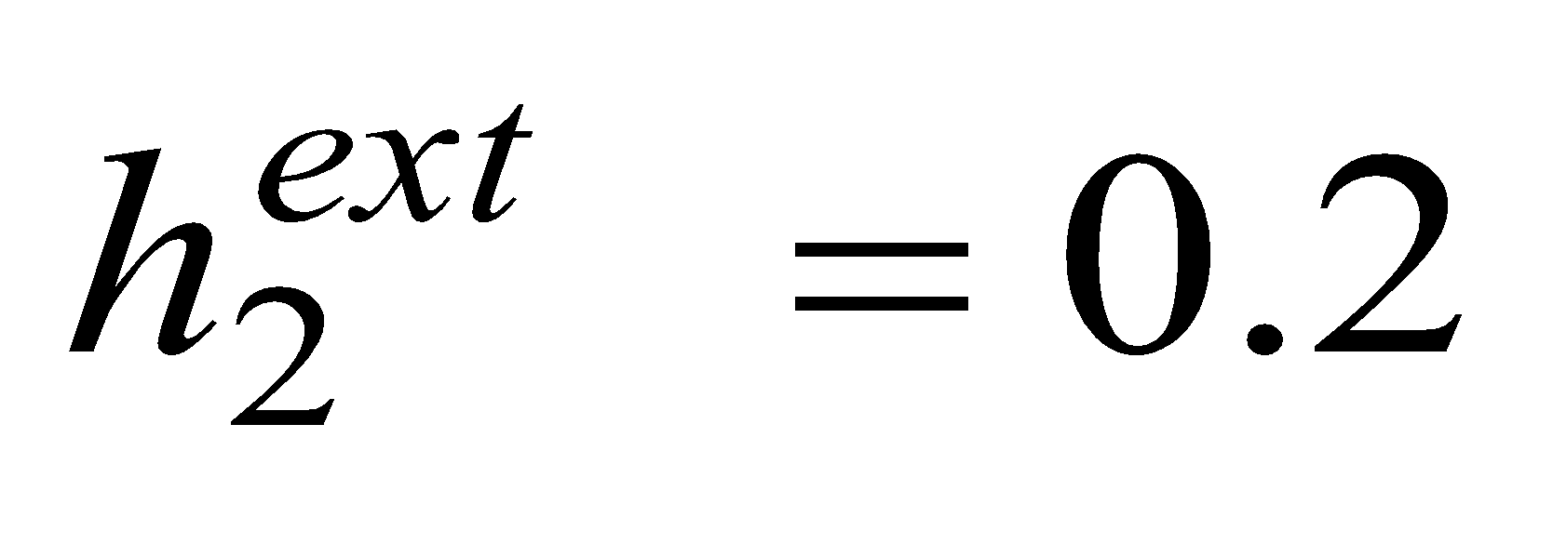
9.4. Theory of decision dynamics: biased input
Phase plane – biased input:
Population activity

Slide 37
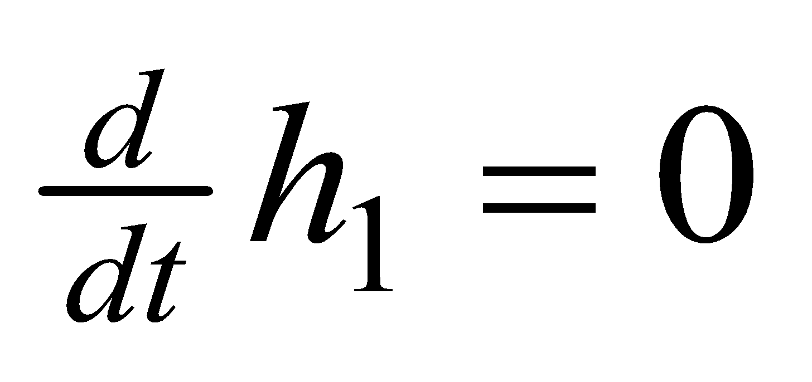
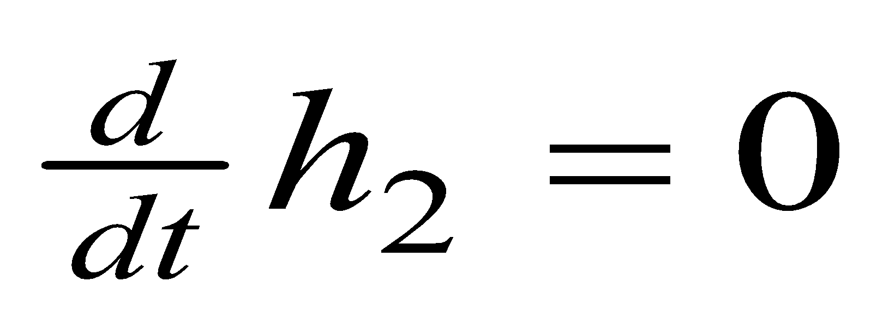
9.4. Theory of decision dynamics: unbiased weak
Phase plane – symmetric but small input
Weak external input:
Stable fixed point

Slide 38
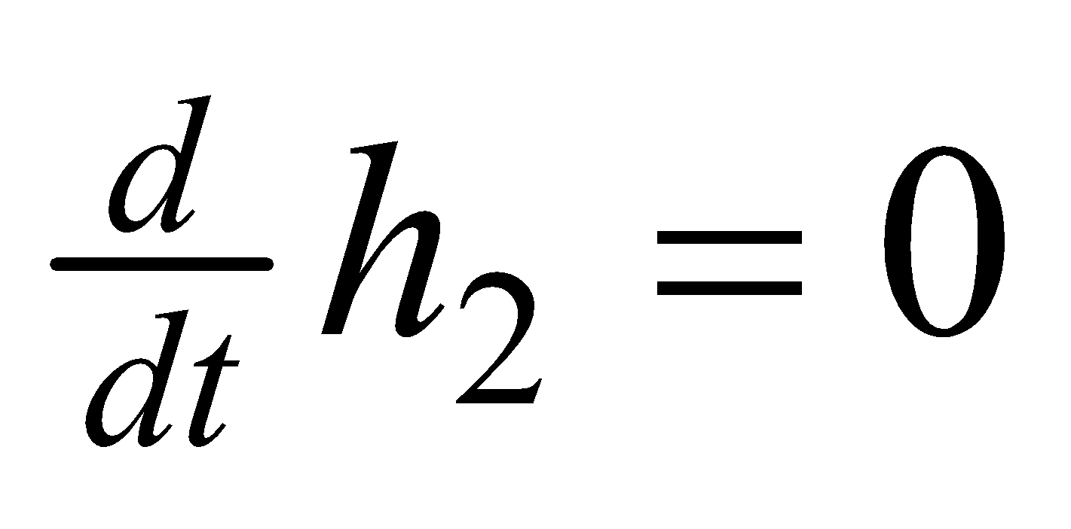
9.4. decision dynamics: unbiased strong to biased
Symmetric, but strong input
Phase plane
unbiased strong input
= 2 stable fixed points

Slide 39
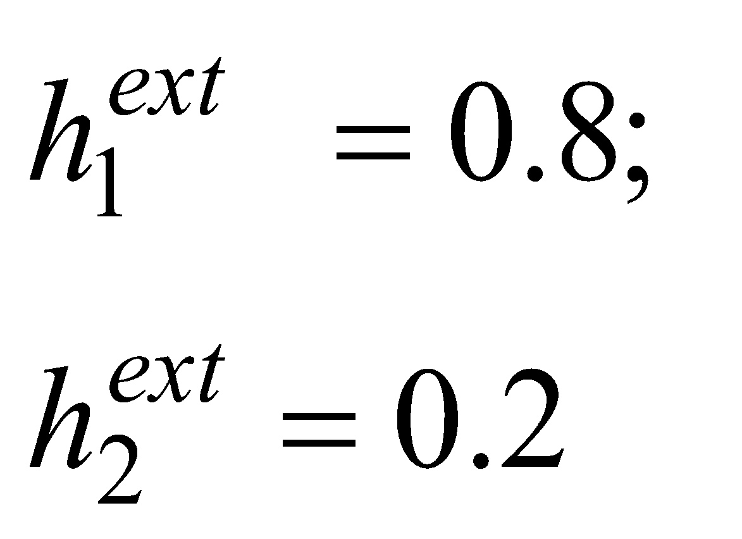
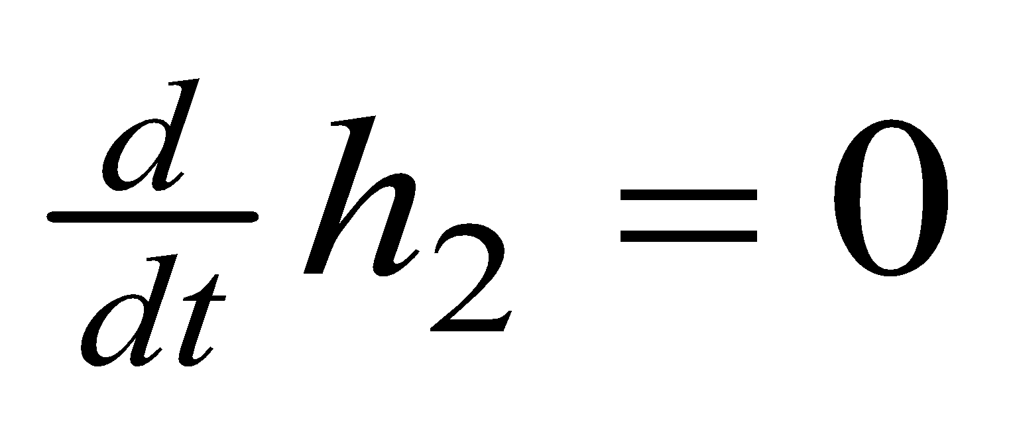
9.4. Theory of decision dynamics: biased strong
Phase plane
Population activity
Biased input = stable fixed point
🡪 decision reflects bias

Slide 40
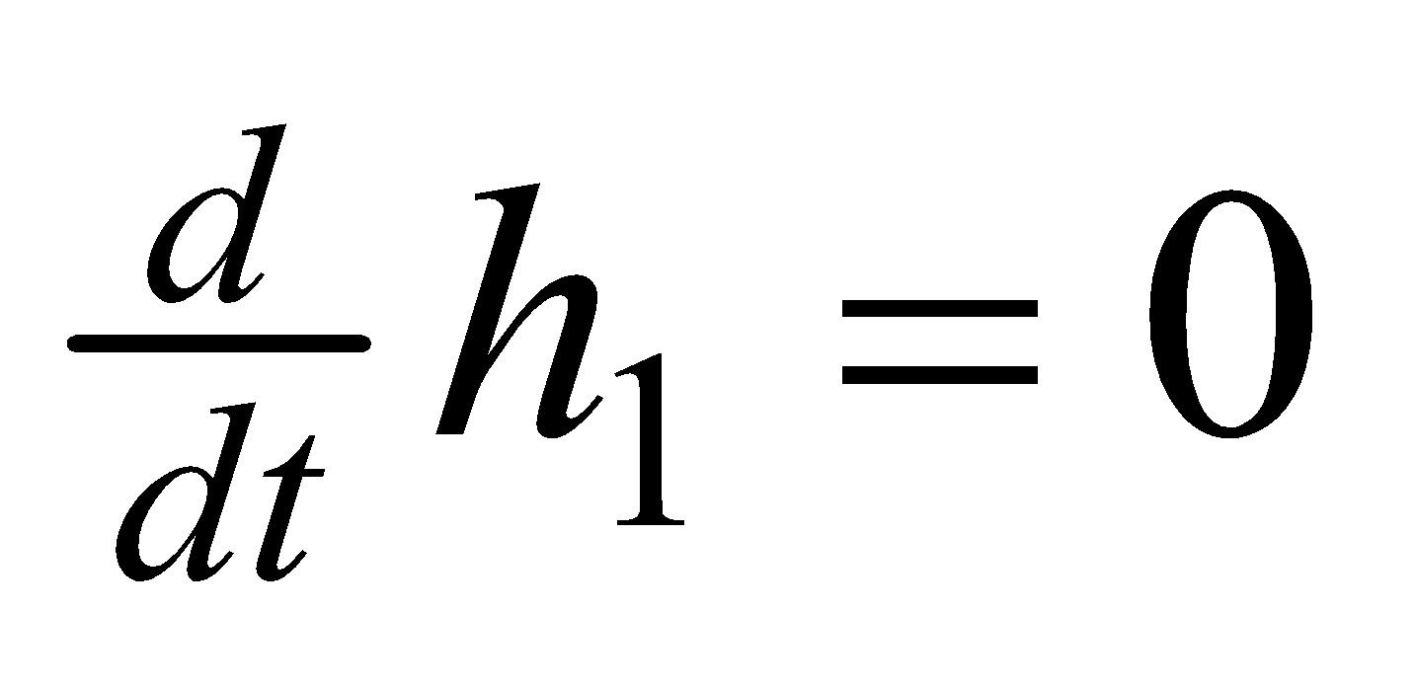
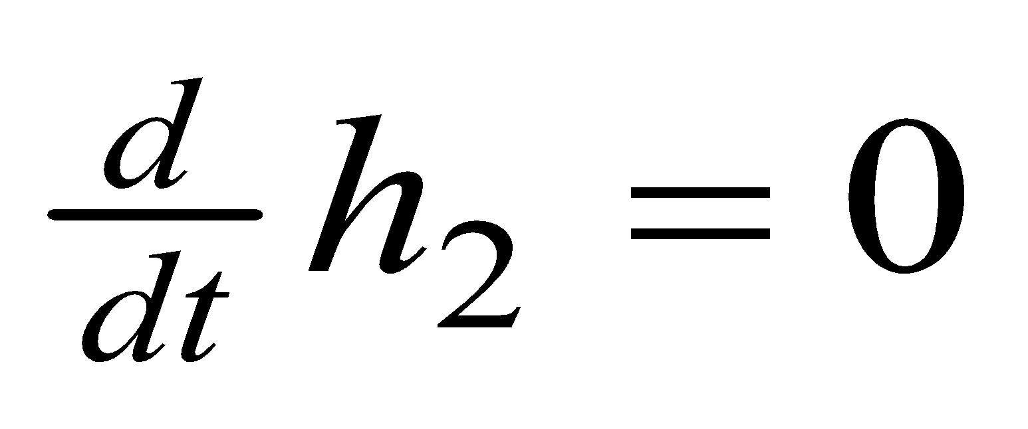
9.4. Theory of decision dynamics: unbiased strong
Phase plane
Homogeneous solution
= saddle point
🡪 decision must be taken

Slide 41
Biological Modeling of Neural Networks:
9.1 Introduction
- decision making
9.2 Perceptual decision making
- V5/MT
- Decision dynamics: Area LIP
9.3 Theory of decision dynamics
- competition via shared inhibition
- effective 2-dim model
9.4. Solutions
- symmetric case
-biased case
9.5. Simulations and Experiments
- simulations and theory
- simulations and experiments
9.6. Decisions, actions, volition
- the problem of free will
Week 9 – Decision models:
Competitive dynamics
Wulfram Gerstner
EPFL, Lausanne, Switzerland
Reading for week 9:
NEURONAL DYNAMICS
Ch. 16 (except 16.4.2)
Cambridge Univ. Press
Notes:
3rd lecture starts here: Simulations of Wang (9.5) + Free will (section 9.6)

Slide 42
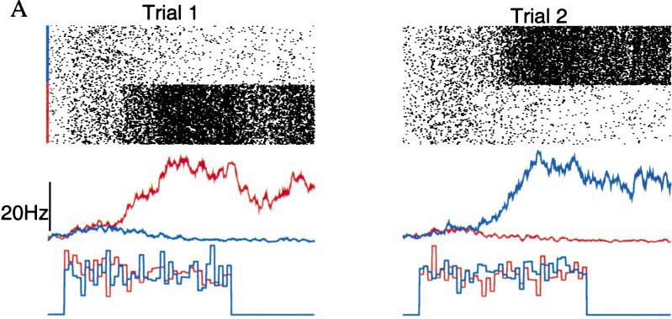
9.5. Decisions in populations of neurons: simulation
Simulation of 3 populations of spiking neurons, unbiased strong input
X.J. Wang, 2002
NEURON
Popul. 2
Popul.1
stimulus
Notes:
Start here at 11:15

Slide 43
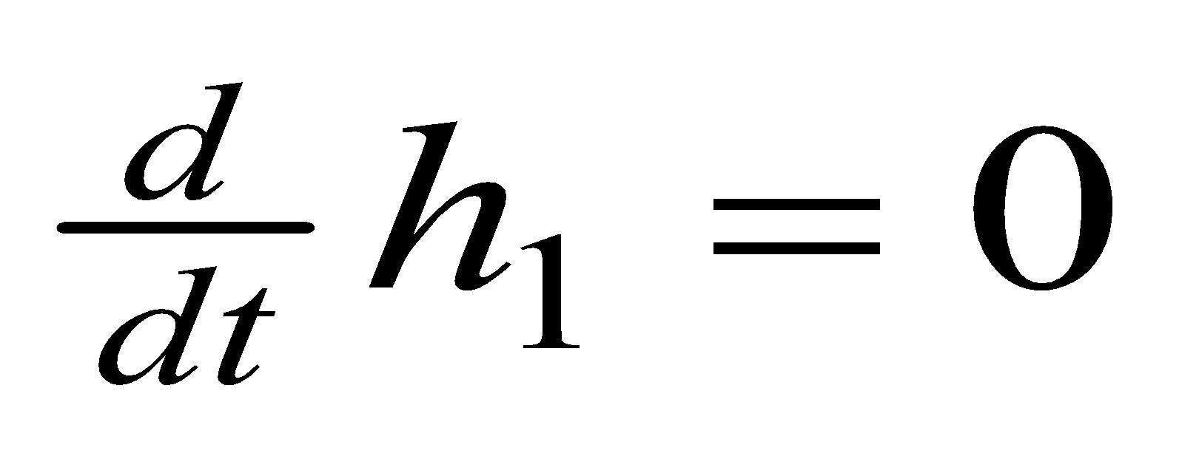
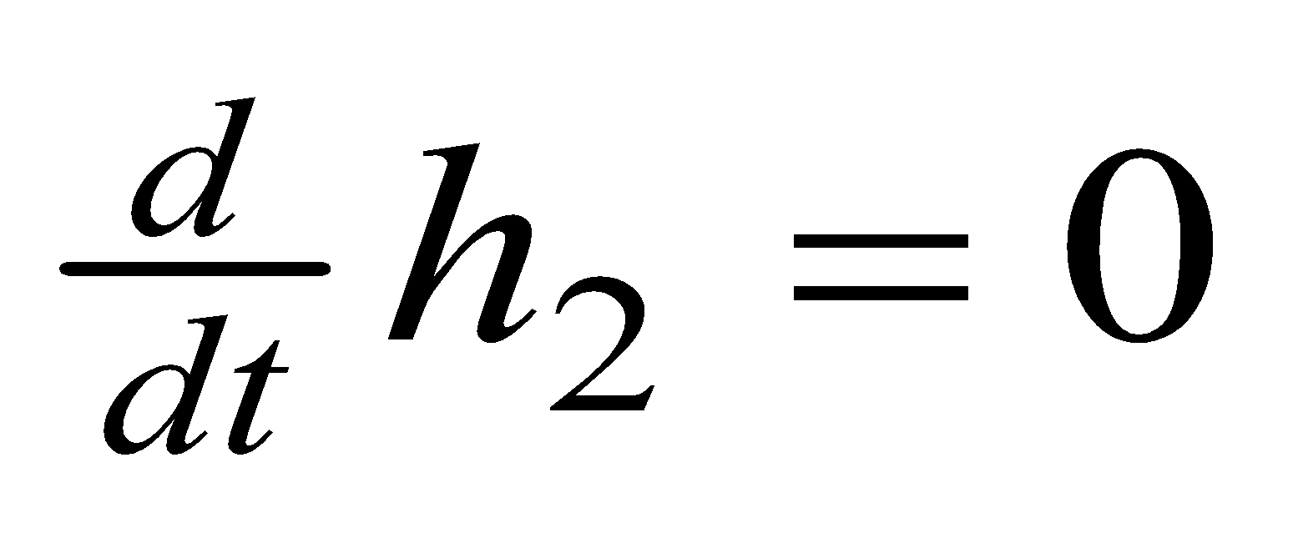
9.5: Comparison: Simulation and Theory
1) Before stimulus is given: symmetric but small input
Weak unbiased input:
Stable fixed point
🡪 no decision
Exercise 2 at home:
stability of symmetric solution

Slide 44
9.5: Comparison: Simulation and Theory
2) When stimulus is given: symmetric but strong input
Phase plane
Homogeneous solution
= saddle point
🡪 decision must be taken

Slide 45
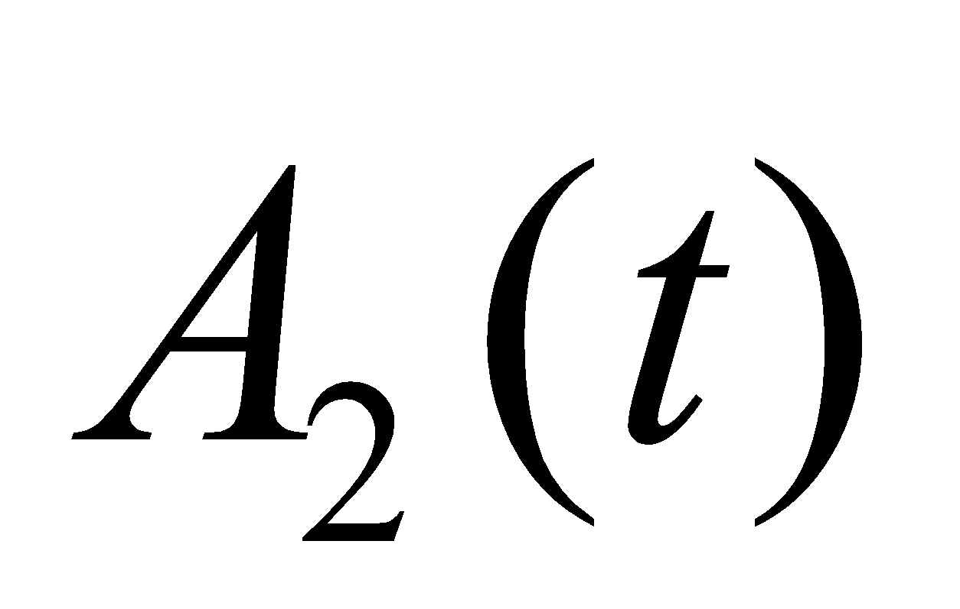
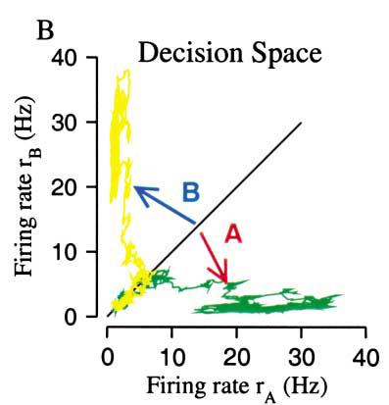
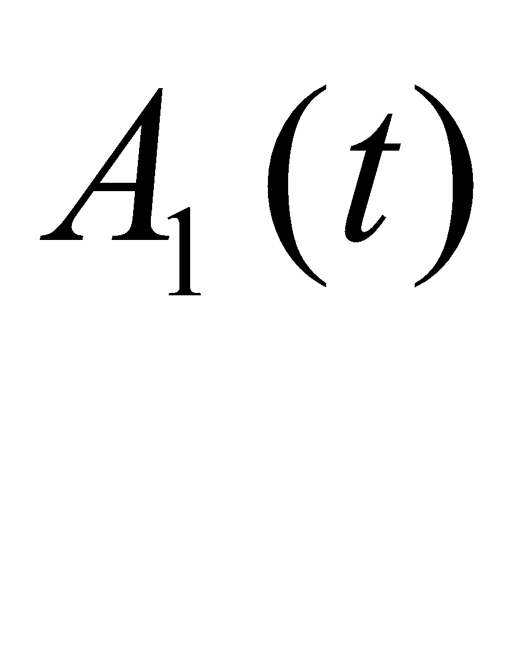
9.5: Decisions in populations of neurons: simulation
Simulation of 3 populations of spiking neurons, unbiased strong input
X.J. Wang, 2002
NEURON
Popul. 2
Popul.1
stimulus
Notes:
Start here at 11:15

Slide 46
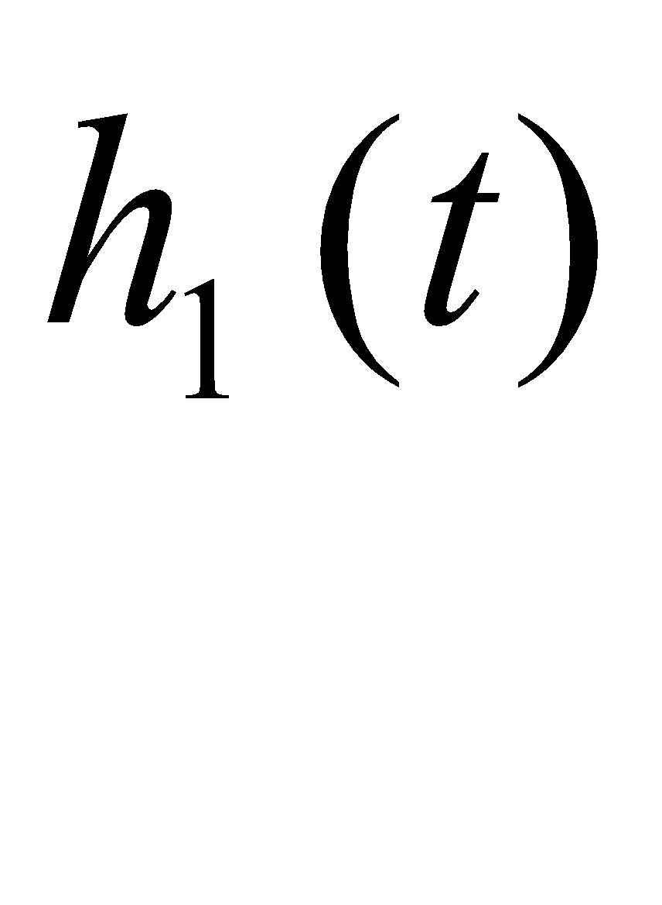
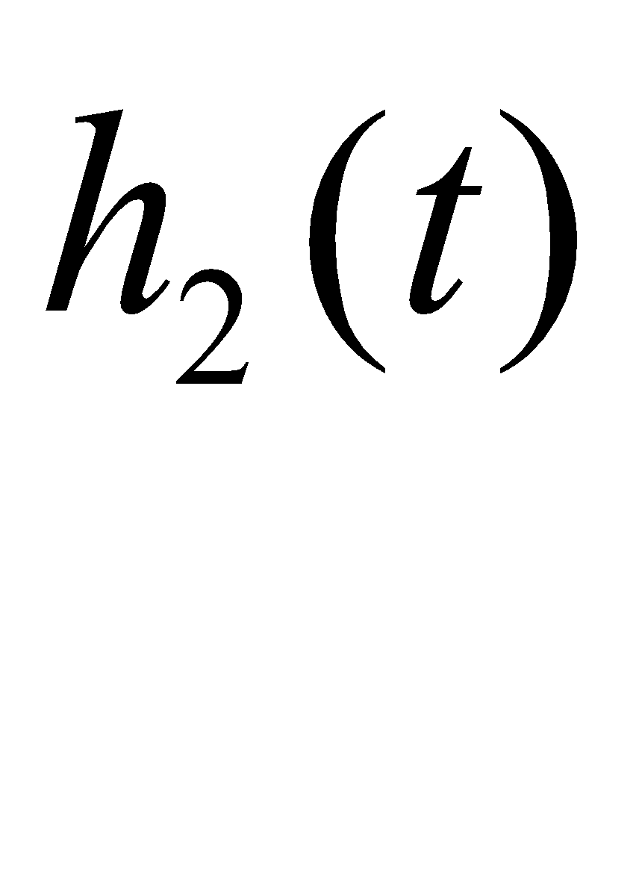
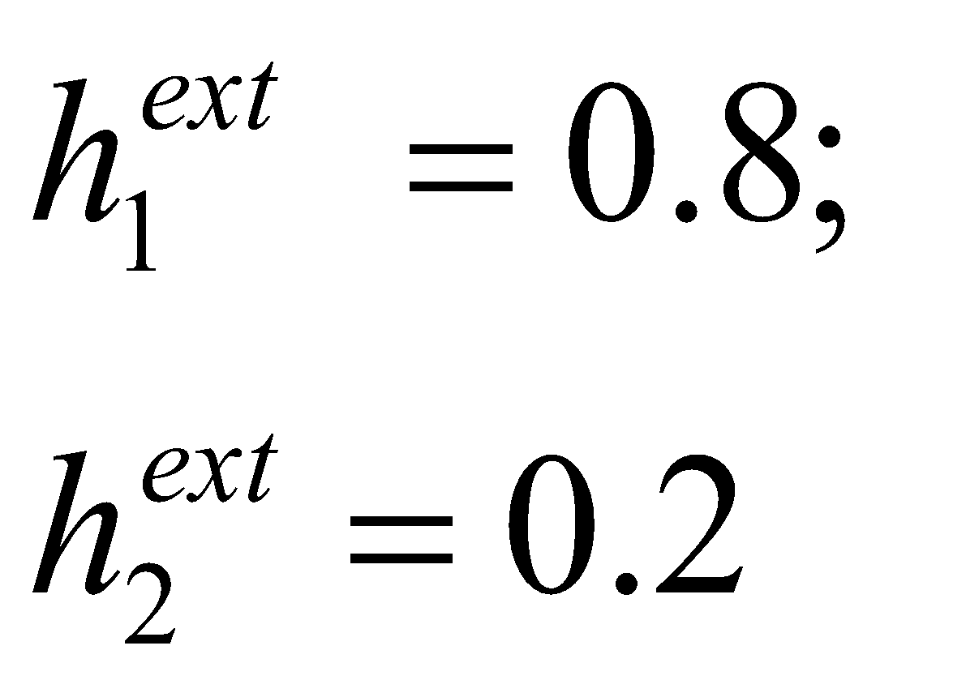
9.5. Comparison with experiment: biased strong input
Prediction by theory - for input potential
- population activity
Biased input = stable fixed point
🡪 decision reflects bias

Slide 47
9.5. Decisions in populations of neurons: LIP data
Stimulus onset
saccade onset
Roitman and Shadlen 2002
Notes:
End of second lecture

Slide 48
9.5. Decisions in populations of neurons: simulations and data
simulation of competing populations
shares properties with LIP data:
- faster increase for strong bias
- suppression for opposite saccade
BUT: there is no claim that
decision is taken in LIP
LIP is somewhere in the processing
stream from input to saccades
Notes:
End of second lecture

Slide 49
Biological Modeling of Neural Networks:
9.1 Introduction
- decision making
9.2 Perceptual decision making
- V5/MT
- Decision dynamics: Area LIP
9.3 Theory of decision dynamics
- competition via shared inhibition
- effective 2-dim model
9.4. Solutions
- symmetric case
-biased case
9.5. Simulations and Experiments
- simulations and theory
- simulations and experiments
9.6. Decisions, actions, volition
- the problem of free will
Week 9 – Decision models:
Competitive dynamics
Wulfram Gerstner
EPFL, Lausanne, Switzerland
Reading for week 9:
NEURONAL DYNAMICS
Ch. 16 (except 16.4.2)
Cambridge Univ. Press
Notes:
Lecture 1, includes the
Blackboard part of the Salzman et al experiment
Blackboard part Reduction from 3 to 2 dimensions
Lecture 2
continuation of blackboard with linearization of the inhibitory neurons
Then Exercise 1, nullclines etc. from 10:25-10:38
Afterwards, the shifting nullclines, discussion of regimes, fixed points etc.
3rd lecture: Simulations of Wang + Free will (section 9.5)

Slide 50
9.6. Decision: risky vs. safe
How would you decide?
goal

Slide 51
9.6. Decision: risky vs. safe
How would you decide?
goal
Start

Slide 52
9.6. fMRI variant of Libet experiment: volition and free will
Decision and Movement
Preparation
-Subject decides spontaneously
to move left or right hand
- report when they made their decision
Libet, Behav. Brain Sci., 1985
Soon et al., Nat. Neurosci., 2008

Slide 53
What decides? Who decides?
‘Your brain decides what you want or what you prefer … ’
‘ … but your brain – this is you!!!’
Your experiences are memorized in your brain
Your values are memorized in your brain
Your decisions are reflected in brain activities
‘We don’t do what we want, but we want what we do’ (W. Prinz)
goal
goal
The problem of
Free Will
(see e.g. Wikipedia
article)
Start

Slide 54
9.6. Decision: risky vs. safe
- decisions are taken in the brain
- competition between populations is a
transparent model
- relevant decisions involve
personal values and experiences
goal

Slide 55
9.6. Selected References: Decision Making
Suggested Reading: - Salzman et al. Nature 1990
- Roitman and Shadlen, J. Neurosci. 2002
- Abbott, Fusi, Miller:
Theoretical Approaches to Neurosci.
- X.-J. Wang, Neuron 2002
- Libet, Behav. Brain Sci., 1985
- Soon et al., Nat. Neurosci., 2008
- free will, Wikipedia
Chapter 16, Neuronal Dynamics, Gerstner et al. Cambridge 2014

Slide 56
Exercise 2.1 now: stability of homogeneous solution
Membrane potential caused by input
Assume:
a) Calculate homogeneous fixed point
b) Analyze stability of the fixed point h(b) as a function of b

