Slide 1
Biological Modeling of Neural Networks
Wulfram Gerstner
EPFL, Lausanne, Switzerland
Week 1: A first simple neuron model/
neurons and mathematics
Week 2: Hodgkin-Huxley models and
biophysical modeling
Week 3: Two-dimensional models and
phase plane analysis
Week 4: Two-dimensional models,
type I and type II models
Week 5,6: Associative Memory,
Hebb rule, Hopfield
Week 7-10: Networks, cognition, learning
Week 11,12: Noise models, noisy neurons
and coding
Week 13: Estimating neuron models for
coding and decoding: GLM
Week x: Online video: Dendrites/Biophysics
Week xx: Density equations
TAs in 2020:
Martin Barry (head)
Valentin Schmutz
Georgios Iatropoulos
Christos Sourmpis
COURSE WEBPAGE:
Moodle
Notes:
Formality slides only for moodle, not for lectures.

Slide 2
LEARNING OUTCOMES
Solve linear one-dimensional differential equations
Analyze two-dimensional models in the phase plane
Develop a simplified model by separation of time scales
Analyze connected networks in the mean-field limit
Formulate stochastic models of biological phenomena
Formalize biological facts into mathematical models
Prove stability and convergence
Apply model concepts in simulations
Predict outcome of dynamics
Describe neuronal phenomena
Look at samples of
past exams
Use a textbook,
(Use video lectures)
don’t use slides (only)
Transversal skills
Plan and carry out activities in a way which makes optimal use of available time and other resources.
Collect data.
Write a scientific or technical report.
miniproject

Slide 3
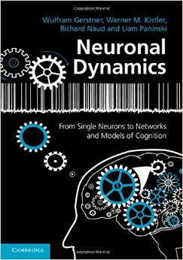
Biological Modeling of Neural Networks
Written Exam (70%)
+ miniproject (30%)
Miniproject consists of
3 extended computer exercises,
of which you have to hand in 2
(first one is easier, recommended)
Textbook:
http://neuronaldynamics.epfl.ch/
Video:
https://lcnwww.epfl.ch/gerstner/NeuronalDynamics-MOOC1.html
https://lcnwww.epfl.ch/gerstner/NeuronalDynamics-MOOC2.html

Slide 4
Welcome back to EPFL!!
Today: Course in BS 170
BS 170 for the first week, but
INM 200 for the rest of the semester
Notes:
I hope that the exams went well – may be some vacation, too. Welcome to the first week of spring term, first hour …h

Slide 5
Biological Modeling of Neural Networks
1.1 Neurons and Synapses:
Overview
1.2 The Passive Membrane
- Linear circuit
- Dirac delta-function
1.3 Leaky Integrate-and-Fire Model
1.4 Generalized Integrate-and-Fire Model
1.5. Quality of Integrate-and-Fire Models
Week 1 – neurons and mathematics:
a first simple neuron model
Wulfram Gerstner
EPFL, Lausanne, Switzerland
Reading for week 1:
NEURONAL DYNAMICS
- Ch. 1 (without 1.3.6 and 1.4)
- Ch. 5 (without 5.3.1)
Cambridge Univ. Press
Notes:
Important: Formalities only in the second lecture, so that we start the first exercise on time!
Exercise 1 starts: 9:47
Exercise 2 starts: 10:53
Diese Version: erstmals 2014 im Unterricht (adaptiert vom MOOC).
2015: fast unveraendert.

Slide 6
Biological Modeling of Neural Networks
1.1 Neurons and Synapses:
Overview
1.2 The Passive Membrane
- Linear circuit
- Dirac delta-function
1.3 Leaky Integrate-and-Fire Model
1.4 Generalized Integrate-and-Fire
Model
1.5. Quality of Integrate-and-Fire
Models
Notes:
Welcome!

Slide 7
Neuronal Dynamics – 1.1. Neurons and Synapses/Overview
motor
cortex
How do we recognize things?
Models of cognition
Weeks 5-10
frontal
cortex
visual
cortex
to motor
output

Slide 8
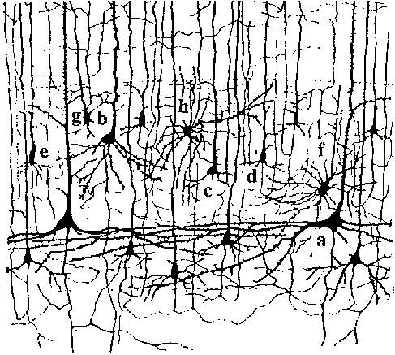
Neuronal Dynamics – 1.1. Neurons and Synapses/Overview
10 000 neurons
3 km of wire
motor
cortex
1mm
frontal
cortex
to motor
output

Slide 9
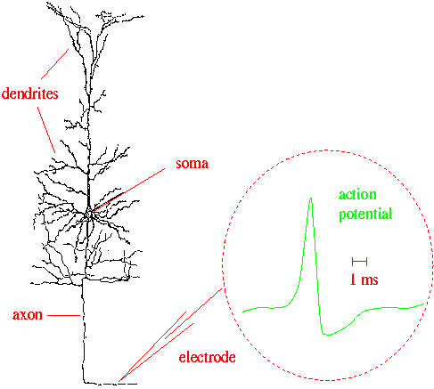
Neuronal Dynamics – 1.1. Neurons and Synapses/Overview
Signal:
action potential (spike)
10 000 neurons
3 km of wire
1mm
action
potential
Ramon y Cajal

Slide 10
Neuronal Dynamics – 1.1. Neurons and Synapses/Overview
Hodgkin-Huxley type models:
Biophysics, molecules, ions
(week 2)
Signal:
action potential (spike)
-70mV
Na⁺
action
potential
K⁺
Ca²⁺
Ions/proteins

Slide 11
Neuronal Dynamics – 1.1. Neurons and Synapses/Overview
Signal:
action potential (spike)
action
potential

Slide 12
Neuronal Dynamics – 1.1. Neurons and Synapses/Overview
Integrate-and-fire models:
Formal/phenomenological
(week 1 and week 7-9)
Spike emission
Spike reception
synapse
t
-spikes are events
-triggered at threshold
-spike/reset/refractoriness
Postsynaptic
potential

Slide 13
Noise and variability in integrate-and-fire models
j
Spike emission
i
Output
-spikes are rare events
-triggered at threshold
Subthreshold regime:
trajectory of potential shows fluctuations
Random spike arrival

Slide 14
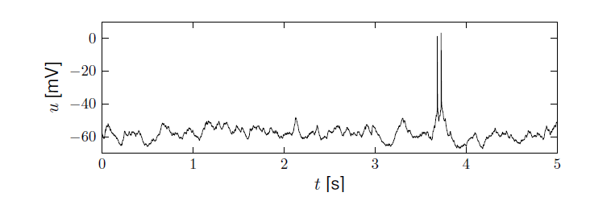
Neuronal Dynamics – membrane potential fluctuations
Spontaneous activity in vivo
electrode
What is noise?
What is the neural code?
(week 11-13)
Brain
awake mouse, cortex, freely whisking,
Lab of Prof. C. Petersen, EPFL
Crochet et al., 2011

Slide 15
Biological Modeling of Neural Networks – Quiz 1.1
Milan Vojnovic (PhD 2003 with J-Y Le Boudec)
A cortical neuron sends out signals which are called:
[ ] action potentials
[ ] spikes
[ ] postsynaptic potential
The dendrite is a part of the neuron
[ ] where synapses are located
[ ] which collects signals from other
neurons
[ ] along which spikes are sent to other
neurons
In an integrate-and-fire model, when the voltage hits the threshold:
[ ] the neuron fires a spike
[ ] the neuron can enter a state of
refractoriness
[ ] the voltage is reset
[ ] the neuron explodes
In vivo, a typical cortical neuron exhibits
[ ] rare output spikes
[ ] regular firing activity
[ ] a fluctuating membrane potential
Multiple answers possible!

Slide 16
Biological Modeling of Neural Networks
Wulfram Gerstner
EPFL, Lausanne, Switzerland
Week 1: A first simple neuron model/
neurons and mathematics
Week 2: Hodgkin-Huxley models and
biophysical modeling
Week 3: Two-dimensional models and
phase plane analysis
Week 4: Two-dimensional models,
type I and type II models
Week 5,6: Associative Memory,
Hebb rule, Hopfield
Week 7-10: Networks, cognition, learning
Week 11,12: Noise models, noisy neurons
and coding
Week 13: Estimating neuron models for
coding and decoding: GLM
Week x: Online video: Dendrites/Biophysics

Slide 17
Biological modeling of Neural Networks
Course: Monday : 9:15-13:00
have your laptop
with you
A typical Monday:
1st lecture 9:15-9:50
1st exercise 9:50-10:00
2nd lecture 10:15-10:35
2nd exercise 10:35-11:00
3rd lecture 11:15 – 11:40
3rd exercise 11:45-12:40
paper and pencil
paper and pencil
paper and pencil
OR interactive toy
examples
on computer
Course of 4 credits = 6 hours of work per week
4 ‘contact’ + 2 homework
moodle.epfl.ch

Slide 18
Biological Modeling of Neural Networks
Week 1 – part 2: The Passive Membrane
1.1 Neurons and Synapses:
Overview
1.2 The Passive Membrane
- Linear circuit
- Dirac delta-function
1.3 Leaky Integrate-and-Fire Model
1.4 Generalized Integrate-and-Fire Model
1.5. Quality of Integrate-and-Fire Models
Week 1 – neurons and mathematics:
a first simple neuron model
Wulfram Gerstner
EPFL, Lausanne, Switzerland

Slide 19
Neuronal Dynamics – 1.2. The passive membrane
electrode
Spike emission
synapse
t
potential
Integrate-and-fire model

Slide 20
Neuronal Dynamics – 1.2. The passive membrane
j
i
Spike reception
I
Subthreshold regime
- linear
- passive membrane
- RC circuit

Slide 22
Neuronal Dynamics – 1.2. The passive membrane
I(t)
Time-dependent input
i
I(t)
Math development:
Derive equation
(Blackboard)
u

Slide 23
Passive Membrane Model
I(t)
u

Slide 24
Passive Membrane Model
j
i
I
Math Development:
Voltage rescaling
(blackboard)

Slide 25
Passive Membrane Model

Slide 26
Passive Membrane Model/Linear differential equation
Free solution:
exponential decay

Slide 27
Start Exerc. at 9:47.
Next lecture at
10:15
Neuronal Dynamics – Exercises NOW
Step current input:
Pulse current input:
arbitrary current input:
Calculate the voltage,
for the
3 input currents

Slide 28
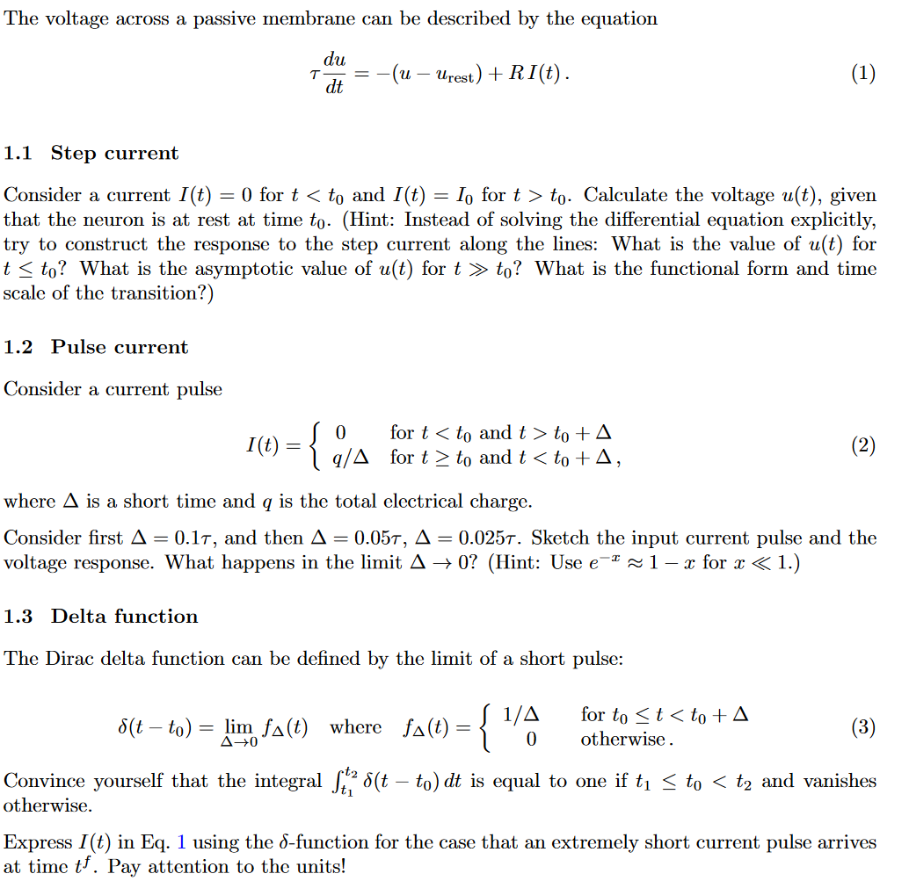
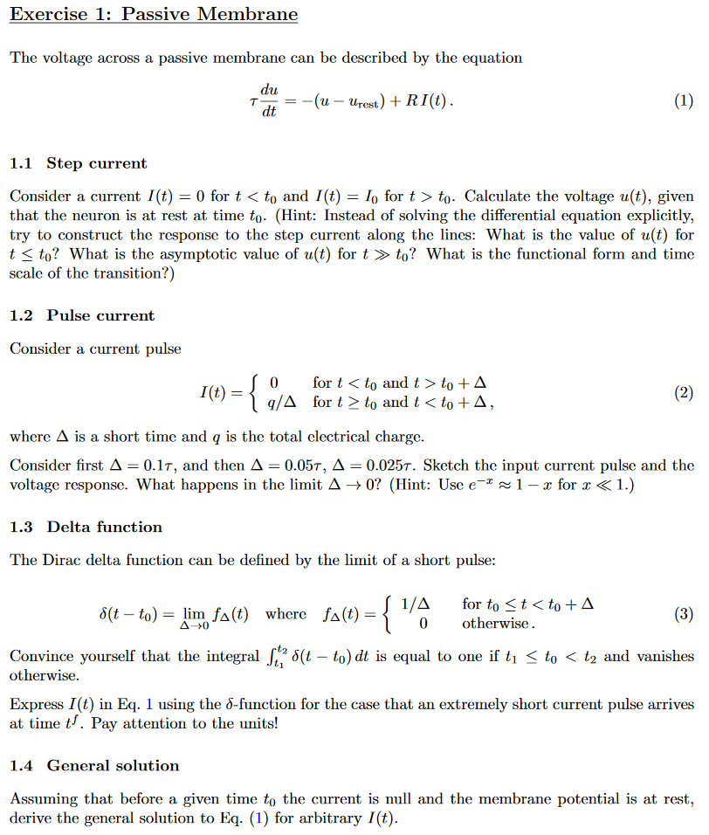

Slide 30
Passive Membrane Model – exercise 1 now
i
Step current input:
I(t)
impulse reception:
impulse response
function
Linear equation

Slide 31
Triangle: neuron – electricity - math
i
I(t)
u

Slide 32
Pulse input – charge – delta-function
Pulse current input

Slide 33
Dirac delta-function

Slide 34
Neuronal Dynamics – Solution of Ex. 1 – arbitrary input
Arbitrary input
Single pulse
you need to know the solutions
of linear differential equations!

Slide 35
Passive membrane, linear differential equation

Slide 36
Passive membrane, linear differential equation
If you have difficulties,
watch lecture 1.2detour.
Three prerequisits:
Analysis 1-3
Probability/Statistics
Differential Equations or Physics 1-3 or Electrical Circuits
https://lcnwww.epfl.ch/gerstner/NeuronalDynamics-MOOC1.html

Slide 37
LEARNING OUTCOMES
Solve linear one-dimensional differential equations
Analyze two-dimensional models in the phase plane
Develop a simplified model by separation of time scales
Analyze connected networks in the mean-field limit
Formulate stochastic models of biological phenomena
Formalize biological facts into mathematical models
Prove stability and convergence
Apply model concepts in simulations
Predict outcome of dynamics
Describe neuronal phenomena
Look at samples of
past exams
Use a textbook,
(Use video lectures)
don’t use slides (only)
Transversal skills
Plan and carry out activities in a way which makes optimal use of available time and other resources.
Collect data.
Write a scientific or technical report.
miniproject

Slide 38
Biological Modeling of Neural Networks
Written Exam (70%)
+ miniproject (30%)
Miniproject consists of
3 extended computer exercises,
of which you have to hand in 2
(first one is easier, recommended!)
Textbook:
http://neuronaldynamics.epfl.ch/
Video:
https://lcnwww.epfl.ch/gerstner/NeuronalDynamics-MOOC1.html
https://lcnwww.epfl.ch/gerstner/NeuronalDynamics-MOOC2.html

Slide 39
Biological Modeling of Neural Networks
Questions?
This is not a course on
Deep learning or Artificial neural networks
Deep Learning, master EE, (Fleuret)
Artificial NN, master CS, (Gerstner)

Slide 40
Summary of Section 1.1 and 1.2.
Neurons emit spikes (action potentials) which are short standardized events in the form of voltage pulses.
Spikes are emitted at the firing threshold.
Below the threshold the electrical behavior is often well characterized by a linear differential equation (math) corresponding to an RC circuit (electricity) or to a passive membrane (biology). We will often in this class walk along the triangle that connects math with electricity and biology.
This class has a strong focus on mathematical modeling of the biological phenomena. Differential equations, Dirac-delta pulses, and their link to biology are important concepts.
The time constant of an RC circuit is τ=RC.

Slide 41
Biological Modeling of Neural Networks
Week 1 – part 3: Leaky Integrate-and-Fire Model
1.1 Neurons and Synapses:
Overview
1.2 The Passive Membrane
- Linear circuit
- Dirac delta-function
- Detour: solution of 1-dim linear
differential equation
1.3 Leaky Integrate-and-Fire Model
1.4 Generalized Integrate-and-Fire
Model
1.5. Quality of Integrate-and-Fire
Models
Week 1 – neurons and mathematics:
a first simple neuron model
Wulfram Gerstner
EPFL, Lausanne, Switzerland

Slide 42
Neuronal Dynamics – 1.3 Leaky Integrate-and-Fire Model
Notes:
Welcome back: in the previous part we have discussed the passive membrane. A model of passive membrane, is a reasonable description of some of the subthreshold phenomema observed in real neurons, but it cannot account for output spikes. In order to generate spikes, we need to introduce the notion of a threhold.

Slide 43
Neuronal Dynamics – Integrate-and-Fire type Models
Spike emission
Input spike causes an EPSP
= excitatory postsynaptic potential
Simple
Integate-and-Fire Model:
passive membrane
+ threshold
-output spikes are events
-generated at threshold
-after spike: reset/refractoriness
Leaky Integrate-and-Fire Model
Notes:
The simplest integrate-and-fire model is a passive membrane combined with a threshold.

Slide 44
Neuronal Dynamics – 1.3 Leaky Integrate-and-Fire Model
Spike emission
j
i
reset
I
linear
Fire+reset
threshold

Slide 45
Neuronal Dynamics – 1.3 Leaky Integrate-and-Fire Model
I(t)
Time-dependent input
i
Math development:
Response to step current
I(t)
-spikes are events
-triggered at threshold
-spike/reset/refractoriness

Slide 46
Week1 – Quiz 2.
Take 90 seconds:
Consider the linear differential equation
with initial condition
The solution for t>0 is
(i)
(ii)
(iii)
(iv)
You will have to use the
results: response to
constant input/step input
again and again
Consider the linear differential equation
with initial condition
The solution for t>0 is
(i)
(ii)
(iii)
(iv)

Slide 47
Neuronal Dynamics – 1.3 Leaky Integrate-and-Fire Model
I(t)
CONSTANT input/step input
i
I(t)
I(t)

Slide 49
Leaky Integrate-and-Fire Model (LIF)
LIF
If
‘Firing’
Repetitive, current I0
u
T
1/T
frequency-current
relation
t
Repetitive, current I1> I0
u
f-I curve
t
I

Slide 50
Neuronal Dynamics – First week, Exercise 2
frequency-current
relation
1/T
f-I curve
I

Slide 51
EXERCISE 2 NOW: Leaky Integrate-and-fire Model (LIF)
LIF
If firing:
Exercise!
Calculate the
interspike interval T
for constant input I.
Firing rate is f=1/T.
Write f as a function of I.
What is the
frequency-current curve
f=g(I) of the LIF?
repetitive
u
t
Start Exerc. at 10:53.
Next lecture at
11:15

Slide 52
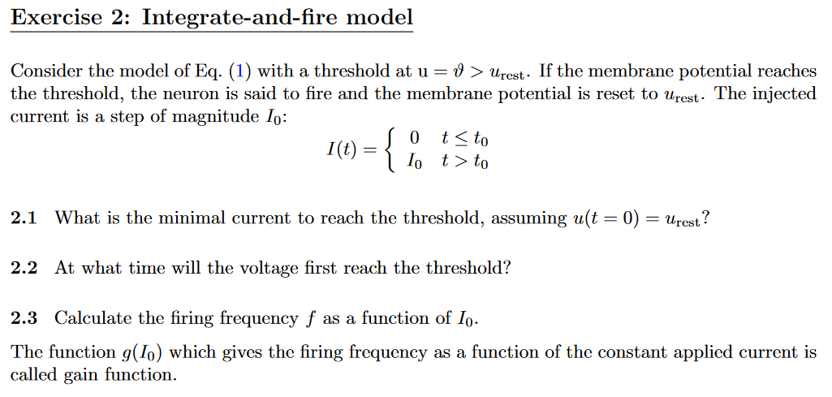

Slide 53
Summary of Section 1.3.
The leaky integrate-and-fire neuron model is the combination of a passive membrane (linear differential equation) with a threshold. The moment when the potential hits the threshold defines the firing time of a spike. Immediately after firing the voltage is reset to a lower value (not necessarily to the resting potential).
For the leaky integrate-and-fire model, the gain function (frequency of firing for constant input, as a function of input strength) can be calculated analytically. The firing frequency decreases with decreasing input. If the constant input is below a critical value no firing can occur. This value defines the rheobase current threshold.
For the leaky integrate-and-fire model the rheobase current threshold can be predicted from the voltage threshold and the model parameters R and C.
.

Slide 54
Biological Modeling of Neural Networks
Week 1 – part 4: Generalized Integrate-and-Fire Model
1.1 Neurons and Synapses:
Overview
1.2 The Passive Membrane
- Linear circuit
- Dirac delta-function
1.3 Leaky Integrate-and-Fire Model
1.4 Generalized Integrate-and-Fire
Model
1.5. Quality of Integrate-and-Fire
Models
Week 1 – neurons and mathematics:
a first simple neuron model
Wulfram Gerstner
EPFL, Lausanne, Switzerland

Slide 55
Neuronal Dynamics – 1.4. Generalized Integrate-and Fire
Spike emission
reset
Integrate-and-fire model
LIF: linear + threshold
Notes:
In the previous lecture, we have see the leaky integrate-and-fire model: The responses to incoming spikes are summed LINEARLY, until a threshold is reached.
Let us now look again at the leaky IF, but from a slighlty different perspective

Slide 56
Neuronal Dynamics – 1.4. Leaky Integrate-and Fire revisited
I=0
I>0
LIF
If firing:
u
resting
repetitive
u
u
t
t
Notes:
The LIF is characterized by a linear differential equation.

Slide 58
Neuronal Dynamics – 1.4. Nonlinear Integrate-and Fire
LIF
NLIF
If firing:

Slide 59
Neuronal Dynamics – 1.4. Nonlinear Integrate-and Fire
Nonlinear
Integrate-and-Fire
I=0
I>0
NLIF
u
u
firing:

Slide 60
Nonlinear Integrate-and-fire Model
Spike emission
j
i
F
reset
I
NONlinear
Fire+reset
threshold

Slide 61
Nonlinear Integrate-and-fire Model
I=0
I>0
u
u
Quadratic I&F:
NONlinear
Fire+reset
threshold

Slide 63
Nonlinear Integrate-and-fire Model
I=0
I>0
u
u
Quadratic I&F:
exponential I&F:
Fire+reset

Slide 64
Nonlinear Integrate-and-fire Model
I=0
u
exponential I&F:
NONlinear
Fire+reset
threshold

Slide 65
Nonlinear Integrate-and-fire Model
Where is the firing threshold?
I=0
I>0
u
u
resting
u
t
t

Slide 66
Summary of Section 1.4.
Nonlinear integrate-and-fire models with a nonlinear function f(u) of the voltage u are excellent models of spiking behavior. The exponential integrate-and-fire (EIF) model is linear for low voltage, but combines it with an exponential nonlinearity for large voltages. The quadratic integrate-and-fire (QIF) is symmetric for low and large voltages. The LIF has a linear function $f\left(u\right)=u−u_{rest}$ . All generalized integrate-and-fire models have a voltage reset after a spike. For constant input, the zero-crossings of the function f(u) define stationary states.
We distinguish two important stimulation paradigms: (i) stimulation with short current pulses (Dirac delta pulses) – such pulses correspond to an initial condition on the voltage axis; (ii) stimulation with constant current – such stimuli correspond to a vertical shift of the function f(u). We find in both EIF and QIF that the minimal current for spike initiation depends on the stimulation protocol.

Slide 67
Biological Modeling of Neural Networks
Week 1 – part 5: How good are Integrate-and-Fire Model?
1.1 Neurons and Synapses:
Overview
1.2 The Passive Membrane
- Linear circuit
- Dirac delta-function
1.3 Leaky Integrate-and-Fire Model
1.4 Generalized Integrate-and-Fire
Model
- where is the firing threshold?
1.5. Quality of Integrate-and-Fire
Models
- Neuron models and experiments
Week 1 – neurons and mathematics:
a first simple neuron model
Wulfram Gerstner
EPFL, Lausanne, Switzerland

Slide 68
Neuronal Dynamics – 1.5.How good are integrate-and-fire models?
Can we compare neuron models
with experimental data?

Slide 69
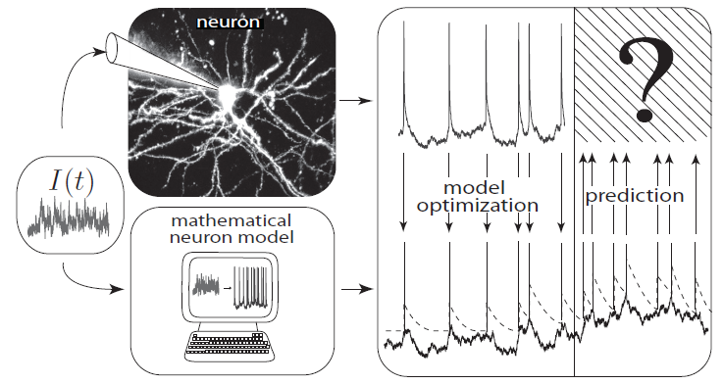
Neuronal Dynamics – 1.5.How good are integrate-and-fire models?
What is a good neuron model?
Can we compare neuron models
with experimental data?
Notes:
What is a good neuron model? Would the nonlinear integrate-and-fire model be good?

Slide 70
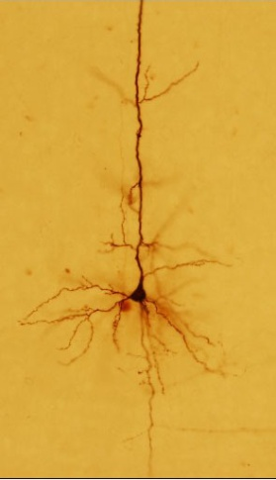
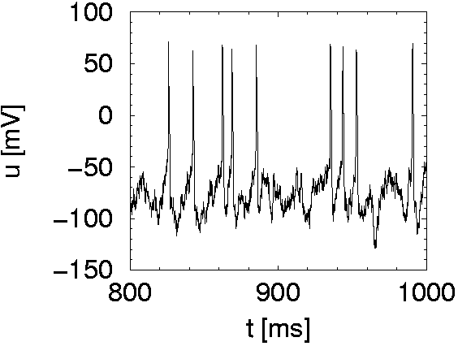
Neuronal Dynamics – 1.5.How good are integrate-and-fire models?
I(t)
Spike
Integrate-and-fire model

Slide 71
Nonlinear Integrate-and-fire Model
I=0
Can we measure
the function F(u)?
u
Quadratic I&F:
exponential I&F:
Fire+reset

Slide 72
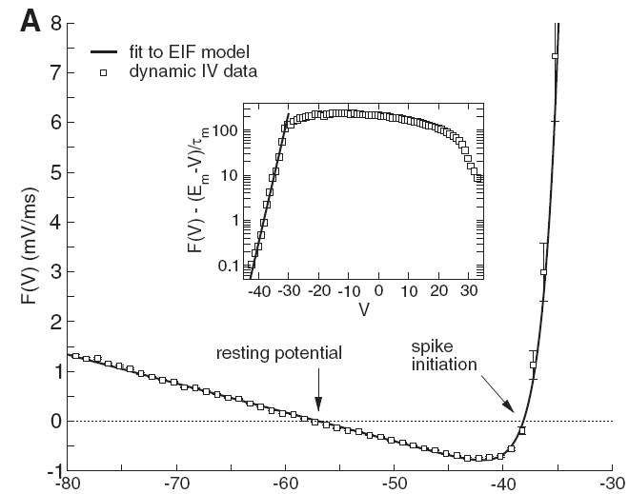
Neuronal Dynamics – 1.5.How good are integrate-and-fire models?
voltage
I(t)
u [mV]
Badel et al., J. Neurophysiology 2008
Notes:
What is a good neuron model? Would the nonlinear integrate-and-fire model be good?

Slide 73
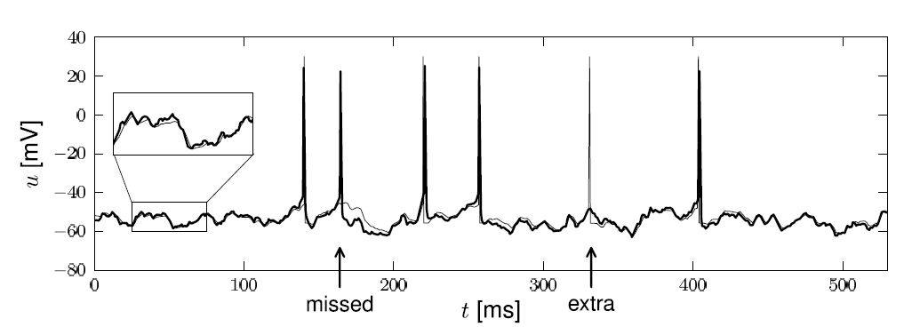
Neuronal Dynamics – 1.5.How good are integrate-and-fire models?
Notes:
What is a good neuron model? Would the nonlinear integrate-and-fire model be good?

Slide 74
Neuronal Dynamics – 1.5.How good are integrate-and-fire models?
Nonlinear integrate-and-fire models
are good
Mathematical description → prediction
Need to add
- adaptation
- noise
- dendrites/synapses
Computer exercises:
Python
Notes:
What is a good neuron model? Would the nonlinear integrate-and-fire model be good?

Slide 75
Biological Modeling of Neural Networks
http://neuronaldynamics.epfl.ch/
Textbook:
Lecture today:
Chapter 1
Chapter 5
Exercises today:
-Install PYTHON for Computer Exercises
-Exercise 3, on sheet
Videos (for today: ‘week 1’):

Slide 76
Biological Modeling of Neural Networks – week1/Exercise 3
I=0
Homework!
u

Slide 77
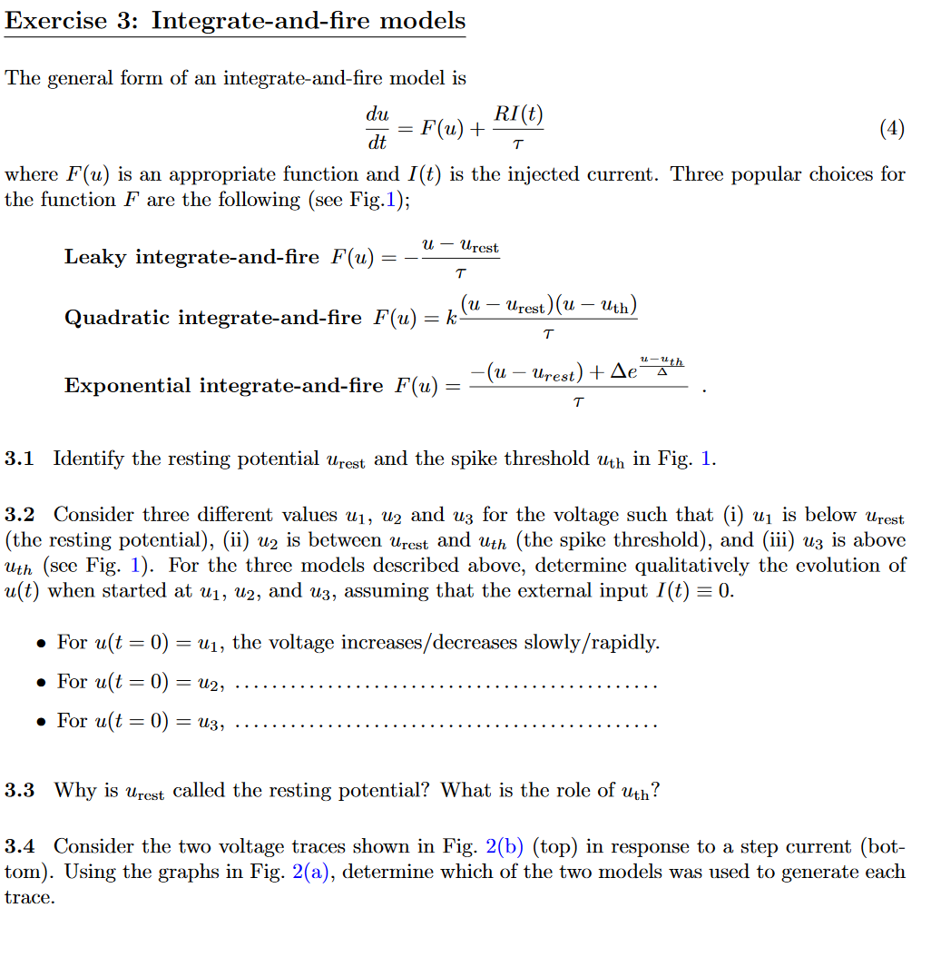
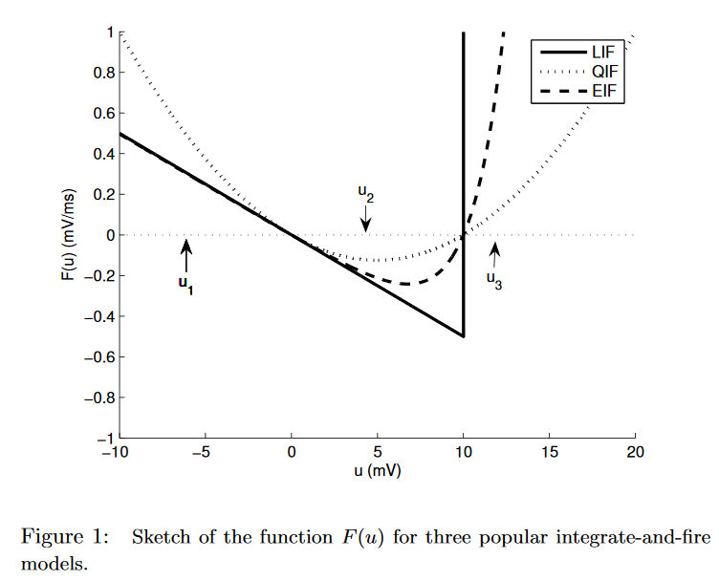
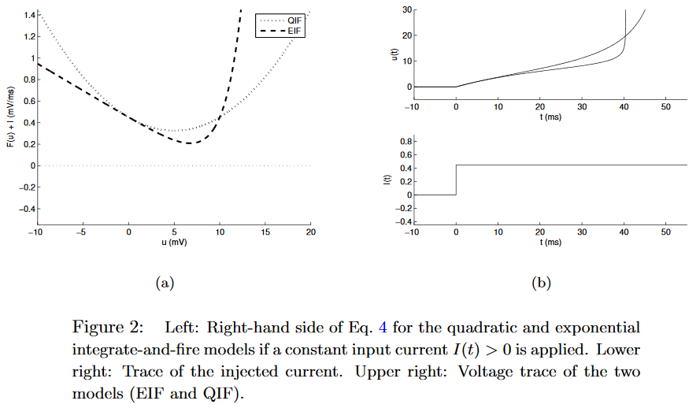

Slide 78
Summary of Section 1.5.
The exponential integrate-and-fire (EIF) model is an excellent model of spike initiation in neurons. [ - And better than the QIF which is ‘too symmetric’].
The quality of a neuron model can be measured by predicting spikes for new input that was used to optimize the model parameters. Further improvements of generalized integrate-and-fire models are possible and involve (i) noise in the spike generation process and (ii) adaptation.

Slide 79
First week – References and Suggested Reading
Reading: W. Gerstner, W.M. Kistler, R. Naud and L. Paninski,
Neuronal Dynamics: from single neurons to networks and
models of cognition. Chapter 1: Introduction. Cambridge Univ. Press, 2014
Selected references to linear and nonlinear integrate-and-fire models
- Lapicque, L. (1907). Recherches quantitatives sur l'excitation electrique des nerfs traitee comme une polarization. J. Physiol. Pathol. Gen., 9:620-635.
Stein, R. B. (1965). A theoretical analysis of neuronal variability. Biophys. J., 5:173-194.
-Ermentrout, G. B. (1996). Type I membranes, phase resetting curves, and synchrony.
Neural Computation, 8(5):979-1001.
Fourcaud-Trocme, N., Hansel, D., van Vreeswijk, C., and Brunel, N. (2003). How spike generation mechanisms determine the neuronal response to fluctuating input.
J. Neuroscience, 23:11628-11640.
Badel, L., Lefort, S., Berger, T., Petersen, C., Gerstner, W., and Richardson, M. (2008). Biological Cybernetics, 99(4-5):361-370.
- Latham, P. E., Richmond, B., Nelson, P., and Nirenberg, S. (2000). Intrinsic dynamics in neuronal networks. I. Theory. J. Neurophysiology, 83:808-827.

Slide 80
First week
THE END (of main lecture)
MATH DETOUR SLIDES
(for online VIDEO)

Slide 81
Neuronal Dynamics: Computational Neuroscience of Single Neurons
Week 1 – part 2: Detour/Linear differential equation
1.1 Neurons and Synapses:
Overview
1.2 The Passive Membrane
- Linear circuit
- Dirac delta-function
- Detour: solution of 1-dim linear
differential equation
1.3 Leaky Integrate-and-Fire Model
1.4 Generalized Integrate-and-Fire
Model
1.5. Quality of Integrate-and-Fire
Models
Week 1 – neurons and mathematics:
a first simple neuron model
Wulfram Gerstner
EPFL, Lausanne, Switzerland

Slide 82
Neuronal Dynamics – 1.2Detour – Linear Differential Eq.

Slide 83
Neuronal Dynamics – 1.2Detour – Linear Differential Eq.
Math development:
Response to step current
I(t)
u

Slide 84
Neuronal Dynamics – 1.2Detour – Step current input
I(t)
u

Slide 85
Neuronal Dynamics – 1.2Detour – Short pulse input
short pulse:
Math development:
Response to short
current pulse
I(t)
u

Slide 86
Neuronal Dynamics – 1.2Detour – Short pulse input
short pulse:
I(t)
u

Slide 87
Neuronal Dynamics – 1.2Detour – arbitrary input
Single pulse
Multiple pulses:
Impulse response function,
Green’s function

Slide 88
Neuronal Dynamics – 1.2Detour – Greens function
Single pulse
Multiple pulses:
Impulse response function,
Green’s function

Slide 89
Neuronal Dynamics – 1.2Detour – arbitrary input
If you don’t feel at ease yet,
spend 10 minutes on these
mathematical exercises
And quiz 2 in week 1.
Arbitrary input
Single pulse
you need to know the solutions
of linear differential equations!

