Slide 1
Biological Modeling of Neural Networks
Start at 9h15
Location: Room IN-M 200

Slide 2
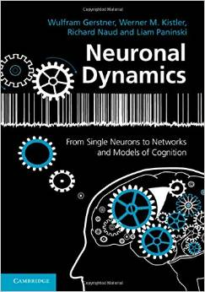
Biological Modeling of Neural Networks
2.1 Biophysics of neurons
- Overview
2.2 Reversal potential
  - Nernst equation
2.3 Hodgin-Huxley Model
2.4 Threshold in the
Hodgkin-Huxley Model
- where is the firing threshold?
2.5. Detailed biophysical models
- the zoo of ion channels
Week 2 – Biophysical modeling:
The Hodgkin-Huxley model
Wulfram Gerstner
EPFL, Lausanne, Switzerland
Reading for week 2:
NEURONAL DYNAMICS
- Ch. 2 (without 2.3.2 - 2.3.5)
Cambridge Univ. Press
Notes:
In 2015 and earlier years:
1st hour: The first quiz comes after less than 10 minutes (Cell membrane, ion channel etc)
The first exercises at 9:35 until 9:45. Then HH model until current conservation equation. Then break.
2nd lecture: gating variables; exercise 2 starts at 10:30
3rd lecture: exercise 3 from 11:33-11:48, finish at 12:00: In 2019 I lost time at the beginning of lecture 3 with threshold and refractoriness and then the timing did not work out.
(Detailed multi-compartment biophysical models shifted to later session/Toledo-Rodrigues slides also shifted to later session)
Exceptionally for 2016 and 2020: I moved all exercises to the second hour 10:15-11:00 because I had to attend a lecture. This worked as well. (Old location of exercises as hidden slides!)

Slide 3
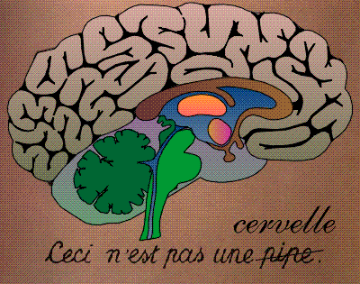
Review of week 1: Neurons and synapses
motor
cortex
frontal
cortex
visual
cortex
to motor
output

Slide 4
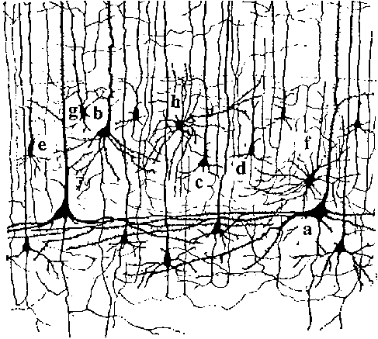
Review of week 1: Neurons and synapses
motor
cortex
10 000 neurons
3 km of wire
1mm
frontal
cortex
to motor
output

Slide 5
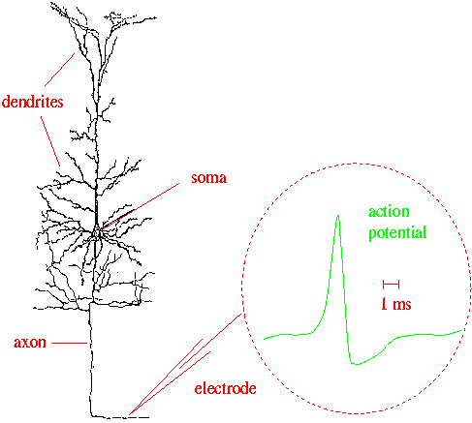
Review of week 1: Neurons and synapses
Signal:
action potential (spike)
10 000 neurons
3 km of wire
1mm
action
potential
How is a spike generated?
Ramon y Cajal

Slide 6
Review of week 1: Integrate-and-Fire models
Spike emission
synapse
t
Postsynaptic
potential
-spikes are events
-triggered at threshold
-spike/reset/refractoriness

Slide 7
Neuronal Dynamics – week 2: Biophysics of neurons
Cell surrounded by membrane
Membrane contains
- ion channels
- ion pumps
Signal:
action potential (spike)
-70mV
Na⁺
action
potential
K⁺
Ca²⁺
Ions/proteins

Slide 8
Neuronal Dynamics – week 2: Biophysics of neurons
Cell surrounded by membrane
Membrane contains
- ion channels
- ion pumps
Resting potential -70mV
→ how does it arise?
-70mV
Ions flow through channel
→ in which direction?
Na⁺
Neuron emits action potentials
→ why?
K⁺
Ca²⁺
Ions/proteins

Slide 9
Neuronal Dynamics – 2. 1. Biophysics of neurons
Resting potential -70mV
→ how does it arise?
Ions flow through channel
→ in which direction?
Neuron emits action potentials
→ why?
Hodgkin-Huxley model
Hodgkin&Huxley (1952)
Nobel Prize 1963

Slide 10
Neuronal Dynamics – 2. 1. Biophysics of neurons
Hodgkin-Huxley model
Hodgkin&Huxley (1952)
Nobel Prize 1963

Slide 11
Week 2 – Quiz
In a natural situation, the electrical potential inside a neuron is
[ ] the same as outside
[ ] is different by 50-100 microvolt
[ ] is different by 50-100 millivolt
Neurons and cells
[ ] Neurons are special cells because they are surrounded by a membrane
[ ] Neurons are just like other cells surrounded by a membrane
[ ] Neurons are not cells
Ion channels are
[ ] located in the cell membrane
[ ] special proteins
[ ] can switch from open to closed
If a channel is open, ions can
[ ] flow from the surround into the cell
[ ] flow from inside the cell into the
surrounding liquid
Multiple answers possible!

Slide 12
Biological Modeling of Neural Networks
Week 2 – part 2: Reversal potential and Nernst equation
2.1 Biophysics of neurons
- Overview
2.2 Reversal potential
  - Nernst equation
2.3 Hodgin-Huxley Model
2.4 Threshold in the
Hodgkin-Huxley Model
- where is the firing threshold?
2.5. Detailed biophysical models
- the zoo of ion channels
Week 2 – Biophysical modeling:
The Hodgkin-Huxley model
Wulfram Gerstner
EPFL, Lausanne, Switzerland

Slide 13
Neuronal Dynamics – 2.2. Resting potential
Cell surrounded by membrane
Membrane contains
- ion channels
- ion pumps
Resting potential -70mV
→ how does it arise?
-70mV
Ions flow through channel
→ in which direction?
Na⁺
Neuron emits action potentials
→ why?
K⁺
Ca²⁺
Ions/proteins

Slide 14
Neuronal Dynamics – 2. 2. Resting potential
Resting potential -70mV
→ how does it arise?
Ions flow through channel
→ in which direction?
Neuron emits action potentials
→ why?
Hodgkin-Huxley model
Hodgkin&Huxley (1952)
Nobel Prize 1963

Slide 15
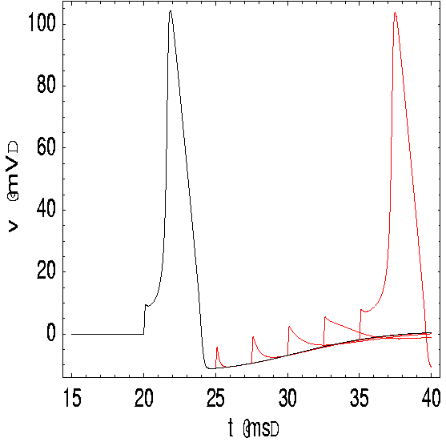
Neuronal Dynamics – 2. 2. Reversal potential
inside
100
Ka
K
density
mV
Na
outside
Ion channels
Ion pump
0
Ion pump ⬄ Concentration difference
E
Mathetical derivation

Slide 16
Neuronal Dynamics – 2. 2. Nernst equation
inside
100
K
Ka
mV
Na
outside
0
Ion channels
Ion pump

Slide 17
Neuronal Dynamics – 2. 2. Nernst equation
inside
100
Ka
K
mV
Na
outside
0
Ion channels
Ion pump
Reversal potential
Concentration difference ⬄ voltage difference

Slide 18
Exercise 1.1 Reversal potential of ion channels
Calculate the reversal potential
for Sodium
Postassium
Calcium
given the concentrations
What happens if you change
the temperature T from 37
to 18.5 degree?
Reversal potential
Start exercise at 9:35
Next Lecture 9:45

Slide 19
Neuronal Dynamics – 2. 2. Reversal potential
inside
Ka
K
Na
outside
Ion channels
Ion pump
Ion pump → Concentration difference
Concentration difference ⬄ voltage difference
Reversal potential
Nernst equation

Slide 20
Neuronal Dynamics:
Computational Neuroscience of Single Neurons
Week 2 – part 3 : Hodgkin-Huxley Model
2.1 Biophysics of neurons
- Overview
2.2 Reversal potential
  - Nernst equation
2.3 Hodgkin-Huxley Model
2.4 Threshold in the
Hodgkin-Huxley Model
- where is the firing threshold?
2.5. Detailed biophysical models
- the zoo of ion channels
Week 2 – Biophysical modeling:
The Hodgkin-Huxley model
Wulfram Gerstner
EPFL, Lausanne, Switzerland

Slide 21
Neuronal Dynamics – 2. 3. Hodgkin-Huxley Model
giant axon
of squid
Hodgkin-Huxley model
Hodgkin&Huxley (1952)
Nobel Prize 1963
Na⁺

Slide 22
Neuronal Dynamics – 2.3. Hodgkin-Huxley Model
Hodgkin and Huxley, 1952
inside
I
Ka
C
R_{K}
R_{Na}
R_{l}
Na
outside
Ion channels
Ion pump
Mathematical
derivation

Slide 23
Neuronal Dynamics – 2.3. Hodgkin-Huxley Model
I
C
R_{K}
R_{Na}
R_{l}

Slide 24
Neuronal Dynamics – 2.3. Hodgkin-Huxley Model
Hodgkin and Huxley, 1952
100
inside
I
Ka
C
mV
g_{K}
g_{l}
g_{Na}
Na
0
outside
Ion channels
Ion pump
stimulus
n₀(u)
u
u

Slide 25
Neuronal Dynamics – 2.3. Ion channel
r₀(u)
u
u

Slide 26
Exercise 1.1 Reversal potential of ion channels
Calculate the reversal potential
for Sodium
Postassium
Calcium
given the concentrations
What happens if you change
the temperature T from 37
to 18.5 degree?
Reversal potential

Slide 27
Exercise 2 and 1.2 NOW!! - Ion channel
r₀(u)
Exercises
1+2 NOW!
If finished, start
Exercise 3.
Next lecture
At 11:15
u
u
Exercises
2 NOW!
If finished, start
Exercise 3.
Next lecture
At 10:52

Slide 28
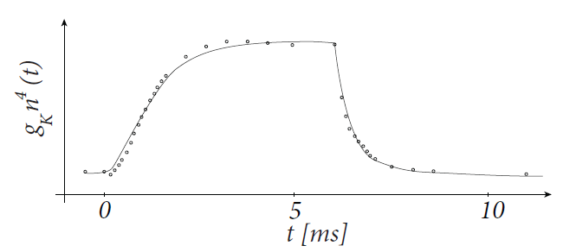
Exercise 3.1-3.3 – Hodgkin-Huxley – ion channel dynamics
voltage step
u2
Determine ion channel dynamics
u
inside
Ka
Na
Ion channels
Ion pump
outside
I
C
g_{K}
stimulus
apply voltage step
n₀(u)
Start Exercise 3 at 11:33
Next Lecture at:
11.52
u
u
adapted from
Hodgkin&Huxley 1952

Slide 29
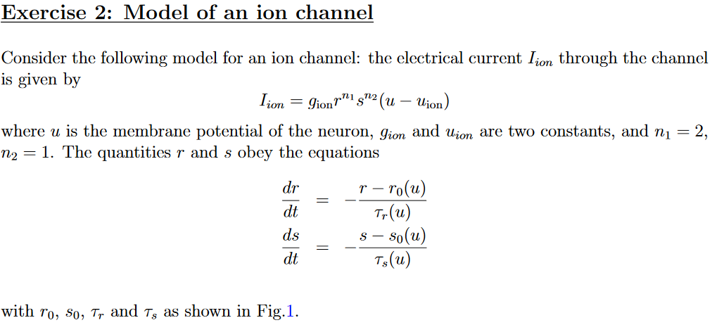
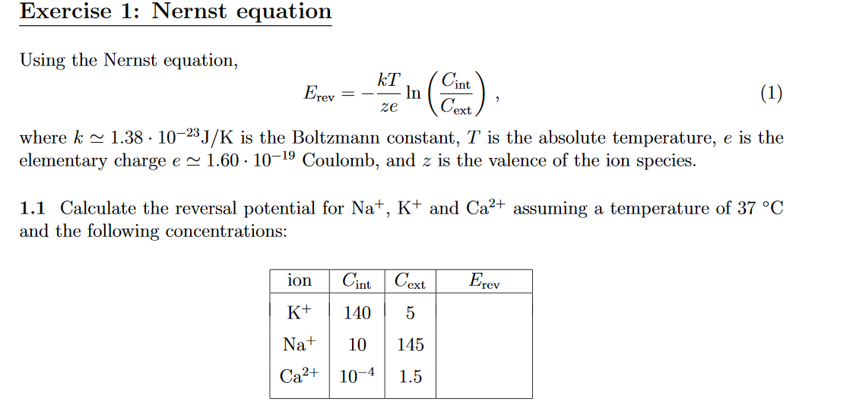
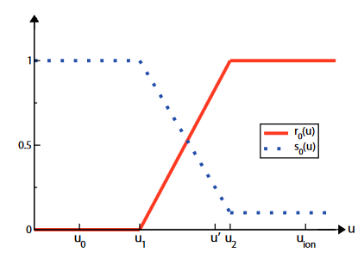
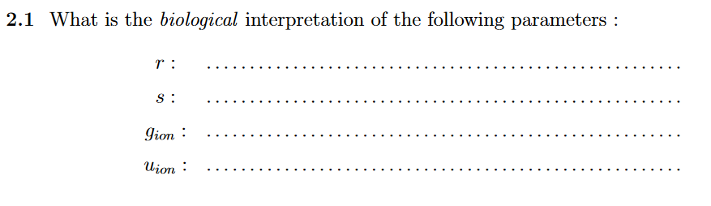
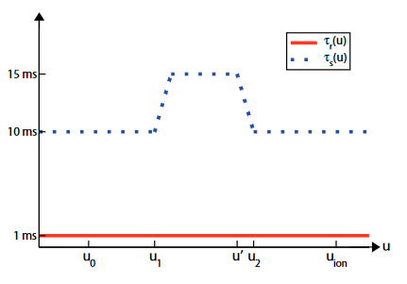
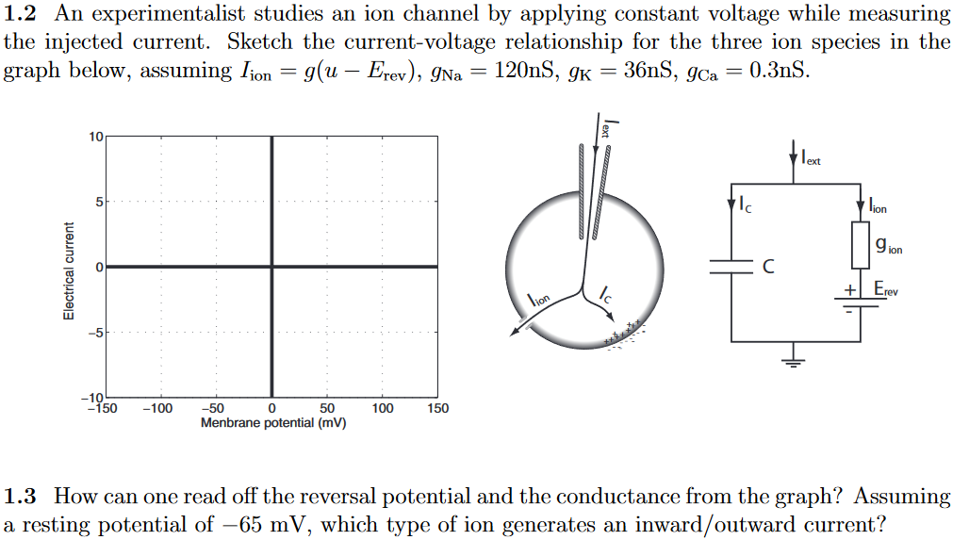
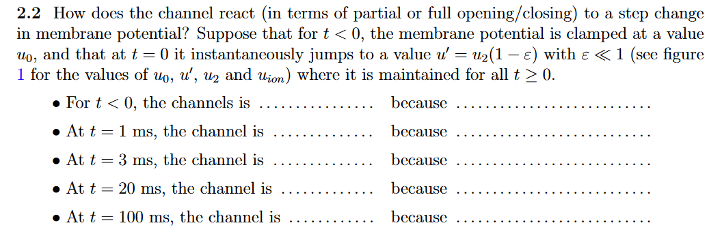
Exercises 1 -3.3 NOW! NEXT
lecture at 11:15

Slide 30
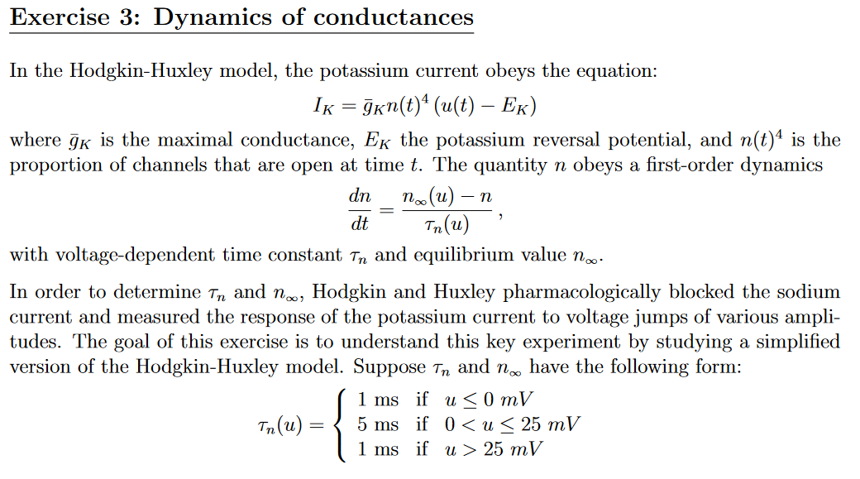
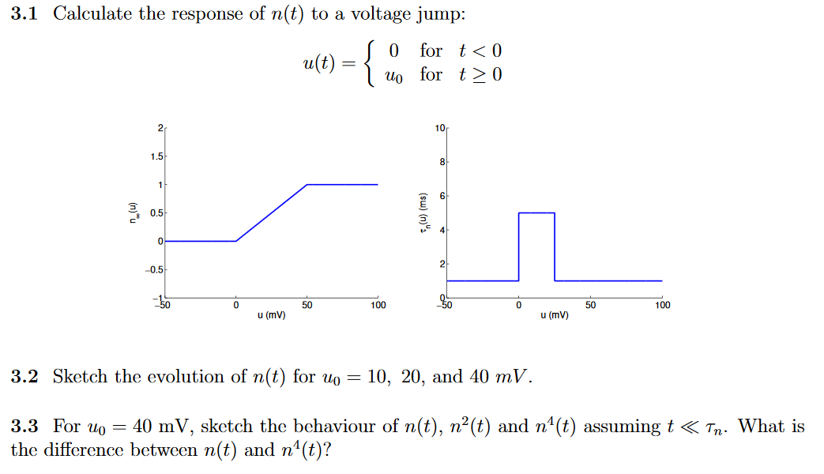
Exercises 1 -3.3 NOW! NEXT
lecture at 11:15

Slide 31
Biological Modeling of Neural Networks
Week 2 – part 4: Threshold in the Hodgkin-Huxley Model
2.1 Biophysics of neurons
- Overview
2.2 Reversal potential
  - Nernst equation
2.3 Hodgin-Huxley Model
2.4 Threshold in the
Hodgkin-Huxley Model
- where is the firing threshold?
2.5. Detailed biophysical models
- the zoo of ion channels
Week 2 – Biophysical modeling:
The Hodgkin-Huxley model
Wulfram Gerstner
EPFL, Lausanne, Switzerland

Slide 32
Neuronal Dynamics – 2.4. Threshold in HH model
inside
Ka
Na
outside
Ion channels
Ion pump

Slide 33
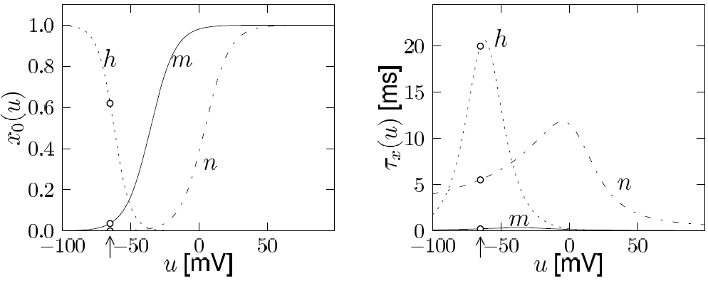
Neuronal Dynamics – 2.4. Threshold in HH model
inside
I
Ka
C
g_{K}
g_{Na}
g_{l}
Na
outside
Ion channels
Ion pump
Where is the threshold for firing?
m₀(u)
h₀(u)
u
u

Slide 34
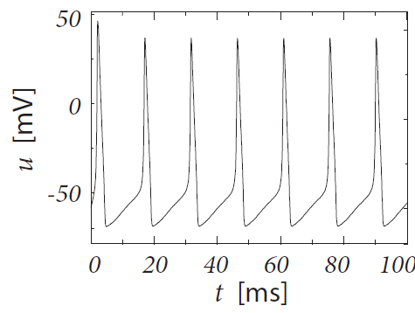
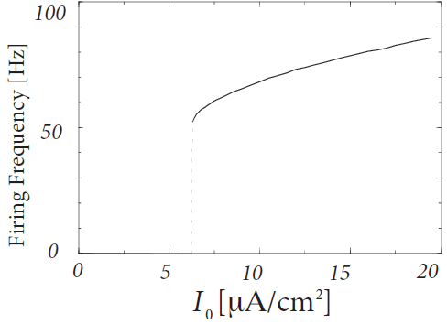
Neuronal Dynamics – 2.4. Threshold in HH model
Constant current input
I0
I
C
g_{K}
g_{Na}
g_{l}
Threshold?
for repetitive firing
(current threshold)

Slide 35
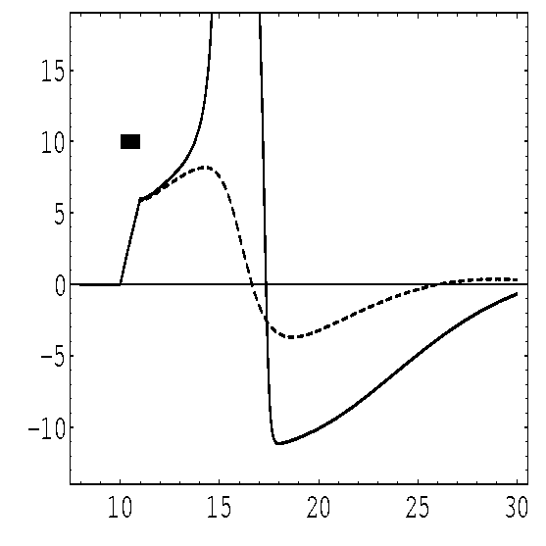
Neuronal Dynamics – 2.4. Threshold in HH model
pulse input
inside
I(t)
Ka
Na
outside
Ion channels
Ion pump
Threshold?
- AP if amplitude 7.0 units
- No AP if amplitude 6.9 units
(pulse with 1ms duration)
(and pulse with 0.5 ms duration?)

Slide 36
Neuronal Dynamics – 2.4. Threshold in HH model
pulse input
I(t)
m₀(u)
h₀(u)
u
u
Mathematical explanation
Stim.

Slide 37
Neuronal Dynamics – 2.4. Threshold in HH model
pulse input
I(t)
m₀(u)
h₀(u)
u
u
Stim.
Why start the explanation
with m and not h?
What about n?
Where is the threshold?

Slide 38
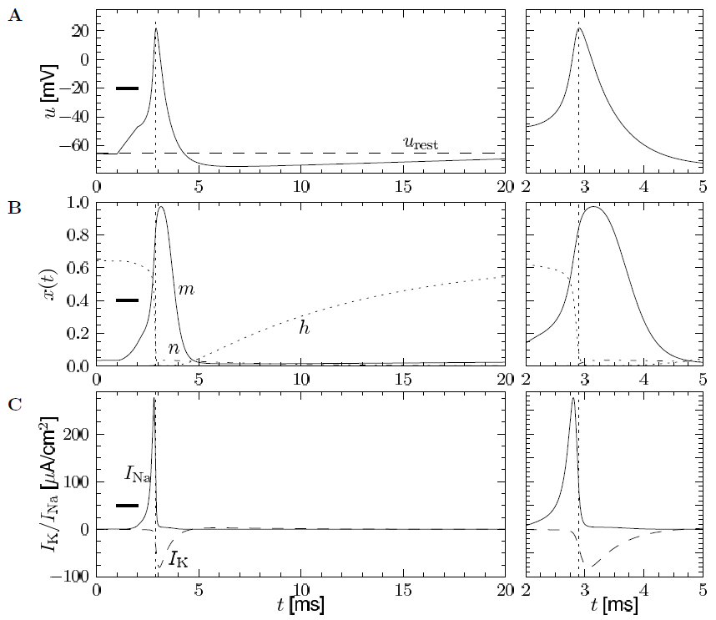
Neuronal Dynamics – 2.4. Threshold in HH model

Slide 39
Neuronal Dynamics – 2.4. Threshold in HH model
First conclusion:
There is no strict threshold:
Coupled differential equations
‘Effective’ threshold
in simulations?

Slide 40
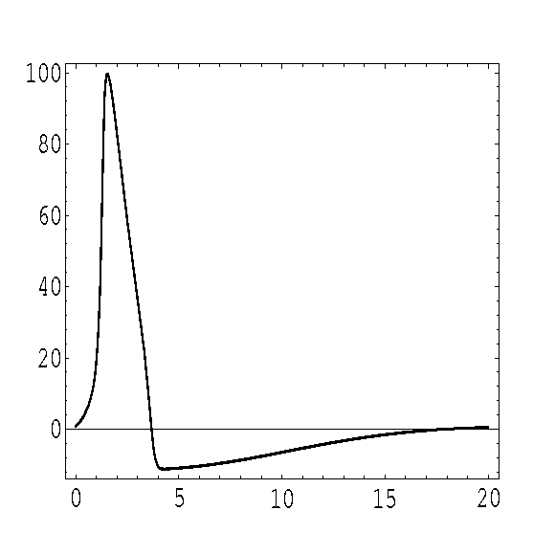
Neuronal Dynamics – 2.4. Refractoriness in HH model
Where is the firing threshold?
Action potential
refractoriness
100
100
mV
mV
0
0
0
ms
20
strong
stimuli
Strong
stimulus
Strong
stimulus
Refractoriness! Harder to elicit a second spike

Slide 41
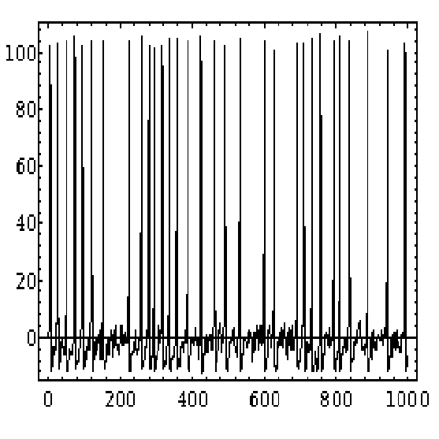
Neuronal Dynamics – 2.4. Simulations of the HH model
100
mV
Stimulation with
time-dependent
input current
0
I(t)

Slide 42
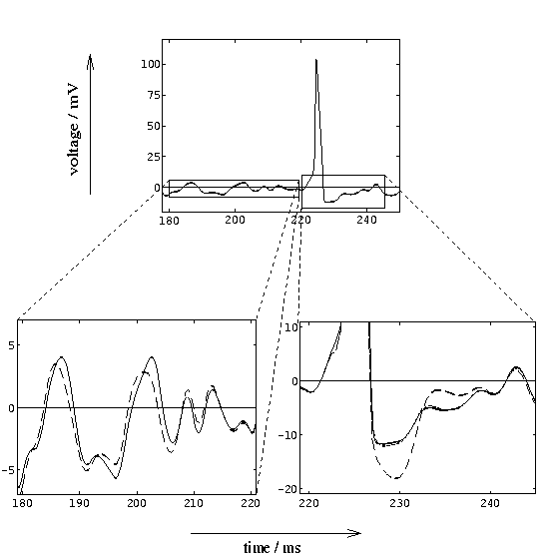
Neuronal Dynamics – 2.4. Simulations of the HH model
100
100
mV
mV
0
0
mV
5
I(t)
Subthreshold
response
0
Spike
-5

Slide 43
Neuronal Dynamics – 2.4. Threshold in HH model
I2
Step current input
I

Slide 44
Neuronal Dynamics – 2.4. Threshold in HH model
Where is the firing threshold?
I(t)
There is no threshold
- no current threshold
- no voltage threshold
pulse input
I2
step input
I
‘effective’ threshold
- depends on typical input
ramp input

Slide 45
Neuronal Dynamics – 2.4. Type I and Type II
Hodgkin-Huxley model
with other parameters
(e.g. for cortical pyramidal
Neuron )
Hodgkin-Huxley model
with standard parameters
(giant axon of squid)
Response at firing threshold?
Type I type II
ramp input/
constant input
f-I curve
f-I curve
f
f
I0
I0
I0

Slide 46
Neuronal Dynamics – 2.4. Hodgkin-Huxley model
4 differential equations
no explicit threshold
effective threshold depends
on stimulus
BUT: voltage threshold good
approximation
Giant axon of the squid
→ cortical neurons
Change of parameters
More ion channels
Same framework

Slide 47
Exercise 3.1-3.3 – Hodgkin-Huxley – ion channel dynamics
voltage step
u2
Determine ion channel dynamics
u
inside
Ka
Na
Ion channels
Ion pump
outside
I
C
g_{K}
stimulus
apply voltage step
n₀(u)
Start Exercise 3 at 11:33
Next Lecture at:
11.52
u
u
adapted from
Hodgkin&Huxley 1952

Slide 48
Biological Modeling of Neural Networks
Week 2 – part 5: Detailed Biophysical Models
2.1 Biophysics of neurons
- Overview
2.2 Reversal potential
  - Nernst equation
2.3 Hodgkin-Huxley Model
2.4 Threshold in the
Hodgkin-Huxley Model
- where is the firing threshold?
2.5. Detailed biophysical models
- the zoo of ion channels
Week 2 – Biophysical modeling:
The Hodgkin-Huxley model
Wulfram Gerstner
EPFL, Lausanne, Switzerland

Slide 49
Neuronal Dynamics – 2.5 Biophysical models
inside
Ka
There are about 200
identified ion channels
Na
outside
Ion channels
Ion pump
http://channelpedia.epfl.ch/
Hodgkin-Huxley model
Provides flexible framework
α
β

Slide 50
Neuronal Dynamics – 2.5 Biophysical models
inside
Ka
Individual ion channels
can be measured.
Opening and closing is
stochastic
Na
outside
Ion channels
Ion pump
α
β

Slide 51
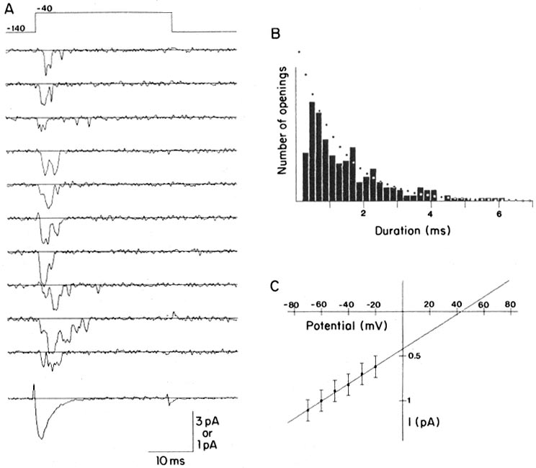
Neuronal Dynamics – 2.5 Ion channels
Na⁺
K⁺
Steps:
Different number
of channels
Ca²⁺
Ions/proteins
Na+ channel from rat heart (Patlak and Ortiz 1985)
A traces from a patch containing several channels.
Bottom: average gives current time course.
B. Opening times of single channel events

Slide 52
Neuronal Dynamics – 2.5 Biophysical models
inside
Ka
Na
Hodgkin-Huxley:
Cambridge lab
Plymouth lab
outside
Ion channels
Ion pump
β
Hodgkin-Huxley model
provides flexible framework
Hodgkin&Huxley (1952)
Nobel Prize 1963
Notes:
They deserved their nobel prize!
Still in use today, over 50 years later, the basis of many big simulation projects,

Slide 53
Exercise 4 – Hodgkin-Huxley model – gating dynamics
A) Often the gating dynamics is formulated as
Calculate
B) Assume a form
How are a and b related to and in the equations
C ) What is the time constant ?

Slide 54
Now Computer Exercises:
Play with Hodgkin-Huxley model
The End

Slide 55
Week 2 – References and Suggested Reading
Reading: W. Gerstner, W.M. Kistler, R. Naud and L. Paninski,
Neuronal Dynamics: from single neurons to networks and
models of cognition. Chapter 2: The Hodgkin-Huxley Model, Cambridge Univ. Press, 2014
- Hodgkin, A. L. and Huxley, A. F. (1952). A quantitative description of membrane current and its application to conduction and excitation in nerve. J Physiol, 117(4):500-544.
Ranjan, R.,et al. (2011). Channelpedia: an integrative and interactive database for ion channels. Front Neuroinform, 5:36.
Toledo-Rodriguez, M., Blumenfeld, B., Wu, C., Luo, J., Attali, B., Goodman, P., and Markram, H. (2004). Correlation maps allow neuronal electrical properties to be predicted from single-cell gene expression profiles in rat neocortex. Cerebral Cortex, 14:1310-1327.
Yamada, W. M., Koch, C., and Adams, P. R. (1989). Multiple channels and calcium dynamics. In Koch, C. and Segev, I., editors, Methods in neuronal modeling, MIT Press.
- Aracri, P., et al. (2006). Layer-specic properties of the persistent sodium current in sensorimotor cortex. Journal of Neurophysiol., 95(6):3460-3468.

