Slide 1
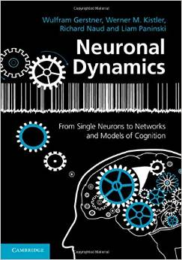
Biological Modeling of Neural Networks
3.1 From Hodgkin-Huxley to 2D
- Overview: From 4 to 2 dimensions
- MathDetour 1: Exploiting similarities
- MathDetour 2: Separation of time scales
3.2 Phase Plane Analysis
  - Role of nullclines
3.3 Analysis of a 2D Neuron Model
- constant input vs pulse input
- MathDetour 3: Stability of fixed points
3.4 TypeI and II Neuron Models
next week!
Week 3 – Reducing detail:
Two-dimensional neuron models
Wulfram Gerstner
EPFL, Lausanne, Switzerland
Reading for week 3:
NEURONAL DYNAMICS
- Ch. 4.1- 4.3
Cambridge Univ. Press
Notes:
In 2017 and 2018: back to version with integrated exercises. First one was targeted to start at 9:50 (but in practice we started ex 1 at 10:15, also in 2018); Exercise 2 was moved to the end. Worked out fine (finished at 11:45)
In 2016: Exercises 1.1-1.5 and Exercise 2.1 from 10:15-11:00 (this was also a nice way to do it, I could try this again!)
1st lecture: Quiz on number of variables after a few minutes. Lecture on exploiting the similarity of h and n.
In 2015 First Exercise at 9:50 (separation of time scales) as slide 20.
Second Lecture: Discussion and extension of exercise 1. Then nullclines and flow. Finish with Quiz3.3
Third Lecture: 15 minutes lectures with slides, then exercise stability. Then continue with slides.

Slide 2
3.1. Review of week 2 :Hodgkin-Huxley Model
cortical neuron
Hodgkin-Huxley model
→Compartmental models

Slide 3
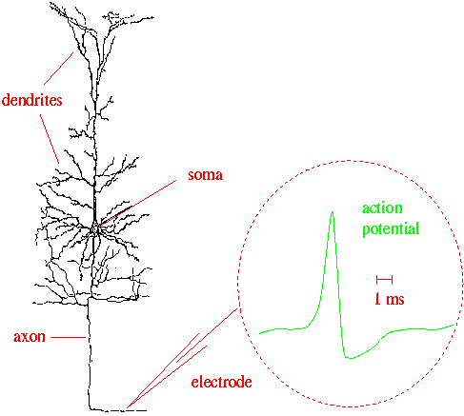
3.1 Review of week 2 : Hodgkin-Huxley Model
Week 2:
Cell membrane contains
- ion channels
- ion pumpsa
Dendrites (week x:video):
Active processes?
assumption:
passive dendrite
→ point neuron
spike generation
-70mV
Na⁺
action
potential
K⁺
Ca²⁺
Ions/proteins

Slide 4
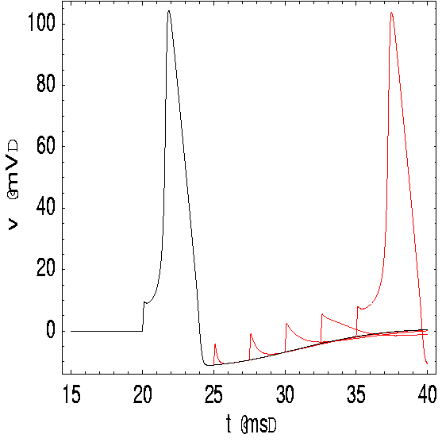
3.1. Review of week 2 :Hodgkin-Huxley Model
inside
100
Ka
K
mV
Na
outside
0
Ion channels
Ion pump
Reversal potential
ion pumps →concentration difference ⬄ voltage difference

Slide 5
3.1. Review of week 2: Hodgkin-Huxley Model
Hodgkin and Huxley, 1952
inside
100
I
Ka
C
mV
g_{K}
g_{l}
g_{Na}
Na
outside
0
Ion channels
Ion pump
stimulus
4 equations
= 4D system
n₀(u)
u
u

Slide 6
Week 3 – 3.1. Overview and aims
Can we understand the dynamics of the HH model?
- mathematical principle of Action Potential generation?
- constant input current vs pulse input?
- Types of neuron model (type I and II)? (next week)
- threshold behavior? (next week)
→ Reduce from 4 to 2 equations
Type I and type II models
ramp input/
constant input
f-I curve
f-I curve
f
f
I0
I0
I0

Slide 7
Week 3 – 3.1. Overview and aims
Can we understand the dynamics of the HH model?
→ Reduce from 4 to 2 equations

Slide 8
Week 3 – Quiz 3.1.
A - A biophysical point neuron model
with 3 ion channels,
each with activation and inactivation,
has a total number of equations equal to
[ ] 3 or
[ ] 4 or
[ ] 6 or
[ ] 7 or
[ ] 8 or more

Slide 9
Week 3 – 3.1. Overview and aims
Toward a
two-dimensional neuron model
Reduction of Hodgkin-Huxley to 2 dimension
-step 1: separation of time scales
-step 2: exploit similarities/correlations

Slide 10
3.1. Reduction of Hodgkin-Huxley model
stimulus
m₀(u)
h₀(u)
u
u
Details later!
1) dynamics of m are fast

Slide 11
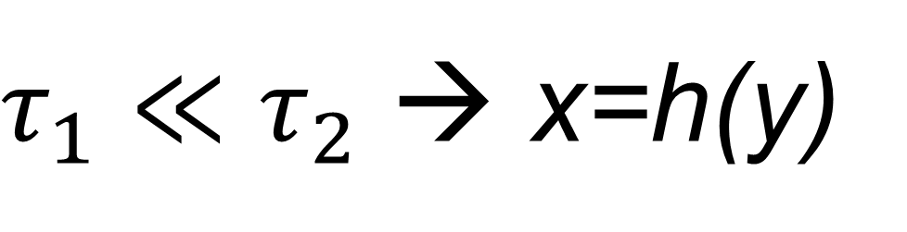
Reduction of dimensionality: Separation of time scales
Two coupled differential equations
Exercise 1 (week 3)
at beginning of lecture 2 !
Separation of time scales
$τ_{1}≪τ_{2}$ → x=h(y)
Reduced 1-dimensional system

Slide 12
3.1. Reduction of Hodgkin-Huxley model
stimulus
n₀(u)
h₀(u)
u
u
1) dynamics of m are fast
2) dynamics of h and n are similar

Slide 13
3.1. Reduction of Hodgkin-Huxley model
Reduction of Hodgkin-Huxley
Model to 2 Dimension
-step 1:
separation of time scales
-step 2:
exploit similarities/correlations
Now !

Slide 14
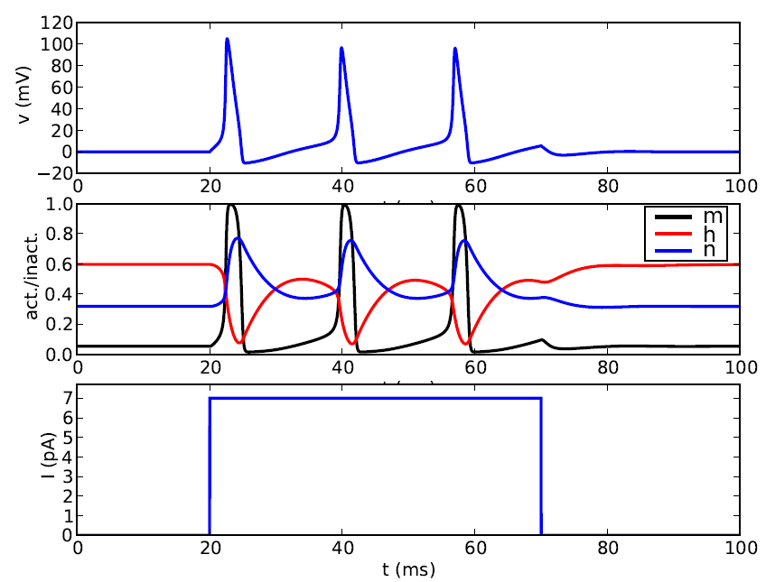
3.1. Reduction of Hodgkin-Huxley model
stimulus
2) dynamics of h and n are similar
Blackboard now
u
t
1
hrest
h(t)
nrest
n(t)
0
t

Slide 15
3.1 Detour 1. Exploit similarities/correlations
dynamics of h and n are similar
h
1-h
Math. Argument
(blackboard)
n
1
hrest
h(t)
nrest
n(t)
0
t

Slide 16
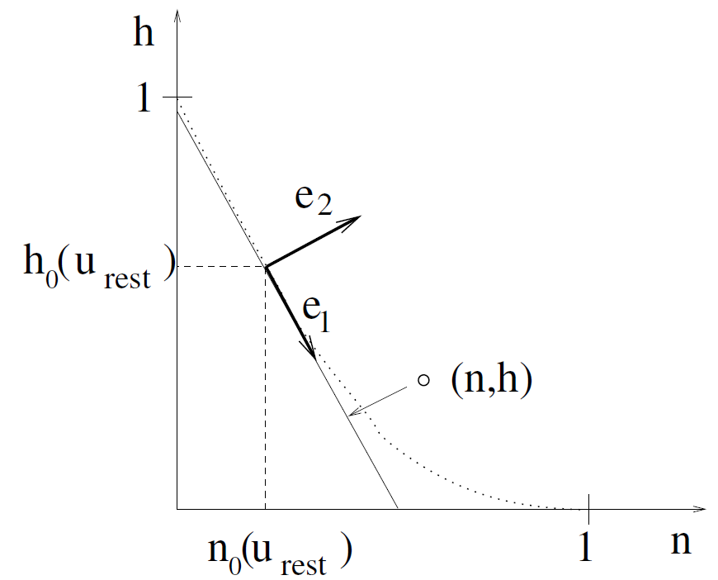
3.1 Detour 1. Exploit similarities/correlations
dynamics of h and n are similar
at rest
n
1
hrest
h(t)
nrest
n(t)
0
t

Slide 17
3.1 Detour 1. Exploit similarities/correlations
dynamics of h and n are similar
Rotate coordinate system
Suppress one coordinate
Express dynamics in new variable
n
1
hrest
h(t)
nrest
n(t)
0
t

Slide 18
3.1. Reduction of Hodgkin-Huxley model
1) dynamics of m are fast
2) dynamics of h and n are similar
w(t)
w(t)

Slide 19
3.1. Reduction of Hodgkin-Huxley model

Slide 20
3.1. Reduction to 2 dimensions
2-dimensional equation
Enables graphical analysis!
Phase plane analysis
-Discussion of threshold
- Constant input current vs pulse input
-Type I and II
- Repetitive firing

Slide 21
Week 3 – Quiz 3.2-similar dynamics
Exploiting similarities:
A sufficient condition to replace two gating variables r,s
by a single gating variable w is
[ ] Both r and s have the same time constant (as a function of u)
[ ] Both r and s have the same activation function
[ ] Both r and s have the same time constant (as a function of u)
AND the same activation function
[ ] Both r and s have the same time constant (as a function of u)
AND activation functions that are identical after some additive rescaling
[ ] Both r and s have the same time constant (as a function of u)
AND activation functions that are identical after some multiplicative
rescaling

Slide 22
NOW Exercise 1.1-1.5: separation of time scales
A:
- calculate x(t)!
- what if τ is small?
0
1
t
Exercises:
1.1-1.5 now!
1.6 homework
?
t
B: -calculate m(t)
if τ is small!
- reduce to 1 eq.
Exerc. 9h50-10h20
Next lecture:
10h20

Slide 23
Biological Modeling of Neural Networks
3.1 From Hodgkin-Huxley to 2D
- Overview: From 4 to 2 dimensions
- MathDetour 1: Exploiting similarities
- MathDetour 2: Separation of time scales
3.2 Phase Plane Analysis
  - Role of nullclines
3.3 Analysis of a 2D Neuron Model
- constant input vs pulse input
- MathDetour 3: Stability of fixed points
3.4 TypeI and II Neuron Models
next week!
Week 3 – Reducing detail:
Two-dimensional neuron models
Wulfram Gerstner
EPFL, Lausanne, Switzerland

Slide 24
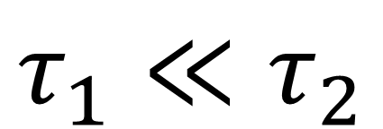
Discussion Exercise 1 – MathDetour 3.1: Separation of time scales
Exercise 1 (week 3)
Two coupled differential equations
Draw graph,
On blackboard
Ex. 1-A
step
c(t)
Separation of time scales
$$τ_{1}≪τ_{2}$$
Reduced 1-dimensional system

Slide 25
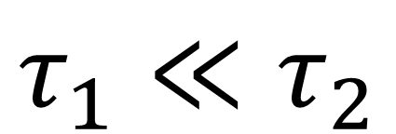
Discussion Exercise 1 – MathDetour 3.1 Separation of time scales
Two coupled differential equations
Draw graph,
On blackboard
a=0
a=1
a
x
$$τ_{1}≪τ_{2}$$
c
Two cases:
I

Slide 26
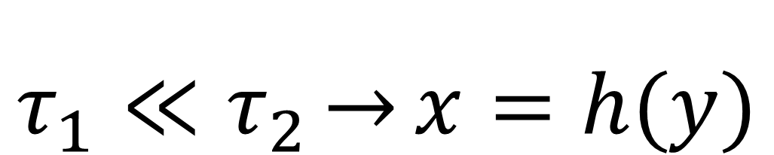
Discuss Exercise 1 – MathDetour 3.1: Separation of time scales
Two coupled differential equations
Exercise 1 (week 3)
even more general
Separation of time scales
$$τ_{1}≪τ_{2}\underset{→}{}x=h(y)$$
Reduced 1-dimensional system

Slide 27
Discuss exercise 1 – Reduction of Hodgkin-Huxley model
stimulus
n₀(u)
h₀(u)
u
u
dynamics of m is fast
Fast compared to what?

Slide 28
Neuronal Dynamics – Quiz 3.3.
A- Separation of time scales:
We start with two equations
[ ] If then the system can be reduded to
[ ] If then the system can be reduded to
[ ] None of the above is correct.
Pay attention to I(t):
We assume that I(t) is slow compared to both time constants.
Attention
If I(t) can move rapidly,
choice [1] is
not always correct
<<
<<

Slide 29
Week 3 – Summary 3.1
In order to reduce the HH model from 4 to 2 equations we have to simplify. We use two different mathematical methods.
Separation of time scale.
If the time scale of two variables is different by a factor 10 or a hundred, we can assume that the faster one of the two variables has already converged to its ‘momentary stable state’ on the slow time scale. Thus, we can remove the fast variable. We use the separation of time scale to remove the variable m.
Exploit similarities.
If two variables evolve on the same time scale, they have, if we are lucky, some similar temporal evolution. We can reduce the two variables to one dimension by turning the coordinate system such that the first dimension is the one where the two variables evolve ‘together’. The simplification consists in suppressing the second variable. This is similar to PCA where you would also only keep the first component. However, we need to do this such that also the DYNAMICS stays approximately correct, after reduction to 1 dimension.
We use this trick to compress h and n into a single variable w.

Slide 30
Biological Modeling of Neural Networks
3.1 From Hodgkin-Huxley to 2D
- Overview: From 4 to 2 dimensions
- MathDetour 1: Exploiting similarities
- MathDetour 2: Separation of time scales
3.2 Phase Plane Analysis
  - Role of nullclines
3.3 Analysis of a 2D Neuron Model
- constant input vs pulse input
- MathDetour 3: Stability of fixed points
3.4 TypeI and II Neuron Models
next week!
Week 3 – Reducing detail:
Two-dimensional neuron models
Wulfram Gerstner
EPFL, Lausanne, Switzerland

Slide 31
3.2. Reduced Hodgkin-Huxley model
stimulus

Slide 32
3.2. Phase Plane Analysis/nullclines
2-dimensional equation
stimulus
First step:
Enables graphical analysis!
u-nullcline:
all points with du/dt=0
-Discussion of threshold
-Type I and II
w-nullcline:
all points with dw/dt=0

Slide 33
3.2. FitzHugh-Nagumo Model
MathAnalysis,
blackboard
u-nullcline
w-nullcline
Notes:
We set b0=b1-2

Slide 34
3.2. flow arrows
Stimulus I=0
w
Consider change in small time step
u
Flow on nullcline
I(t)=0
Flow in regions between nullclines
Stable fixed point

Slide 35
Biological Modeling of Neural Networks
3.1 From Hodgkin-Huxley to 2D
- Overview: From 4 to 2 dimensions
- MathDetour 1: Exploiting similarities
- MathDetour 2: Separation of time scales
3.2 Phase Plane Analysis
  - Role of nullclines
3.3 Analysis of a 2D Neuron Model
- constant input vs pulse input
- MathDetour 3: Stability of fixed points
3.4 TypeI and II Neuron Models
next week!
Week 3 – Reducing detail:
Two-dimensional neuron models
Wulfram Gerstner
EPFL, Lausanne, Switzerland
Notes:
In 2016: Exercises
1st lecture: Quiz on number of variables after a few minutes. Lecture on exploiting the similarity of h and n.
In 2015 First Exercise at 9:50 (separation of time scales) as slide 20.
Second Lecture: Discussion and extension of exercise 1. Then nullclines and flow. Finish with Quiz3.3
Third Lecture: 15 minutes lectures with slides, then exercise stability. Then continue with slides.

Slide 36
Neuronal Dynamics – 3.2. flow arrows
Stimulus I=0
w
Consider change in small time step
u
Flow on nullcline
I(t)=0
Flow in regions between nullclines
Stable fixed point

Slide 37
Week 3 – Quiz 3.4
A. u-Nullclines
[ ] On the u-nullcline, arrows are always vertical
[ ] On the u-nullcline, arrows point always vertically upward
[ ] On the u-nullcline, arrows are always horizontal
B. w-Nullclines
[ ] On the w-nullcline, arrows are always vertical
[ ] On the w-nullcline, arrows are always horizontal
[ ] On the w-nullcline, arrows point always to the left
Take 1 minute

Slide 38
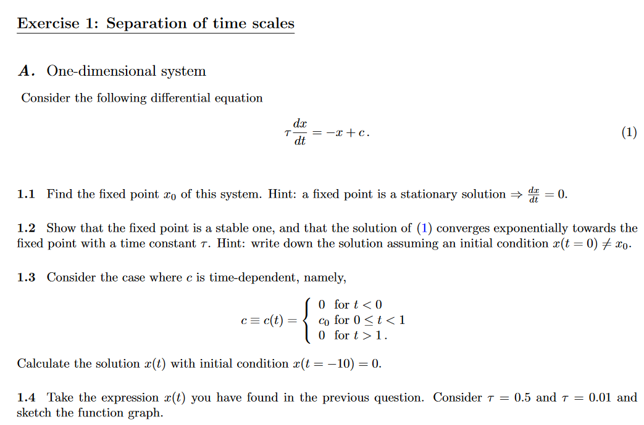
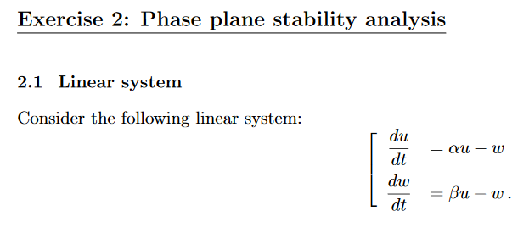
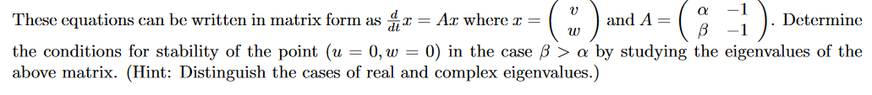
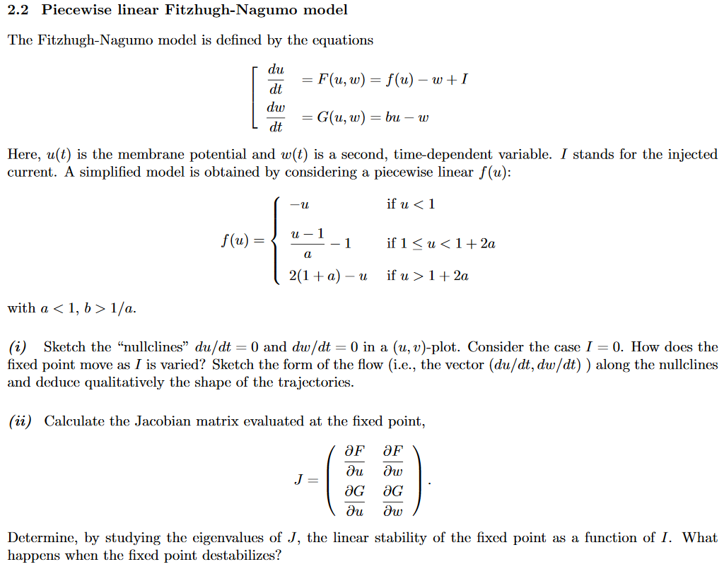
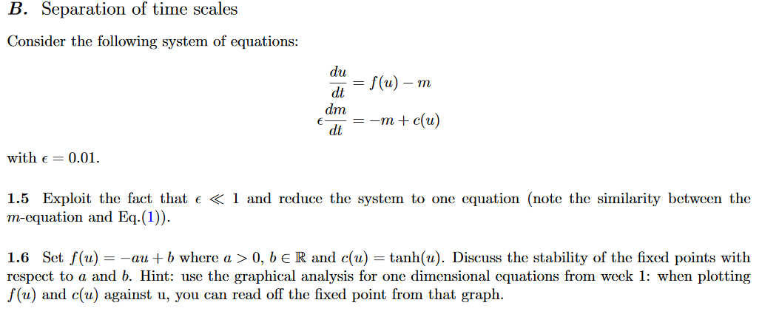
Now Ex 1 and 2.1
Lecture at 11h15

Slide 39
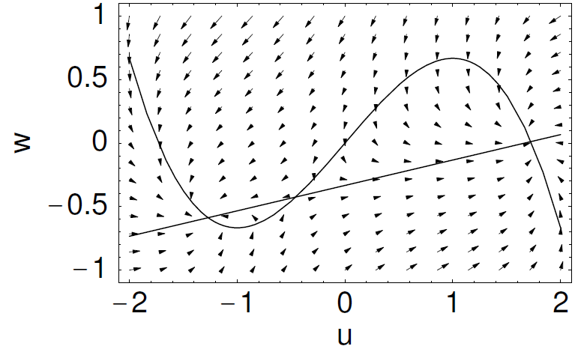
3.2. FitzHugh-Nagumo Model
-w
change b0 , b1
Image: Neuronal Dynamics,
Gerstner et al.,
Cambridge Univ. Press (2014)
Notes:
We set b0=b1-2

Slide 40
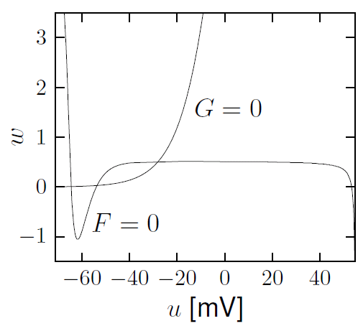
3.2. Nullclines of reduced HH model
stimulus
u-nullcline
w-nullcline
Stable fixed point
Image: Neuronal Dynamics,
Gerstner et al.,
Cambridge Univ. Press (2014)

Slide 41
3.2. Phase Plane Analysis
2-dimensional equation
stimulus
Enables graphical analysis!
Application to
neuron models
Important role of
- nullclines
- flow arrows

Slide 42
Week 3 – Summary 3.2
Once we are in two dimensions we can use phase plane analysis. Two important concepts are the ‘nullclines’; and the local direction of the ‘flow’.
Intersections of the two nullclines correspond to fixed points. It is a bit of work to decide whether a fixed point is stable or not. However, in some cases (such as a saddle point) stability is visible directly from the graph.
Stability of a fixed point is determined by linearizing around the fixed point. Since we are in 2 dimensions, linearization yields a 2x2 matrix. The eigenvalues determine the stability (See exercise 2.1).
The FitzHuhg Nagumo model is a particularly simple 2-dimensional model. The reduction of the full Hodgkin-Huxley model yields a more complicated picture in the phase plane.

Slide 43
Week 3 – part 3: Analysis of a 2D neuron model
3.1 From Hodgkin-Huxley to 2D
3.2 Phase Plane Analysis
  - Role of nullcline
3.3 Analysis of a 2D Neuron Model
- pulse input
- constant input
-MathDetour 3: Stability of fixed points
3.4 Type I and II Neuron Models
(next week)

Slide 44
3.3. Analysis of a 2D neuron model
2-dimensional equation
stimulus
2 important input scenarios
- Pulse input
- Constant input
Enables graphical analysis!

Slide 45
3.3. 2D neuron model : Pulse input
pulse input

Slide 46
3.3. FitzHugh-Nagumo Model : Pulse input
w
I(t)=0
u
I(t)
Pulse input: jump of voltage
pulse input

Slide 47
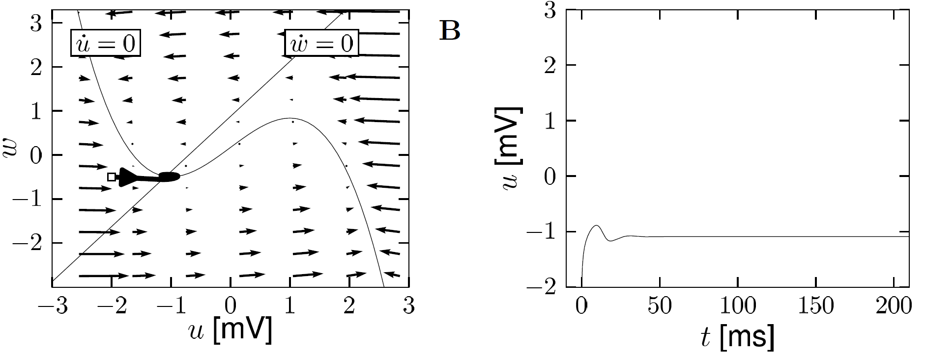
3.3. FitzHugh-Nagumo Model : Pulse input
FN model with
Image: Neuronal Dynamics,
Gerstner et al.,
Cambridge Univ. Press (2014)
Pulse input: jump of voltage/initial condition

Slide 48
3.3. FitzHugh-Nagumo Model – 2 different inputs
DONE!
Pulse input:
- jump of voltage
- ‘new initial condition’
- spike generation for large input pulses
w
I(t)=0
2 important input scenarios
constant input:
- graphics?
- spikes?
- repetitive firing?
u
Now

Slide 49
3.3. FitzHugh-Nagumo Model: Constant input
w
w-nullcline
I(t)=I₀
u
Intersection point (fixed point)
moves
changes Stability
u-nullcline

Slide 50
Week 3 – part 3: Analysis of a 2D neuron model
3.1 From Hodgkin-Huxley to 2D
3.2 Phase Plane Analysis
  - Role of nullcline
3.3 Analysis of a 2D Neuron Model
- pulse input
- constant input
-MathDetour 3: Stability of fixed points
3.4 Type I and II Neuron Models
(next week)

Slide 51
Discussion of exercise 2 Detour. Stability of fixed points
2-dimensional equation
stimulus
How to determine stability
of fixed point?

Slide 52
Discussion of exercise 2 - Detour: Stability of fixed points.
w
w-nullcline
stable?
I(t)=I₀
u
u-nullcline

Slide 53
Discussion of Exercise 2: Detour - Stability of fixed points
stimulus
w
I(t)=I₀
u
unstable
saddle
stable

Slide 54
Discussion of Exercise 2: Detour. Stability of fixed points
w
w-nullcline
stable?
zoom in:
I(t)=I₀
u
unstable
saddle
Math derivation
now
stable
u-nullcline

Slide 55
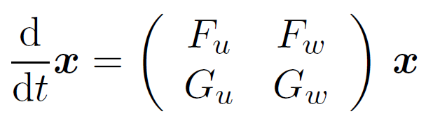
3.3. Neuron models and Stability of fixed points
2-dimensional equation
Now Back:
Application to our
neuron model
Stability characterized by Eigenvalues of linearized equations

Slide 56
3.3. FitzHugh-Nagumo Model: Constant input
w
w-nullcline
I(t)=I₀
u
Intersection point (fixed point)
moves
changes Stability
u-nullcline

Slide 57
3.3. FitzHugh-Nagumo Model: Constant input
w
w-nullcline
I(t)=I₀
u
Intersection point (fixed point)
moves
changes Stability
u-nullcline

Slide 58
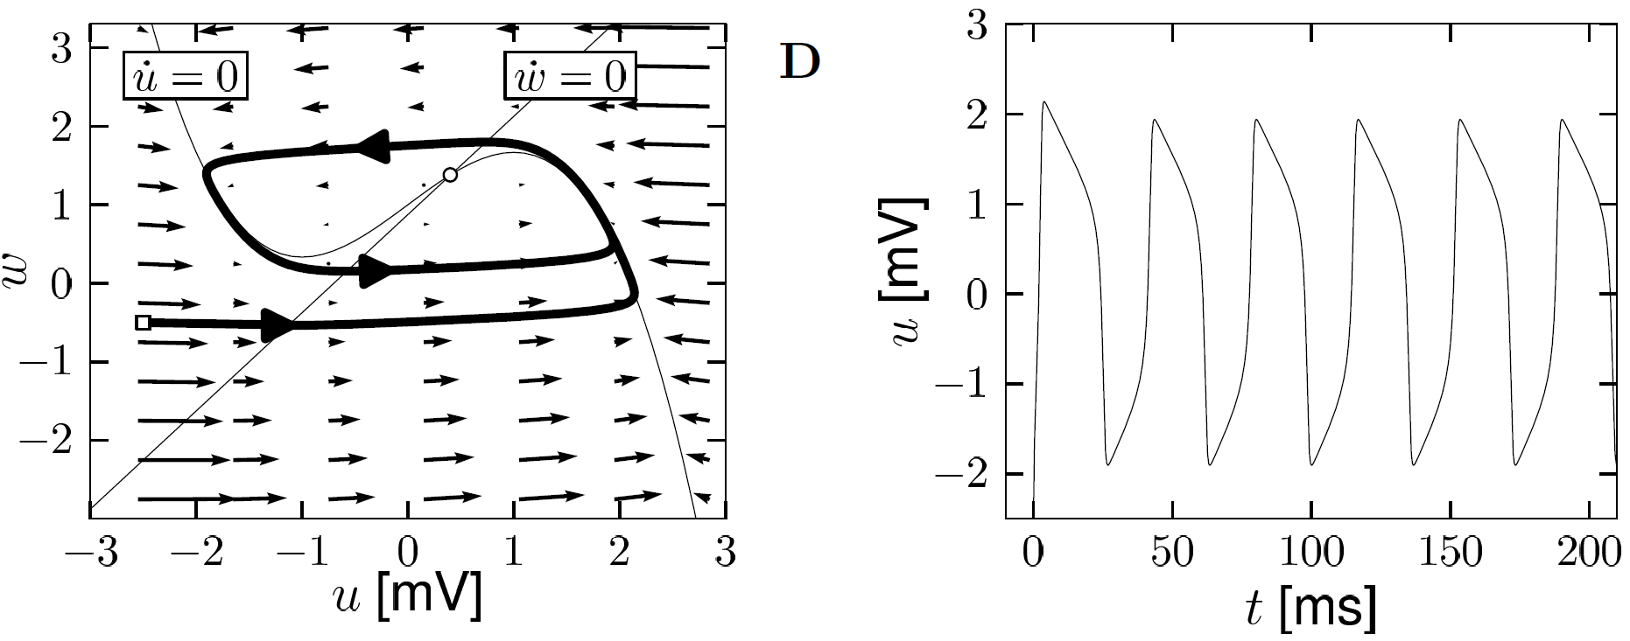
3.3. FitzHugh-Nagumo Model : Constant input
Image:
Neuronal Dynamics,
Gerstner et al.,
Cambridge (2014)
FN model with
f-I curve
f
constant input: u-nullcline moves
limit cycle
I0

Slide 59
Neuronal Dynamics – Quiz 3.5.
Short current pulses. In a 2-dimensional neuron model, the effect of a delta current pulse can be analyzed
[ ] By moving the u-nullcline vertically upward
[ ] By moving the w-nullcline vertically upward
[ ] As a potential change in the stability or number of the fixed point(s)
[ ] As a new initial condition
[ ] By following the flow of arrows in the appropriate phase plane diagram
B. Constant current. In a 2-dimensional neuron model, the effect of a constant current can be analyzed
[ ] By moving the u-nullcline vertically upward
[ ] By moving the w-nullcline vertically upward
[ ] As a potential change in the stability or number of the fixed point(s)
[ ] By following the flow of arrows in the appropriate phase plane diagram

Slide 60
NOW Exercise 2.1: Stability of Fixed Point in 2D
w
- calculate stability
- compare
Exercises:
2.1now!
2.2 homework
I(t)=I₀
u

Slide 61
Week 3 – Summary 3.3
Phase plane analysis of neuron models is particularly interesting because the input I only enters into the first variable (voltage u).
As a consequence of this observation, we can discuss two important input scenarios as follows:
Constant input. In this case the u-nullcline is shifted vertically.
Pulse input. In this case the u-nullcline is not shifted, but the pulse causes a horizontal shift of the initial condition.

Slide 62
Computer exercise now
Can we understand the dynamics of the 2D model?
The END for today
Now: computer exercises
Type I and type II models
ramp input/
constant input
f-I curve
f-I curve
f
f
I0
I0
I0

Slide 63
NOW Exercise 2.1: Stability of Fixed Point in 2D
w
- calculate stability
- compare
Exercises:
2.1 start now!
2.2 homework
(you may start if you
have time)
I(t)=I₀
u
Exercise: later
11h20-11h35
Next lecture:
11h35
Notes:
In 2017 this exercise was moved to the end

Slide 64
Discussion of Exercise 2 Detour. Stability of fixed points
Fixed point at
At fixed point
zoom in:

Slide 65
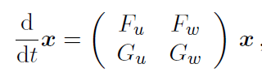
Discussion of Exercise 2 - Detour. Stability of fixed points
Fixed point at
At fixed point
zoom in:

Slide 66

Discussion of Exercise 2 Detour. Stability of fixed points
Linear matrix equation
Search for solution
Two solution with Eigenvalues

Slide 67
Discussion of Exercise 2: Detour. Stability of fixed points
Linear matrix equation
Stability requires:
Search for solution
Two solution with Eigenvalues
and

Slide 68
Discussion of exercise 2: Detour. Stability of fixed points
stimulus
w
I(t)=I₀
u
unstable
saddle
stable

