Slide 1

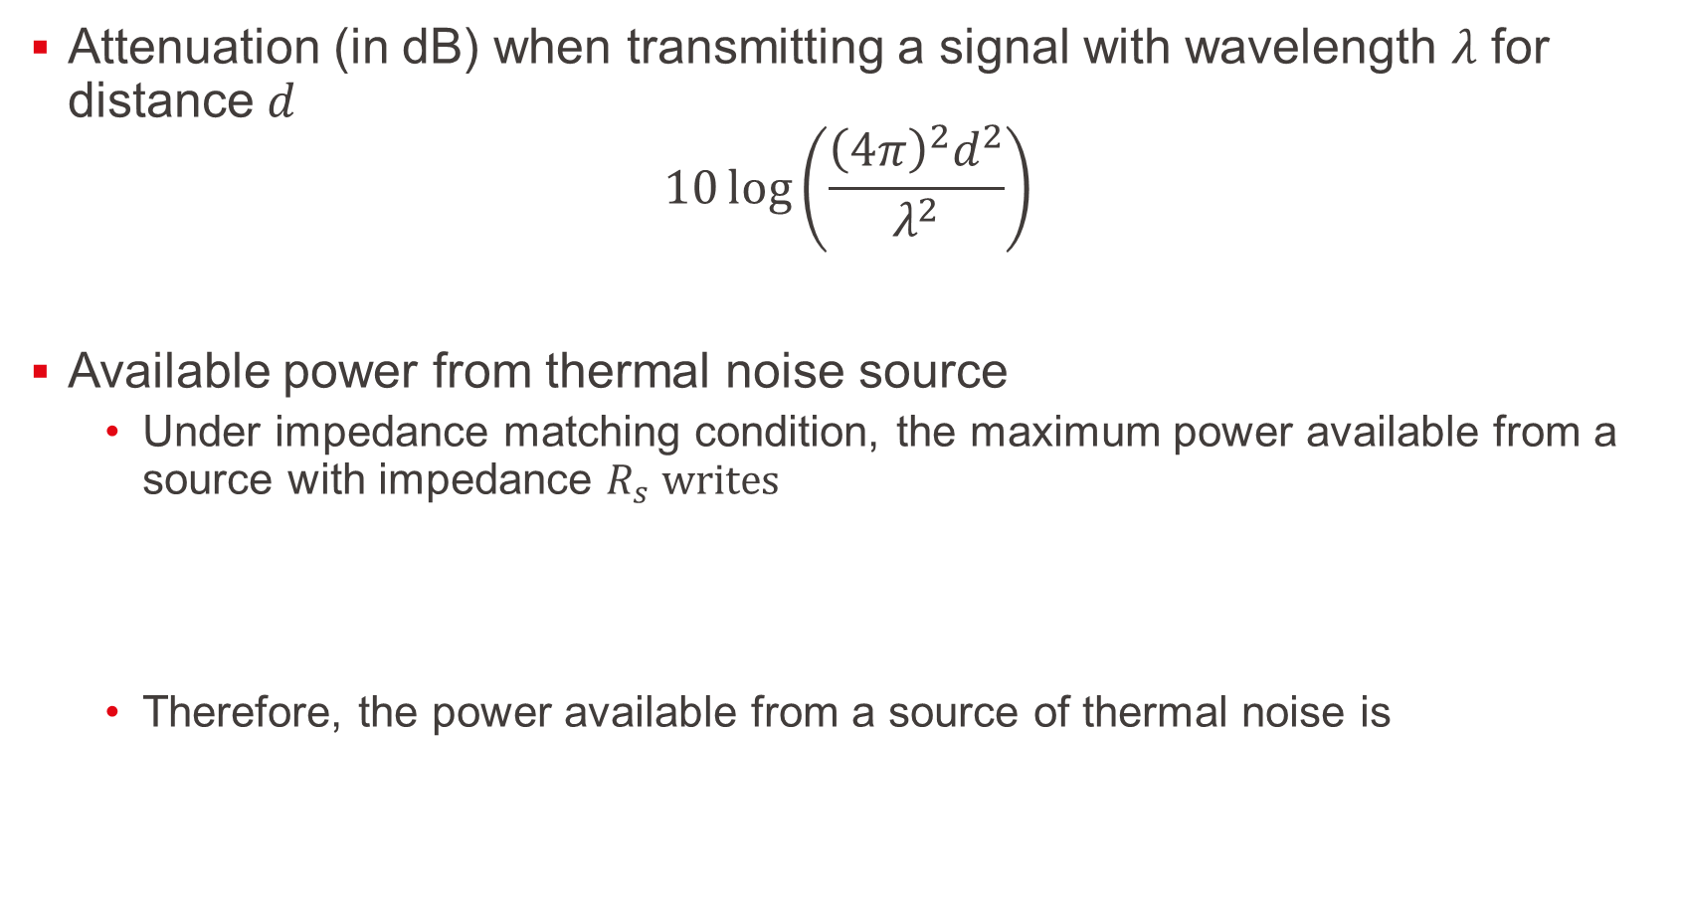
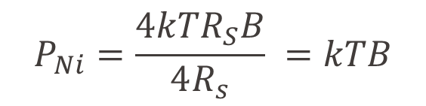
Kick-off for Ex.7
Attenuation (in dB) when transmitting a signal with wavelength $λ$ for distance $d$
$$10\log\left(\frac{{\left(4π\right)}^{2}d^{2}}{λ^{2}}\right)$$
Available power from thermal noise source
  Under impedance matching condition, the maximum power available from a source with impedance $R_{s} writes$
  Therefore, the power available from a source of thermal noise is
$$P_{S}= \frac{V_{S}^{2}}{4R_{S}}$$
$$P_{Ni}=\frac{4kTR_{S}B}{4R_{s}} =kTB$$

